Slide 1
INDUCTANCE

Slide 2
INERTIA…………………????
An object at rest tends to remain at rest
An object in motion tends to stay in motion
A force has to be applied to overcome inertia

Slide 3
INDUCTANCE
It is the characteristic of an electrical conductor that opposes a change in current flow
If current is moving through a conductor inductance helps it keep it moving. The effect of inductance is sometimes desirable and other times undesirable

Slide 4
As magnetic flux lines build up, create an opposition to current flow
Counter emf
Lenz’s Law

Slide 5
INDUCTANCE
Symbol
Unit

Slide 6
Types of Inductor
Depending on the core material
Magnetic Core Inductors
Non magnetic core inductors
Depending on values
Fixed
Variable

Slide 7
Maximum inductance when core material is in line with coil

Slide 8
Different types of Inductors
Air Core Inductors
Ferrite Core Inductors
Toroid Inductors
Shielded Inductors
Laminated Iron Core Inductors

Slide 9
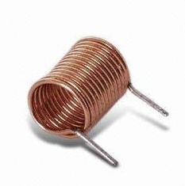
Air Core Inductors
Upto 5 mH

Slide 10
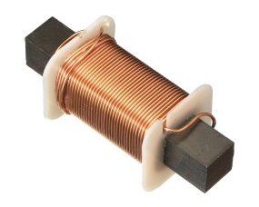
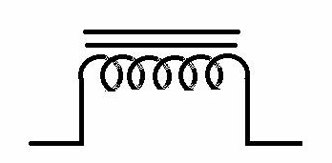
Ferrite Core Inductors
Powdered iron core inductors
Used upto 200 mH
Also called choke
Symbol

Slide 11
Toroid Inductors
Donut shaped
Offer high inductance

Slide 12
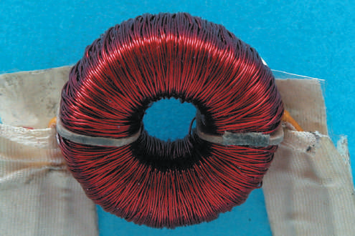
Toroid Inductor

Slide 13
Shielded Inductors
To protect them from influence of other magnetic feilds

Slide 14
Laminated Iron Core Inductors
Very Large values
0.1 H to 100H
They are used infiltering circuits of power supply to remove AC components from the DC components
Also called chokes

Slide 15
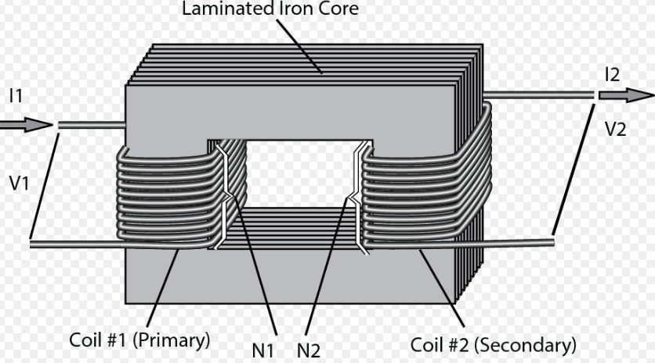

Slide 16
Connecting Inductors
Series
Parallel
Series-parallel

Slide 17
L/R TIME CONSTANT
Opposition to change
Storage of energy

Slide 18
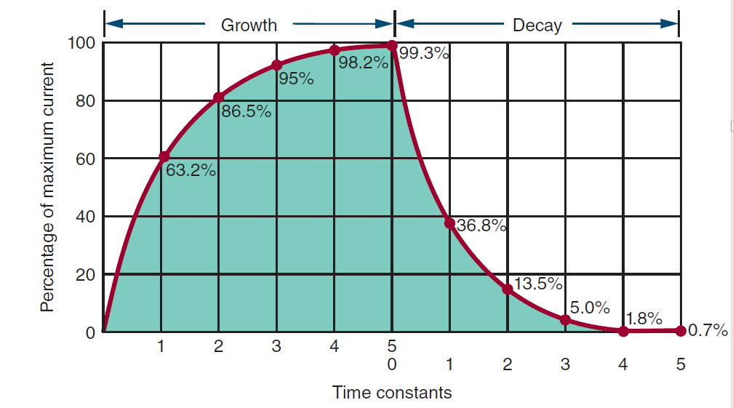

Slide 19
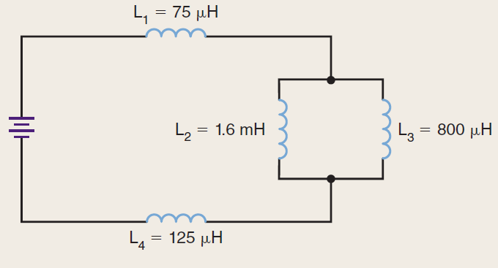
QUESTION:
What is the total inductance for the circuit shown ?

Slide 20
QUESTION:
How long does it take to fully build up a magnetic field for a 0.1-henry inductor in series with a 100,000-ohm resistor?

