Slide 1
CAPACITANCE

Slide 2
Capacitance
Capacitance
  Ability to store electrical energy in an electrostatic field
  Basic unit is the farad (F)
  Represented by letter C
Capacitor
  Possesses a specific amount of capacitance
  Either fixed or variable

Slide 3
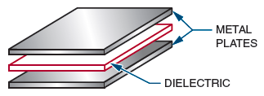
Capacitance (cont’d.)
Figure 11-1. A capacitor consists of two plates (conductors)
separated by a dielectric (insulator or nonconductor).

Slide 4
Capacitors
Factors that affect capacitance
  Area of the plate
  Distance between the plates
  Type of dielectric material
  Temperature

Slide 5
Dielectric Constants
Effectiveness of a material as an insulator
Air=1
Paper= 2 to 3
Mica= 5 to 6
Titanium= 90 to 170

Slide 6
Types of Capacitors
Fixed Capacitors
Variable Capacitors
Trimmer Capacitor- d/s
Tuning Capacitor –amount of meshing

Slide 7
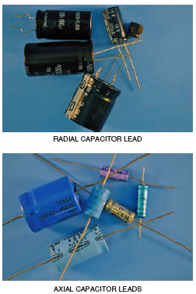
Figure 11-3. Electrolytic capacitors.

Slide 8

CAUTION

Slide 9
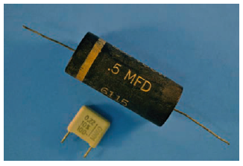
Capacitors (cont’d.)
Figure 11-4. Paper and plastic capacitors.
BY ROLLED FOIL TECHNIQUE

Slide 10
Plastic Film Capacitors
Metallised fim
Reduces distance between plates and small size

Slide 11
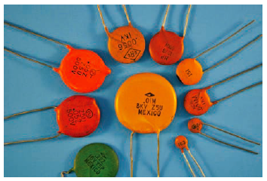
Capacitors (cont’d.)
Figure 11-5. Ceramic disk capacitors.

Slide 12
Ceramic Capacitors
Inexpensive to produce
0.1 µF and lower

Slide 13
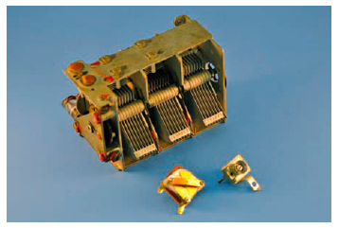
Capacitors (cont’d.)
Figure 11-6. Variable capacitors.

Slide 14
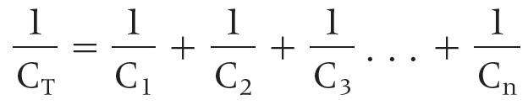

Capacitors (cont’d.)
Total capacitance in series circuits:
Total capacitance in parallel circuits:

Slide 15
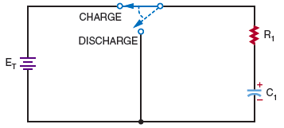
RC Time Constants
Figure 11-7. Circuit used to determine RC time constant.

Slide 16
RC Time Constants (cont’d.)
RC circuit time constant formula:
t = RC
  where: t = time in seconds
  R = resistance in ohms
  C = capacitance in farads

Slide 17
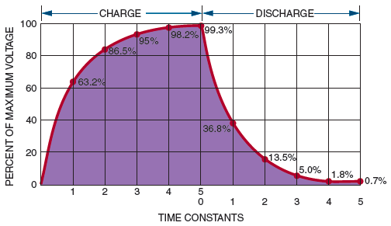
RC Time Constants (cont’d.)
Figure 11-8. Chart of time constants required to charge and discharge a capacitor.

Slide 18
NUMERICALS ON POWER

Slide 19
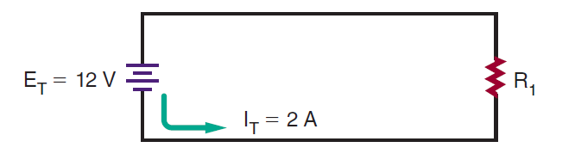
Calculate the power consumed in the circuit shown in Figure

Slide 20
What voltage is required to deliver 2 amperes of current at 200 watts?

Slide 21
How much current does a 100-watt, 120-volt light bulb use?

Slide 22
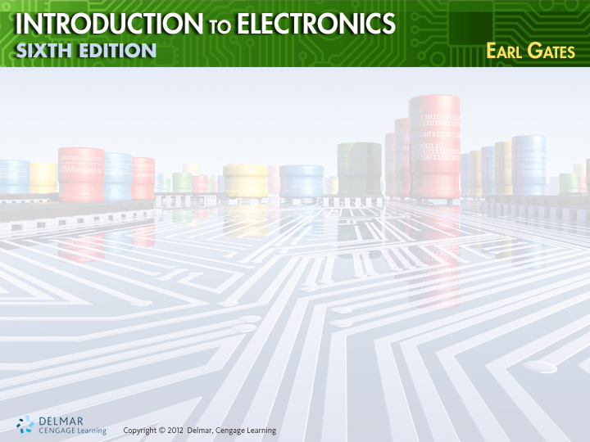
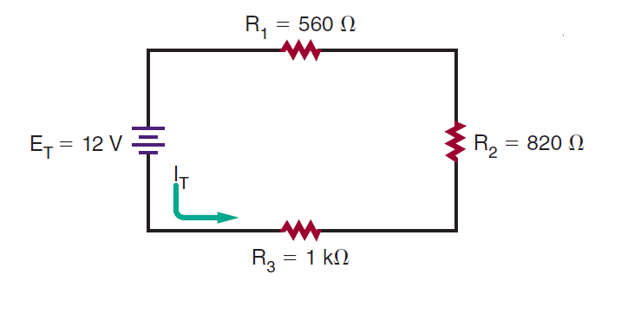
How much power is consumed in the circuit shown in Figure
Ans.=0.06 W

Slide 23
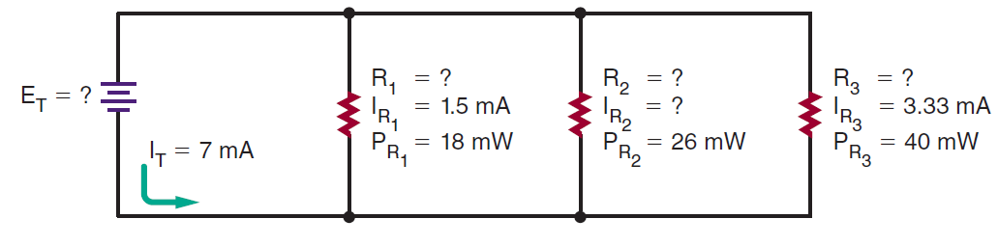
What is the value of resistor R2 in the circuit shown in Figure
Ans.=5530 ohm

Slide 24
If a current of 0.05 ampere flows through a 22-ohm resistor, how much power does the resistor dissipate?.
Ans= 55 mW

