Slide 1
Magnetism

Slide 2
Magnetic Fields
Magnetite
  Mineral…Natural magnet
Artificial magnet
  Created by rubbing soft iron with a piece of magnetite
Electromagnet
  Created by current flowing through a coil of wire

Slide 3
Various Shapes of Magnet
Horse Shoe
Bar
Rectangular
Ring

Slide 4
Definitions
Permanent Magnet
Temporary Magnets
Magnets are made of metallic or ceramic materials
-- Alnico
--Cunife

Slide 5
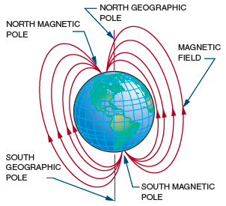
Magnetic Fields (cont’d.)
Figure 9-2. The earth’s magnetic north and south poles are
situated close to the geographic North and South Poles.
BAR MAGNET SUSPENDED
→ COMPASS

Slide 6


Figure 9-3. The domains in unmagnetized material are randomly arranged with no overall magnetic effect
Colour Code for Magnets
Figure 9-4. When material becomes magnetized, all
the domains align in a common direction.

Slide 7
Evidence of Domain Theory-Magnet heated or hit hard

Slide 8
Direction of M.F. by electrons depends on the electrons direction of spin
Fe, Ni, and Co property(2 valence electrons)
Naturally magnetic elements
In other elements electrons spin in opposite direction and cancel out the their magnetic characteristic

Slide 9
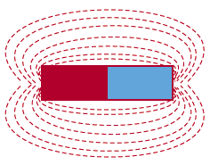
Magnetic Fields (cont’d.)
EXPERIMENT TO CHECK THEM.

Slide 10
Important Characteristics of Flux Lines
Polarity
Form a complete loop
Donot cross each other
Tend to form smallest loop possible
PERMEABILITY

Slide 11
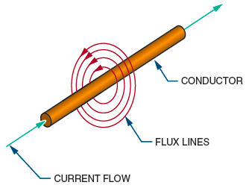
Electricity and Magnetism
Figure 9-7. A current flowing through a conductor
creates a magnetic field around the conductor.

Slide 12
TESTS
By a compass
North pole of compass– direction of flux lines
Two wires, placed next to each other carrying current

Slide 13
LEFT HAND RULE FOR CONDUCTORS
Determine direction of flux lines around the conductor when direction of current flow is known

Slide 14
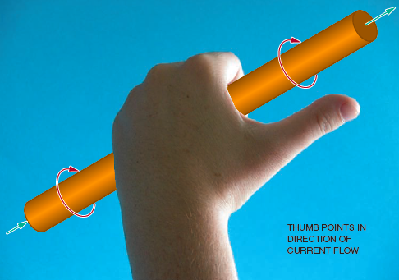
Figure 9-8. Determining the direction of the flux lines around a conductor when the direction of the current flow is known (left-hand rule for conductors).

Slide 15
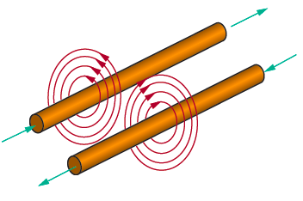
Electricity and Magnetism (cont’d.)
Figure 9-9. When current flows in opposite directions through two conductors placed next to each other, the resulting magnetic fields repel each other.

Slide 16
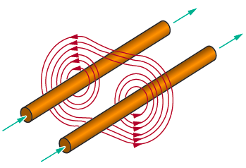
Electricity and Magnetism (cont’d.)
Figure 9-10. When current flows in the same direction through two conductors
placed next to each other, the magnetic fields combine.

Slide 17
Magnetic Field by a single wire
Wire twisted into loop or coiled
This leads to ELECTROMAGNET

Slide 18
ELECTROMAGNET
Strength of Magnetic field
-----No. of turns
-----Amount of Current
To increase strength of Magnetic Field
-----Insert ferromagnetic core(Higher permeability)

Slide 19
LEFT HAND RULE FOR COILS
To determine polarity of electromagnet
Coil- Left hand
Fingers-pointing in direction of current
Thumb-points at the north pole

Slide 20
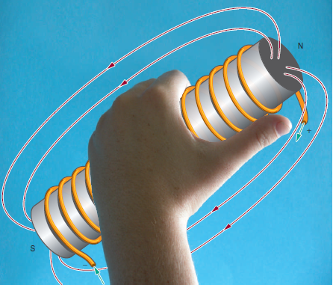

Slide 21
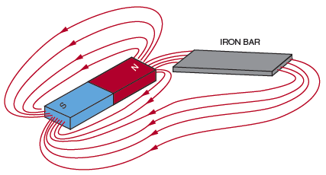
Magnetic Induction
Domains align
Figure 9-12. Placing an iron bar in a magnetic field extends the
magnetic field and magnetizes the iron bar.

Slide 22
TERMS
Residual Magnetic Field
Retentivity
---- Soft Iron > Low retentivity
---- Alnico> High retentivity
Low Reluctance Material
>> Called Magnetic Shield> Mu-Metal

Slide 23
ELECTROMAGNETIC INDUCTION
Principle for generation of Electricity
Here either the M.F. or the Conductor must move to produce induced voltage
Amount of induced voltage depends on:
4 Factors

Slide 24
FARADAY’S LAW
The induced voltage in a conductor is directly proportional to the rate at which the conductor cuts the magnetic field.

Slide 25
LEFT HAND RULE FOR GENERATORS
For Polarity of induced voltage in the generators

Slide 26
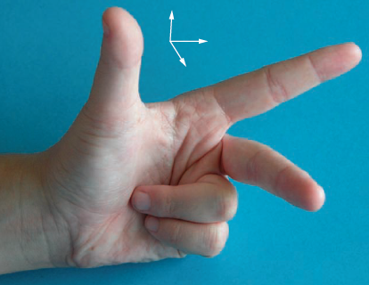
MOTION
FLUX
CURRENT
Figure 9-13. The left-hand rule for generators can be used to determine the direction of the induced current flow in a generator.

Slide 27
AC GENERATORS
Convert Mechanical Energy to electrical energy

Slide 28
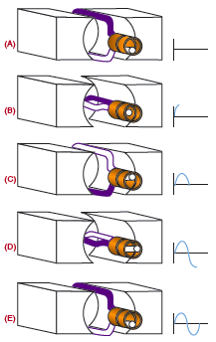
Figure 9-14. Induced voltage in an AC generator.

Slide 29
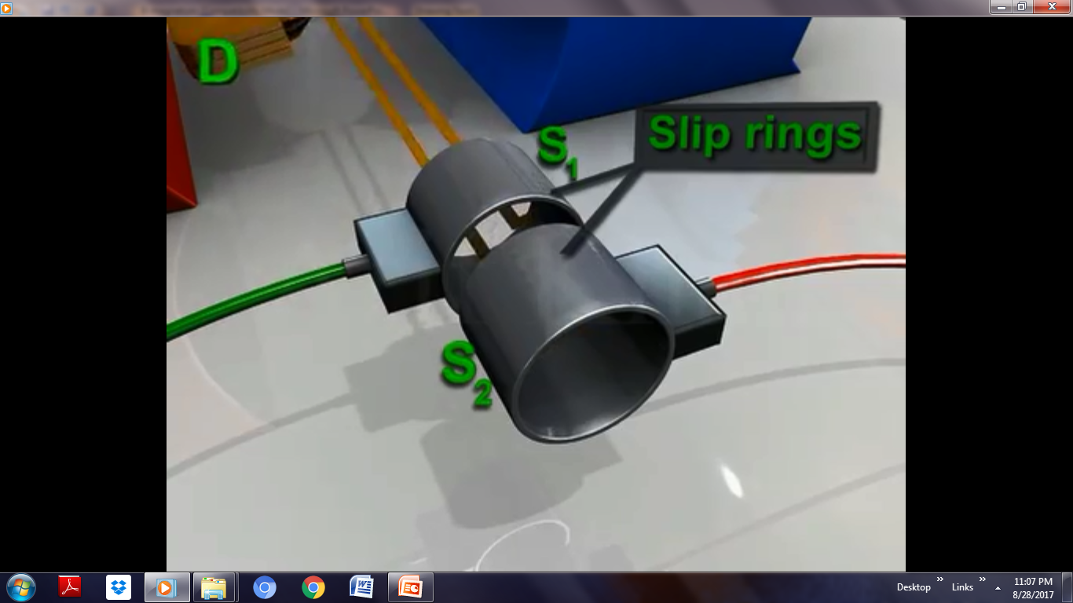


Slide 30
Rotating Loop→ Armature
Source of Electromagnetic Field→ Field
Armature can have any no. of loops
Frequency of AC or AV= no. of complete cycles completed per second
(Speed of rotation determines the frequency
AC Generator→ often called alternator)

Slide 31
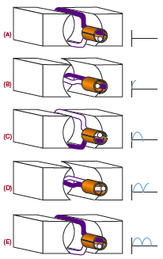
Figure 9-15. Induced voltage in an DC generator.

Slide 32
Applications:
Relay
Door Bell
Solenoids
Phonograph Pick-Ups
Loudspeakers
Many others

Slide 33
VIDEO

