Slide 1
TRANSISTOR
Then bipolar transistors have the ability to operate within three different regions:
• 1. Active Region - the transistor operates as an amplifier
• 2. Saturation - the transistor is "fully-ON" operating as a switch
• 3. Cut-off - the transistor is "fully-OFF" operating as a switch

Slide 2
There are two basic types of bipolar transistor construction,
NPN
PNP

Slide 3
These three terminals are known and labelled as the
Emitter ( E)
Base ( B )
Collector ( C ) respectively.

Slide 4
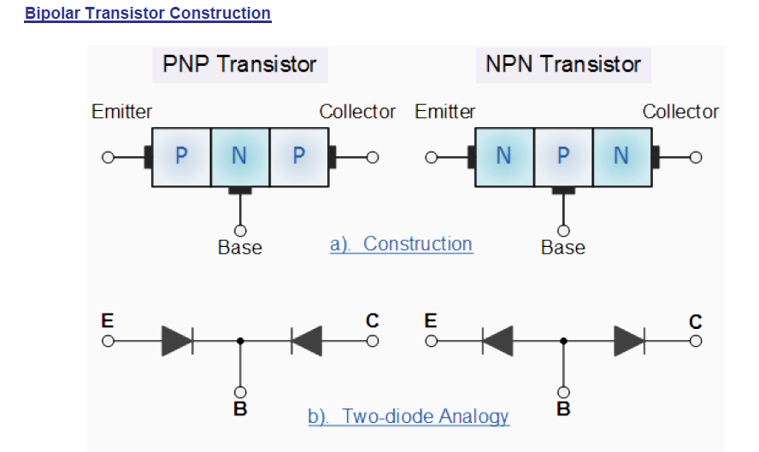

Slide 5
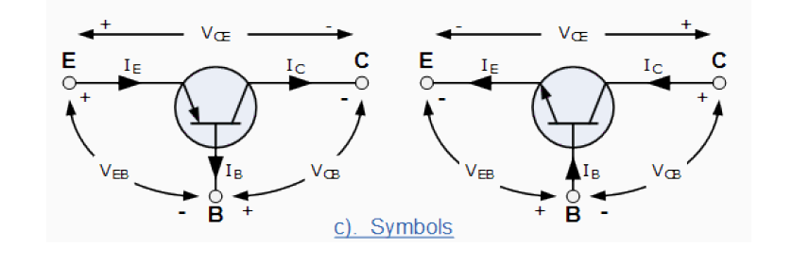

Slide 6
Bipolar Transistor Configurations
1. Common Base Configuration - has Voltage Gain but no Current Gain.
• 2. Common Emitter Configuration - has both Current and Voltage Gain.
• 3. Common Collector Configuration - has Current Gain but no Voltage Gain.

Slide 7
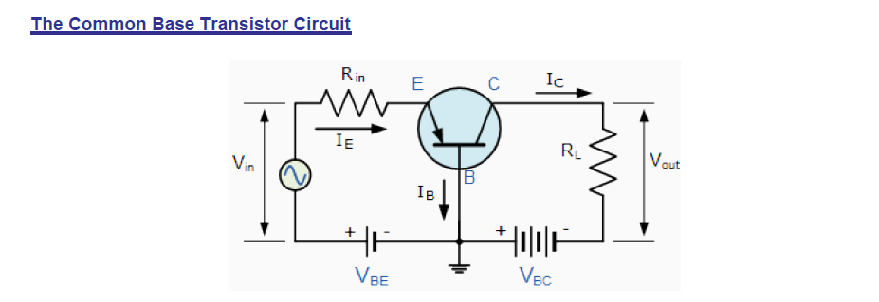
The signal voltages Vin and Vout are in-phase. This type of transistor arrangement is not very common due to its unusually high voltage gain characteristics.

Slide 8
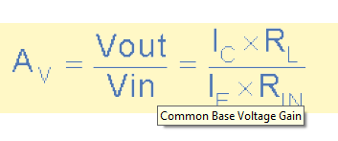
Common Base Voltage Gain

Slide 9
Applications
The common base circuit is generally only used in:
single stage amplifier circuits such as microphone pre-amplifier
radio frequency (Rf) amplifiers due to its very good high frequency response.

Slide 10
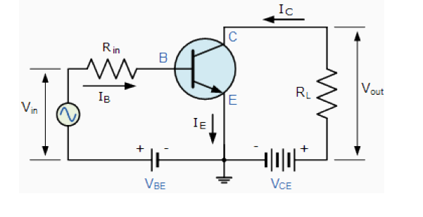
The Common Emitter (CE) Configuration In the Common Emitter or grounded emitter configuration, the input signal is applied between the base, while the output is taken from between the collector and the emitter .

Slide 11
the current flowing out of the transistor must be equal to the currents flowing into the transistor as the emitter current .
the load resistance (RL) is connected in series with the collector, the current gain of the common emitter transistor configuration is quite large .
The common emitter configuration is an inverting amplifier circuit resulting in the output signal being 180 degree out-of-phase with the input voltage signal.

Slide 12
The Common Collector (CC) Configuration
In the Common Collector or grounded collector configuration, the collector is now common through the supply. The input signal is connected directly to the base, while the output is taken from the emitter load .
known as a Voltage Follower or Emitter Follower circuit
is very useful for impedance matching applications because of the very high input impedance

Slide 13
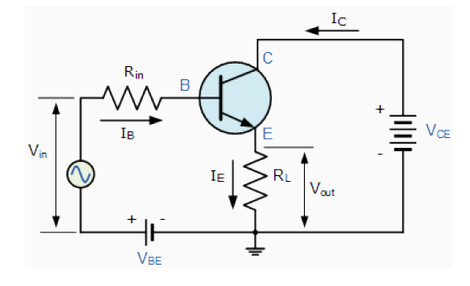
The Common Collector (CC) Configuration

Slide 14
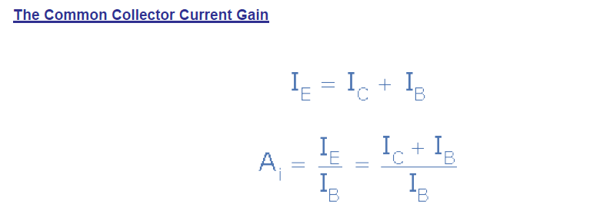

Slide 15
The Common Collector (CC) Configuration
This type of bipolar transistor configuration is a non-inverting circuit in that the signal voltages of Vin and Vout are in-phase. It has a voltage gain that is always less than "1" (unity).

Slide 16
Difference between CB,CE,CC
Transistor CB (Common Base) configuration
It is transistor circuit in which base is kept common to the input and output circuits. Characteristics: • It has low input impedance (on the order of 50 to 500 Ohms). • It has high output impedance (on the order of 1 to 10 Mega Ohms). • Current gain(alpha) is less than unity.

Slide 17
Transistor CE (Common Emitter) configuration
It is transistor circuit in which emitter is kept common to both input and output circuits. Characteristics (applications): • It has high input impedance (on the order of 500 to 5000 Ohms). • It has low output impedance (on the order of 50 to 500 Kilo Ohms). • Output is 180 degree out of phase.

Slide 18
Transistor CC (Common Collector) configuration
It is transistor circuit in which collector is kept common to both input and output circuits. It is also called as emitter follower. Characteristics: • It has high input impedance (on the order of about 150 to 600 Kilo Ohms). • It has low output impedance (on the order of about 100 to 1000 Ohms). • Current gain (Beta) is about 99. • Voltage and power gain is equal to or less than one.

Slide 19
