Slide 1
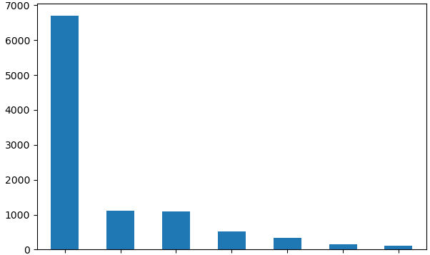
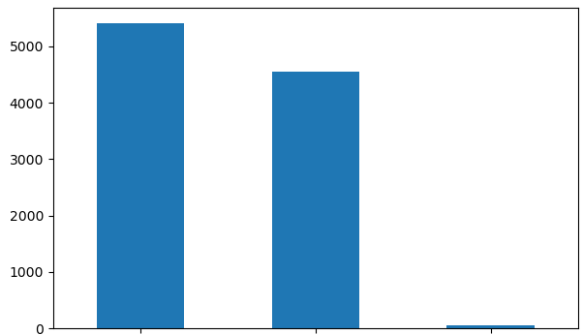
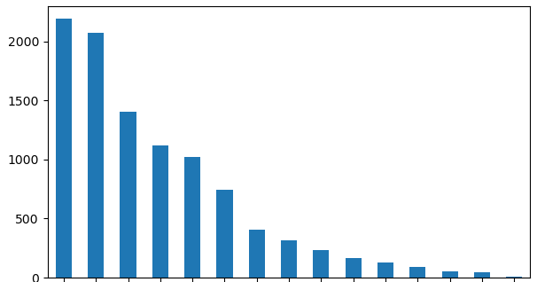
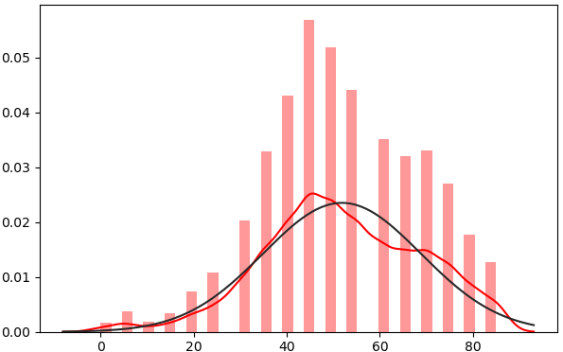
Class Wise Data Visualization
Gender Wise Data Visualization
Count of Images
Count of Images
NV
MEL
BKL
BCC
DF
Male
Female
Unknown
AKIEC
VASC
Body Part Wise Data Visualization
Age Wise Data Visualization
Count of Images
Density
Face
Foot
Neck
Ear
Back
Scalp
Acral
Trunk
Chest
Hand
Genital
Abdomen
Unknown
Age
Upper Extremity
Lower Extremity

