Slide 1
Understanding Modern LLM Architectures: A Deep Dive
Document Generator

Slide 2
Agenda
• Introduction
• 1. The Transformer Architecture
• 2. The Training Process
• 3. Real-World Applications
• 4. Future Directions and Conclusion
• Key Takeaways

Slide 3
Executive Summary
1
The Transformer architecture enables massive scalability by leveraging parallel processing, allowing organizations to utilize modern hardware for developing significantly more powerful AI capabilities.
2
Self-attention mechanisms solve critical context retention issues, enabling models to maintain accuracy across long documents and complex interactions superior to legacy technologies.
3
The development lifecycle dictates a strategic split between capital-intensive pre-training for general knowledge and targeted fine-tuning to adapt models for specific, high-value business use cases.
4
Reinforcement Learning from Human Feedback (RLHF) serves as the essential safety and alignment layer, transforming raw data predictions into reliable, user-safe tools suitable for enterprise deployment.
5
LLMs are driving immediate ROI by fundamentally upgrading operational capacities in customer service automation, software engineering productivity, and content generation workflows.

Slide 4
Introduction
• Revolutionize NLP by transforming machine language understanding paradigms.
• Power critical applications from chatbots to code generation tools.
• Leverage Transformer architecture and Attention mechanism for deep context.
• Employ pre-training and fine-tuning to master specialized tasks.
Notes:
Large Language Models have fundamentally shifted how machines process language, powering tools from customer service bots to coding assistants. This presentation explores the underlying engineering, specifically the Transformer architecture and the training lifecycle.

Slide 5
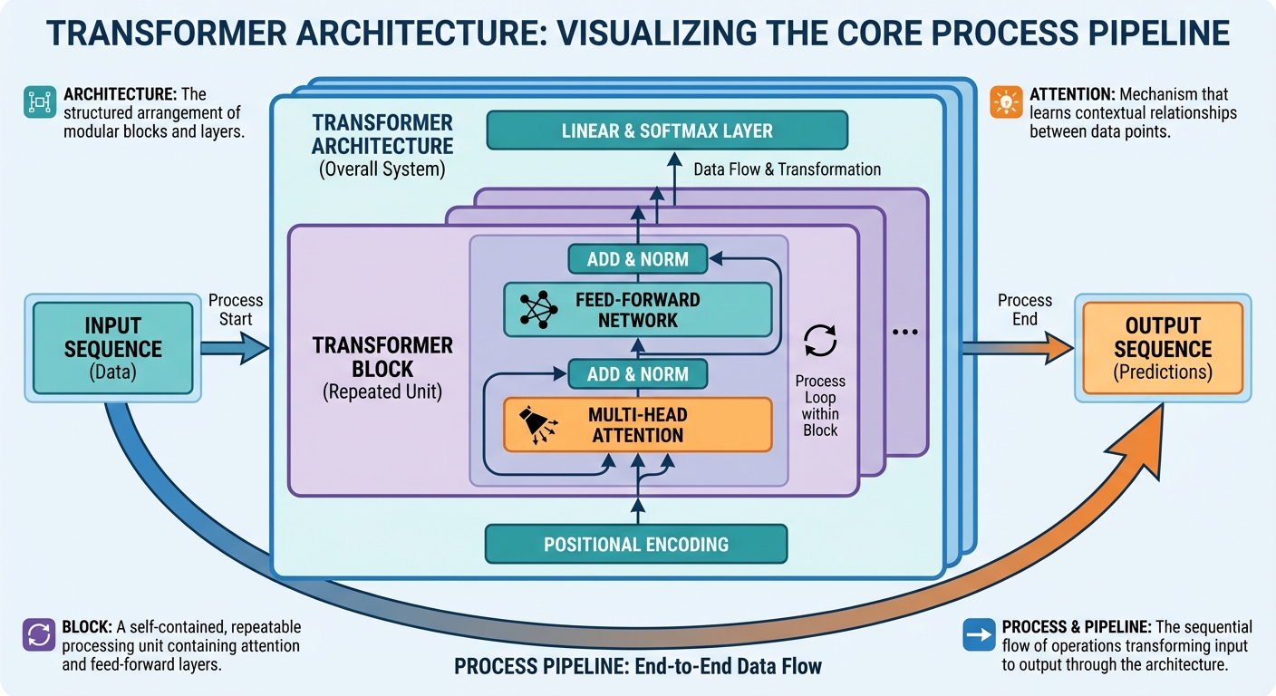
1. The Transformer Architecture
Infographic for 1. The Transformer Architecture

Slide 6
1. The Transformer Architecture
• Replaced inefficient sequential networks with parallel processing capabilities.
• Utilizes self-attention mechanism to discern context across long sequences.
• Optimizes computational efficiency by leveraging modern GPU hardware acceleration.
• Enables training on significantly larger datasets than previous architectures.
Notes:
The 2017 introduction of the Transformer architecture moved the field away from sequential processing to parallelization. By using self-attention, models can now process vast amounts of data efficiently on modern GPUs.

Slide 7
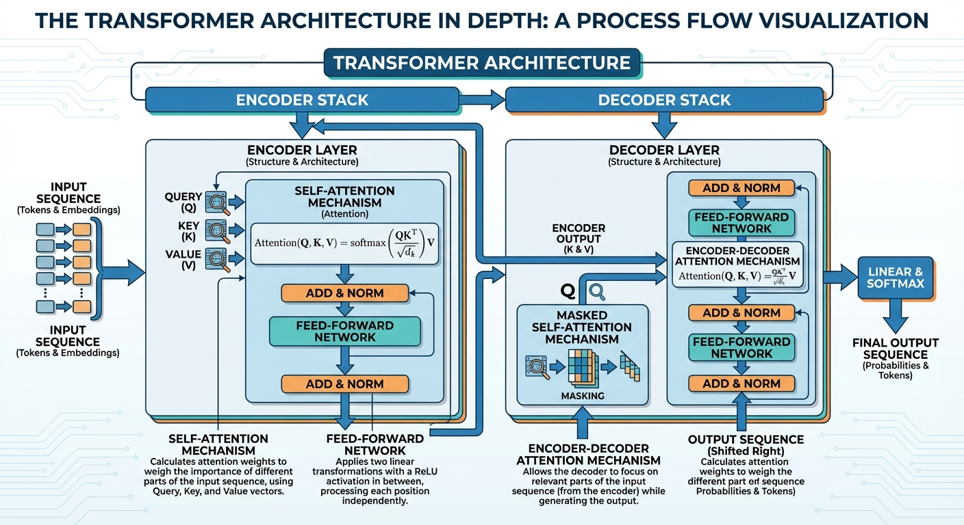
2. The Training Process
Infographic for 2. The Training Process

Slide 8
2. The Training Process
• Transforms random mathematical weights into coherent, reasoning models.
• Absorbs general patterns from massive text corpora during pre-training.
• Utilizes self-supervised next-token prediction to learn linguistic structures.
• Requires distributed computing to process trillions of data tokens.
Notes:
Model intelligence stems from a rigorous pipeline starting with computationally intensive pre-training on massive datasets. Through next-token prediction, the system learns language statistics and reasoning patterns without explicit human labeling.

Slide 9
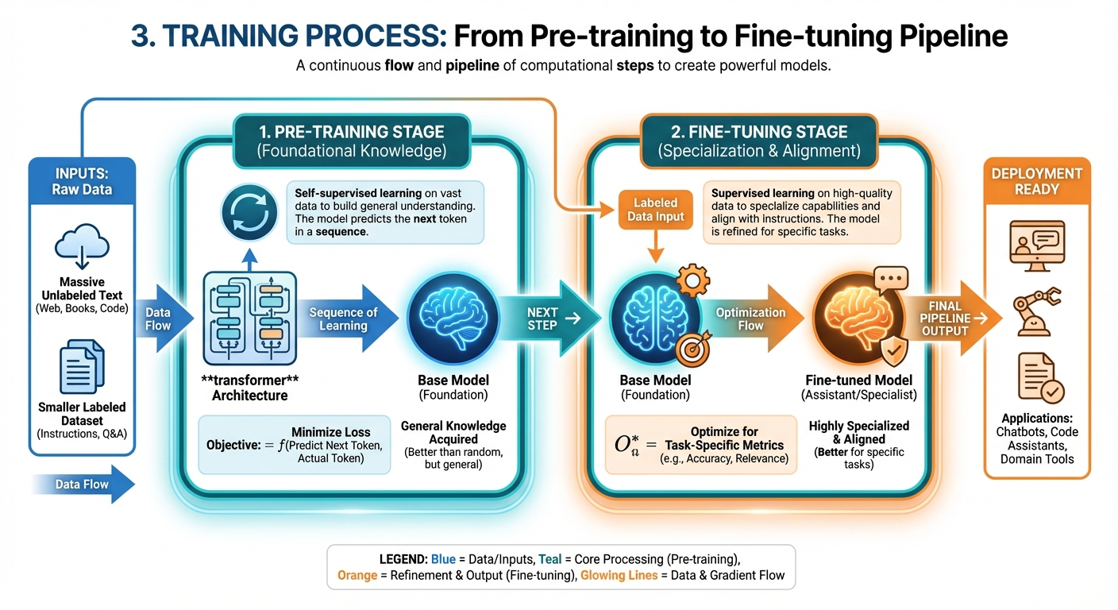
3. Real-World Applications
Infographic for 3. Real-World Applications

Slide 10
3. Real-World Applications
• Elevates customer service with nuanced, context-aware chatbot interactions.
• Accelerates development through automated code generation and complex debugging.
• Streamlines content creation for drafting, editing, and ideation.
• Enhances scientific research by uncovering correlations in vast literature.
Notes:
Modern LLMs have moved beyond rigid scripts to power flexible applications across industries. From writing code to analyzing scientific data, these tools are fundamentally changing how we interact with software.

Slide 11
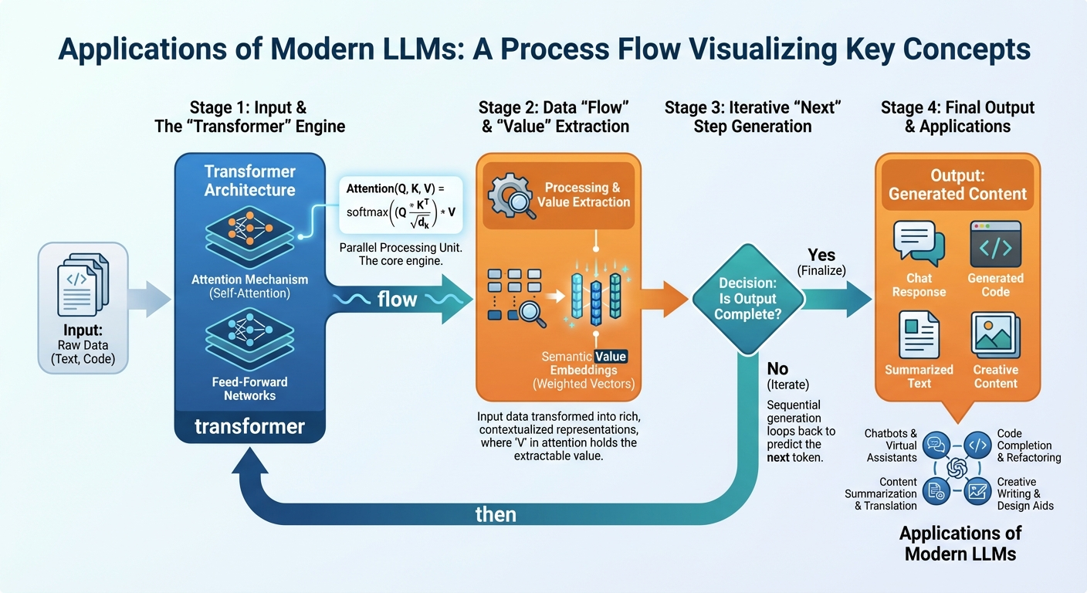
4. Future Directions and Conclusion
Infographic for 4. Future Directions and Conclusion

Slide 12
4. Future Directions and Conclusion
• Develops efficient architectures for accessible deployment on consumer hardware.
• Enhances logical deduction to handle complex, multi-step reasoning tasks.
• Integrates multimodal processing to analyze text, images, and audio.
• Mitigates hallucinations to ensure factual reliability and trustworthy outputs.
Notes:
The future of AI focuses on efficiency, improved reasoning, and multimodal capabilities. Crucially, researchers are working to reduce hallucinations to ensure models provide reliable and factual information.

Slide 13
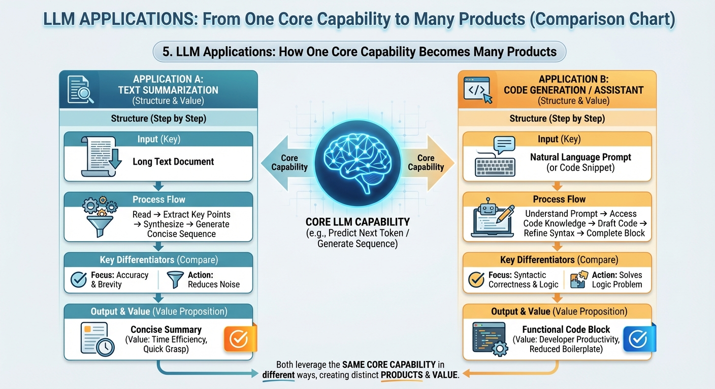
Key Takeaways
Infographic for Key Takeaways

Slide 14
Key Takeaways
• Establish Transformers as the standard for scalable parallel processing.
• Capture long-range dependencies efficiently using the self-attention mechanism.
• Combine massive pre-training with fine-tuning for task-specific alignment.
• Power diverse applications ranging from coding assistants to writing tools.
Notes:
Modern AI is defined by the Transformer architecture's ability to process data in parallel via attention mechanisms. Success relies on a dual training approach that enables versatility across widely varying tasks.

