Slide 1
Creating Reusable Visualization With React and D3
Nitish Kumar
@nitishk88

Slide 2
Session objectives
Operationalize the concept of reusable visualization software
Use D3 to manage static and dynamic elements on the DOM
Review reusability pattern for D3 charts
Integrate D3 into a more robust JavaScript framework (React)
Leveraging reusable code to make small multiples
Discuss challenges of implementing reusable approaches

Slide 3






Doesn't this already exist...?

Slide 4
What's missing?
Complex transitions
Advanced chart types
Custom click events
All reasons you started using D3 in the first place...

Slide 5
If you take the time to build a chart in D3.js, you should be able to reuse it.

Slide 6
What does reusable software look like?
Easy to write, easy to read
Easily used for multiple datasets
Visual encodings are configurable
Programming patterns are consistent

Slide 7
Writing Reusable Software Goals
Write code for charts, not data
Configure charts to handle data and encoding updates
Write visualization software, not project code

Slide 8
Reusable D3 components

Slide 9
We'll aim to mimic the same reusability structure as D3's core library.

Slide 10
Implementation
// Construct a new axis function using the d3.axisBottom method that returns a function var axis = d3.axisBottom(); // Function that returns a function using closure pattern
// Set the scale and orientation of the axis function
axis.ticks(5) // Changes a locally scoped variable, returns the function
.scale(scale); // Changes a locally scoped variable, returns the function
// Create a DOM element in which to render your axis
var axisG = svg.append('g') // Append a 'g' element to your svg in order to render your axis
// Render the axis in the selected axisG
axisG.call(axis); // Call your function in the context of a selected element

Slide 11
// simplified + commented D3 axis code function axis() {
// Default values for the axis var ticks = null,
tickFormat = null;
// Axis function that gets returned, operates on a selected g element function myAxis(context) {
// Build visual axis components
path = path.merge(path.enter().insert("path", ".tick")
.attr("class", "domain")
.attr("stroke", "#000"));
Closure! Function that will manipulate (and access) locally scoped variables.
// put visual elements on the DOM
}
myAxis.ticks = function(_) {
Getter/setter methods to enable referencing each values of interest.
return arguments.length ? (ticks = _, axis) : ticks
};
// Return the myAxis function to operate on return myAxis;
};

Slide 12
Static v.s. Dynamic components

Slide 13
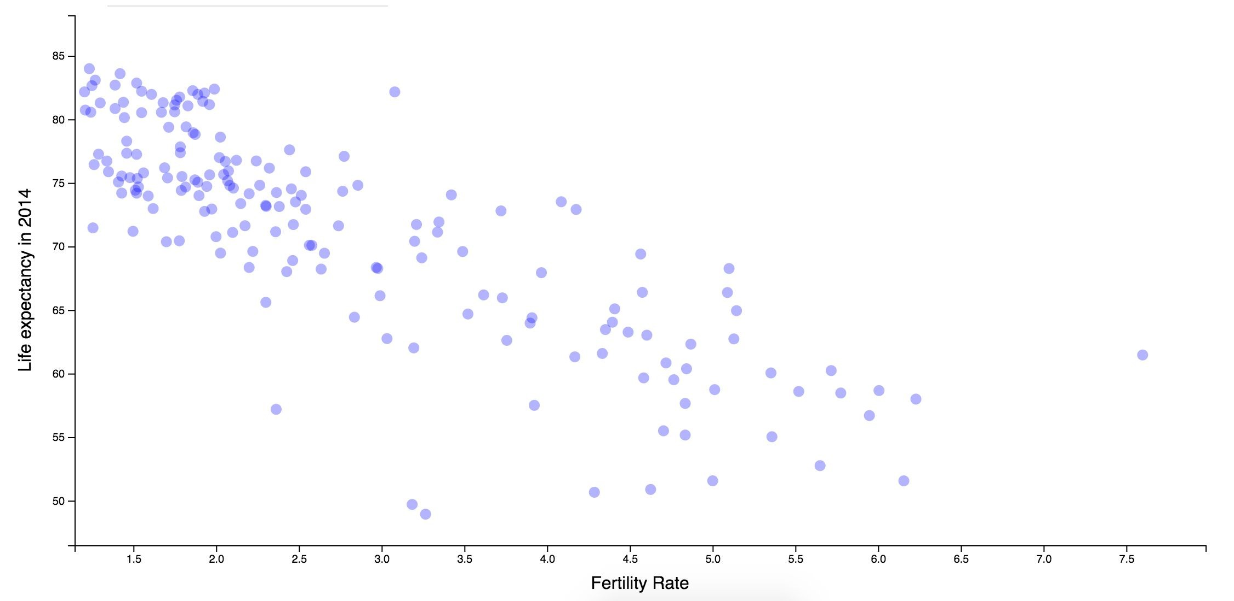
dynamic
We want to update these each time data updates
Which visual elements are static (added once) v.s. dynamic (may be added / removed)?

Slide 14
 |  |  | static We don't want to add these each time data updates
Which visual elements are static (added once) v.s. dynamic (may be added / removed)?

Slide 15
How can we determine if an element has already been added to the screen?

Slide 16
// Store the data-join in a variable `circles`. Specify the identifier of each element var circles = svg.selectAll('circle') // select all circles in the svg
.data(data, function(d){return d.id}); // bind the data to your selection
// Append a circle element for each observation that was added to the data. circles.enter() // Determine what elements are new to the dataset
.append('circle'); // Append a circle for each entering element
.merge(circles) // Merge update selection to apply changes to entering AND updating
.attr('r', 5) // set a constant radius of 5
.attr('cx', function(d) {return d.x}) // specify the x attribute
.attr('cy', function(d) {return d.y}); // specify the y attribute
// Remove any exiting elements circles.exit().remove();
Use the data-join determine which elements are already on the screen

Slide 17
var svg = ele.selectAll("svg").data([data]); // bind a single piece of data
// Append static elements (i.e., only added once)
var gEnter = svg.enter() // will return an empty selection if there is an svg
.append("svg")
.attr('width', width)
.attr("height", height)
.append("g");
// g element for markers
gEnter.append('g') // append a g element to the *entering* g
.attr('transform', 'translate(' +
.attr('height', chartHeight)
.attr('width', chartWidth)
.attr('class', 'chartG');
margin.left + ',' + margin.top + ')')
Do the same thing to conditionally add static elements

Slide 18
Building your API

Slide 19
Making charts reusable means parameterizing anything that you want to control.

Slide 20
Width Height X title Y Title
Radius (function?) Color (function?) Legend
Scale min/max Transitions Scale Type
For a simple chart, what would you want to parameterize?

Slide 21


Slide 22
function chart() {
var width = 720, // default width height = 80; // default height
Basic reusable D3 approach
function myChart() {
// generate chart here with data join, using `width` and `height`
}
myChart.width = function(value) {
if (!arguments.length) return width; width = value;
return myChart;
};
myChart.height = function(value) {
// same pattern as for width
};
return my;
};

Slide 23
Iterate through selections for multiple charts
var chart = function() {
// Set defaults up here
// Internal function that gets returned function my(selection) {
// For each selected element, perform the function selection.each(function(data, i) {
// generate chart here; `data` is the data and `this` is the element
});
}
return my;
}

Slide 24
Using your function
// Construct a new instance of the chart function
var myChart = chart() // Function that returns a function
.width(500) // set parameters
.height(500); // set parameters
// Bind your dataset (datum) to a div element and call the chart function var chartWrapper = d3.select('#my-div')
.datum(dataSet) // bind dataset, datum is used b/c only 1 chart element is created
.call(myChart); // call the chart function!

Slide 26

<Todo />)

Slide 27
// Input Component
var InputComponent = React.createClass({ getInitialState:function() {
return {text:''};
},
update:function(event) {
var value = event.target.value; this.setState({text:value});
},
render:function() { return (
<div>
<input onChange={this.update} />
<br/>
<text>The user has typed: {this.state.text}</text>
</div>
);
}
});

Slide 32
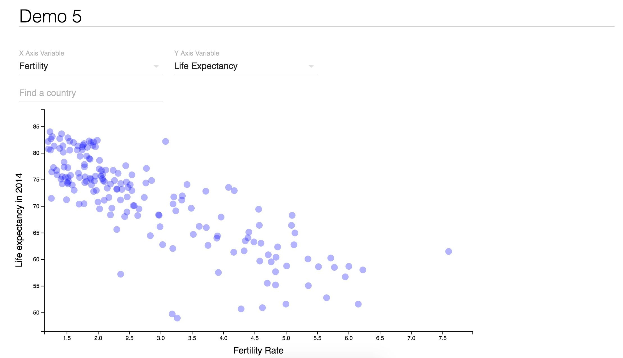
Demo

Slide 33



Slide 34
var App = React.createClass({ getInitialState() {
return {
data:[],
xVar:'gdp', yVar:'life_expectancy', idVar:'country', search:''
}
},
componentWillMount() {
// Get data
d3.csv('data/prepped_data.csv', function(data){ this.setState({data:data})
}.bind(this))
},

Slide 35
render() {
// Prep data
let chartData = this.state.data.map((d) => { return {
x:d[this.state.xVar], y:d[this.state.yVar], id:d[this.state.idVar]
}
});
return(
<ScatterPlotComponent titles={titles} search={this.state.search} data={chartData} width={window.innerWidth/2}
height={window.innerHeight * .9} />
)

Slide 36
// Scatterplot component
var ScatterPlotComponent = React.createClass({ componentDidMount(){
// Define scatterplot function this.scatter = ScatterPlot(); this.update();
},

Slide 37
// render
render() {
// Return links and show anything inside the <App> component (children) return (
<div width={this.props.width} height={this.props.height}
ref={(node) => { this.root = node;}} />
);
}

Slide 38
// Update on new props componentWillReceiveProps (props){
this.props = props; this.update();
},

Slide 39
// Create chart update() {
// Update parameters this.scatter
.width(window.innerWidth * .9)
.height(window.innerHeight - 130)
.fill('blue')
.xTitle(this.props.xTitle)
.yTitle(this.props.yTitle)
.radius((d) => d.selected == true ? 6 : 1);
// Call d3 update d3.select(this.root)
.datum(this.props.data)
.call(this.scatter);
},

Slide 40
Demo

Slide 41


Slide 42


Slide 43

// Use d3 data-join at the chart level var charts = d3.select(this.root)
.selectAll('.chart')
.data(this.props.data)// Array of datasets
charts.enter()
.append('div')
.attr('class', 'chart')
.merge(charts)// entering AND updating elements
.call(this.scatter);
charts.exit().remove()

Slide 44
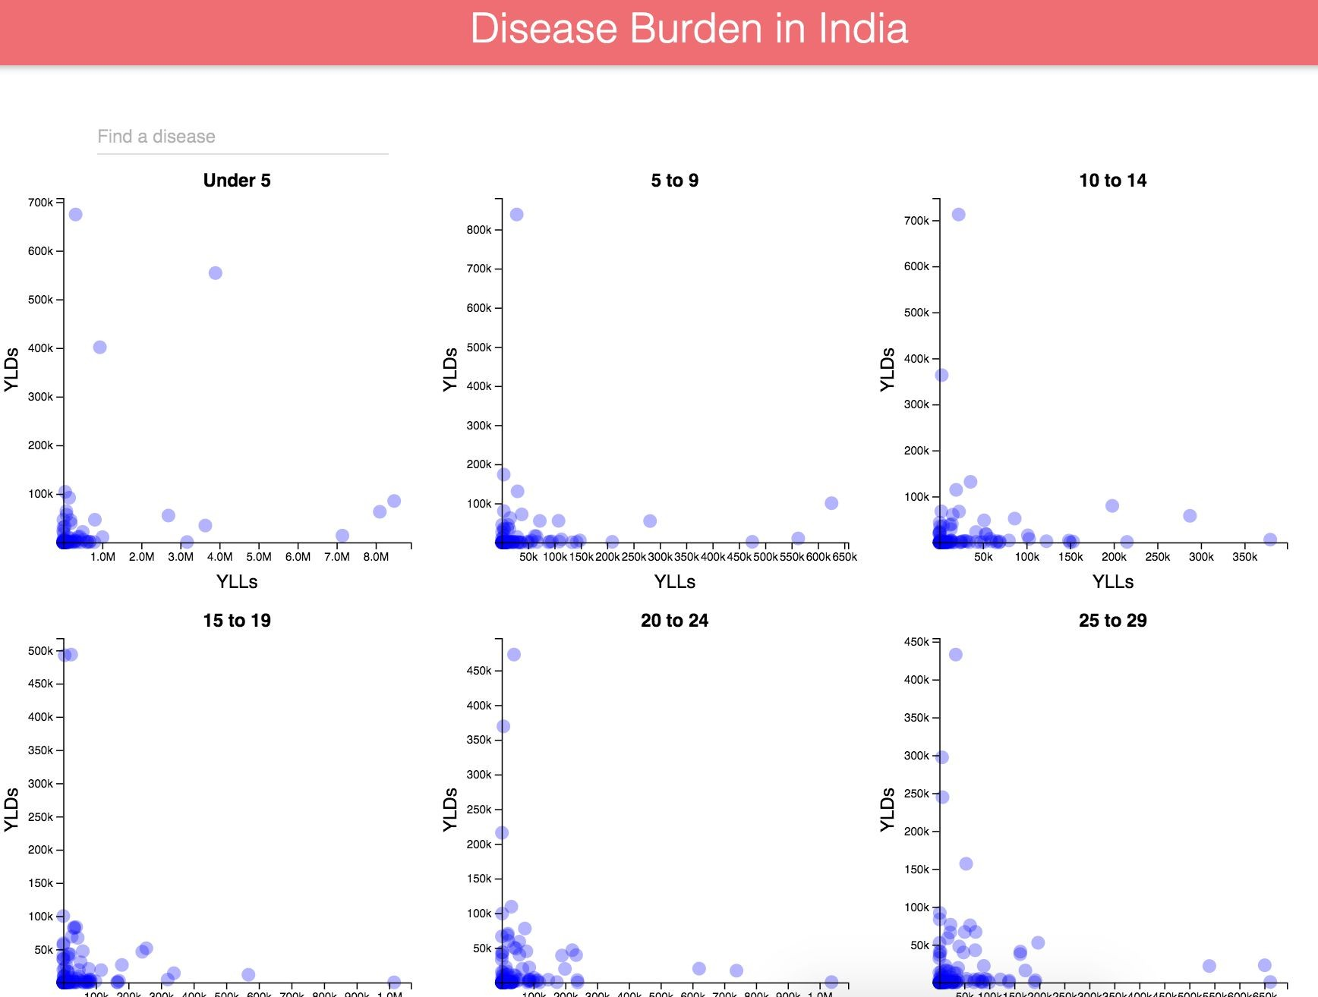
Demo

Slide 46


Slide 47



Slide 48
Nitish Kumar
@nitishk88

