Slide 1
CYBERTHREATFORGE
Advanced Cybersecurity Simulation and Threat Defense Platform
Prepared by: CyberThreatForge AI Engine Date: June 2026

Slide 2
1. Executive Summary & Overview
• An enterprise threat modeling range designed to simulate modern cyber warfare scenarios.
• Integrates real-time defensive monitoring dashboards with multi-domain vulnerability assessments.
• Includes post-quantum cryptographic simulation modules for secure communications auditing.
• Bridges the gap between raw threat telemetry and blue-team interactive training exercises.

Slide 3
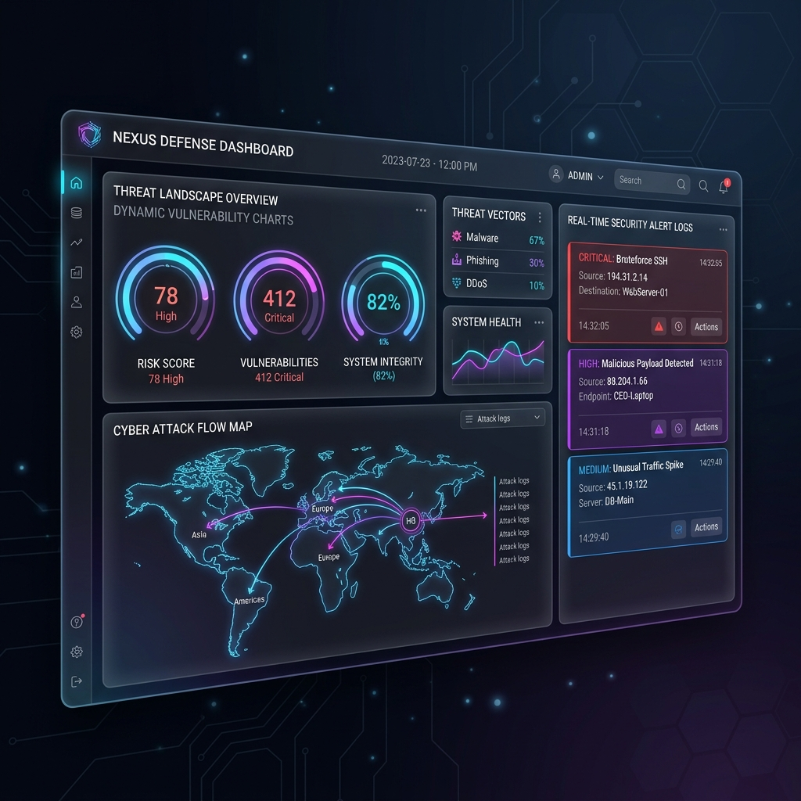
2. Central Security Dashboard
• Real-time visual monitoring of network health, cyber attack feeds, and warning system logs.
• Glassmorphism dark UI designed for quick situational analysis by security operations teams.
• Aggregates alerts from core modules (OSINT, DeFiGuard, ModelDefender) in a single stream.
• Dynamic status health indicators for critical network zones.

Slide 4
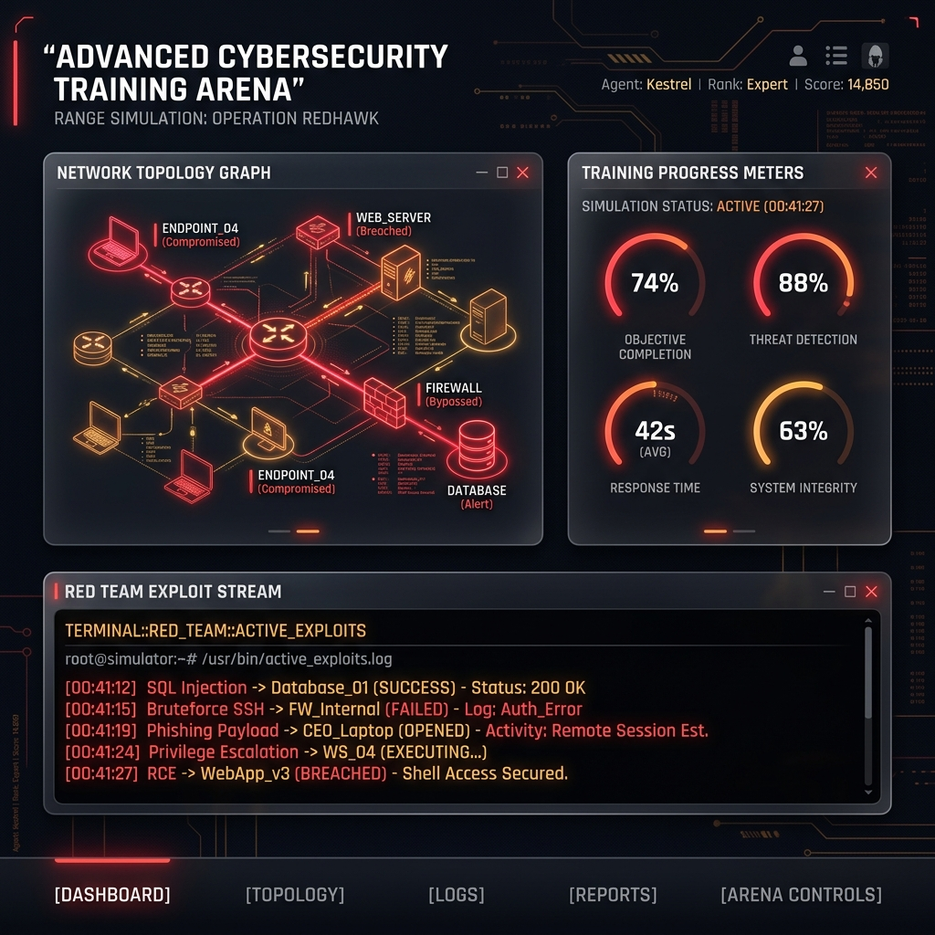
3. Interactive Cyber Range Arena
• Full simulated sandbox environment for defense training and active incident exercises.
• Visualization of network topologies showing active attack paths and compromised segments.
• Training meters and scorecards to assess blue-team incident response times.
• Simulates red-team exploit streams in an isolated sandbox context.

Slide 5
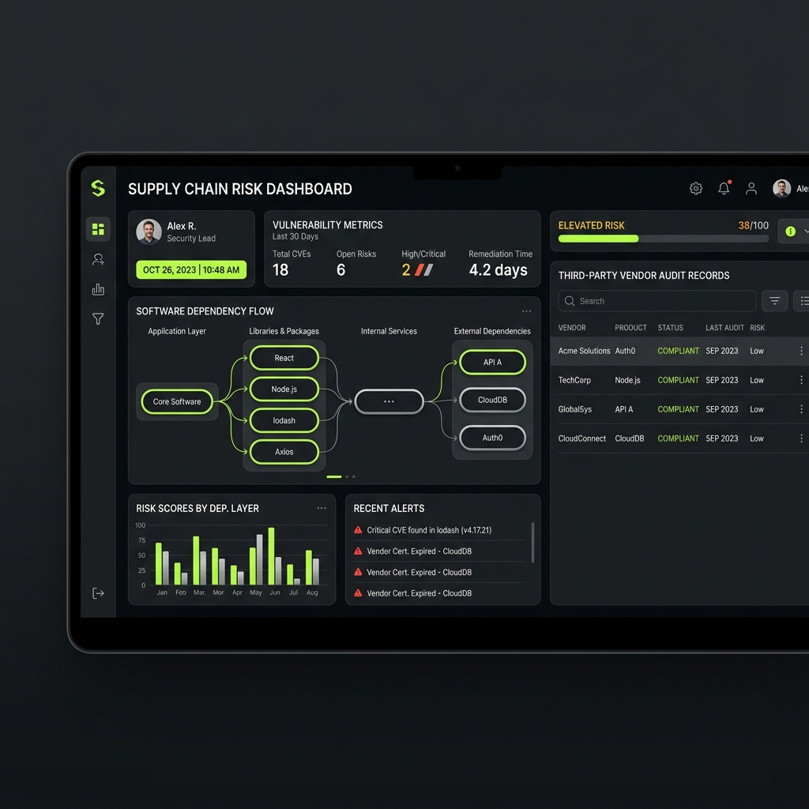
4. Software Supply Chain Auditor
• Map dependency structures to identify package vulnerabilities and transit risks.
• Audit vendor profiles and verify package checksums in transit.
• Calculates risk scores based on nested components and third-party dependencies.
• Detailed database models configured to log vendor compliance status.

Slide 6
5. Specialty Defense Modules
• ModelDefender: Embeds robust watermarks in ML models to protect IP and detect spoofing.
• DeFiGuard: Scans blockchain ledger interactions and audits Tornado Cash proxy addresses.
• FirmwareGuard: Automatically checks signatures and hashes for SCADA/IoT devices.
• PsyOpsForge: Models and tracks misinformation campaigns across target demographics.
• LegacyShield: Validates air-gap and SCADA legacy protocol communications (Modbus/TCP).

Slide 7
6. Deployment & Setup Commands
• The platform is completely containerized for simple setup across dev/staging environments.
• Launch with Docker Compose: $ docker-compose up --build
• Kubernetes Orchestration config manifests: $ kubectl apply -f k8s/deployment.yaml $ kubectl apply -f k8s/service.yaml
• Fully automated local Python range launcher script included (run_local.py).

