Slide 1

POWER BI PROJECT
Supply Chain Visibility System
With Optimization Analytics
Turning fragmented operational data into one decision-ready view
DATA
ANALYTICS
ACTION
01
02
03
Orders • products • customers • shipments
Inventory • delivery • suppliers • transport
KPI signals • bottlenecks • recommendations
POWER BI | POWER QUERY | DAX | POSTGRESQL
Supply Chain Visibility System With Optimization Analytics
01 / 15

Slide 2
PROBLEM STATEMENT
Inventory
Slow-moving and dead stock can hide inside total stock.
CORE PROBLEM
I
Fragmented data leads to delayed decisions.
Delivery
Regional and warehouse bottlenecks become visible too late.
D
Suppliers
Quality and reliability signals are difficult to compare.
Orders, inventory, delivery, suppliers, transportation and warehouses are analyzed separately, making it difficult to identify root causes, detect risks early, and take timely action.
S
Transport
Shipping-mode cost and delay trade-offs need comparison.
T
GOAL → One connected view for smarter decisions
Warehouses
Utilization varies widely across sites.
W
THE DATA ALREADY SHOWS THE COST OF THESE GAPS
76.7%
17.1%
53.9%
15.9–84.2%
slow-moving stock
on-time delivery
supplier reliability
warehouse utilization
Supply Chain Visibility System With Optimization Analytics
02 / 15

Slide 3
DATASET
10,000
58
118
rows in the main fact table
columns in the fact table
supplier records
DATA DOMAINS
WHY THESE FIELDS MATTER
O
Orders
C
Customers
•
Sales & Quantity
measure demand and revenue
Order ID • Sales • Quantity • Status
Customer ID • Segment • City • Country
•
Order / Delivery Status
measure fulfillment and delay
P
Products
S
Shipping
•
Shipping Mode
compare cost and service
Product • Category • Price • Department
Mode • Scheduled days • Real days • Delay
•
Warehouse & Inventory
measure capacity and stock
I
Inventory
S
Suppliers
•
Safety Stock / Reorder
support replenishment logic
Stock • Safety stock • Reorder level • Value
Lead time • Quality score • Reliability
•
Dates & Geography
enable trend and regional analysis
Supply Chain Visibility System With Optimization Analytics
03 / 15

Slide 4
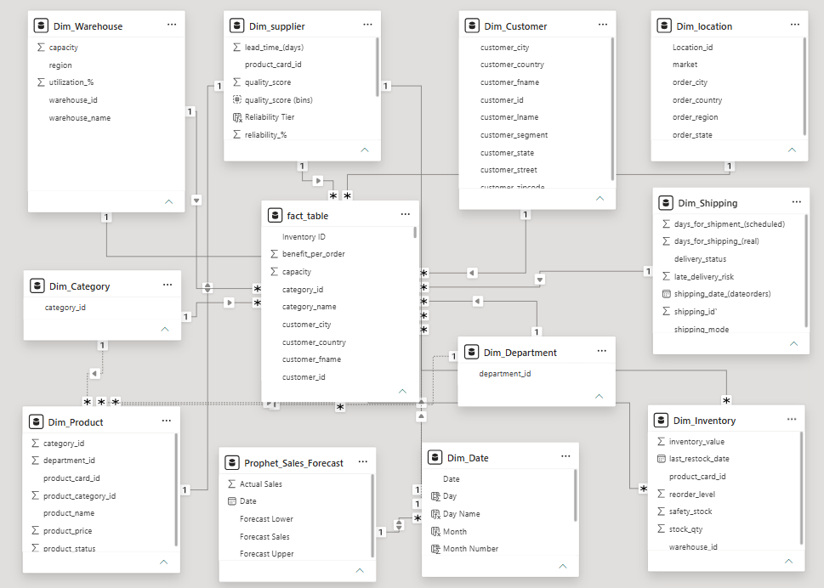
DATA MODEL
HOW TO READ THE MODEL
01
Fact Table
Orders / inventory / shipment measures live here.
02
Dimensions
Product, customer, location, date, supplier, warehouse, etc.
03
Relationships
Dimensions filter the fact data for consistent slicing.
04
DAX Layer
Measures convert raw fields into business KPIs.
Result → cleaner relationships + reliable KPI roll-ups
Supply Chain Visibility System With Optimization Analytics
04 / 15

Slide 5
DASHBOARD ARCHITECTURE
1
2
3
4
5
6
RAW DATA
→
POSTGRE SQL
→
POWER QUERY
→
STAR SCHEMA
→
DAX + KPIs
→
POWER BI
Orders Products Customers Shipments
Structured source for required analytics
Clean
Transform
Standardize
Fact + dimensions + relationships
Measures
Ratios
business rules
Interactive views Filters
Drill-down
ANALYTICAL MODULES
Executive
KPI pulse
Inventory
Stock health
Delivery
Service
E
I
D
Supplier
Risk
Transportation
Cost + delay
Warehouse
Capacity
S
T
W
BUSINESS INSIGHT → ACTION
Supply Chain Visibility System With Optimization Analytics
05 / 15

Slide 6
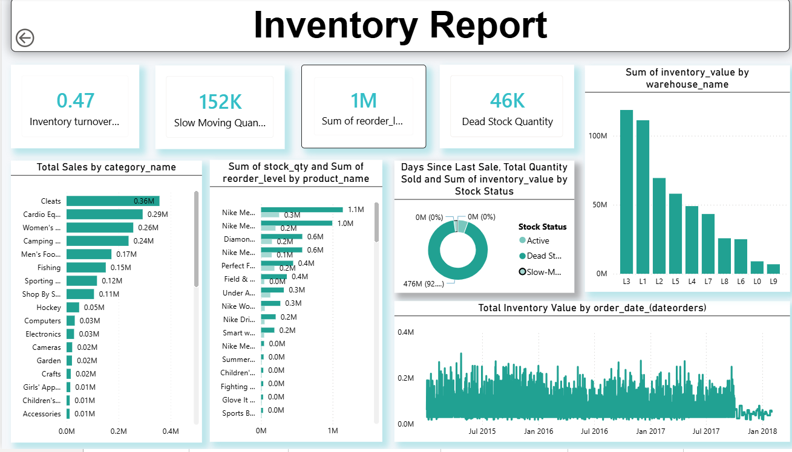
INVENTORY ANALYTICS
76.7%
slow-moving stock
~1M
dead-stock units
0.47x
inventory turnover
WHAT THIS REPORT ANSWERS
Business Idea: Optimize inventory by reducing slow-moving and dead stock while maintaining sufficient stock levels.
Business Insight: 76.7% slow-moving stock and low inventory turnover indicate excess working capital is tied up in inventory.
•
Inventory turnover ratio
•
Category performance
•
Slow / fast movers
•
Dead stock identification
•
Warehouse-wise inventory
Supply Chain Visibility System With Optimization Analytics
06 / 15

Slide 7
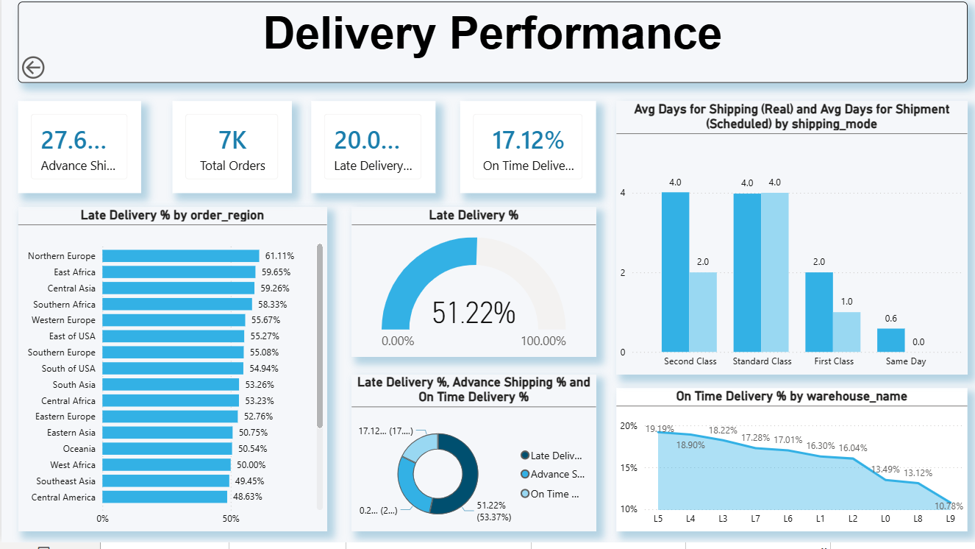
DELIVERY ANALYTICS
17.1%
on-time delivery
51.2%
late-delivery trend
7K
total orders
WHAT THIS REPORT ANSWERS
•
On-time vs delayed deliveries
•
Regional delay comparison
Business Idea: Improve customer service by identifying regions, warehouses and shipping patterns responsible for delivery delays.
Business Insight: With only 17.1% on-time delivery, the business should prioritize high-delay areas and improve fulfillment processes.
•
Lead-time analysis
•
Warehouse fulfillment
•
Shipping trend
Supply Chain Visibility System With Optimization Analytics
07 / 15

Slide 8
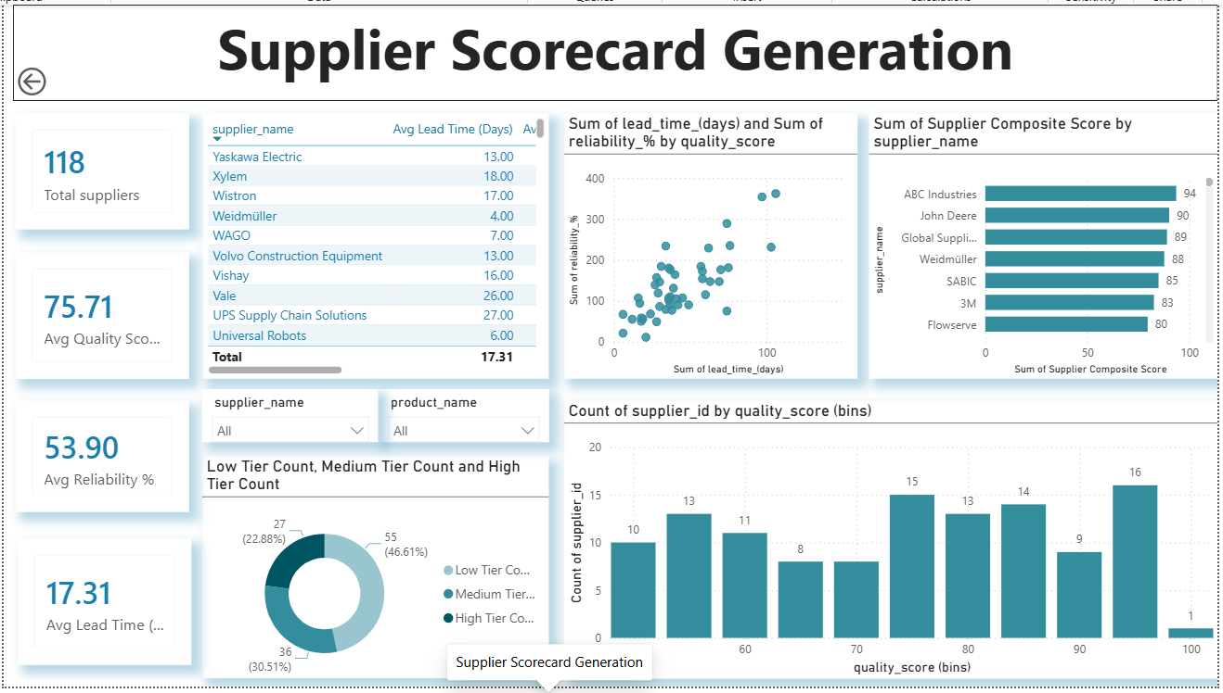
SUPPLIER ANALYTICS
118
suppliers
75.71
avg quality score
53.9%
avg reliability
WHAT THIS REPORT ANSWERS
•
Reliability tiers
•
Quality score distribution
Business Idea: Build a reliable supplier base by balancing supplier quality, reliability and lead time.
Business Insight: Average reliability is 53.9%, so suppliers should be ranked and monitored to reduce sourcing and disruption risks.
•
Supplier ranking
•
Lead-time comparison
•
Composite score
Supply Chain Visibility System With Optimization Analytics
08 / 15

Slide 9
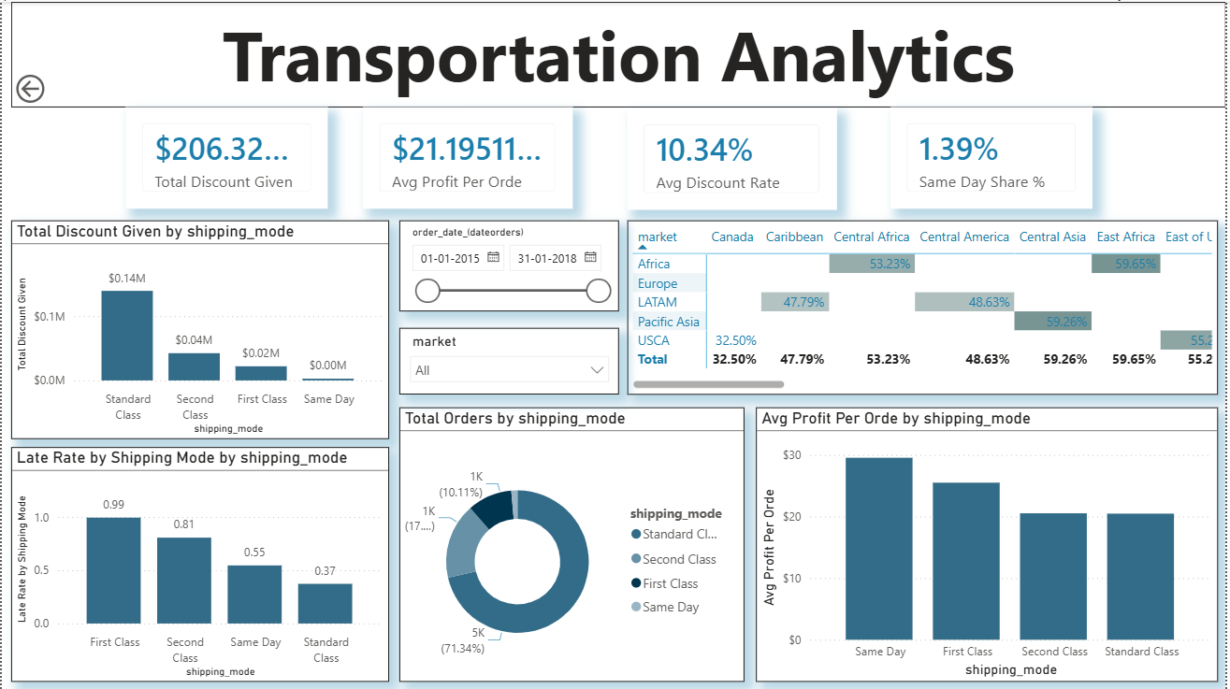
TRANSPORTATION ANALYTICS
$206K
discount load
10.34%
avg discount rate
≈50%
late-rate pattern
WHAT THIS REPORT ANSWERS
•
Discount by shipping mode
•
Late rate by mode
Business Idea: Select transportation modes based on the best balance of cost, delivery speed and service reliability.
Business Insight: The high late-rate pattern and discount load show an opportunity to optimize shipping modes and reduce unnecessary transportation costs.
•
Orders by mode
•
Profit per order
•
Regional / market comparison
Supply Chain Visibility System With Optimization Analytics
09 / 15

Slide 10
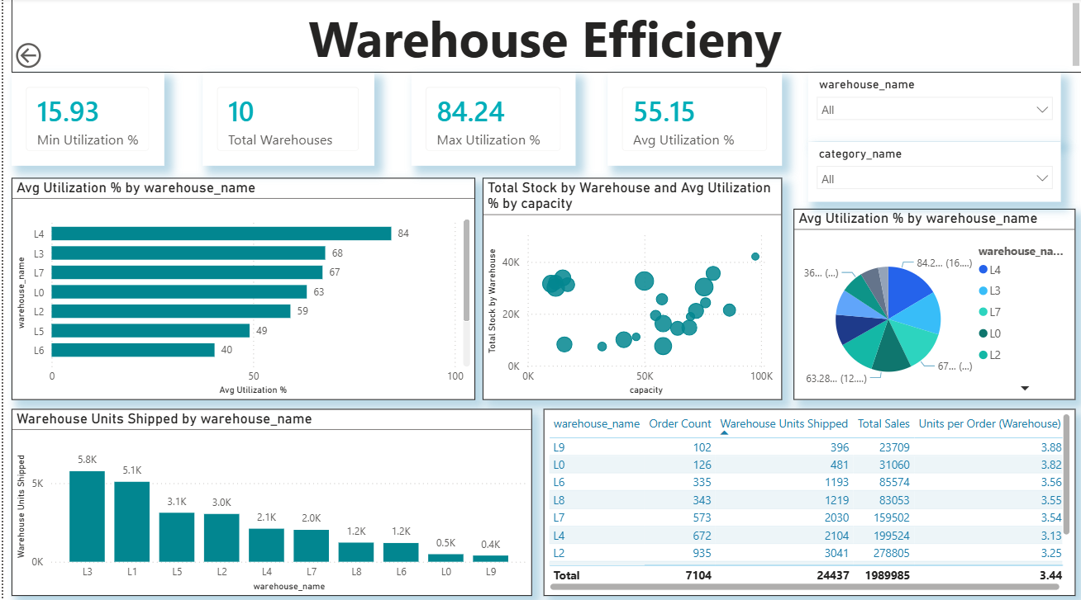
WAREHOUSE ANALYTICS
15.9–84.2%
utilization range
10
warehouse sites
5.8K
top shipped units
WHAT THIS REPORT ANSWERS
•
Utilization by warehouse
Capacity vs stock
•
Business Idea: Balance warehouse capacity and throughput by shifting inventory and orders away from overloaded locations.
Business Insight: Utilization ranges from 15.9% to 84.2%, indicating uneven capacity usage and an opportunity for better warehouse allocation.
•
Units shipped
•
Sales contribution
t
•
Warehouse productivity
Supply Chain Visibility System With Optimization Analytics
10 / 15

Slide 11
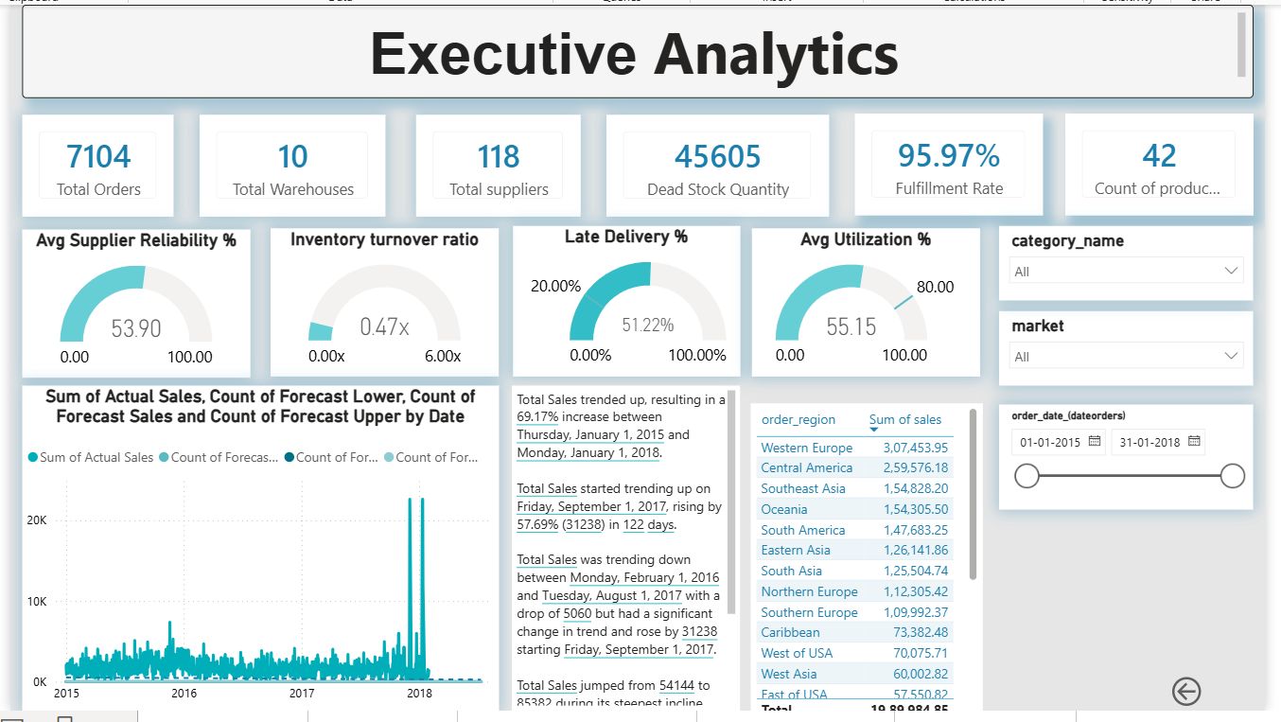
GLIMPSE OF DASHBOARD
INTERACTION LAYER
01
Filter
Date • market • category
02
Cross-filter
Select a visual to filter
03
Drill
Region → warehouse → order
04
Navigate
Open the detailed module
05
Explain
Hover for KPI context
DECISION LENS
MONITOR → DIAGNOSE
LOCATE → ACT
EXECUTIVE SNAPSHOT • 7,104 orders • 10 warehouses • 118 suppliers • 45,605 dead-stock units
Supply Chain Visibility System With Optimization Analytics
11 / 15

Slide 12
KEY INSIGHTS
76.7%
17.1%
53.9%
84.2%
1
2
3
4
Slow-moving stock
On-time delivery
Supplier reliability
Peak utilization
WORKING CAPITAL
SERVICE
SOURCING RISK
CAPACITY
Most inventory is slow-moving. Focus on ageing, rebalancing and clearance.
Service is weak. Isolate delay drivers by region, warehouse and mode.
Reliability is moderate. Compare quality score + lead time before switching.
Selected sites are near capacity. Rebalance volume before adding space.
FROM SIGNAL → BUSINESS ACTION
Inventory
Ageing → reduce dead stock → free working capital
DECISION RULE
High impact
+
High urgency
=
First action
Delivery
Prioritize L8/L9 + high-delay regions → improve service
Suppliers
Balance quality + reliability + lead time → reduce sourcing risk
Warehouses
Compare utilization + throughput → rebalance capacity
Takeaway: address inventory pressure + delivery risk together.
Supply Chain Visibility System With Optimization Analytics
12 / 15

Slide 13
CHALLENGES
01
Data Cleaning & Transformation
02
Data Model & Relationships
03
Date & Time Data Issues
Raw supply-chain data required significant cleaning, column removal, renaming, and transformation before analysis.
Handling duplicate Customer IDs created relationship issues while building the dimensional model.
Order-date fields had formatting/type problems, which affected date slicers and time-based analysis.
04
DAX Calculation Accuracy
05
Inventory Classification
06
Dashboard Design & Usability
Measures such as Fulfillment Rate and Dead Stock Quantity required careful validation to ensure the results matched the expected values
Identifying slow-moving and dead stock accurately was challenging because the logic had to be based on inventory movement rather than simply displaying quantities
  Combining inventory, delivery, supplier, transportation, and warehouse KPIs into an interactive dashboard while keeping it clear and readable was another challenge.
Data Cleaning → Relationship Validation → DAX Testing → KPI Validation → Dashboard Refinement
Supply Chain Visibility System With Optimization Analytics
13 / 15

Slide 14
FUTURE SCOPE
01
AI demand forecasting
02
Predictive inventory
03
Real-time IoT
Predict demand using history, seasonality and market signals before replenishment decisions.
Recommend reorder points, quantities and safety stock using demand variability and lead time.
Bring live warehouse and logistics signals—capacity, movement and shipment status—into the decision layer.
04
Automated alerts
05
Supplier risk ML
06
Cloud deployment
Alert teams to late-delivery risk, dead stock, unusual utilization and supplier deterioration.
Predict quality or reliability deterioration from score, lead time and delivery behavior.
Scale refresh, collaboration, governance and secure access with one KPI source of truth.
ROADMAP
AUTOMATE
→
PREDICT
→
RECOMMEND
→
ACT
EXPECTED VALUE • earlier risk detection • lower excess inventory • better delivery • faster supplier decisions • smarter capacity allocation
Supply Chain Visibility System With Optimization Analytics
14 / 15

Slide 15
TEAMMATES
Prudhvi Surla
Abhay Kumar
PS
Inventory Analytics
AK
Delivery Performance
THANK YOU
From raw supply-chain data
to actionable insight.
Nitish Kumar Yadav
Raghul
NY
Supplier Performance
R
Transportation Analytics
DEMO • DISCUSSION
MS
Mohinish Sai
Devid Mahesh
Warehouse Analytics
DM
Warehouse Analytics
Supply Chain Visibility & Optimization
Project outcome → a single decision layer across inventory, delivery, suppliers, transport and warehouses.
Infosys Springboard Project
Supply Chain Visibility System With Optimization Analytics
15 / 15

