Slide 2
Data Cleaning
Loaded data from csv file
Verified the additional rows like head and tails are not present
All the columns with null values greater than 30% was removed from data-set. Removed column which has same values in all the rows
Removed additional strings and converted the data types
Imputed values in columns with lower percentage of null values
Removed the outliers present

Slide 3
Univariate Analysis – Ordered categorical variable
Grades
Term
Employment length
Issue year
Issue Month

Slide 4
Univariate Analysis – Unordered categorical variable
Purpose
Loan status
Home ownership
Address state

Slide 5
Univariate Analysis – Quantative variable
Loan Amount Range
Funded Amount Range
Interest rate range
Annual Income Range
DTI

Slide 6
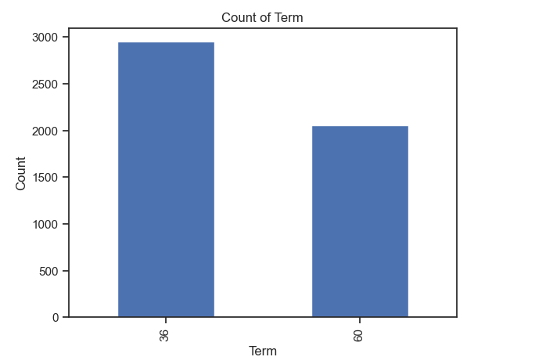
Univariate Analysis – Ordered categorical variable : Term
The graph shows that the
count of defaulted loan is higher for
loans with a 36-month term
compared to those with a
60-month term.

Slide 7
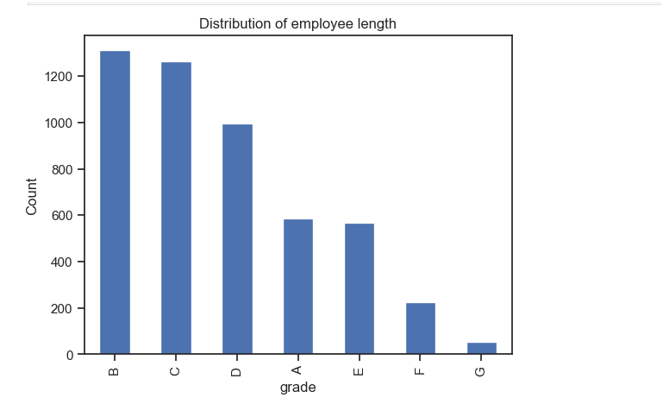
Univariate Analysis – Ordered categorical variable : Employment length
The graph shows that the
count of defaulted loan is
higher with grade 'B' and
lowest with grade 'G'

Slide 8
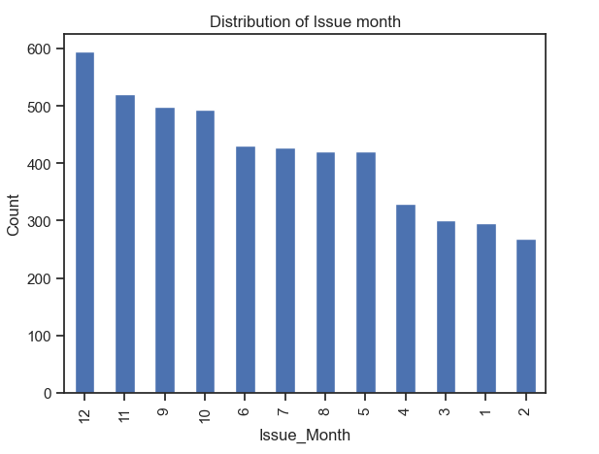
Univariate Analysis – Ordered categorical variable : Issue Month
The graph shows count
of defaulted loan is
highest in dec and
lowest in feb

Slide 9
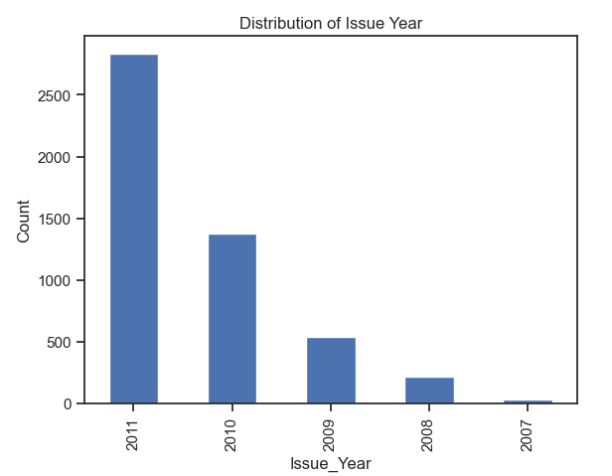
Univariate Analysis – Ordered categorical variable : Issue Year
The graph shows
count of defaulted
loan is highest in 2011
and lowest in 2007

Slide 10
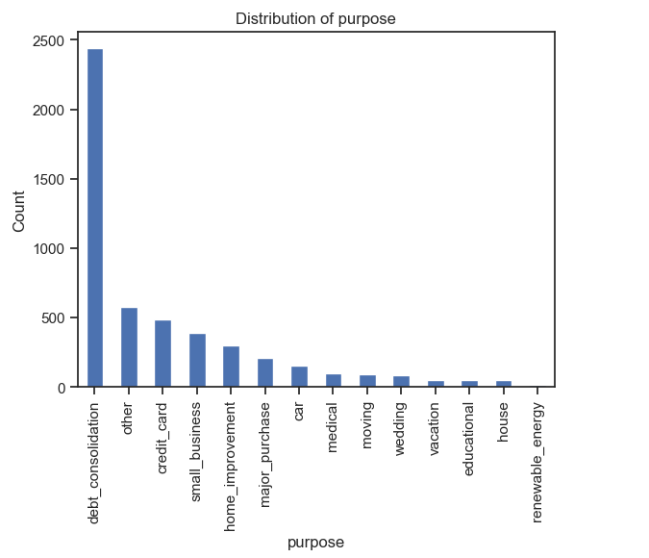
Univariate Analysis – unordered categorical variable : Purpose
The graph shows the
count of defaulted loan is
highest for debt_consolidation
purpose and lowest for
renewable energy.

Slide 11
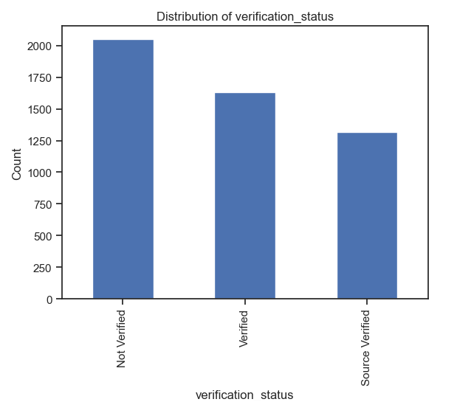
Univariate Analysis – unordered categorical variable : Verification status
The graph shows count of
defaulted loan is higher for
'Not Verified' customers and
lowest for 'Source verified
customers'

Slide 12
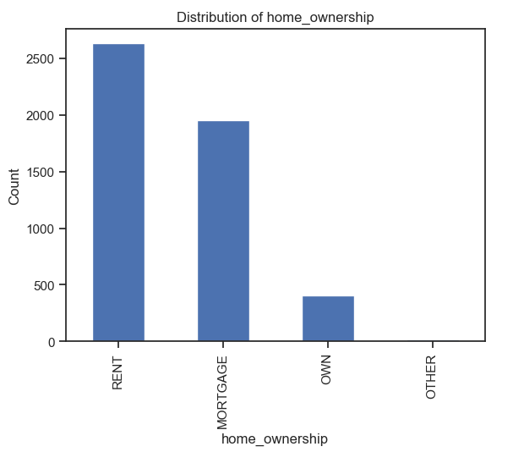
Univariate Analysis – unordered categorical variable : Home Ownership
The graph shows count of
defaulted loan is highest for
people who stay in rented place
and lowest for 'Other'

Slide 13
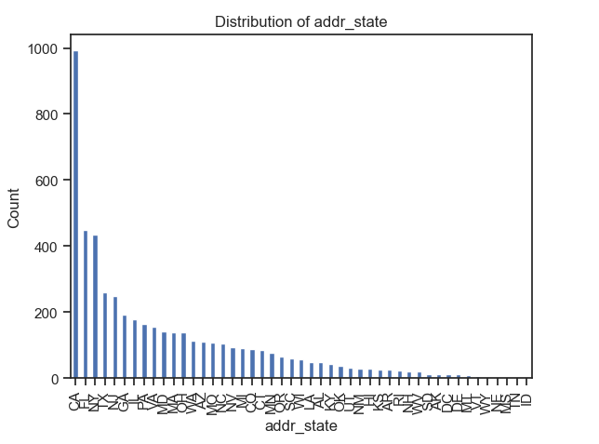
Univariate Analysis – unordered categorical variable : Address state
The graph shows count of
defaulted loan is highest in
'CA' and lowest in 'WY, NE, MS,
IN and ID'

Slide 14
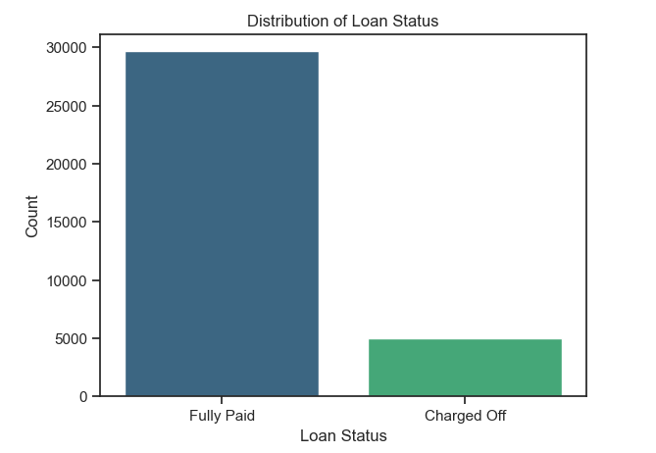
Univariate Analysis – unordered categorical variable : Loan Status
The graph shows count
of Fully paid loan status
is more than charged off

Slide 15
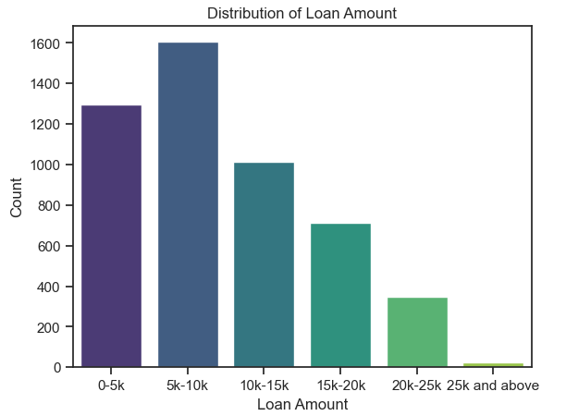
Univariate Analysis – Quantitative variable : Loan Amount
The count of defaulted loan
is highest for loan amount
5k-10k and lowest for
25k and above

Slide 16
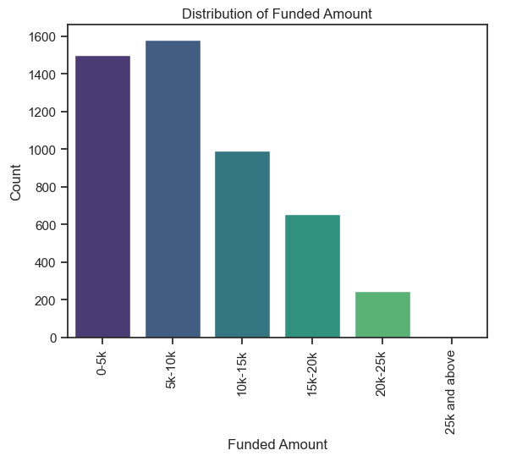
Univariate Analysis – Quantitative variable : Funded Amount
The count of loan funded
amount is highest for 5k -10k
and lowest for 25k and above

Slide 17
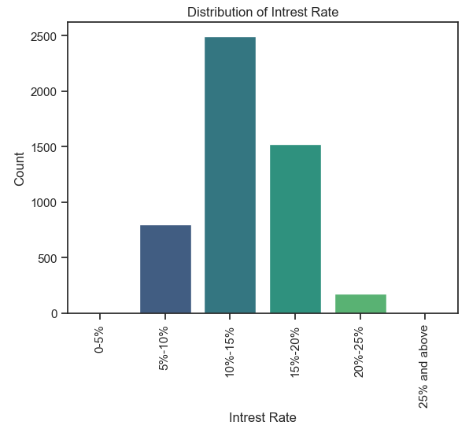
Univariate Analysis – Quantitative variable : Interest rate
The graph shows that defaulted
loans are most common within
the 10% to 15% interest rate range,
while loans with interest rates
of 25% or higher have the
fewest defaults.

Slide 18
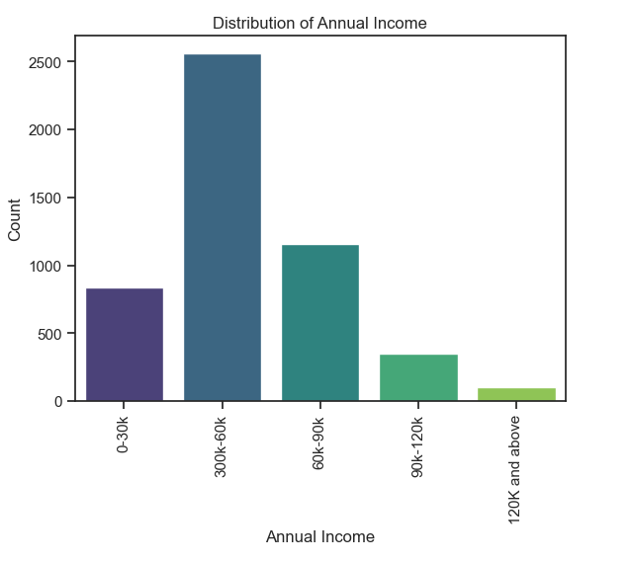
Univariate Analysis – Quantitative variable : Annual Income
The graph shows that default
loans are most common within
30K - 60 K Annual income range
and lowest for 120k and above

Slide 19
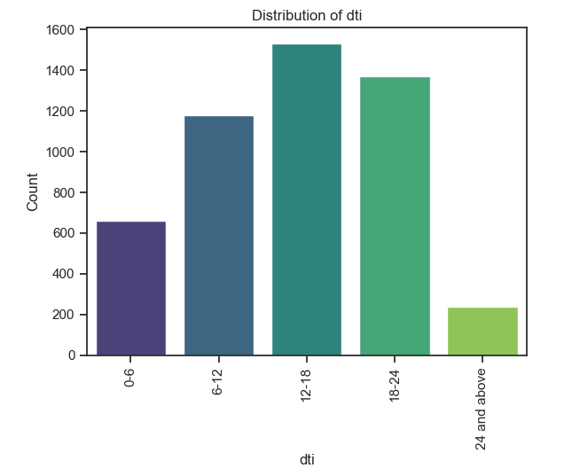
Univariate Analysis – Quantitative variable : Dti
The graph shows count
of defaulted loan is highest
for 12-18 dti and lowest for
14 and above dti

Slide 20
Bivariate Analysis – Ordered categorical variable
Grade
Term
Employment Length
Issue Year
Issue Month

Slide 21
Bivariate Analysis – Unordered categorical variable
Purpose
Home Ownership
Address state

Slide 22
Bivariate Analysis – Quantitative variable
Loan Amount Range
Funded Amount Range
Interest rate range
Annual Income Range
DTI

