Slide 1


CORNERSTONE PROJECT · COP7001
Accelerated Mobile
Video Processing System
Salil Gujar — 2025MCS2106
Nitish Kumar — 2025MCS2100
IIT Delhi · April 2026

Slide 2
Problem Statement
● Phones expose three compute units: scalar cores, NEON SIMD, mobile GPU
● Assignment asks to exploit all three with measurable acceleration
● Approach split into five anchors:
– Live 30 FPS camera feed through the pipeline
– Four execution modes, user-switchable at runtime
– Speedup measured against scalar baseline, not assumed
– On-screen dashboard so behaviour stays observable
– Stable operation on a physical device, not an emulator
Accelerated Mobile Video Processing · COP7001
2 / 16
IIT Delhi

Slide 3
Why Sobel Edge Detection
● 3×3 local operation — fits SIMD lanes and GPU threadgroups cleanly
● Deterministic scalar version serves as correctness oracle
● Compute-heavy enough that Sobel actually dominates baseline frame time
● Visual output makes mistakes obvious during development
Accelerated Mobile Video Processing · COP7001
3 / 16
IIT Delhi

Slide 4
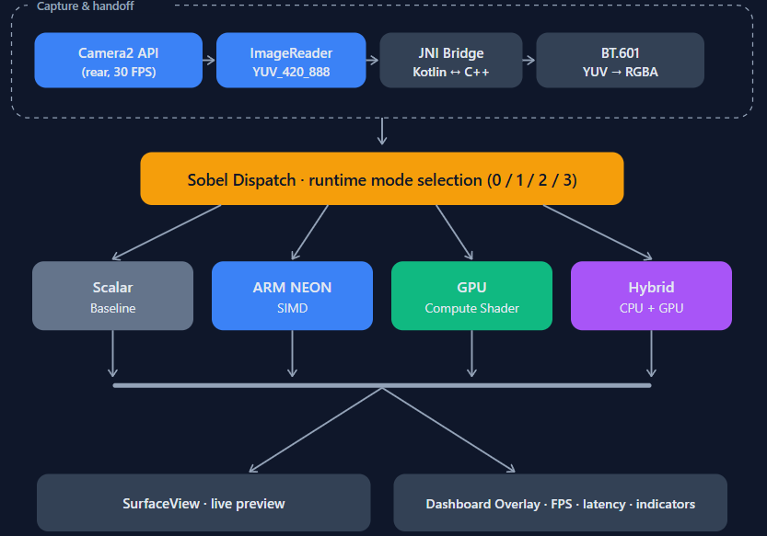
System Block Diagram
Accelerated Mobile Video Processing · COP7001
4 / 16
IIT Delhi

Slide 5
Phase 1 — Baseline Pipeline
● NDK + JNI toolchain, camera + storage permissions
● Camera2 + ImageReader @ 30 FPS, YUV_420_888 on a background thread
● BT.601 YUV → RGBA conversion in native C++
● Scalar Sobel — nested loops, 3×3 kernels, clamp-to-edge border handling
● SurfaceView output + first dashboard (mode, FPS, latency)
Accelerated Mobile Video Processing · COP7001
5 / 16
IIT Delhi

Slide 6
Phase 2 — SIMD (ARM NEON)
● NEON warm-up on a simpler op first → validates toolchain and layout
● Sobel kernel processes 16 pixel positions per iteration (128-bit lanes)
● Widen-accumulate-narrow pattern through NEON intrinsics
● Correctness checked against scalar with ±1 tolerance
● Runtime mode switching — baseline ↔ SIMD without app restart
Accelerated Mobile Video Processing · COP7001
6 / 16
IIT Delhi

Slide 7
Phase 3 — GPU Compute
● Headless EGL context so compute runs without on-screen rendering
● Compute shader — one invocation per output pixel, reads 3×3 neighbourhood
● Texture-based input path for better cache behaviour than raw SSBO
● Workgroup configurations benchmarked per device, fastest latched
● Correctness verified against scalar with ±2 tolerance (float arithmetic)
● Lesson: GPU is not automatically faster than SIMD for a small local filter
Accelerated Mobile Video Processing · COP7001
7 / 16
IIT Delhi

Slide 8
Hybrid Mode + Adaptive Split
CPU — ARM NEON
top rows · 16 px / iter
● Frame split horizontally — CPU + GPU fire in parallel
● CPU thread: NEON Sobel on top rows (16 px/iter)
● GPU shader: concurrent dispatch on bottom rows
● EMA tracks per-row cost (α = 0.1, spiked α = 0.25)
● Split rebalances each frame so both halves finish together
● Clamped to 10–90% — prevents degenerate single-device splits
● Thermal-aware: trims GPU share above 40.5 °C / 43 °C
● Measured ~8.9 ms @ 720p · ~15 ms @ 1080p — sync cost keeps it just behind NEON
g_hybridMidRow
EMA-controlled
GPU — Compute Shader
bottom rows · concurrent dispatch
Accelerated Mobile Video Processing · COP7001
8 / 16
IIT Delhi

Slide 9
Runtime Mode & Resolution Switching
● Mode switch affects the dispatcher only — camera stays up
● Resolution switch is heavier — Camera2 has to rebuild the session
● Careless switching caused stale callbacks and camera-session races
● Guarded transitions: drop stale frames, reset measurement state
Accelerated Mobile Video Processing · COP7001
9 / 16
IIT Delhi

Slide 10
Live Performance Dashboard
● Mode · FPS · per-stage latency · end-to-end latency
● SIMD and GPU activity indicators light only when those paths run
● Hybrid split ratio surfaced while hybrid mode is active
● Speedup stabilised via per-mode averages + warm-up exclusion
● Dashboard treated as a core deliverable, not an afterthought
Accelerated Mobile Video Processing · COP7001
10 / 16
IIT Delhi

Slide 11
Testing & Correctness
● Every accelerated mode diffed per-pixel vs scalar on same input frame
● Tolerances derived from arithmetic, not chosen arbitrarily:
– NEON ±1 — widen-accumulate-narrow introduces 1 LSB of rounding
– GPU ±2 — float round-trip adds 1 additional LSB on top of NEON
● Verification runs once on mode switch (too expensive per-frame)
● Rule: if verification fails, speedup is not reported — fix the mode first
● Tested on physical device across 720p and 1080p resolutions
● Mode switching stress-tested: rapid toggling under sustained camera load
Accelerated Mobile Video Processing · COP7001
11 / 16
IIT Delhi

Slide 12
Results · Quantitative Table
Mode | 720p Sobel (ms) | 1080p Sobel (ms) | 720p FPS | 1080p FPS
Scalar Baseline | ~41.8 | ~92.5 | ~18 | ~8
SIMD (NEON) | ~6.9 ~6.0× | ~13.7 ~6.8× | ~30 | ~24
GPU Compute | ~7.7 ~5.4× | ~14.7 ~6.3× | ~30 | ~24
Hybrid NEON+GPU | ~8.9 ~4.7× | ~15.0 ~6.2× | ~30 | ~23
Accelerated Mobile Video Processing · COP7001
12 / 16
IIT Delhi

Slide 13
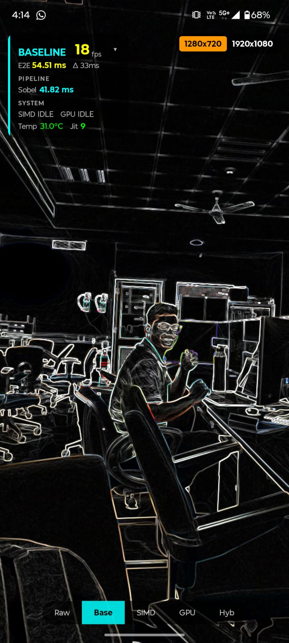
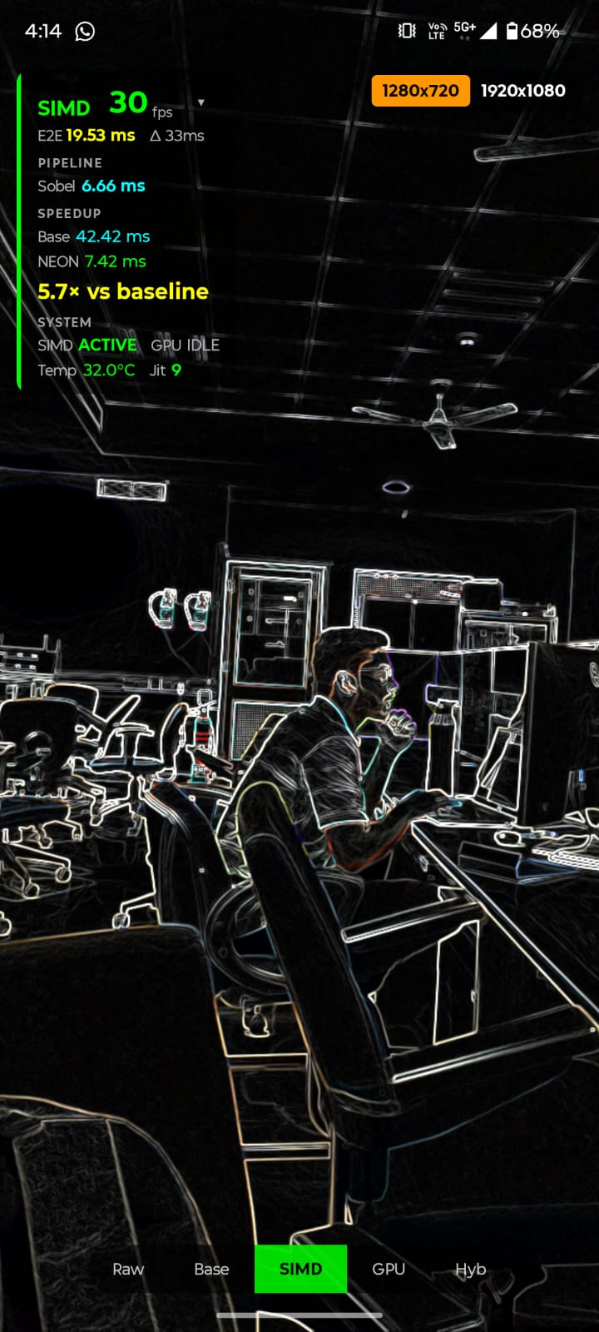
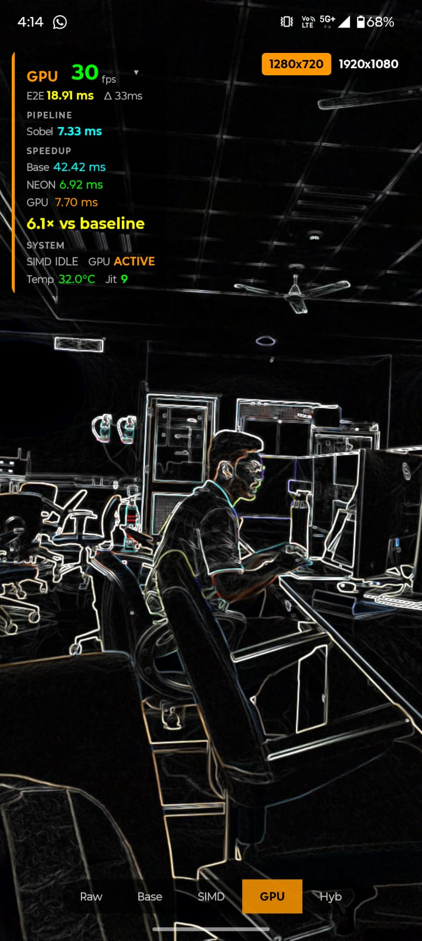
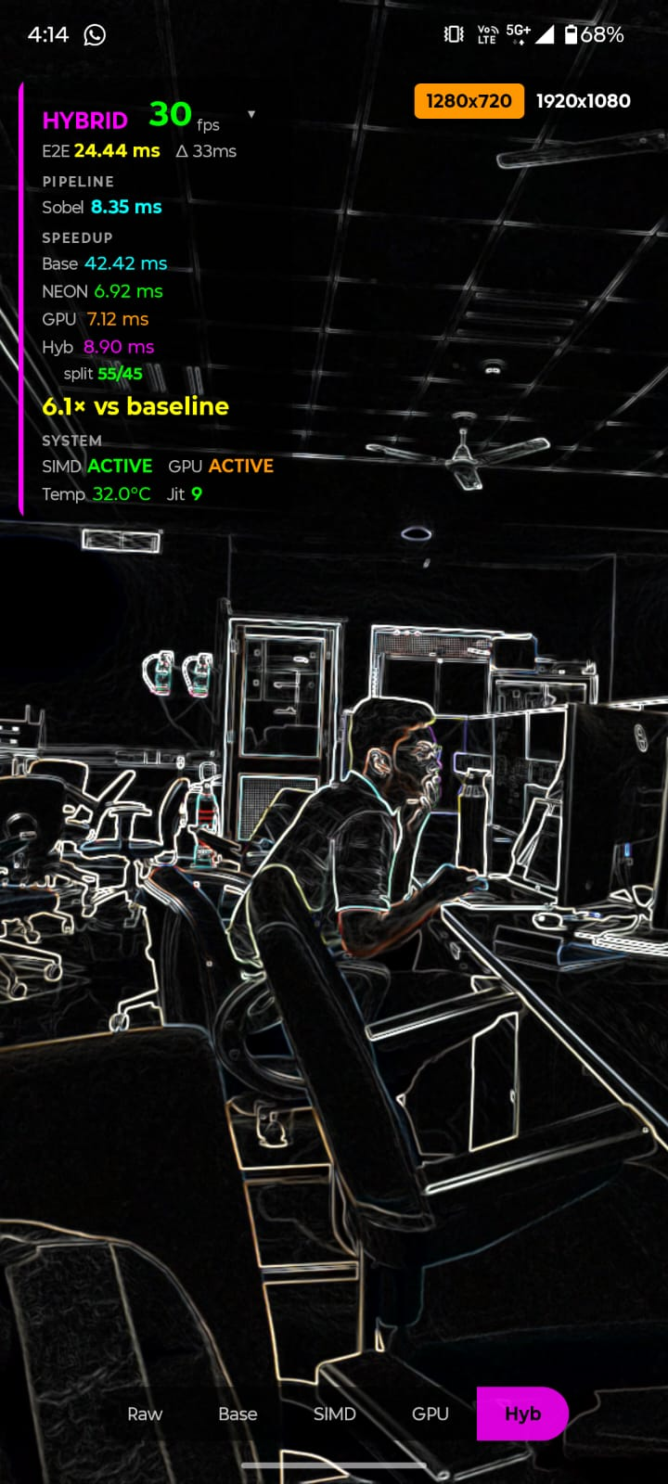
Application Output · Screenshots
Baseline (Scalar)
Neon SIMD
GPU
Hybrid
Accelerated Mobile Video Processing · COP7001
13 / 18

Slide 14
Results · Latency & Frame Stability
● 720p · baseline ~18 FPS · SIMD / GPU / Hybrid reach ~30 FPS (camera cap)
● 1080p · baseline drops to ~8 FPS · accelerated modes stay interactive
● Baseline: Sobel dominates frame time
● GPU: upload + readback dominate total latency
● SIMD is the fastest pure-Sobel path on the tested device
Accelerated Mobile Video Processing · COP7001
13 / 16
IIT Delhi

Slide 15
SIMD & GPU Utilization Evidence
● SIMD indicator lit in NEON and hybrid modes
● GPU indicator lit in GPU and hybrid modes
● Hybrid: both indicators lit with a live split ratio on the dashboard
● For a small local filter like Sobel, GPU ≠ automatically faster than SIMD
Accelerated Mobile Video Processing · COP7001
14 / 16
IIT Delhi

Slide 16
Engineering Lessons
● Multiple compute units (scalar, SIMD, GPU) can meaningfully cooperate
● Acceleration must be evaluated in system context, not in isolation
● Correctness against the scalar baseline is non-negotiable
● Hybrid heterogeneous execution is practical, not just a theoretical idea
● Observability is what makes the performance story honest
Accelerated Mobile Video Processing · COP7001
15 / 16
IIT Delhi

Slide 17
AI Usage Disclosure
How AI Was Used
Our Own Work
● Tools used: ChatGPT, Gemini — treated as collaborative assistants
● NEON path (well-understood):
– Debugging, compiler-error clarification, static analysis
● GPU & hybrid paths (less prior experience):
– Boilerplate: EGL setup, shader compilation, buffer management
– We provided high-level design; AI translated to GLSL / C++
– Focus stayed on system-level integration and adaptive balancing
● Core system architecture — designed entirely by us
● SIMD acceleration strategy — our background in CPU-level optimisation
● GPU integration approach — we set the design, AI helped with API mechanics
● Hybrid split concept — our original idea:
– Horizontal frame split, concurrent CPU+GPU dispatch
– Adaptive split ratio from measured per-row throughput so both sides finish together
– AI did not suggest or contribute to the hybrid strategy
● 30-minute final stability run — joint effort by both team members
Accelerated Mobile Video Processing · COP7001
1 / 2

Slide 18
Team Contributions
Phase 1 — Baseline Pipeline
Nitish — Android project, NDK toolchain, Camera2 integration, YUV→RGBA conversion
Salil — Scalar Sobel filter, SurfaceView rendering, initial live dashboard
Phase 2 — SIMD Acceleration
Nitish — NEON warm-up experiment, NEON-vectorized Sobel (16 px/iter)
Salil — Correctness verification framework, mode-switching UI, SIMD dashboard indicators
Phase 3 — GPU & Hybrid
Nitish — Headless EGL context, compute shader, hybrid frame-split logic
Salil — GPU correctness verification, stress testing, GPU/hybrid dashboard indicators
Phase 4 — Optimization & Finalization
Nitish — Latency profiling, memory/buffer optimisation, NEON cache tuning
Salil — Workgroup-size experiments, texture access, dynamic split ratio, dashboard layout
Joint: 30-minute final stability run and integration testing done together on a physical device
Accelerated Mobile Video Processing · COP7001
2 / 2

Slide 19
Thank You
Accelerated Mobile Video Processing · COP7001
16 / 16
IIT Delhi

