Slide 1

INFORMATION VISUALIZATION · IIT DELHI
Chrono
Matrix
2D/3D Visual Analytics for Multithreaded Execution
Nitish Kumar (2025MCS2100)
Dipesh Kant (2025MCS2110)

Slide 2
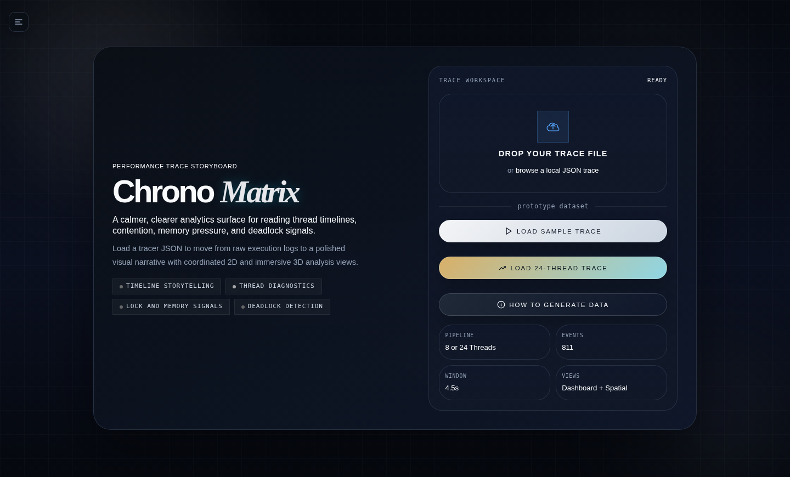
01 · WHAT IS MY PROJECT?
Chrono-Matrix
A performance trace storyboard for multithreaded C++ programs
Interactive Dashboard
Browser-based visual analytics with 8+ coordinated views. No install required — load a JSON trace and explore instantly.
Thread Behavior
Visualizes execution timing, lock waits, memory access patterns, and deadlock signals from real C++ programs.
2D + 3D Views
Timeline lanes, heatmaps, chord diagrams, dependency graphs, and immersive 3D spatial/flow/galaxy views.
IIT Delhi Project
Built for the Information Visualization course to showcase coordinated, multi-view visual analytics over HPC data.

Slide 3
02 · WHAT PROBLEM DID WE SOLVE?
From Raw Logs to Visual Clarity
Debugging multithreaded programs is notoriously hard — we built a solution.
BEFORE · Without Chrono-Matrix
AFTER · With Chrono-Matrix
Raw JSON logs with thousands of events — no visual structure
Interactive timeline lanes per thread — see exactly when events fire
Can't tell WHEN threads conflict or HOW LONG they wait
Zoom and pan to any time window; duration shown on hover
Lock contention invisible until deadlock actually occurs
→
Chord diagram + bar chart shows which mutexes block most
Memory hotspots buried in address hex strings
Heatmap of address activity reveals cache-line contention
No way to see thread relationships or causal chains
Dependency graph shows who is waiting for whom
Comparing thread performance requires manual grep & awk
Per-thread profiler breaks down compute vs wait time

Slide 4
03 · HOW DO WE GATHER THE DATA?
The Tracer Pipeline
An LD_PRELOAD shared library silently intercepts thread & memory APIs — zero changes to your code.
01
02
03
04
C++ Target
Build Library
Run & Capture
Explore Trace
Annotate with
cm_annotate.h
Compile the
LD_PRELOAD hook
Intercept all
thread API calls
Drag JSON into
the dashboard
LD_PRELOAD
=./tracer/libcmhijack.so
./tracer/my_program
Emits: my_program.json → { ts, tid, event, addr, duration_us, scenario }

Slide 5
04 · TOOLS USED TO VISUALIZE
Technology Stack
A pure browser-based stack — no server, no framework, just the browser and D3.
D3.js v7
PRIMARY
Three.js
3D
HTML5 + CSS3
UI
Core Visualization Engine
3D Immersive Views
UI Shell & Layout
Powers the Gantt timeline, memory heatmap, chord diagram, dependency force graph, and overview charts. Handles data binding, scales, axes, and DOM manipulation.
Renders the Spatial Timeline, Thread Galaxy (particle clusters), and Flow Field (particle streams). Handles WebGL camera, orbit controls, and shader effects.
Custom sidebar navigation, dark-theme design system, animated loading screen, responsive layout, tooltip system, and scanline/glow ambient effects.
Vanilla JS (ES6+)
LOGIC
JSON Trace File
DATA
C++ / LD_PRELOAD
TRACER
Orchestration & Data
Data Format
Data Collection
Multi-page router, event bus for cross-view coordination, JSON trace parser, scenario filter system, and reactive data pipeline connecting all views.
Self-describing structured event log emitted by the C++ tracer. Loaded via file drag-and-drop or the sample dataset buttons. Single source of truth for all views.
cm_hijacker.cpp intercepts POSIX thread APIs at runtime with zero code changes. cm_annotate.h macros let you annotate compute and memory events manually.
All visualization runs entirely in the browser — load index.html via a static server, drag in a trace JSON, and every view renders instantly.

Slide 6
05 · VISUALIZATION TECHNIQUES — 2D VIEWS
2D Analytical Views
Each view is tuned to answer a specific question about thread behavior.
Thread Timeline
Memory Analysis
Trace Atlas
Gantt / Swimlane Chart
2D Heatmap
Dual-Panel View
Q: Which memory addresses are contended, and when?
Q: How does thread time activity relate to memory space activity?
Q: When did each thread run, and what was it doing?
Lock Contention
Thread Profiler
Dependency Graph
Chord Diagram + Bar Chart
Stacked Bar Chart
Force-Directed Graph
Q: Which mutexes block the most threads, and for how long?
Q: What fraction of each thread's time is wasted waiting?
Q: Who is waiting for whom, and how did that evolve over time?

Slide 7
05 · VISUALIZATION TECHNIQUES — 3D VIEWS
3D Immersive Views
Three.js-powered exploratory views for spatial and temporal navigation.
Spatial Timeline (3D)
3D
Thread Galaxy (3D)
3D
Flow Field (3D)
3D
3D Bar / Duration Map
Particle Cluster Field
Particle Stream Animation
Question:
Question:
Question:
How do event durations compare across threads and time in 3D space?
How do threads cluster based on their behavioral similarity?
How do events flow and evolve from older to newer states over time?
How it works:
How it works:
How it works:
Events extruded as 3D bars. X = thread lane, Z = time, Y = duration. Orbit, zoom, and pan with mouse. Color encodes event type. Helps spot unusually long events at a glance.
Each thread rendered as a glowing particle cluster. Threads with similar event patterns attract each other. Live orbit view — rotate to find thread groups and outliers.
Streaming particle model where particles represent events moving along time dimension. Older events fade, newer ones glow bright. Reveals bursts, pauses, and wave patterns in event flow.
All 3D views remain coordinated with the 2D dashboard — selecting a thread in 3D highlights it across all 2D views via the shared event bus.

Slide 8
04b · AI REPORT GENERATION
AI-Powered Trace Analysis
One click — automated diagnosis, bottleneck identification, and optimization guidance from the loaded trace.
How It Works
What the Report Delivers
1
Load any JSON trace into the dashboard
Executive Summary
01
High-level overview of the trace: total threads, event count, dominant event types, time window, and an overall health score.
2
Click the AI Report view in the sidebar
Problem Diagnosis
3
Dashboard serializes trace metadata & event statistics
02
Identifies and names specific issues — e.g. deadlock on q_mutex between TID 3 and TID 7, false sharing on address 0xAA001040, or thread starvation in TID 5.
4
AI model analyses patterns, detects anomalies & bottlenecks
Optimization Guidance
Report renders inline — diagnosis + recommendations
03
5
Actionable recommendations: use lock-free atomics for the counter, split q_mutex into per-producer locks, pad struct to avoid cache-line sharing, rebalance work across threads.

Slide 9
06 · WHAT INSIGHTS CAN WE GET?
From the Dashboard to Decisions
Chrono-Matrix surfaces answers that would take hours to find manually.
Performance Bottlenecks
Contention & Deadlocks
Memory & Load Balance
Thread Profiler
Lock Contention
Memory Heatmap
Identify threads spending >60% of time in LOCK_WAIT — prime candidates for restructuring.
The mutex with the tallest bar is your primary bottleneck — consider a finer-grained lock or lock-free design.
Bright horizontal bands = multiple threads contending the same address range — likely false sharing.
Timeline
Dependency Graph
Trace Atlas
Spot long idle gaps in thread lanes — threads that could run in parallel but don't.
A cycle in the graph means deadlock — follow the edges to see exactly which thread holds what.
Threads with activity only on the left (temporal) but sparse spatial activity are compute-heavy, not memory-bound.
Overview
Timeline
Timeline
See the ratio of COMPUTE to non-COMPUTE events — a low ratio means the program is mostly waiting.
DEADLOCK_DETECTED events appear as red markers — jump straight to the exact timestamp.
Threads ending at very different times (Uneven Work) show load imbalance — redesign the work-stealing strategy.
Insight is interactive — click any event, thread lane, or node to cross-highlight across all other views simultaneously.

Slide 10
THANK YOU
Chrono-Matrix
2D Visual Analytics for Multithreaded Execution
01
What is the project?
02
Problem solved?
Interactive browser dashboard for multithreaded trace visualization
Made invisible thread behavior — contention, deadlocks, memory — visible
03
How data is gathered?
04
Tools used?
LD_PRELOAD hijacker intercepts pthread/IO APIs and emits a JSON trace
D3.js, Three.js, Vanilla JS, HTML5/CSS3, C++ with cm_annotate.h
05
Visualization techniques?
06
Insights gained?
Gantt, Heatmap, Chord, Force graph, Stacked bars, 3D Particle/Flow
Bottlenecks, deadlock cycles, memory hotspots, load imbalance — instantly
Chrono-Matrix · Information Visualization · IIT Delhi · 2024

