Slide 1
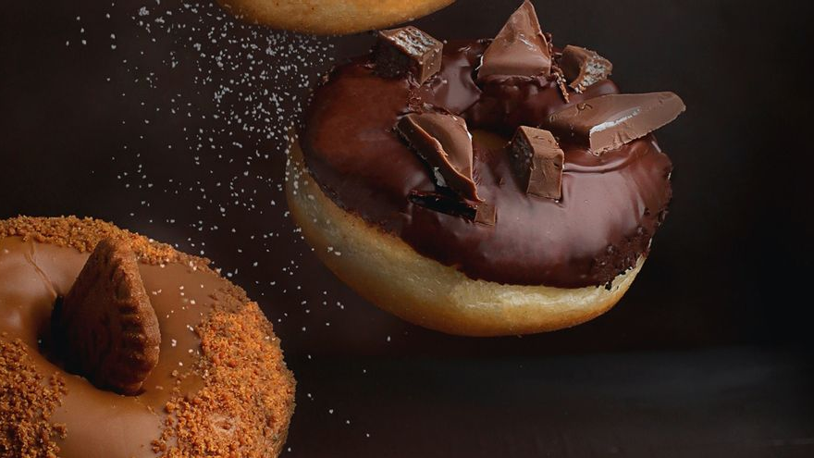

SCM 518: Analytical Decision Modeling I Data Pantheon
P
R
O
D
U
C
T
M
I
X
Team –22492
Abhiram Cheruku
Nitish Potedar
Smitha Raju Basavaraju
Yijian Zheng
Kiran Pramod Murchite

Slide 2
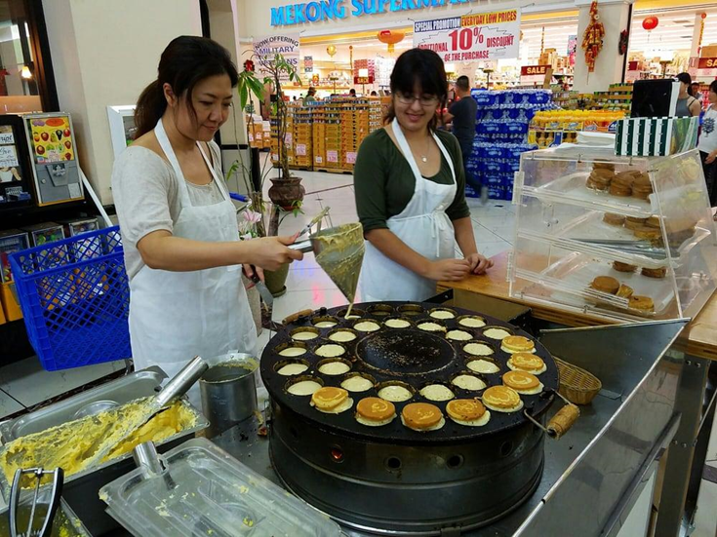
Background
AA Ozzy Bakery is a traditional Taiwanese bakery that has been in business for many years; located in Mekong Plaza, Mesa. The owner is a Taiwanese lady named Joanne. She runs bakeries both in Taiwan and in the United States. Limited by the size of the store and the number of customers, her bakery in Taiwan has a larger scale and greater income. Therefore, she mainly spends her time and energy on the business in Taiwan. For AA Ozzy Bakery in Arizona, she has hired a baker as an agent to manage it. Baker Bella makes a variety of breads, tarts, loafs and cookies according to her own time and approximate customer needs.
Joanne wants us to maximize AA Ozzy Bakery's profit with the current situation.

Slide 3
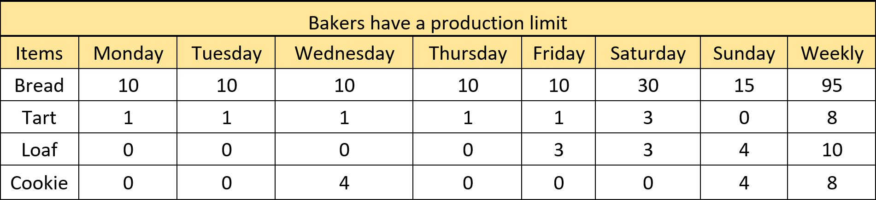
Requirements
Bakers have a production baking cycles limit.
Bread baked 2 cycles more than the customer demand can only sell 60%, and the rest will be thrown away because of expiration. So, the max baking cycle for breads is 2 plus customer demand.

Slide 4
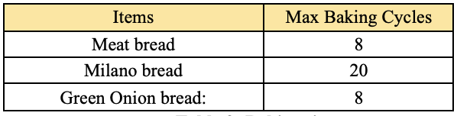
The boss estimates the weekly demand for each item
For Meat, Milano cream and Green Onion materials, to ensure the freshness of the ingredients, they can only be imported once a week, and in order not to waste these ingredients, the imported quantity is fixed, which means that the total number of baking cycles of breads that needs these ingredients is constant.

Slide 5
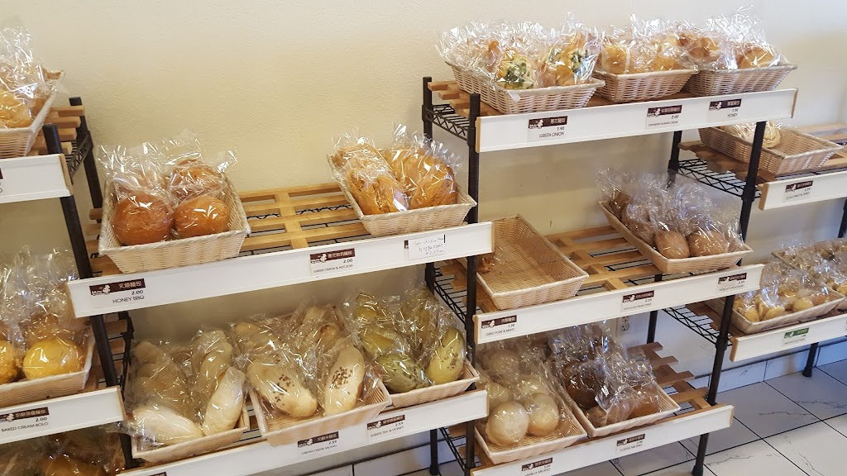
Since there are most customers on Saturday, the boss requires that each flavor of bread be made at least one cycle. In addition, bread of the same type cannot be made more than 2 baking cycles a day. ​
To incentivize employee performance, the boss promises a percentage(10%) of their weekend profit as employee’s bonuses. ​
Since general demand for tarts, loaves and cookies are not high, Joanne prefers to make each flavor of tarts/loafs/cookies at most once per day. ​

Slide 6
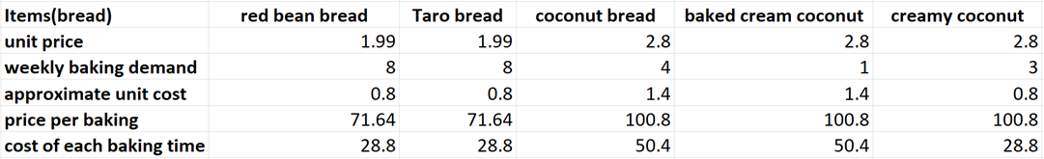
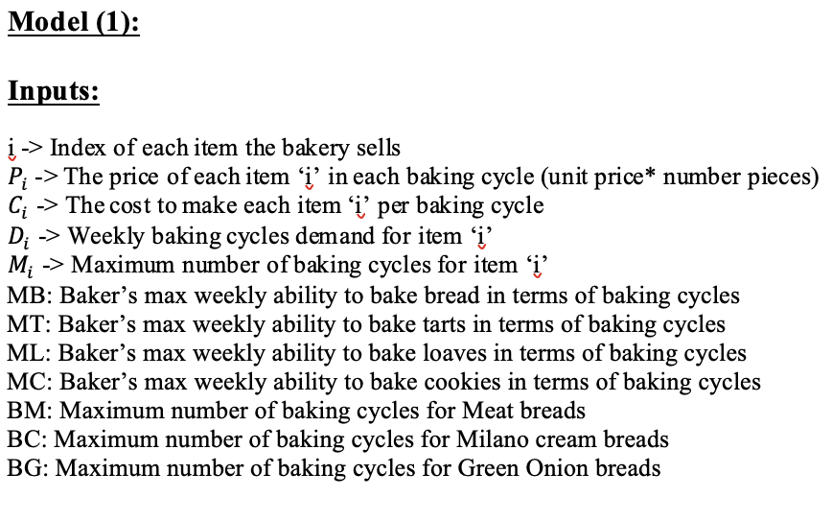
What items should the baker bake weekly to max the profit of the bakery?​
The results of the model 1 show that the maximum weekly income of the bakery is $ 5090.224 (before consider labor cost and fixed cost). In addition, we also know how many times each item should be baked weekly.​

Slide 7
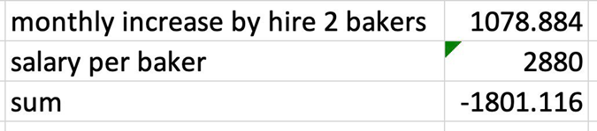
Is it necessary to hire one more baker ?
If we need to hire one more baker, we just need to change the data of the input MT, ML, MC (baker’s maximum weekly baking ability of items) and then run the model again.
As the output shows. There will be increase in profit of $1078, but Joanne needs to pay $2880 extra as the salary of the second baker, so hiring one more baker is not feasible.

Slide 8
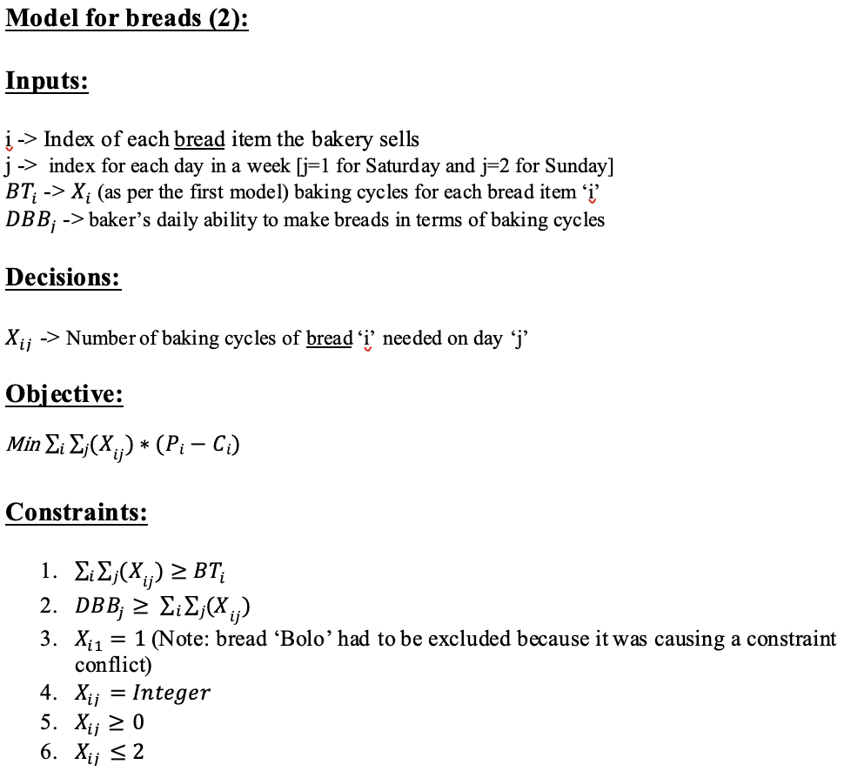
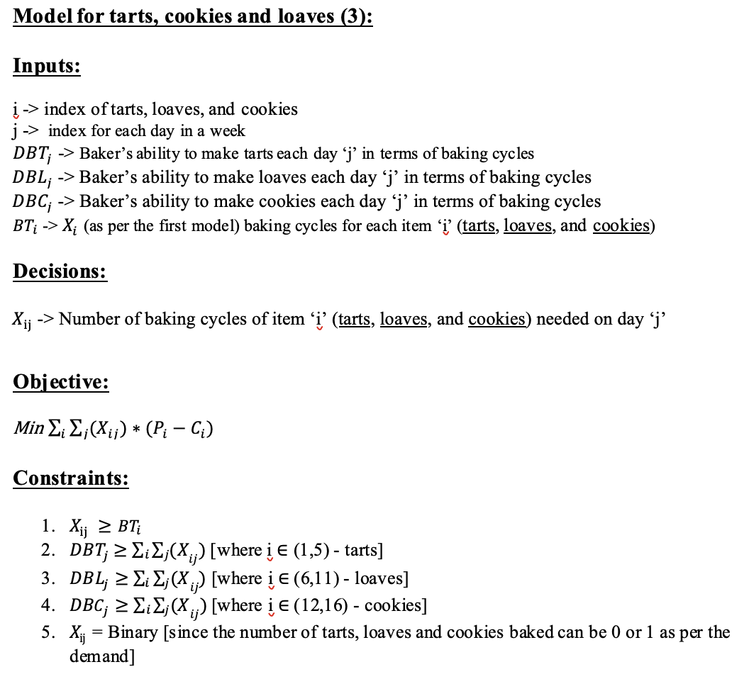
What items should the baker bake daily in order to minimize the bonus?
We split the breads and other items and solved them using two separate models

Slide 9
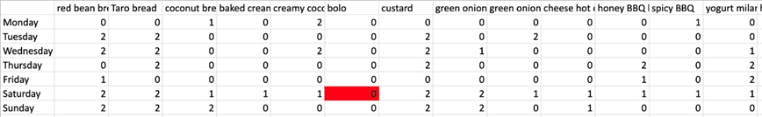
Regarding the second and third models, we added some inputs based on requirements 7, 8. We encountered some feasibility problems when building models 2 and 3. After further checking the model building report, we found two over-constrained parts:
1. Bolo items should not be included to maximize the profit since it was causing a conflict in constraints, but Joanne asked to make each flavor of bread at least once at Saturday. We suggested just cutting this production because the bakery loses profit each time it bakes Bolo bread.
2. Coconut macaron should be made 3 times weekly, but Joanne asked to make each flavor of cookies at most once per day, and the baker only has 2 days to make cookies every week. So, we suggested adding one more day to make cookies.
This is our result. We recommended that the bakery bake daily items according to the following results to maximize the monthly profit. At the same time, Joanne can also pay employees a minimum weekend bonus.

Slide 10
Learnings:
We learnt how to translate a real business problem into a mathematical model and solve it using optimization tools like linear programming. Linear programming methods are often helpful at solving problems related to production. A company that produces multiple types of products can use linear programming methods to calculate how much of each product to produce to maximize its profits.
Suggestions on how to make the project better:
The problem had a lot of input variables which is why we had to split the items across two models. This can be better solved using Python and Gurobi Optimization since it can handle any number of variables.

Slide 11
Conclusion​
We established close communication with project customers, because the data given by customers may need to be updated and customers may change some specific requirements or goals according to the phased result of the project. We successfully met all of Joanne’s requirements.
We shared the conclusions of the model with Joanne, the bakery owner, and she accepted the suggestion to make cookies twice on Monday and Wednesday rather than making 4 cycles on just Wednesday and the baker agreed. However, Joanne hesitated over the proposal to remove Bolo bread from shelves because she doesn't know the bundling status of Bolo bread - if there is no Bolo bread, the sales of other bread may also be affected (like the beer and diaper example). She said that she would temporarily remove Bolo bread for a month and decide whether to permanently remove Bolo bread based on customer feedback.

Slide 12
Thank you!

