Slide 1
Sensory Network Localization
Presented by:
D. Sumanth (M110166CS)
Nitish Rawat (M110248CS)

Slide 2
WSN - Definition
Wireless Sensory Network is a collection of sensors distributed over an area.
Sensors are autonomous system used to collect and control information.
Applications: Environment Monitoring, Target Tracking

Slide 3
Wireless Sensory Network Localization
Localization is the task of discovering the 2D or 3D or d-dimensional positions of sensor nodes.
Sensor node need to know their locations in order to detect and record events.

Slide 4
Ex:2D arrangement
Anchors are nodes whose location is known
Non-anchors are nodes whose location is to be determined.
x
x
X
C
x
x
A
x
B
x
X = anchors
X = non-anchors

Slide 5
What do we have?
Time of Arrival (TOA)
Time Difference of Arrival (TDOA)
Received Signal Strength (RSS)
Angle of Arrival (AOA)

Slide 6
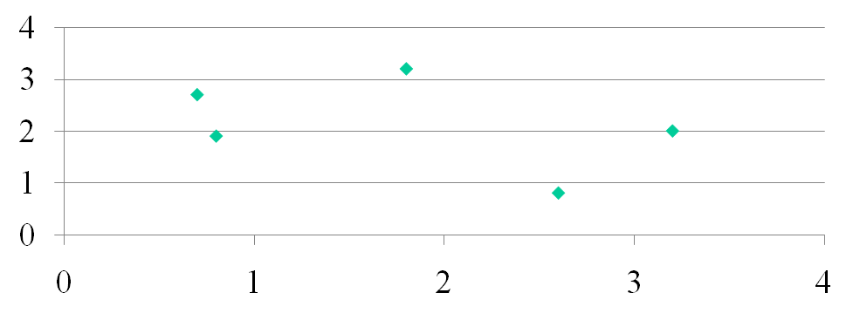
MultiDimensional Scaling
 | S1 | S2 | S3 | S4 | S5
S1 | A | B | C | D | E
S2 | C | D | P | F | W
S3 | B | D | A | P | X
S4 | A | L | D | M | P

Slide 7
Disadvantages of MDS
Unknown dimensions of the data space. For Ex: Received Signals.
Supports only perceptual relations but not conceptual relations.

Slide 8
SemiSupervised Laplacian regularized least squares method
Input:Xa = [x1, . . . ,xm]: location matrix of the anchors.
Si=Signal Strength Vectors or Di=pair-wise distance .
Compute the Gram Matrix. Ki
Calculate the weight function
Calculate the Optimal Coefficient Matrix
Get the unknown labels.

