Slide 1
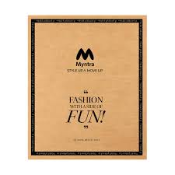

MYNTRA
THE SHOPPING APP

Slide 2
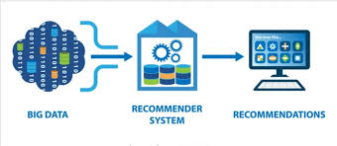
What are Recommender Systems ?
Recommender Systems (RS) are algorithms that suggest products, services, or information to users based on their past behavior, preferences, and interests. The goal is to increase user engagement, satisfaction, and conversion rates.

Slide 3
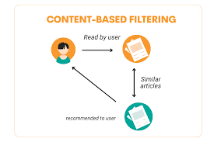
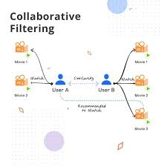
TYPES OF RECOMMENDER SYSTEMS
CONTENT BASED FILTERING
COLLABORATIVE BASED FILTERING

Slide 4
CONTENT-BASED FILTERING
Content-Based Filtering (CBF) is a type of recommender system that recommends items based on their attributes or features.
Key Components
:1. Item attributes (e.g., genre, director, release year)2. User profiles (e.g., interests, preferences)3. Similarity measurement (e.g., cosine similarity)

Slide 5
Example of CBF on myntra
Scenario:
A user, Rohan, searches for "casual shirts" on Myntra.User Profile: Rohan's profile based on his past interactions:- Preferred brands: Nike, Adidas- Preferred categories: Casual wear, Sports wear- Preferred colors: Blue, White- Preferred price range: ₹1,000 - ₹3,000Item Attributes: Myntra's database of shirts with attributes:- Brand- Category- Color- Price- Style (e.g., crew neck, V-neck)- Material (e.g., cotton, polyester)

Slide 6
Collaborative Based filtering
Collaborative Filtering (CF) is a type of recommender system that recommends items to a user based on the behavior of similar users
.Key Components:
User-item interaction matrix (e.g., ratings, clicks)
. Similarity measurement (e.g., cosine similarity, Jaccard similarity)
. Neighborhood selection (e.g., k-nearest neighbors)

Slide 7
Example of CF on Myntra
Scenario:
Rohan, a user, logs in to Myntra and views a Nike casual shirt.User Profile: Rohan's profile based on his past interactions:-
User ID: 1234-
Past purchases: Adidas sports shoes, Levi's jeans- Browsing history: Nike casual shirts, Puma sports shirts- Ratings: 4/5 for Adidas shoes, 5/5 for Levi's jeans

Slide 8
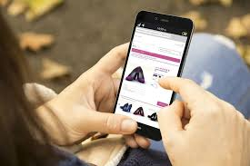
Implementing recommended systems on Myntra shopping app
Integrating recommender systems can enhance user engagement and boost conversion rates
.• Data-driven algorithms tailor product suggestions, improving shopping satisfaction and retentionData-driven algorithms tailor product suggestions, improving shopping satisfaction and retention

Slide 9


