Slide 1

AtliQ Hardware
Solving executive’s Ad-Hoc request using SQL
Overview:
Project Objective
Database
Database Schema
Request, solutions and results

Slide 2
Project Objective:
The top executives of AtliQ Hardware (imaginary hardware manufacturing company from India) want some quick insights to make data informed decisions.
We have 10 ad-hoc requests which we need to execute.
Database:
We have a SQL database named 'gdb023' (atliq_hardware_db) database. It includes six tables:
1. dim_customer: contains customer-related data
2. dim_product: contains product-related data
3. fact_gross_price: contains gross price information for each product
4. fact_manufacturing_cost: contains the cost incurred in the production of each product
5. fact_pre_invoice_deductions: contains pre-invoice deductions information for each product
6. fact_sales_monthly: contains monthly sales data for each product.
For further info about each table , check MetaData.txt file

Slide 3
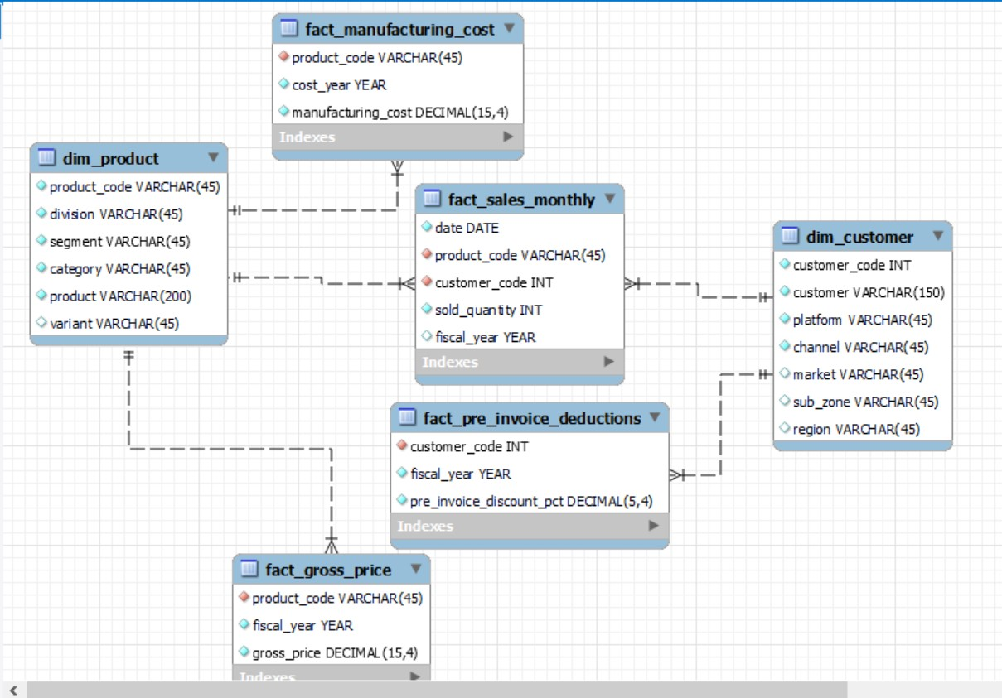
Database Schema

Slide 4
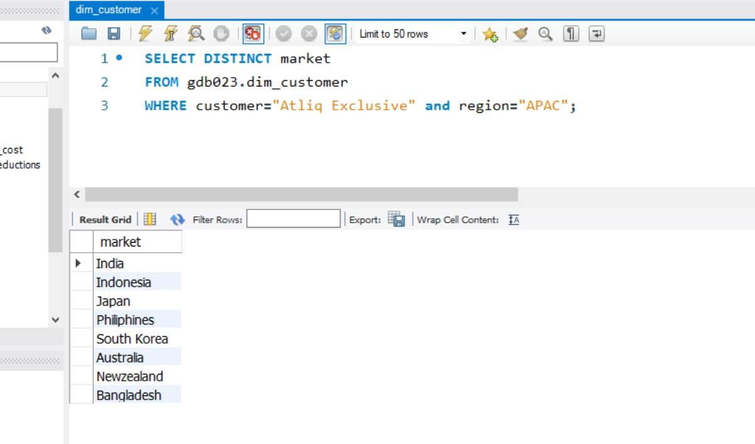
Request 1. Provide the list of markets in which customer "AtliQ Exclusive" operates its business in the APAC region.

Slide 5
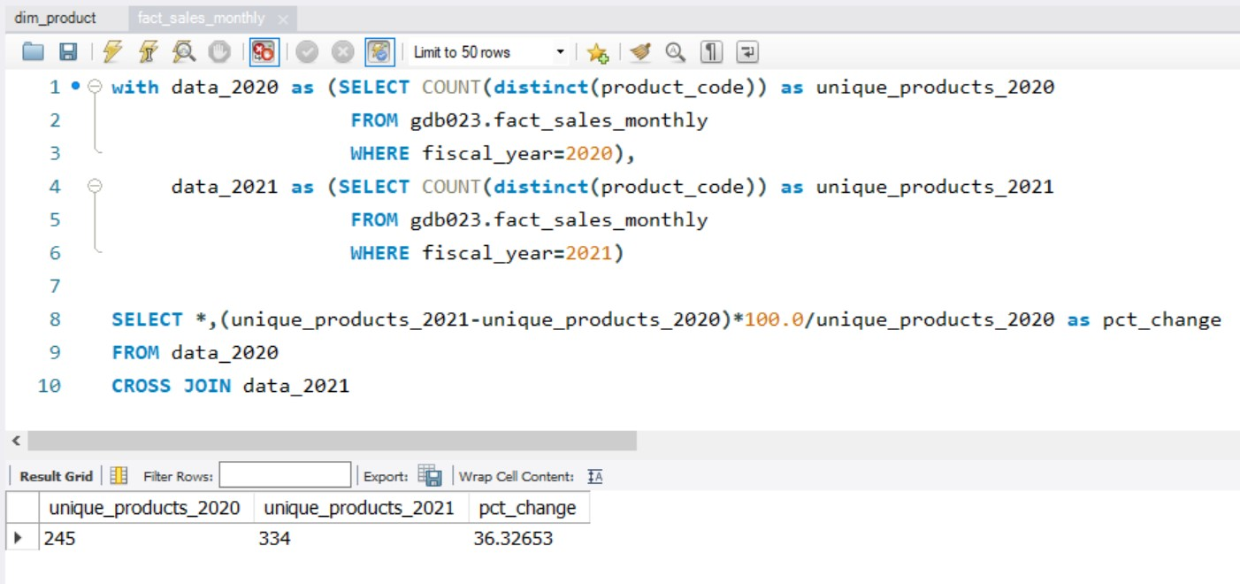
Request 2. What is the percentage of unique product increase in 2021 vs. 2020?

Slide 6
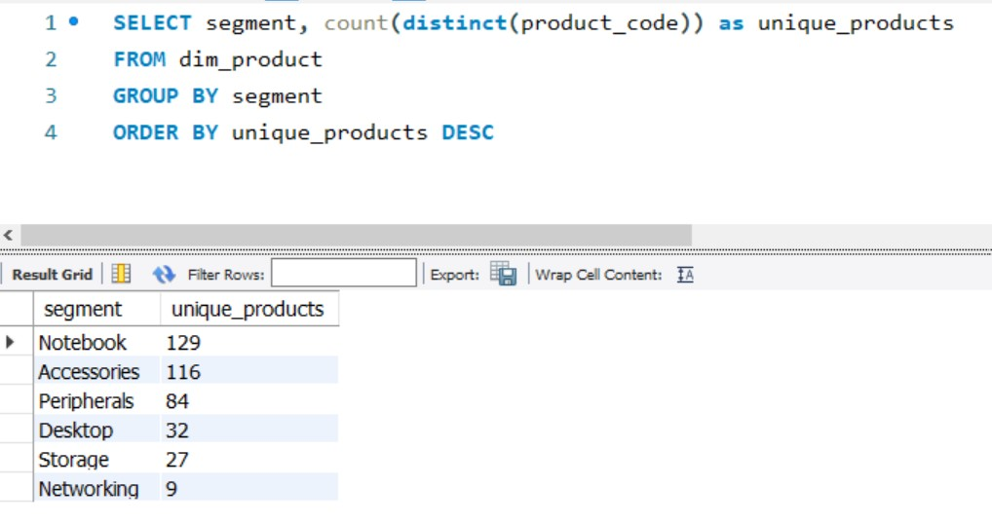
Request 3. Provide a report with all the unique product counts AtliQ has for each segment and sort them in descending order of product counts. The final output contains 2 fields, segment product_count

Slide 7
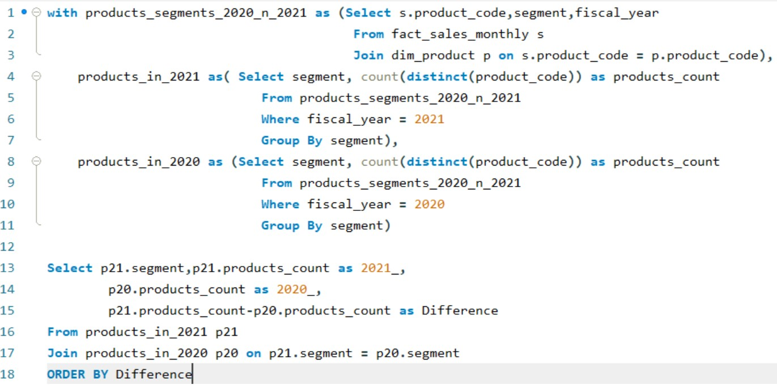
Request 4. Which segment had the most increase in unique products sold in 2021 vs 2020?

Slide 8
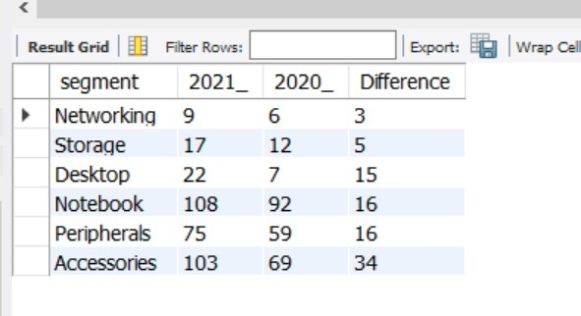
Request 4. Follow-up: Which segment had the most increase in unique products in 2021 vs 2020?

Slide 9
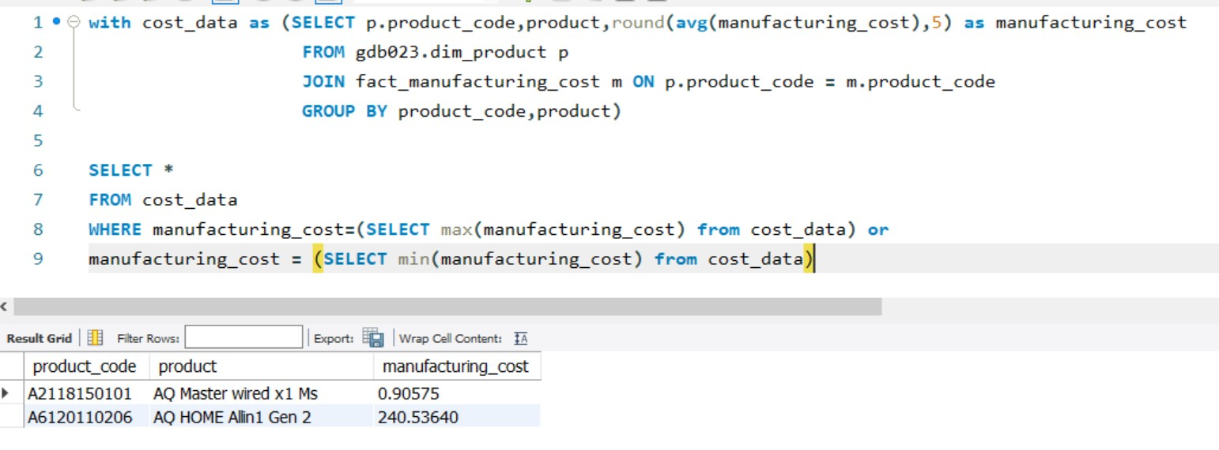
Request 5. Get the products that have the highest and lowest manufacturing costs.

Slide 10
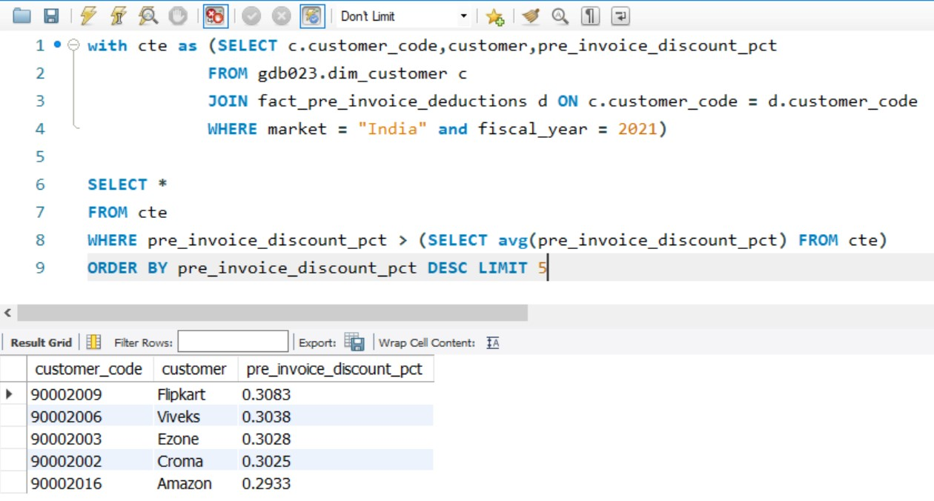
Request 6. Generate a report which contains the top 5 customers who received an average high pre_invoice_discount_pct for the fiscal year 2021 and in the Indian market.

Slide 11
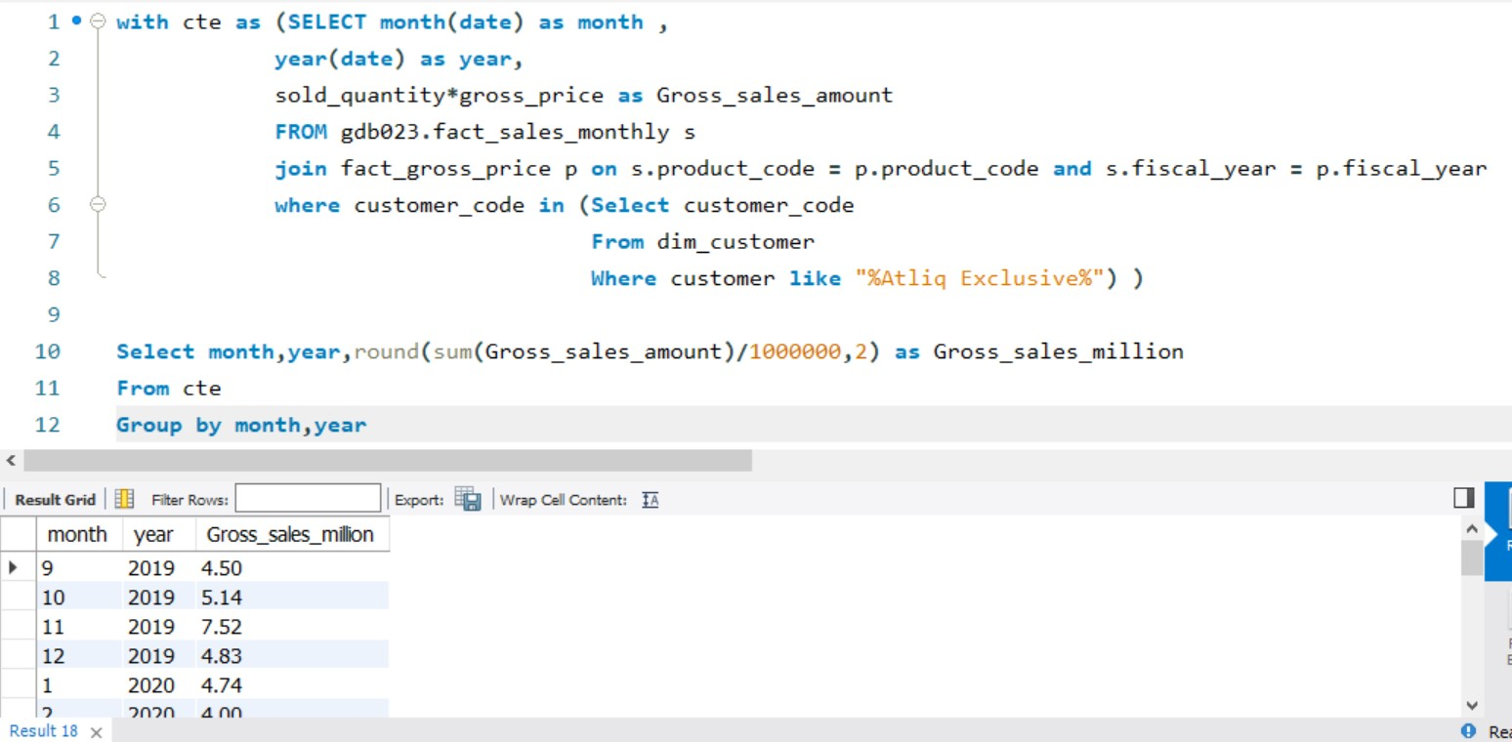
Request 7. Get the complete report of the Gross sales amount for the customer “Atliq Exclusive” for each month.
Final Results exported as CSV file named “AtliQ _Exclusive_monthly_performance”

Slide 12
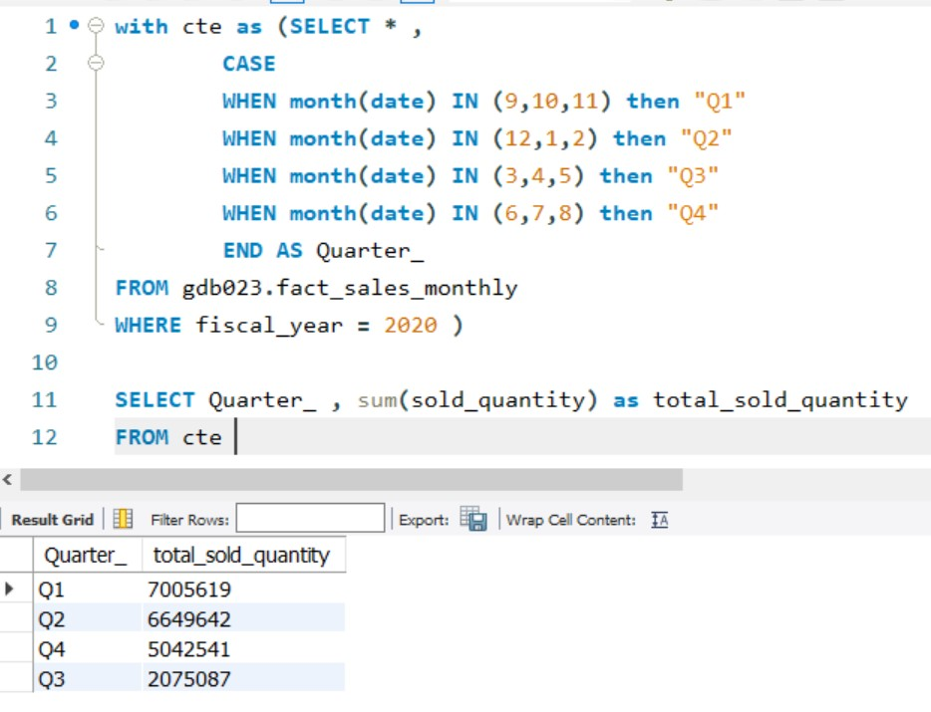
Request 8. Which quarter of 2020, got the maximum total_sold_quantity? The final output contains these fields sorted by the total_sold_quantity, Quarter total_sold_quantity
Notes:
Assuming Fiscal year

Slide 13
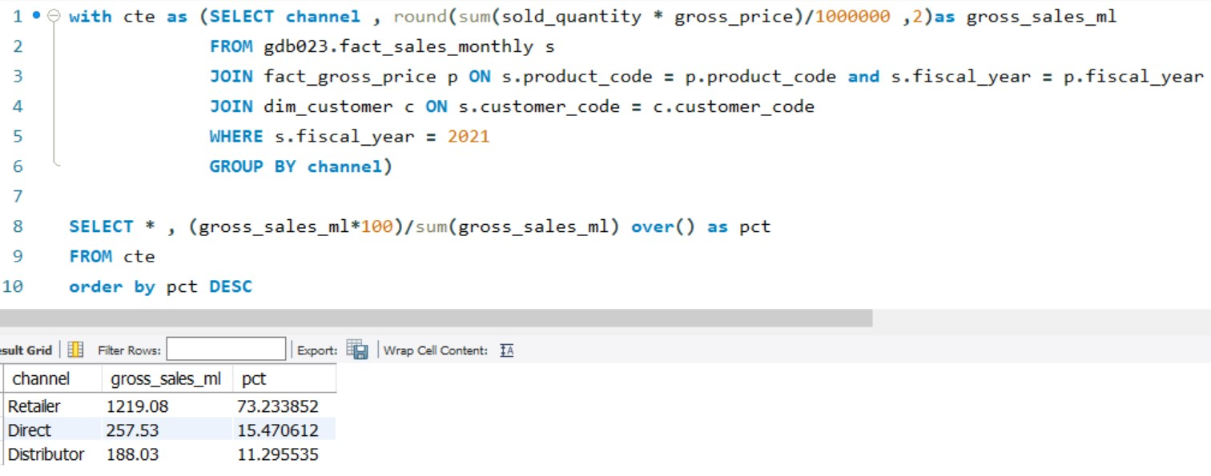
Request 9. Which channel helped to bring more gross sales in the fiscal year 2021 and the percentage of contribution? The final output contains these fields, channel gross_sales_mln percentage

Slide 14
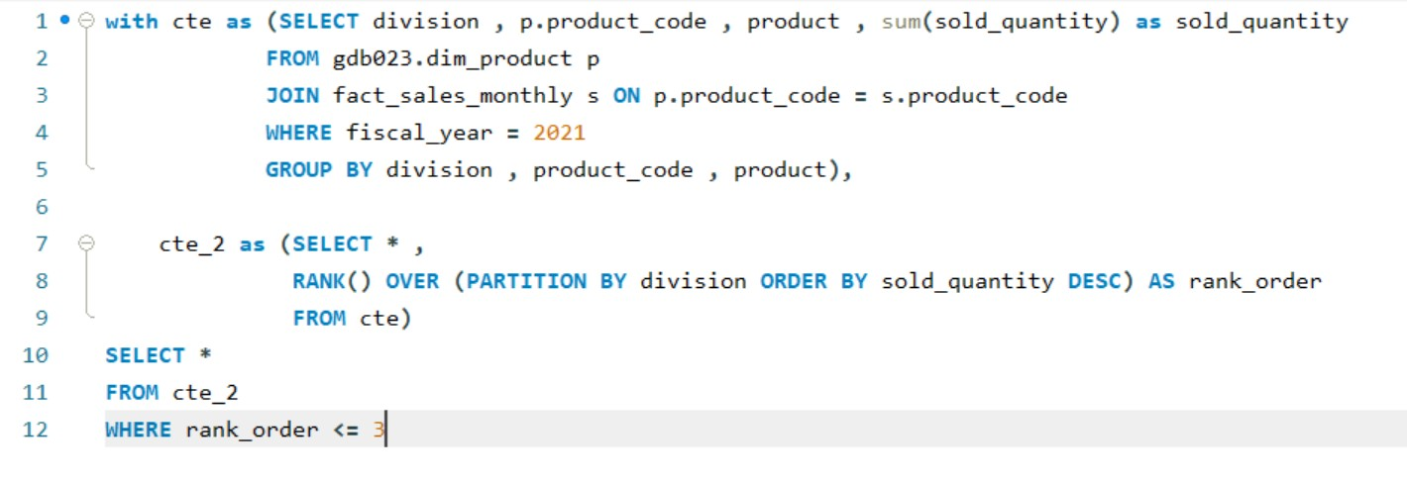
Request 10. Get the Top 3 products in each division that have a high total_sold_quantity in the fiscal year 2021?

Slide 15
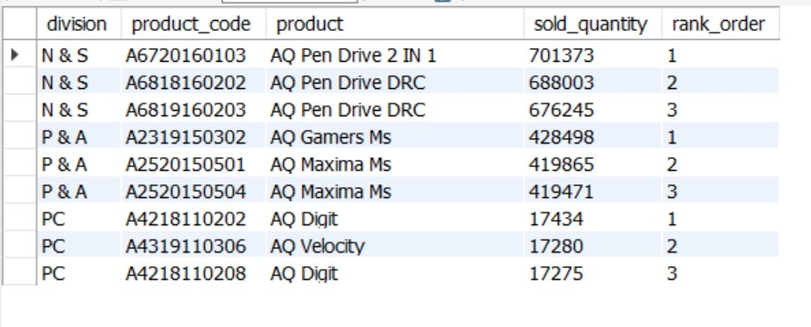
Request 10. Get the Top 3 products in each division that have a high total_sold_quantity in the fiscal year 2021?

