Slide 1

Blockchain
The Digital Barter System of the Future-Analysis
Nitish Venkata Chakravarthy(2024017703)

Slide 2
What is Blockchain?
Definition: Blockchain is a decentralized, distributed digital ledger that records transactions across many computers.
Information stored in blocks; blocks are linked ("chained") together.
Each block contains a list of transactions, a timestamp, and a cryptographic hash of the previous block.
Designed to be secure, transparent, and tamper-proof.

Slide 3
What is a Block?
Index/Number
Timestamp
Data (transactions)
Previous Hash
Nonce (mining number)
Block Hash

Slide 4
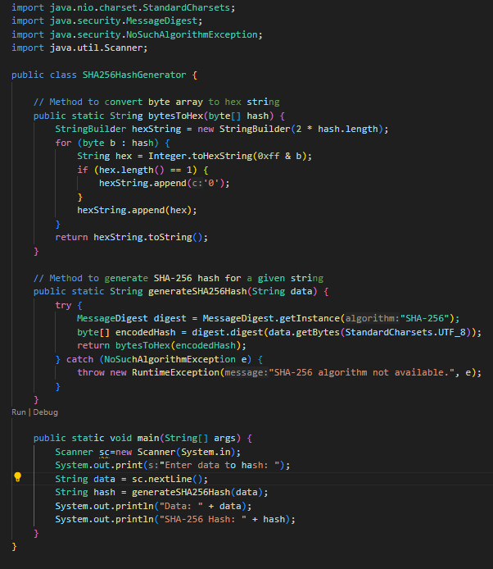
How Do Block Form (Simple code Snippet)

Slide 5
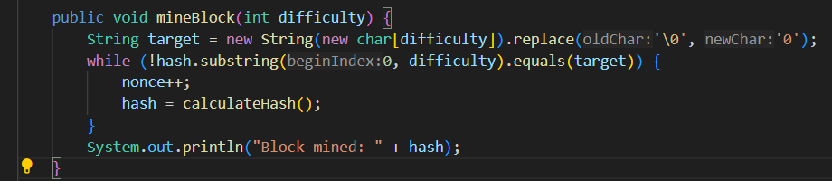
Finding the Nonce (Mining)
Mining: Finding a nonce that makes the block’s hash start with a given number of zeros (difficulty).
Code:

Slide 6
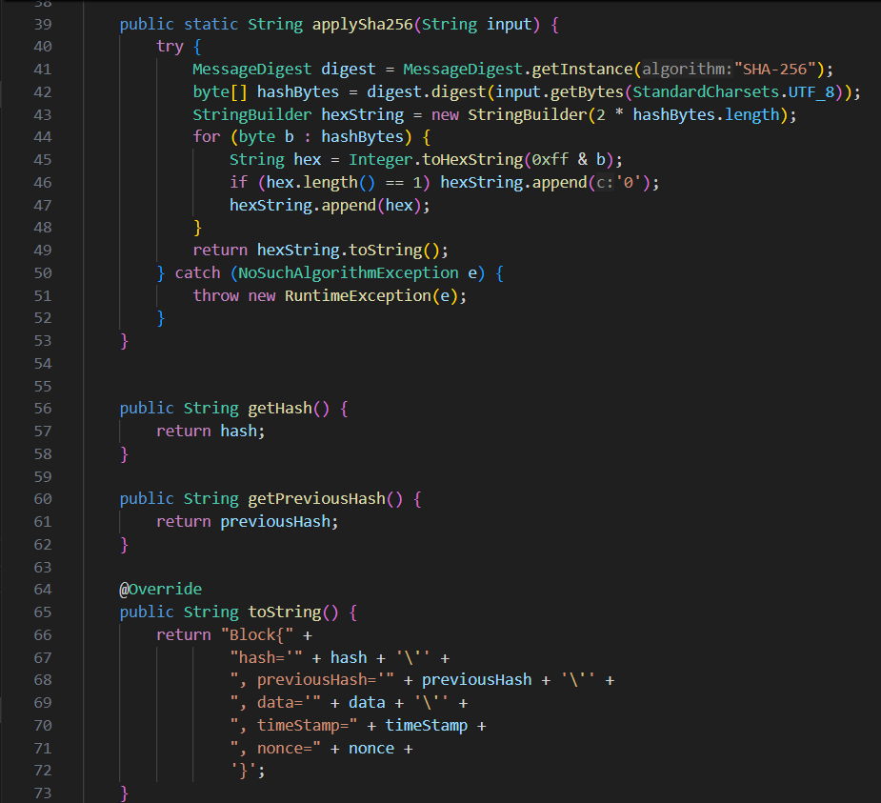
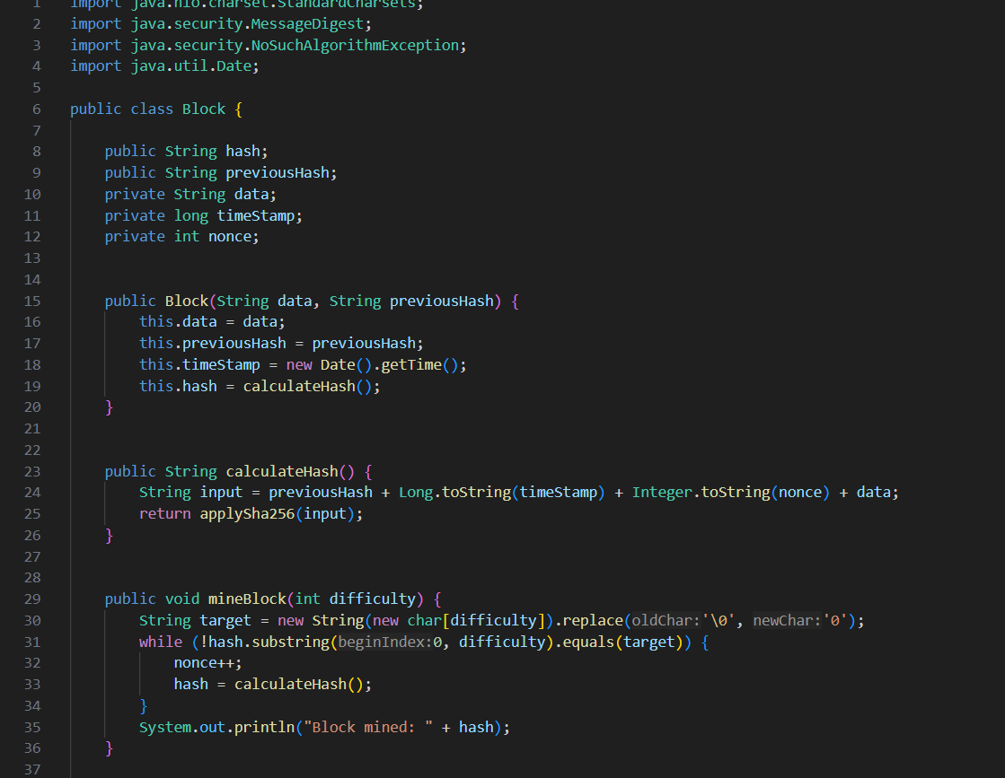
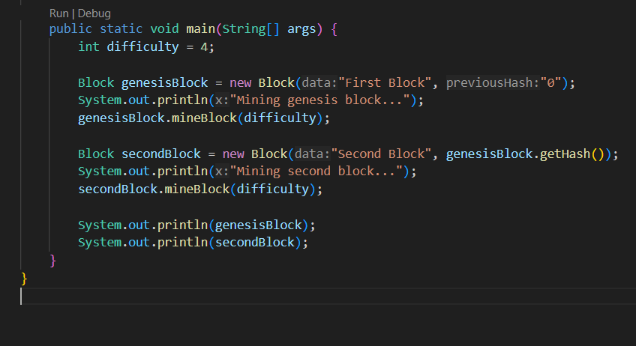
Creating a Block
Code:

Slide 7
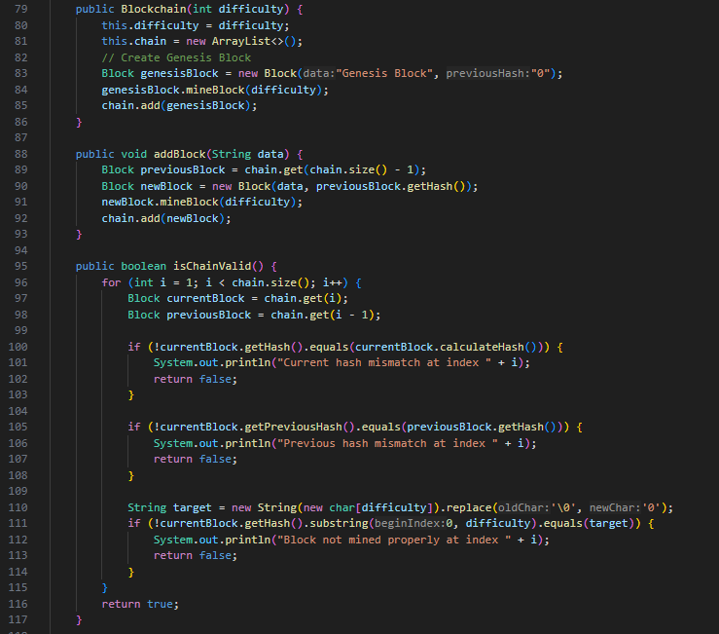
Connecting Blocks in a Chain
Concept: Each block holds the hash of the previous.
Tamper Evidence: Changing one block requires changing all subsequent blocks.
Code:

Slide 8
Live Demo
Mine for a nonce, watch hash change to meet difficulty
Link blocks, observe how changing earlier blocks affect the whole chain
Steps:
Change data, see hash update

Slide 9
Key Takeaways
Immutability: Blocks are secure and tamper-evident due to linking.
Mining: Nonce-finding ensures effort before adding blocks.
Transparency: Code and demos make blockchain principles understandable.

Slide 10
Real-World Examples of Smart Contracts
Voting Systems: Votes are submitted as transactions in blocks. Mining or consensus confirms vote validity and immutability, enabling transparent and trustworthy elections.
Supply Chain: Payment flows automatically when goods are delivered and verified.
Digital Identity: Secure user authentication and access control.

Slide 11
Conclusion
Blockchain revolutionizes digital trust and transparency.
1
Rapidly evolving field; offers many opportunities for innovation.
2

Slide 12

Thank you

