Slide 1

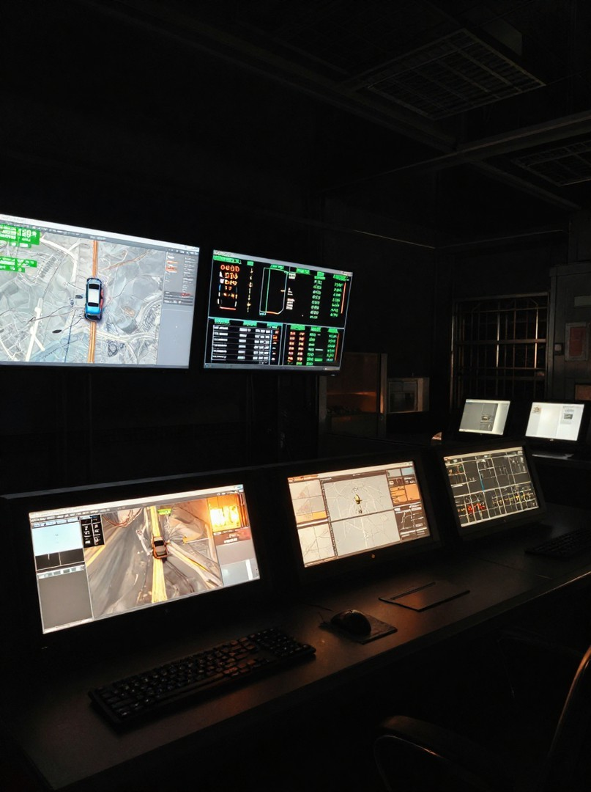
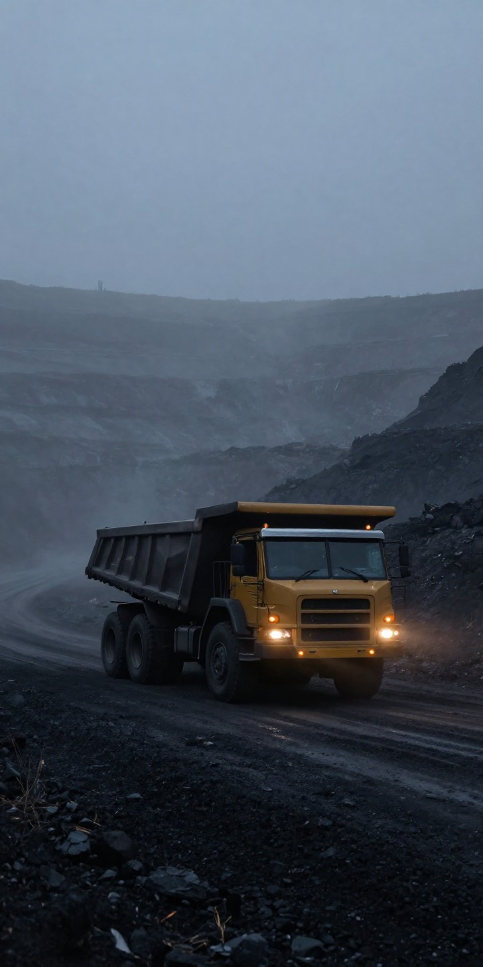
SMART INDIA HACKATHON 2026
Safe Mine Vehicle Operation in Fog & Low Visibility
NMDC Limited is India's largest iron ore producer, producing approximately 53 Million Tonnes Per Annum across three fully mechanized mining complexes — BIOM-Kirandul, BIOM-Bacheli (Chhattisgarh) and Donimalai (Karnataka).
Bailadila alone contributes nearly 37 MTPA — the single largest driver of NMDC's output. Under the National Steel Policy, NMDC targets 100 MT by 2030, with roughly 80 MT expected from Bailadila. It is the region that has to carry most of NMDC's future growth.
SIH 2026 | Problem Statement SIH26007 | NMDC – Ministry of Steel
1

Slide 2
THE PROBLEM
The Monsoon Challenge
Bailadila's growth target runs headlong into its geography and climate. From June to October, heavy rainfall, strong winds, high humidity and thick fog are routine — and on hilltop haul roads, visibility can collapse to almost nothing.
3–5 m
Jun–Oct
~5 months
Visibility in dense fog
Monsoon season
Every single year
At 3–5 m visibility, Heavy Earth Moving Machinery, particularly ore-hauling dumpers can no longer move safely at normal speed. For nearly five months of the year, the very terrain that makes Bailadila productive also makes it one of the hardest places in the country to run mining operations safely.
SIH 2026 | Problem Statement SIH26007 | NMDC – Ministry of Steel
2

Slide 3
WHY IT MATTERS
The Stakes and the Shortfall
THE URGENCY
GAPS IN CURRENT SOLUTIONS
Dense fog during the monsoon creates major operational and safety challenges in the Bailadila mines. Poor visibility restricts dumper movement, forcing operators to slow down or halt entirely.
This directly drives up haul-cycle times, cuts fleet productivity, and reduces ore evacuation ,at the exact time NMDC needs Bailadila scaling toward 80 MT by 2030.
Beyond the productivity hit, the risk of collisions and operational disruption rises sharply every monsoon. This isn't occasional as it recurs for nearly five months every year, so any fix must run reliably through the entire monsoon window.
Existing visibility aids mostly rely on a single sensing method which is typically vision-based and is exactly what fails first as fog thickens.
Current systems are reactive, not predictive: operators slow down only once a hazard is already close, instead of the system anticipating risk from relative motion and stopping distance.
There's no shared awareness between vehicles, and safety margins don't adjust dynamically as sensor confidence degrades in fog, noise or rain thus leaving a system that depends almost entirely on manual caution.
SIH 2026 | Problem Statement SIH26007 | NMDC – Ministry of Steel
3

Slide 4
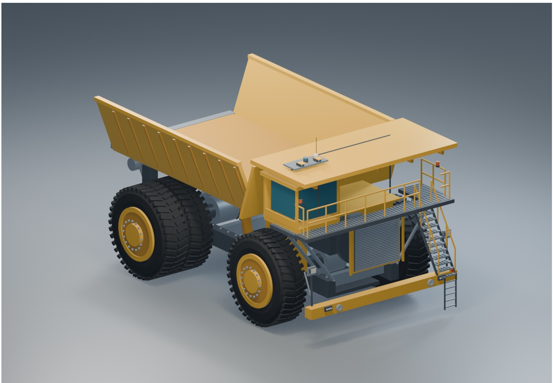



PROPOSED IDEA
Our Solution: First Light
First Light is a multi-sensor, predictive safety system. Instead of depending on any single sensor, it fuses LiDAR, camera, radar, GNSS, IMU and wheel-state data into one continuous picture of the vehicle's surroundings, position and motion.
Predictive hazard tracking
Tracks relative motion, estimates time-to-collision and checks safe stopping distance thus shifting the vehicle from cruise to caution to full stop as needed.
V2V hazard & fog broadcast
Vehicles share hazard and fog observations over V2V comms, accounting for real-world message delay and loss.
6
sensor modalities fused
Automated junction safety
24/7
predictive monitoring
Identifies conflicts between approaching vehicles and assigns yielding which helps in preventing collisions without operator intervention.
SIH 2026 | Problem Statement SIH26007 | NMDC – Ministry of Steel
4

Slide 5
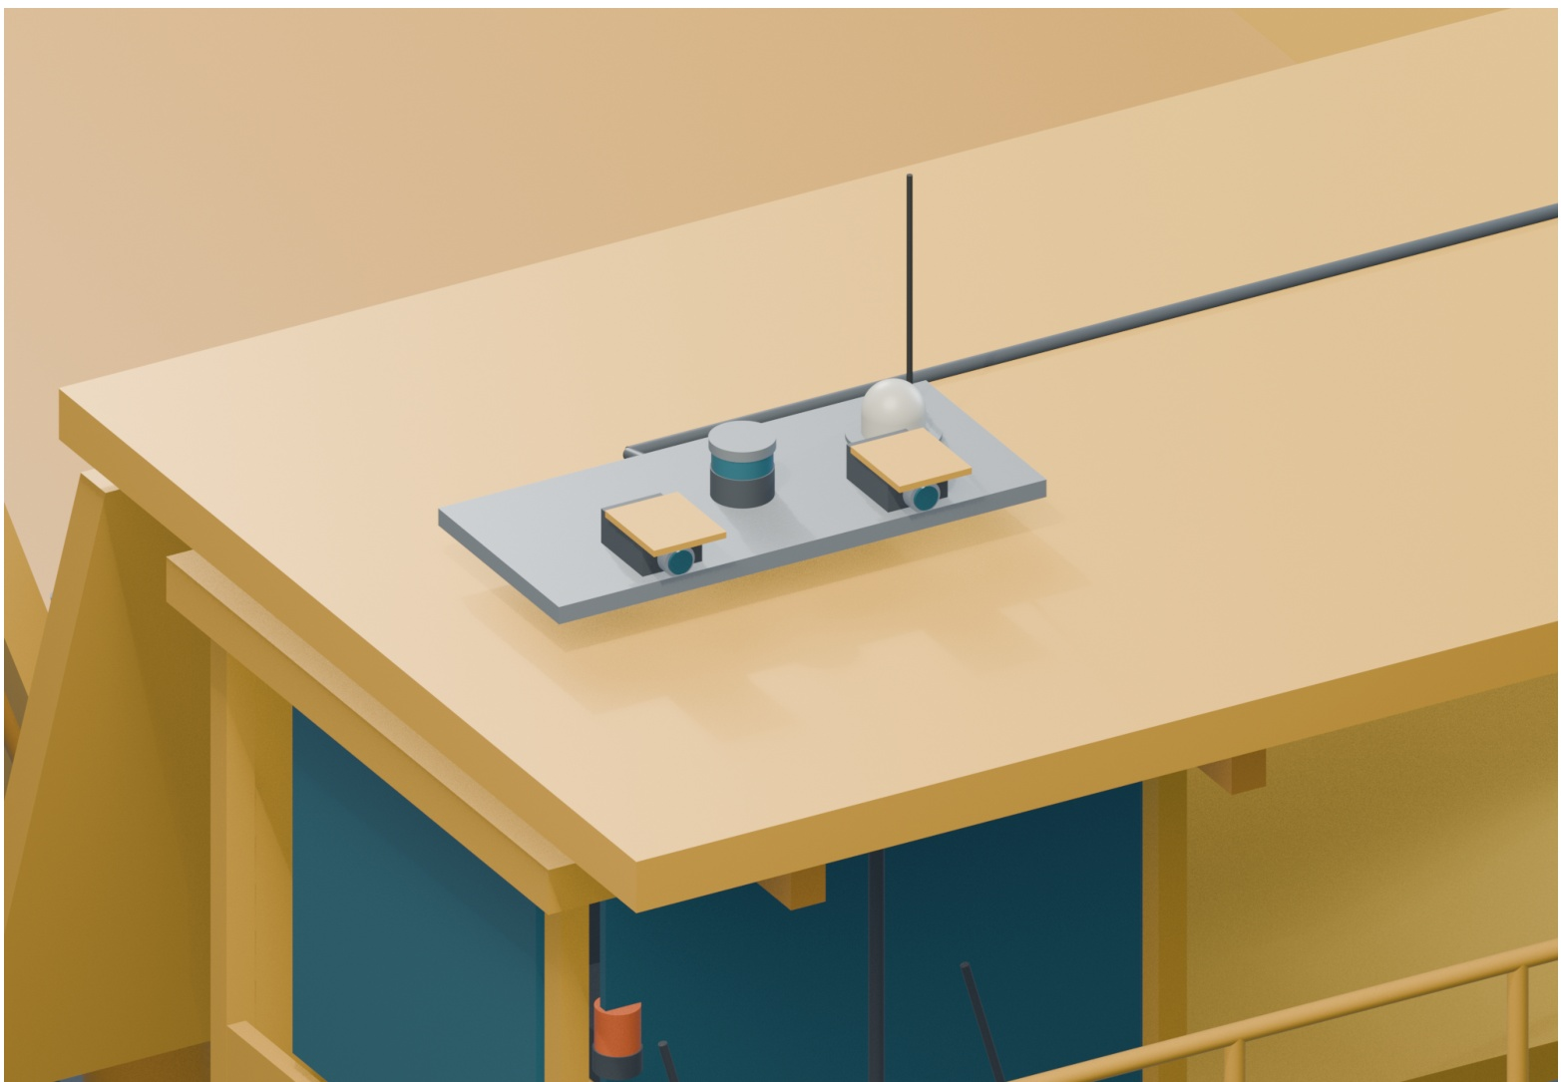

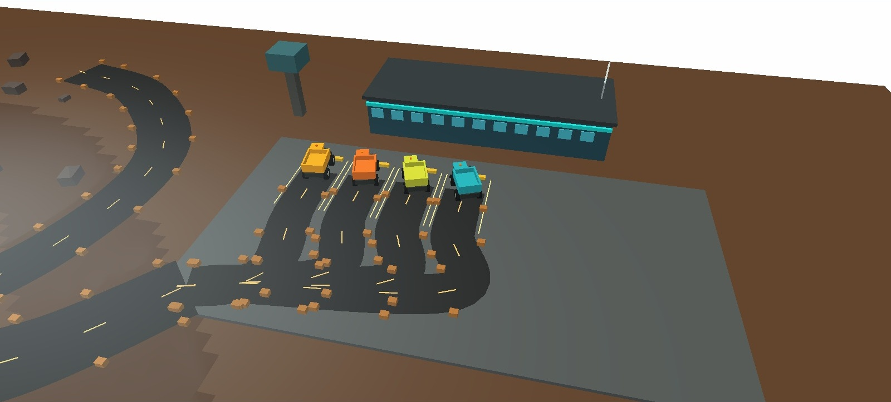

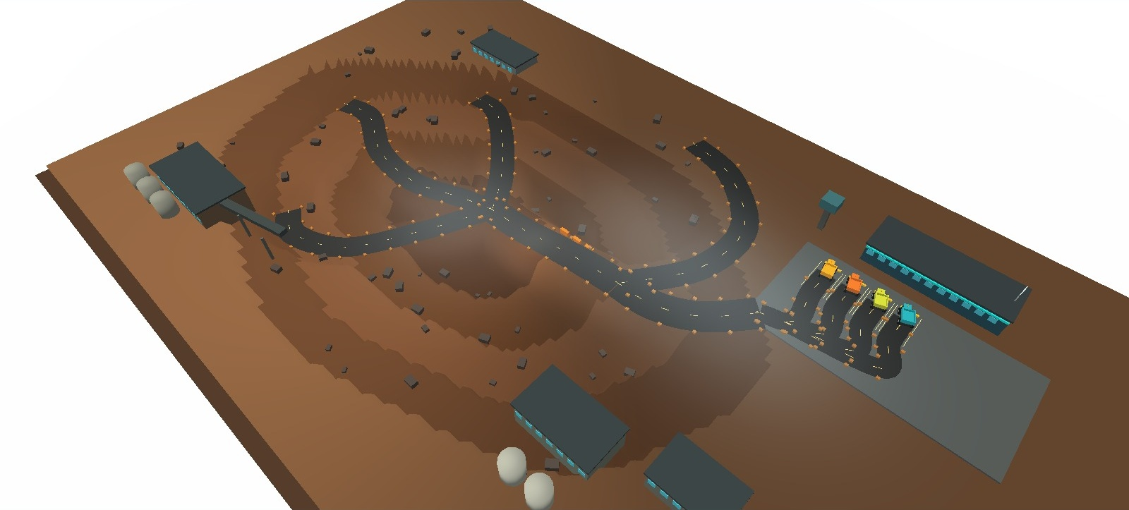

TECHNICAL APPROACH
3-Layer Fog-Safe Vehicle System
A three-layer integrated system ensuring safe, fog-resilient vehicle operations across open-cut mining environments.
Layer 1 — On-Vehicle Sensing
Radar array · Thermal camera · DGPS positioning
ON-VEHICLE SENSING
Layer 2 — V2V / V2I Mesh
V2V comms · Infrastructure broadcast · Delay & loss aware
V2V / V2I MESH
Layer 3 — Command & Control
Control room dashboard · Digital twin · Site-wide oversight
COMMAND & CONTROL
Real-time
fog detection
Sub-meter
positioning
Mesh < 50 ms
Full digital twin
SIH 2026 | Problem Statement SIH26007 | NMDC – Ministry of Steel
5

Slide 6
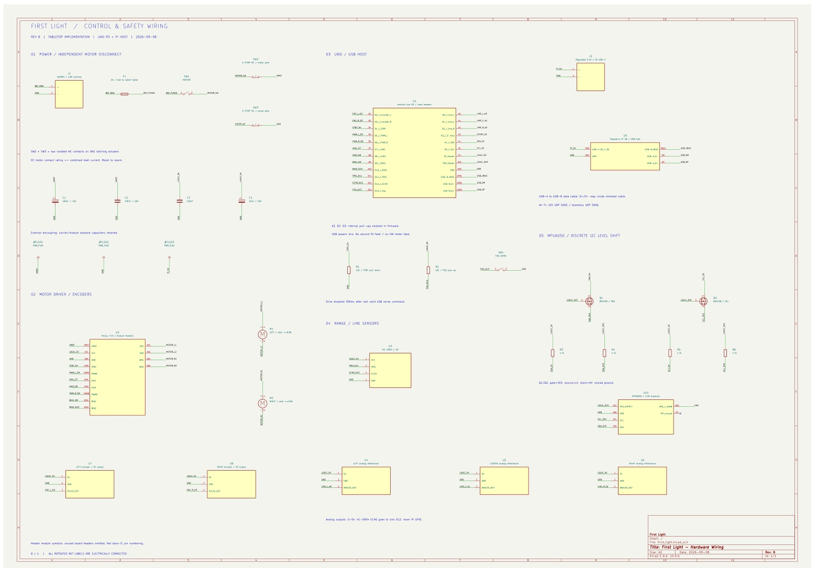
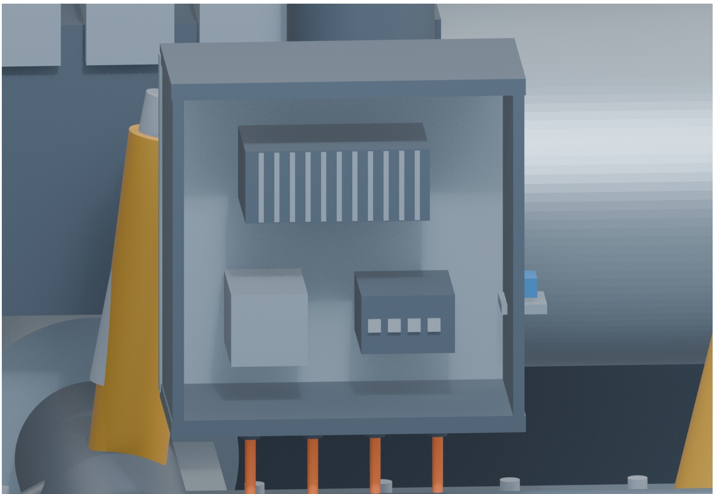
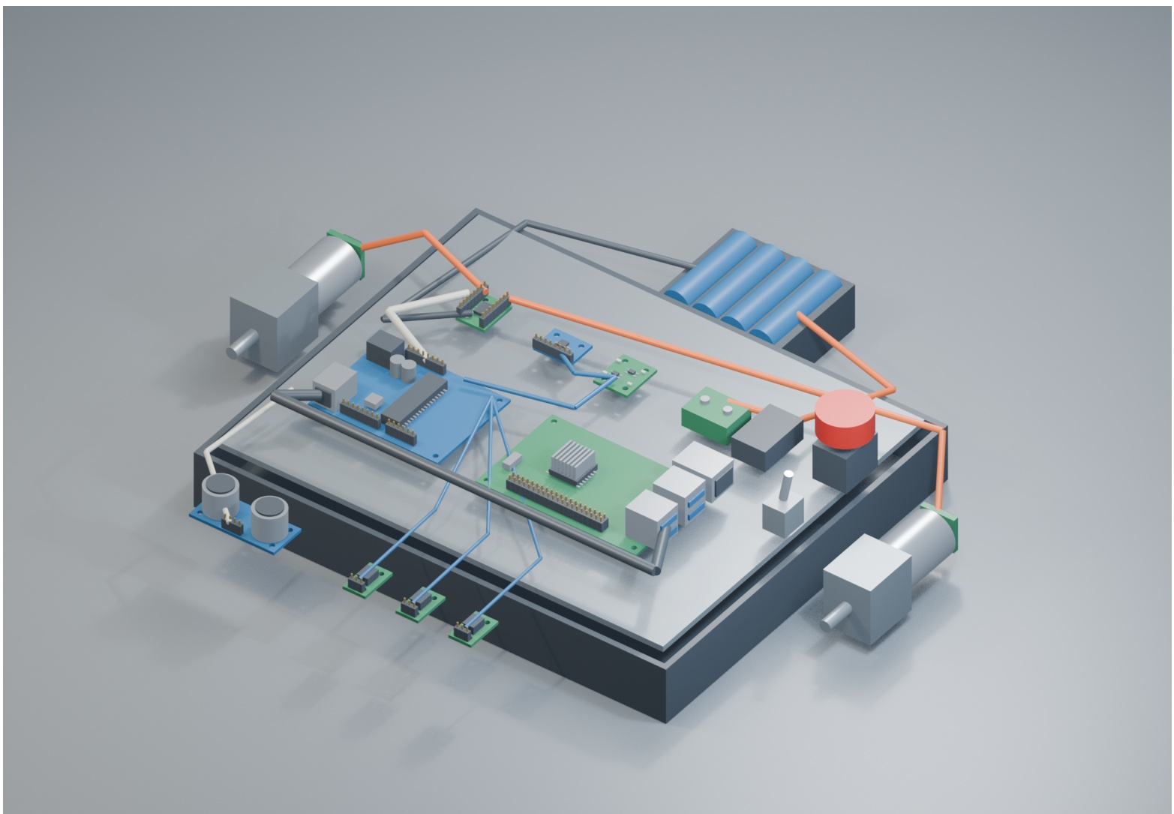
HARDWARE & FEASIBILITY
Built Lean. Engineered Safe.
PROTOTYPE COMPONENTS
Arduino Uno
TB6612FNG motor driver
HC-SR04 ultrasonic
MPU6050 IMU
Wheel encoders
Raspberry Pi (telemetry / V2V)
Low-cost, readily available parts validate the full decision and control logic. The architecture is modular, the same pipeline scales to industrial LiDAR / radar without a redesign, letting NMDC validate cheaply before fleet-wide investment.
CONTROL AND SAFTEY WIRING
BUILT FOR RELIABILITY
Multi-sensor fusion stays reliable even when individual sensors lose confidence in fog.
Fail-safes (NC e-stop, watchdog, command-timeout) default the vehicle to a safe stop on any fault.
Predictive, not reactive and calculates risk before a hazard becomes critical.
Tested against fog, sensor noise, comms delay & message loss, not just ideal cases.
SERVICE ELECTRONICS
DEMO ELECTRONICS
SIH 2026 | Problem Statement SIH26007 | NMDC – Ministry of Steel
6

Slide 7

SIH 2026 – SIH26007
Our Team
Team First Light
Nitish Kumar
Akul Batra
Team Leader
Team Member
Kritika Purbey
Tejas Gupta
Team Member
Team Member
Ghanansh Kuradia
Anika Mittal
Team Member
Team Member
Thank You | SIH 2026 – SIH26007

