Slide 1
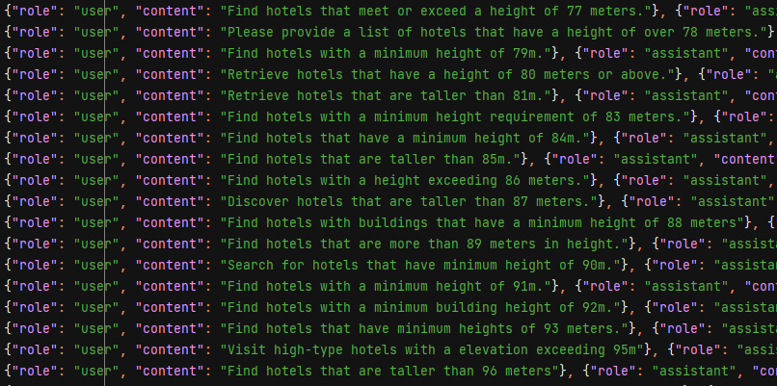
Previous program block 1
Generalize each query in the template
An example that generalizes “find hotels over 40 m” to 1 to 100 meters
Let LLM learn the structure of SPARQL through fine-tuning
Use the fine-tuned model to translate natural language to SPARQL

Slide 2
Previous program problem 1
Lack of generalization ability
Because the parameters of LLM are large, using a small data set can easily lead to overfitting.
Unstable
The output quality is very unstable even sometimes unstructured and we have no way to control output quality.

Slide 3
Previous program block 2
Generated SPARQL
Prompt
If error
Grammar check
Generated SPARQL + Error feedback
Calculate embedding of Prompt .
Using cos_similarity to calculate similar options in the vector store of the SPARQL template.
LLM correction
Checked SPARQL + Prompt
Search prompt in SPARQL template
LLM check
Preprocess search result
Return semantic description of generated SPARQL
If client thinks there is a mismatch
Rerun
searched SPARQL + Prompt
Modify the given SPARQL to match prompt by LLM
Run Query

Slide 4
Previous program problem 2
Mismatches often occur when searching
“Get buildings over 40 m” is semantically same with “Get hotels over 40 m”, but the last query need to search OSM linkage but searching general buildings do not need.
Inaccuracy when modifying
When there is too much input text, LLM does not perform well in replacement.
Lack of generalization ability
Answers are limited to templates and lack generalization capabilities.

Slide 5
Program block
Generated SPARQL
Prompt
If error
Grammar check
Generated SPARQL + Error feedback
LLM correction
Checked SPARQL + Prompt
Multilabel classification
LLM check
Search each label in label templates
Return semantic description of generated SPARQL
If client thinks there is a mismatch
Rerun
Assemble all labels
Run Query

Slide 6
Multilabel classification
Query ontology
Restriction objects
Query requirement
General buildings
Area
Numerical value
Return … with maximum value of …
Distance
Height
Residential buildings
Return … beyond value of …
Specific building type in osm
String value
Building surface
Specific address

Slide 7
Add new template
New template
decomposition
Find new part
Label + SPARQL
Add to label templates
Add new label by LLM

