Slide 1
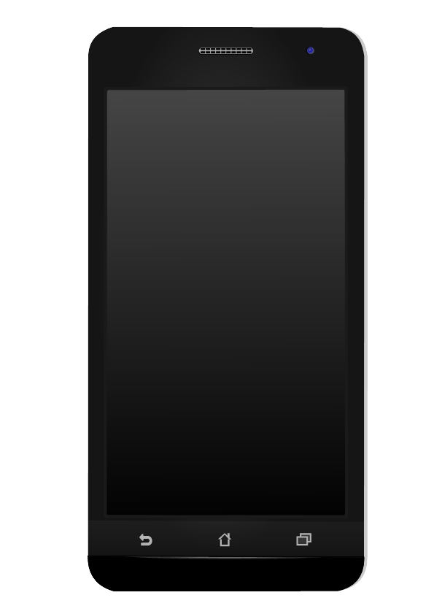
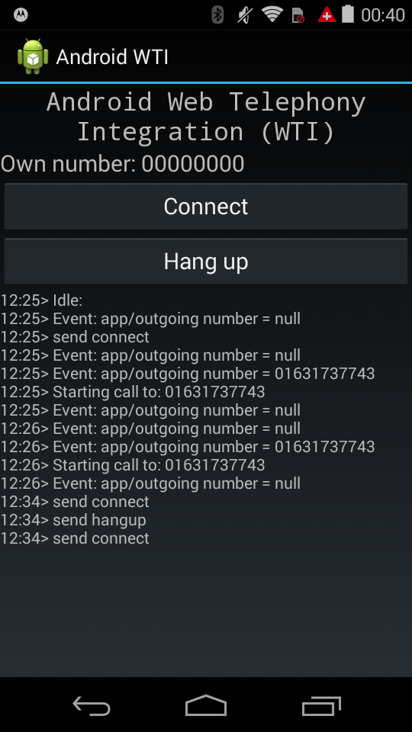




Android App
Uses Internet access for communication
Firebase.com
The Realtime App Platform
Web, singe page app
Uses Javascript to send and receivce events

