Slide 1
Operating Systems
Dr. B.Majhi
Department Of Computer Science and Engineering
National Institute Of Technology Rourkela

Slide 2
Introduction
What is an OS?
A collection of systems programs entrusted with effective utilization of a Computer System.
Effective utilization :
  Is it efficient, good service(quick response), flexibility, convenience
  No unique interpretation of effective : Have meaning in a context e.g. space time trade off, M/c code vs. HLL
OS objectives are complex functions of
  System Configuration : CPU characteristics, Memory (speed and capacity)
  User expectations : number crunching, databases, graphics, real time applications
  Usage environment: Batch/interactive, Distributed/non-distributed, Isolated/Networked

Slide 3
Operating Systems
OS acts like a Govt., Manager of resources, Interface between user and M/C (virtual m/c)
OS=S/W infrastructure added on Bare hardware
computer hardware + operating system = usable machine
Abstraction of Basic H/W Service
(A set of Progs)
M/c as a set resources and managers
User Programs as set of requests and responses
Bare Machine

Slide 4
Goals of an operating system
1. To maximise utilisation of the hardware resources for computing user jobs - sharing the hardware resources among different user programs
2. To maximise the productivity of users using the system by maximising the usability of the system - presenting an easy to use interface for managing data and program execution
3. To provide a system call interface for software developers to use - eliminating need for application programmers to write their own software to manipulate hardware.

Slide 5
Evolution of OS
Changes in design perspectives, and Computer Architectures
Need to study to introduce the concept of sharing and protection, fundamental terminology
Unit of Work: Executing a program: It may consists several activities like compiling, , linking, loading etc. Hence a unit work can be replaced by the term JOB.
A job is a sequence of related programs: If one fails other cannot proceed. Job and program is used interchangeably.

Slide 6
Early Systems – Bare machine (early 1950s)
Structure
  Large machines run from console
  Single user system - Programmer/User as operator
  Paper tape or punched cards
Early Software - Assemblers, compilers, Linkers, loaders + device drivers
Secure
Inefficient use of expensive resources
  Low CPU utilization
  Significant amount of setup time

Slide 7
Simple Batch Systems
Hire an operator
User != operator
Reduce setup time by batching similar jobs
Automatic job sequencing – automatically transfers control from one job to another. First rudimentary operating system.
Resident monitor
  initial control in monitor
  control transfers to job
  when job completes control transfers back to monitor

Slide 8
Simple Batch Systems
Batch Monitor
  Current Job of Batch
  Punched card and .BAT file of DOS
  Standard control cards : specify start and end of job
Example:
//JOB
//EXEC FORTRAN
→ FORTRAN source program
/*
//EXEC
→ Data
/* →End of data
/& → End of job car

Slide 9
Batch Monitor
Batch Monitor
  Resides permanently in memory, hence called resident monitor
Functions
  Initiates a job
  Check the normal or abnormal end of job
H/W and S/ W support
  Hardware memory protection
  Read operations should be performed through the batch monitor to detect end of data and end of job cards.
Parts of resident monitor
  Control card interpreter – responsible for reading and carrying out instructions on the cards.
  Loader – loads systems programs and applications programs into memory.
  Device drivers – know special characteristics and properties for each of the system’s I/O devices.

Slide 10
Problem:
Slow Performance – I/O and CPU could not overlap; card reader very slow.
Solution:
Off-line operation – speed up computation by loading jobs into memory from tapes,with card reading and line printing done off-line.

Slide 11
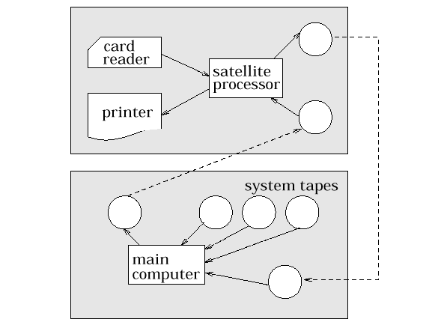
Batch with Off-Line Operation

Slide 12
Off-Line Operation (Cont.)
Advantage – main computer not constrained by the speed of the card readers and line printers, but only by the speed of faster magnetic tape units.
No changes need to be made to the application programs to change from direct to off-line I/O operation.
Real gain – possibility of using multiple reader-to-tape and tape-to-printer systems for one CPU.

Slide 13
Batch with Spooling
Overlap I/O of one job with computation of another job. While executing one job, the OS:
  reads next job from card reader into a storage area on the disk (job queue).
  outputs printout of previous job from disk to printer.
  Spool = Simultaneous Peripheral Operation On-Line
Job pool – data structure that allows the OS to select which job to run next in order to increase CPU utilization.

Slide 14
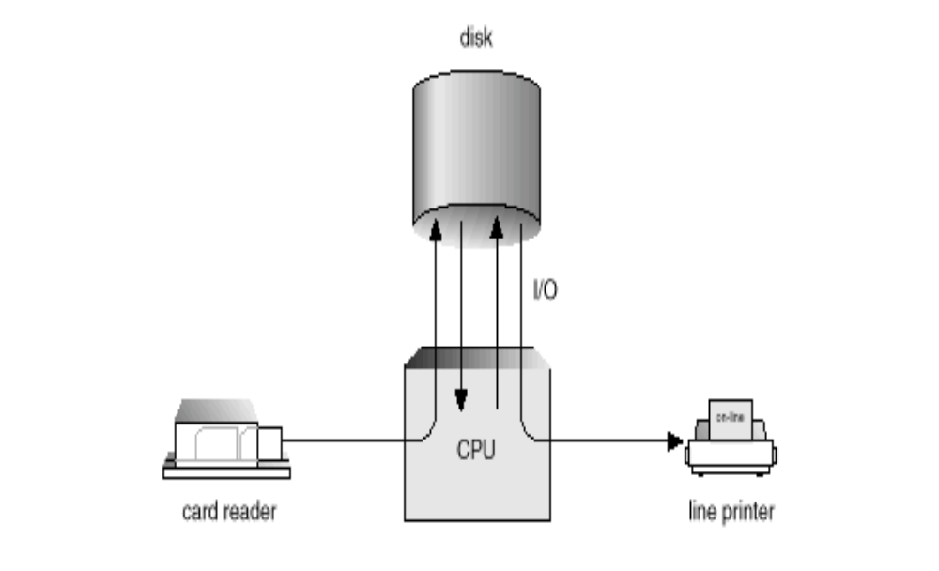
Spooling

Slide 15
Benefits of Batch
TAT: elapsed time between submission of the job for processing and the return of its results to the user. Depends on
Batch formation time,
Execution of all the jobs in the batch
Time involved in printing and sorting the jobs
Hence TAT of a job does not relate at all to its own execution time. Thus user is not benefited as compared to one-job-at-a-time environment
But M/C utilization improves, benefit all users indirectly i.e. Throughput increases.

Slide 16
Sharing & Protection
Protecting user programs from each other
At any time one user job resides in memory, it shares memory with resident monitor. Fence register for protection
Is protection necessary among users, Yes…..
Even if resources are accessed serially by a user program, it could indirectly interfere with next job. It happens if it reads past its own end-of-data. The next job will not execute properly.
Hence all input/output are done thru resident monitor, to avoid this situation

Slide 17
Multiprogramming OS
The objective of a MP system is to reduce the wastage of CPU power due to idling during input-output operations.
Early systems were using IO operations through CPU, and no processing was performed during data transfer. When I/O gets completed, CPU is interrupted and next instruction was getting executed.
To avoid CPU involvement I/O Channels, DMA Device were introduced.
I/O devices are connected to IO channels rather than CPU and have direct paths to memory. An IO channel initiates its operation by getting signal from CPU and interrupts the CPU at the end of data transfer.

Slide 18

Uniprogramming
Processor must wait for I/O instruction to complete before preceding

Slide 19
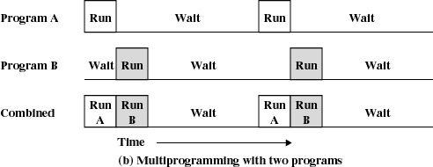
Multiprogramming
When one job needs to wait for I/O, the processor can switch to the other job

Slide 20
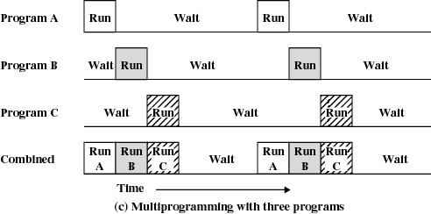
Multiprogramming

Slide 21
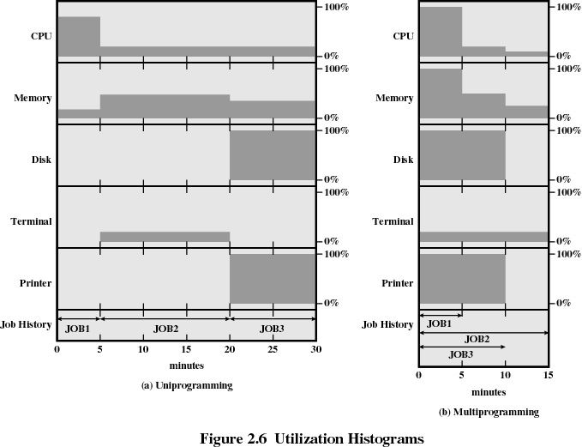

Slide 22
Example
JOB1 JOB2 JOB3
Type of job Heavy compute Heavy I/O Heavy I/O
Duration 5 min. 15 min. 10 min.
Memory required 50K 100 K 80 K
Need disk? No No Yes
Need terminal No Yes No
Need printer? No No Yes

Slide 23
Effects of Multiprogramming
Uniprogramming Multiprogramming
Processor use 22% 43%
Memory use 30% 67%
Disk use 33% 67%
Printer use 33% 67%
Elapsed time 30 min. 15 min.
Throughput rate 6 jobs/hr 12 jobs/hr
Mean response time 18 min. 10 min.

Slide 24
Multiprogramming OS
Data Independence
  IO channels and CPU work concurrently
  Meaningful, when two do carry out computations with IO in a program
  READ A,B,C
  D=A+B
  It is essential to have data independence of CPU and IO activities, else the program would compute wrong results
Solutions
  Buffering the input earlier for computation and fetch next input: how early?
  Use more than one program in the system. CPU activity of one program is independent of IO activity of other program.(MP utilizes this approach)

Slide 25
Multiprogramming OS
MP Organization
  When IO is in progress for job 1 CPU can execute
  Job 2 and resumes job1 when IO completed
MP Supervisor functions
  Allocate different memory areas and
  different
  IO devices to the jobs
  Organize the execution of jobs
  Determine the start and end of each
  job’s IO
  Implement protection against the
  interference in other jobs’ IO and
  processing
MP Supervisor
Job 1
Job2
Job n

Slide 26
Sharing
1. Sharing of memory and IO devices: implemented through mutually exclusive allocation to a job over its lifetime.
2. CPU sharing: notion of CPU scheduling and program priority as 2/3 jobs may require CPU at the same time.
 M/C Architecture
1. Capability to perform CPU and IO activities concurrently: IO Channels, DMA
2. H/W feature for memory protection
3. Privileged state for CPU: IO initiation, IO completions are done in this state. In non-privileged state only user program runs and any attempt to perform IO by such programs would result in hardware interrupt.
Protection (memory)
1. Memory keys
2. Memory Bounds

Slide 27
Memory keys
1. Memory is divided into areas of standard sizes
2. Each area is assigned a memory key, which is typically a small integer number (done by MP OS at the time of memory allocation to all jobs). These keys are stored in special memory, called a protection key storage.
3. User job is also given the memory key stored in PSR
4. CPU is only permitted to access a memory with a key which matches with key in PSR, else memory protection violation interrupt is raised.

Slide 28
Memory Bounds
1.Memory start register and memory end register in CPU is checked with every address generated. If outside the range, memory protection violation is raised.
2.The set of control registers of the CPU is called PSR :
(Processor Status Register)
Start register
Privileged mode
End Register

Slide 29
MP Supervisor Functions
1. Allocating memory: Start and end registers are loaded with CPU.
2. IO devices are allocated in a Mutual Exclusive way.
3. Organizing the execution of a job : CPU state is saved before CPU is taken away, so that it can resume the job.
CPU State: control register(PSR) + CPU registers accessible to programs
4.Managing IO operations: IO operations started in privileged mode through system call. The MP supervisor initiates IO on behalf of user and IO completion is indicated by an interrupt to the supervisor.
5. Preventing mutual interference: User job is executed in non-privileged mode. Attempts at interference in other jobs’ memory or IO now lead to interrupts.

Slide 30
When and why CPU is taken away from a job?
Internal reasons:
1.Job wishes to perform IO operation
2.Job finishes its execution
External reasons:
1.Violation : memory, resource limits
2.Some other job(high priority) has to be executed
When CPU is given back?
Internal reasons:A job finishes its execution
External reasons:When Systems decide to execute this job

Slide 31
EVENT Monitoring
1. An event is said to occur when the corresponding condition becomes true in the system for the first time.(no even occurs if the condition remains true)
2. To organize the execution of jobs in the system, MP OS monitor the occurrence of events.
- Start of IO for executing job
- IO operation finishes
- Constraint violation for an executing job
- Finish of a job

Slide 32
Program state
Indicates what a program is doing currently and can do at preset moment thru state tag
➔ CPU state + state tag
➔ state tag : Running, ready, blocked, finish
➔ changes to state tag occurs due to events(internal & external)
➔ for event monitoring system uses interrupt h/w and interrupt is generated for each event (s/w or h/w interrupt)

Slide 33
Interrupt
1. Interrupt is recorded by IC field in PSR
2. Current PSR is saved into saved PSR location
3. The PSR is loaded with new PSR (ISR)
4. Contents of new PSR location are defined according to the privileges required for performing the interrupt processing actions
Interrupt Processing Actions
1. ➔Changes the state tag to ready
➔Save the CPU state to saved location
2. Analyze the IC and determine the cause of interrupt
3. Perform the appropriate interrupt processing action (serve ISR)
4. Decide next program to run

Slide 34
Decision to take up next program : priorities
For effective utilization of resources priorities are set up by MP OS
• CPU bound job
• IO bound job
• Program mix
• Higher priority to CPU or IO bound jobs
    Good overlap between CPU and IO activities
• Priorities to IO bound jobs utilizes the resources properly

Slide 35
❖ Degree of multiprogramming (m): no. of jobs in the system
1. m larger ➔ good utilization, but less memory for each program
2. Hence a trade off decides about m with good program mix
❖ Benefits of MP OS
1.Throughput : improves as better utilization
2.TAT : may not improve, rather may deteriorate
❖ Time Sharing Systems(TSS)
1.To provide better service to users in terms of TAT and response time
2.Interactive vs. non-interactive jobs

Slide 36
Providing good response time
(a) Serve the users by turn
(b) Don’t allow monopolization
Resulting policy is RR with time slicing
Time slice (δ ) : largest chunk of CPU time that a program is allowed to run when scheduled
1. Program may need to perform IO before time slice elapses
2. Program continues to execute for full time slice (timer interrupt)
In any of the cases CPU is taken away, i.e program is pre-empted in the second case
Response time (r ) = n * δ ,n is the number of users. But normally r < δ

Slide 37
To reduce r
1. δ should be small , but it will lead to scheduling overhead and r= n * (δ + O), O is the scheduling overhead. For t seconds computational time it has to be scheduled |t/δ| + 1 times before completion. Hence effective response time would be much worse.
2. For large δ, it may increase r as most of the programs will consume all δ seconds of CPU time.

Slide 38
Difference between MP and TSS
Dynamic program priority unlike static in MP
Degree of MP is determined by acceptable r and δ , not by memory limitations
n = k. (r/δ) , k is a small integer
no programs can execute larger than δ seconds
Memory management : program size > (memory capacity /n) due to swapping possibility
At any moment, the system only holds some programs in the primary memory
a) Next few programs in scheduling queue
b) Programs performing IO

Slide 39
Real Time OS
Is it immediate response
Response with short fraction of time
No unique definition for real time
Real time application
if not appropriate response time system will fail
deadline (tolerable response time)
Satellite data acquisition system : 10 weather maps / seconds, the response time is 100msecs
Weather forecasting system, Airline reservation system

Slide 40
How to satisfy response requirements?
Worst case response time should be less than the application's response requirement
Situations:
a) Small δ , overhead more, doesn’t guarantee a worst response time
b) Priority to real time applications, improves the response time but interferes the RR scheduling
c) Multitasking : improves the response time in a guaranteed manner (overlapping of IO and processing)
d) Dedicated systems

Slide 41
PORTABLE OS
Problems:
a) Architecture and OS have strong ties due to which computer manufactures face difficulties in marketing new Architectures as OS development take substantial time
b) Develop new set of skills for each OS and M/c
Hence portability is required and standardization is required from both user and architecture point of view
Two components
a) Policy : governs the use of resource, RR policy
b) Mechanisms : implements the policies, RR implementation
Portable OS is structured so as to segregate the policy from the mechanism. This makes the policy implementation of a m/c on which the OS is to be used
Mechanism : Kernel of OS to be rewritten for the new m/c
UNIX supports portability, layered OS
Now work is going on for micro-kernel level to introduce more portability.

Slide 42
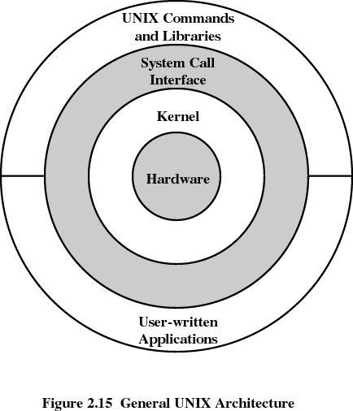
UNIX

Slide 43
