Slide 1
Multilevel Machines
Problem-Oriented Language
Translation (Compiler)
Assembly Language
Translation (Assembler)
Operating Systems
Partial Interpretation (OS)
Instruction Set Architecture
Interpretation (Microprogram)
Microarchitecture
Hardware
Increasing
Abstraction
Digital Logic
B.Majhi

Slide 2
The Operating System Layer
User
User
User
User
System and application programs
Complier
E-Mail
Editor
IRC Chat
Operating System
Hardware
B.Majhi

Slide 3
Operating System Tasks
Process Management
Memory Management
File-System Management
Communications
Error Detection
Accounting
Protection
B.Majhi
Notes:
CMO144 Steve Margetts
Process management: Creation and deletion, suspension and resumption, synchronisation, communication, deadlock avoidance
Memory Management: Keeping track of which process is using which bits of memory, allocation and deallocation of memory
File System Management: creation and deletion of files and directories, keeping track of which files belong to which processes/users
Communications: between processes (shared memory or message-passing) and between computers
Error detection: Many things can go wrong; OS needs to take appropriate action
Accounting: (especially on multi-user systems) Keeping track of who uses what
Protection: of Data, of processes from each other, protecting the OS, the memory and other resources

Slide 4
Protection: The Need for
Hardware Support
Need to ensure that no program can interfere with any other
  Could overwrite other programs
  Need to protect the OS in particular
Graceful recovery from errors detected by the hardware
  E.g. illegal instructions, divide-by-zero…
Hardware invokes the OS
  Trap: a “software interrupt”
  CPU transfers control to an address stored in a trap register
B.Majhi

Slide 5
Dual-Mode Operation
At least two separate modes, implemented using a mode bit
  User mode (mode bit = 0)
  Supervisor mode (mode bit = 1)
OS runs in supervisor mode
User mode is intended to restrict access to the machine
Also need privileged instructions
  Executed only in supervisor mode
  Cause a trap if executed in user mode
  E.g access to the mode bit
B.Majhi
Notes:
CMO144 Steve Margetts
The early Intel chips (8086) did not have a mode bit. It was possible (and easy) for any program to wipe out the operating system and cause it to crash. Later designs (e.g. 80386, Pentium), did include a mode bit, and so the operating systems for these were much more stable.

Slide 6
Privileged Instructions:
I/O Protection
User program could issue illegal I/O instructions
  Write to a non-existence device
  Read more data than a disk holds
Solution: make all I/O instructions privileged
User programs can then only perform I/O by requesting it through the OS
OS retains control over user programs
B.Majhi

Slide 7
Memory Protection
Need to limit access to main memory
  Prevent modification of OS and other programs
Give each program a range of legal addresses
  But need to compare every address issued by the user’s program
Base and Limit registers
  Implemented in hardware
  Privileged instructions used to set them
Supervisor mode has unlimited access
B.Majhi

Slide 8
Base and Limit Registers
Address (supervisor mode)
Base
Base+Limit
Memory
CPU
>=
<
Address
(user mode)
Yes
Yes
No
No
Trap to OS
(Addressing error)
B.Majhi

Slide 9
CPU Protection
Need to prevent programs from hogging the CPU
  Infinite loops
  Waiting for non-existent resources
Use a timer to control program execution
When timer expires, switch to OS
  Context switch
This is the idea of time-slicing
  Each program runs for a few msec
B.Majhi

Slide 10
System Calls (the API)
Provide the interface between a process and the OS
  Process manipulation
  File and I/O manipulation
  Information maintenance
  Communications
Ask the OS to perform some task on the processes behalf
Some languages (C, C⁺⁺, perl,…) allow system calls to be made directly
  Java hides all system calls
B.Majhi
Notes:
CMO144 Steve Margetts
System calls:
Process: end, abort, load, execute, create, terminate, get/set attributes, wait (for time, signal or process), allocate or free memory
File and I/O: create, delete, open, close, read, write, seek, get/set file or device attributes
Information: get/set time and date, get/set system data
Communications: create/delete communication device, send or receive messages, transfer status information, attach/detach remote device

Slide 11
System Programs
Provide an environment for program development and execution
Interfaces to system calls
  Status information (date, time, space…)
  File modification/manipulation (file creation, deletion, renaming, various editors,…)
  Programming support (compilers, linkers, debuggers, assemblers, interpreters…)
  Program loading and execution (command interpreters, graphical interfaces…)
  Communications (email, ftp, telnet…)
B.Majhi

Slide 12
Simple Structure: MS-DOS
Application program
Resident system program
MS-DOS device drivers
ROM BIOS device drivers
No clear separation of functionality
No dual-mode, so applications can access hardware directly
  Fast, but potentially unsafe
B.Majhi

Slide 13
PORTABLE OS
Problems:
a) Architecture and OS have strong ties due to which computer manufactures face difficulties in marketing new Architectures as OS development take substantial time
b) Develop new set of skills for each OS and M/c
Hence portability is required and standardization is required from both user and architecture point of view
Two components
a) Policy : governs the use of resource, RR policy
b) Mechanisms : implements the policies, RR implementation
Portable OS is structured so as to segregate the policy from the mechanism. This makes the policy implementation of a m/c on which the OS is to be used
Mechanism : Kernel of OS to be rewritten for the new m/c
UNIX supports portability, layered OS
Now work is going on for micro-kernel level to introduce more portability.
B.Majhi
Notes:
CMO144 Steve Margetts

Slide 14
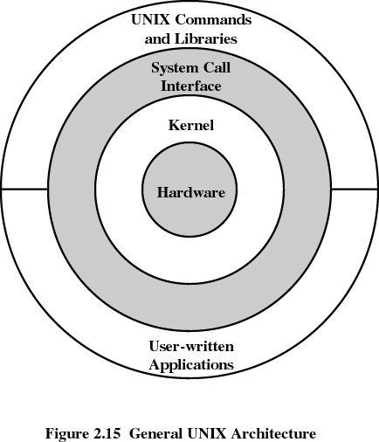
UNIX
B.Majhi

Slide 15
Kernel + System Programs: UNIX
Users
Shells and commands
Compilers and interpreters
System libraries
System-call interface to kernel
Terminal handling
Character I/O
Terminal drivers
File system
Block I/O
Disk/tape drivers
CPU scheduling
Page replacement
Demand paging
Virtual Memory
Kernel interface to hardware
Terminal controllers
Terminals
Device controllers
Disks and tapes
Memory controllers
Physical memory
Easy to port to different hardware
But the kernel is very complex
B.Majhi

Slide 16
Layered Structure: OS/2
Hidden
Operations
Layer M
Layer M-1
Exported
Operations
Hidden
Operations
Exported
Operations
Bottom Layer = hardware
Top layer = user interface
Modularity: very easy to debug
  Difficult to assign appropriate functions to each layer
  Layers add overhead, so can be inefficient
B.Majhi

Slide 17
Microkernels: NT
Win32
Application
OS/2
Application
POSIX
Application
Win32
Server
OS/2
Server
POSIX
Server
Kernel
All non-essential parts of kernel are user-level programs
  Reliability and security
Message-passing communication
  Client/Server architecture
Easy to extend OS
  Don’t need to modify kernel
B.Majhi

Slide 18
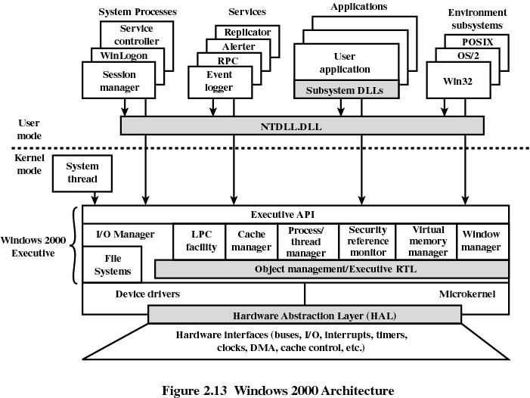

Slide 19
Virtual Machines: IBM
Processes
Processes
Processes
Programming
Interface
Kernel
Kernel
Kernel
VM1
VM2
VM3
Virtual Machine Implementation
Hardware
Provide processes with a virtual copy of underlying hardware
  Instruction interpretation
Users have their own virtual machine
  Difficult to provide exact duplicate of hardware
B.Majhi
Notes:
CMO144 Steve Margetts
Logical conclusion of the layered approach
Makes the OS very safe – difficult for programs to corrupt one another unintentionally
Complete protection of all system resources
But no sharing of resources
Virtual machine operates only in user mode – so need to implement virtual user and supervisor modes(!)
As we are interpreting instructions, this approach can be slow
But – we only really need to interpret the supervisor mode instructions
Very useful for OS research and design, as we can easily change the VM implementation
Can also be used to run programs compiled for different architectures (e.g. MacOS running Windows programs)
This is also the idea behind the Java Virtual Machine

Slide 20
Processes and Threads
We will see:
What a process is, and what it does
The idea of concurrent execution
What a thread is
How processes are implemented in the operating system
How the operating system decides which job to run
B.Majhi

Slide 21
The Process Concept
PC
Code
Data
State
Instruction
Sequence
(Program)
Local
Variables
Registers
Stack
PC
Status
A program is a passive entity
  Just a sequence of instructions
A process is an active entity
  The program in execution
A processor is an agent which executes processes
B.Majhi

Slide 22
Concurrency
P1
…, jmp, loadc, add,…
CPU
P2
…, sub, cmp, breq, jmp,…
P3
…, store, mov, add,cmp,…
P1 is running
Concurrent processes
  Activation of more than one process
Apparent concurrency can be achieved by switching a processor between several processes
  Instruction interleaving
B.Majhi

Slide 23
Processes can Share Code
PC
Code (editor)
Data (file1)
State
P1
PC
Data (file2)
State
P2
Two concurrent instances of a text-editor
Each uses the same program, but has different data and state information
B.Majhi

Slide 24
Process Control Block
Processor state
Program counter (PC)
Machine specific
Registers
Memory limits (Base & Limit)
Process number
Process state
OS specific
List of open files
…
Representation of a process in the OS
Contains all the data about the process
  One PCB per process
B.Majhi

Slide 25
Process State
New
Terminated
Interrupt
Admitted
Exit
Ready
Running
Dispatch
I/O completion
I/O event
Waiting
As a process executes, it changes state
  Only one running process per CPU
  Many ready or waiting
B.Majhi

Slide 26
Context Switching
Running
Idle
Running
P1
Save state
into PCB1
Load state
from PCB2
Save state
into PCB2
Load state
from PCB1
P2
Idle
Running
Idle
Save state of current process
Load state of next process
The CPU does no useful work while switching
B.Majhi

Slide 27
Threads
Context switches take time
  As OS becomes more complex, the amount of data associated with a process increases
A thread is a lightweight process
  One process can have many threads
  Separate machine state
  Share OS resources (code, files,…)
Kernel threads (NT, Digital UNIX)
  Run as separate entities in OS
User threads (thread libraries)
  Run under a single process
B.Majhi

Slide 28
Swapping
Swap
in
Swapped-out
Processes
Swap
out
Ready
Queue
CPU
End
I/O
I/O
Queue
Swapped-out processes are kept on disk
Aim to swap out non-interactive processes
Improves the performance of interactive processes
B.Majhi

Slide 29
Process Scheduling
Aim to have a process running at all times
  Time-sharing
  Maximise use of the CPU
The ready queue
  List of processes which are ready to run
Processes remain in the ready queue until they are dispatched
The scheduler decides which process is to run next
  How it does this affects the whole system
B.Majhi

Slide 30
Priority Pre-emption
Interrupt Handler
Plow
Phigh
Each process is assigned a priority
Processes run until they suspend themselves or are interrupted
If an interrupt makes a higher-priority process ready, then run it instead
B.Majhi

Slide 31
Run-To-Completion
Interrupt Handler
Plow
Plow
Phigh
Process runs until it suspends itself
After an interrupt, the same process continues to run
B.Majhi

Slide 32
Interrupt Latency
Time between an interrupt occurring and a process being run in response to that interrupt
Interrupt Latency= Interrupt lock-out time +
Time to service interrupt +
Time to schedule process
Advantages of priority pre-emption
  Interrupt latency is constant
  Can have low-priority processes which do not interfere with response times
B.Majhi

Slide 33
Interrupt Latency with Natural Break
Ready queue =
P1
P2
Interrupt puts P3 onto ready queue
Ready queue =
P1
P2
P3
P1 runs for 2 msec, P2 runs for 3 msec
Interrupt latency with natural break = 5 msec
Advantages
  Efficient implementation of mutual exclusion
Disadvantages
  User processes must be well-behaved
  Response time depends on user programs
B.Majhi

Slide 34
Time-Sliced Scheduling
P1
P2
P1
P3
Timer
I/O
Timer
Process runs until its time-slice expires or until it suspends itself
Ensures that CPU is shared fairly between users
Interrupt latency is the size of the time-slice
B.Majhi

Slide 35
Multi-Level Queues
Increasing priority
New
Pre-emption
Pre-emption
Done
Done
Done
Increasing time-slice
Dynamic priority assignment
Favours interactive jobs
  Get a good response time
Used in UNIX
B.Majhi

Slide 36
Summary
The fundamental unit of computation is a process
Managing processes one of the most important jobs of an operating system
The operating system uses a scheduling strategy to decide which process to run when
B.Majhi

Slide 37
Types of Process Interaction
Sharing
  Two processes sharing an object
  Require mutually exclusive access to prevent interference
Synchronisation
  One process triggering another
Communication
  One process passing a message to another
These are all closely related
B.Majhi

