Slide 1
Lecture 9: Memory Management
Memory management is about how the OS manages the allocation of memory to the various processes in a system
Topics:
Logical versus Physical Address Space
Contiguous Allocation
Paging
Segmentation

Slide 2
From Source Code to an Executing Program
Compiler
Linker
Loader
Program
Code
Object
Module
Load
Module
Executable
Program
Other
Object
Modules
System
Library
Dynamically
Loaded
Library

Slide 3
Single Contiguous
Store Allocation
Code
Operating System
Global Data
User program
(code + data)
Heap
Free space
No special hardware needed
Program must fit into main store
  (or use an Overlay)
Compiler can generate absolute code
Stack

Slide 4
Multiprocessing System
Process 1
Code
Process 2
Operating System
Hard
Disk
Global Data
Code
Physical
Memory
Heap
Process 3
Global Data
Free space
Code
Heap
Stack
Global Data
Free space
Heap
Stack
Free space
Stack
Processes can reside anywhere in memory
  Or even be swapped out to disk

Slide 5
Address binding
Program must be brought into memory and converted into a process for it to be executed.
More than one process is held in physical memory at the same time
During execution processes make references to physical memory locations i.e. locations in chips
BUT - Program code represents locations symbolically e.g. variable names
Mapping of one type of address to another type of address known as address binding
Address binding can happen at three different stages.

Slide 6
Binding of Instructions/Data to Memory
1. Compile time: If the location of where the process is to be placed in memory is known when the program is compiled, then compiler can replace symbolic references to data in program code with actual addresses in memory where that data is to be held. You must recompile code if location of process in memory is to change.

Slide 7
2. Load time: If the location of where the process is to be placed in memory is NOT known when the program is compiled - compiler replaces symbolic references to data with relocatable addresses. These are addresses that are relative to address of begining of program code I.e. first word of program code is given address 0 and then all other locations within program are given addresses as offset from start of program. The actual address of beginning of program code when it is placed in memory is added to all addresses when program is loaded into memory.

Slide 8
3. Execution time: the location of where the process is to be placed in memory is only known when the process is to be executed (run time binding) - as before compiler replaces symbolic references to data with relocatable addresses. However, process may be moved during its execution from one part of memory to another. Hardware (e.g., base and limit registers) is used to generate actual address to identify location in memory chip - e.g. relocatable address + address in some relocation register gives real address to be used. This is done for each memory reference.

Slide 9
Logical vs. Physical Address Space
Execution time binding of addresses means that the address that is generated by the process when it is running on the CPU may be different to the address of the actual physical location that holds the instruction or data required - the address generated by the process running on CPU (known as logical address or virtual address) has to be translated into physical address of location in memory
Logical and physical addresses are the same in compile-time and load-time address-binding, but may be different in run-time binding

Slide 10
Memory-Management Unit (MMU)
MMU is a hardware device that maps virtual to physical address.
In MMU every address generated by a user process is modified (e.g. by adding a relocation register value to address) before sending it to memory.
Base and limit registers are an example of a simple MMU.

Slide 11
Memory allocation
memory allocation is the process by which the OS decides what memory to allocate to a process for its code, data and system data
There are 3 general schemes for allocating memory to processes:
  contiguous allocation
  paging
  segmentation

Slide 12
Contiguous Allocation
The physical memory space of a process is held in one area of memory i.e. all locations are contiguous (next to each other)
Main memory divided into two parts:
  Resident operating system - held in low memory.
  Memory for processes in high memory
memory area for processes can be organised either
  to hold the address space of a single process at a time (called single partition allocation)
  to hold the address space of several processes at the same time (multiple partition allocation) - one partition for each process

Slide 13
Single-partition allocation
Relocation-register scheme used to protect operating-system code and data.
Base register (also sometimes called relocation register) contains value of physical address of start of process memory area, limit register contains range of logical addresses – each logical address must be less than the limit register.

Slide 14
Contiguous Allocation (Cont.)
Multiple-partition allocation
  Hole – this is a block of memory that is currently available (free) to be allocated to a process. Holes of various sizes are scattered throughout memory.
  When a process arrives, it is allocated memory from a hole large enough to accommodate it.
  Operating system maintains information about:
  a) allocated partitions b) free partitions (holes)
OS
OS
OS
OS
process 5
process 5
process 5
process 5
process 9
process 9
process 8
process 10
process 2
process 2
process 2
process 2

Slide 15
Dynamic Storage-Allocation Problem
How to satisfy a request for memory of size n from a list of free holes:
First-fit: Allocate the first hole from list that is big enough.
Best-fit: Allocate the smallest hole that is big enough; must search entire list, unless ordered by size. Produces the smallest leftover hole.
Worst-fit: Allocate the largest hole; must also search entire list. Produces the largest leftover hole.

Slide 16
Fragmentation
External fragmentation – enough total memory space exists for a process, but it is not all in one block i.e. not contiguous. The free memory is divided into small areas (many small holes) - thus process cannot be loaded into memory even though total free space is enough.
The unusable memory space exists outside of the memory partitions allocated to the running processes, thus it is called external fragmentation.

Slide 17
Reduce external fragmentation by compaction
  Shuffle memory contents in memory to place all free memory together in one large block.
  Compaction is possible only if relocation is dynamic, and is done at execution time.
Internal fragmentation – memory allocated to a process may be slightly larger than amount of memory requested. This may be because if only the area of memory actually needed is allocated then the area leftover is too small to be of any use so all block is allocated. The unused area of memory is internal to a partition. Hence it is called internal fragmentation.

Slide 18
Paging
In paging physical address space of a process can be noncontiguous i.e. addresses of consecutive logical locations in process may have non-consecutive physical addresses. The memory of the process may be divided up into a number of separate blocks in memory, the physical address is relative to the start address of the block of memory in which the required memory resides. As a result a process can be allocated physical memory wherever the latter is available.

Slide 19
In paging scheme physical memory is divided up into into fixed-sized blocks called frames (normally between 1/2K and 8K in size).
logical memory of a process is also divided into blocks of same size as the page frames. These blocks called pages.
OS keeps track of all free frames.
To run a program of size n pages, need to find n free frames and load program into them.
Then set up a page table to translate logical to physical addresses. Separate page table for each process.

Slide 20
Address Translation Scheme
Address generated by CPU is divided into:
Page number (p) – used as an index into a page table which contains base address of each page in physical memory.
Page offset (d) – combined with base address to define the physical memory address that is sent to the memory unit.
Paging eliminates external fragmentation, but internal fragmentation can still exist.

Slide 21
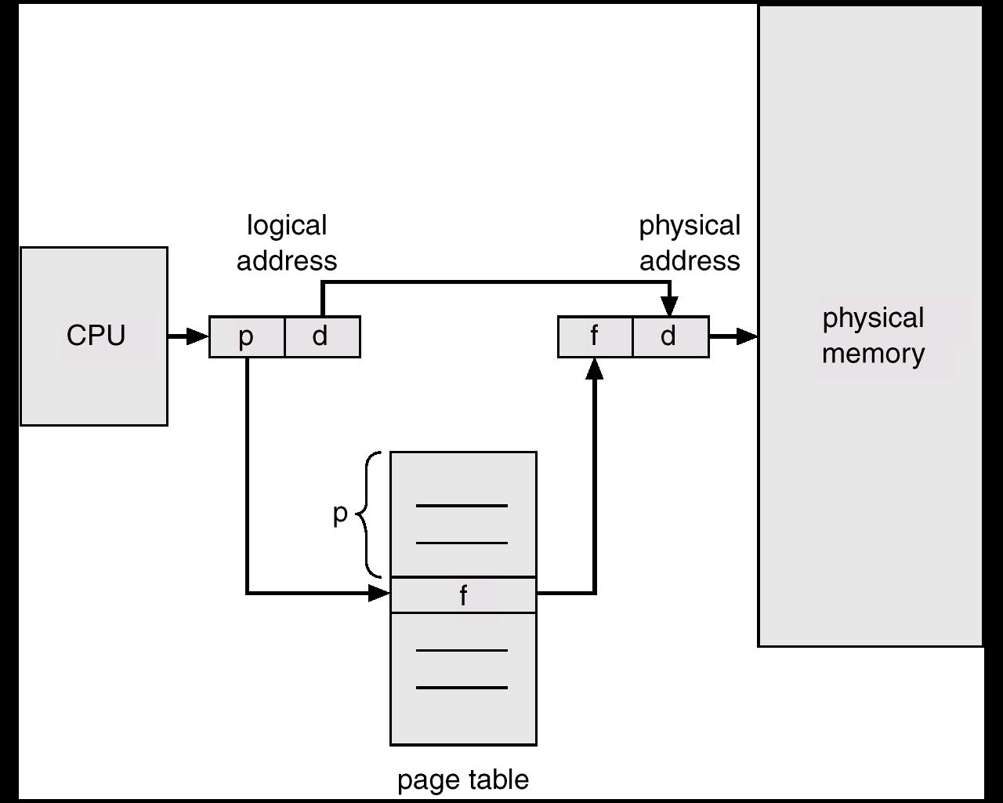
Address Translation Architecture

Slide 22

Paging Example

Slide 23
Implementation of Page Table
Page table is kept in main memory.
Page-table base register (PTBR) points to the page table.
Page-table length register (PRLR) indicates size of the page table.
In this scheme every data/instruction access requires two memory accesses. One to get the page frame address from the page table and one to actually get the data/instruction.
The two memory access problem can be solved by the use of a special fast-lookup hardware cache called associative registers or translation look-aside buffers (TLBs)

Slide 24
Associative Register
Associative registers – allow parallel search
If page number is in associative register, get frame number out.
Otherwise get frame number from page table in memory and add it to associative registers
Page #
Frame #

Slide 25
Effective Access Time
Associative Lookup = T_{a} time units
Assume memory cycle time is 1 microsecond
Hit ratio – percentage of times that a page number is found in the associative registers; ratio related to number of associative registers.
If hit ratio = α, then Effective Access Time (EAT) can be found as follows:

Slide 26
if page no. in associative regs then use 1 microsecond to access memory for data + time for associative lookup (this will happen α fraction of the time)
if page no. not in associative regs then in addition to time for associative lookup, use 2 microseconds to access page frame address and data both in memory (this will happen 1- α fraction of the time)
EAT = α(1 + T_{a} ) + (1 – α)(2 + T_{a} )
= 2 + T_{a} – α

Slide 27
Memory Protection
Memory protection is implemented by associating a protection bit with the page table entry for each frame - the bit specifies whether frame is read/write or read only
Also Valid-invalid bit attached to each entry in the page table - bits loaded for each process as part of context switch for process:
  “valid” indicates that the associated page is in the process’ logical address space, and is thus a legal page for the process to access.
  “invalid” indicates that the page is not in the process’ logical address space and should thus generate an error

Slide 28
Segmentation
Memory-management scheme that divides up processes’ address space into a number of blocks called segments
segments are similar to pages, but the difference is that pages all have the same size, whereas segments may be a number of different sizes
In this scheme a program is treated as a collection of segments. A segment is a logical unit e.g. main part of program, a group of functions, the set of global data values, arrays, a stack, in OO languages may be individual objects

Slide 29
Logical View of Segmentation
1
1
4
2
3
4
2
3
user space
physical memory space

Slide 30
Segmentation Architecture
Logical address consists of a pair: <segment-number, offset>,
  Segment number is an index into the segment table - with one segment table for each process
  offset is the value to be added to start address of segment to give real physical address
each entry in segment table has:
  base value – contains the starting physical address where the segment resides in memory.
  limit – specifies the length of the segment.
Offset address is legal if offset < limit value

Slide 31
Segment-table base register (STBR) points to the segment table’s location in memory.
Segment-table length register (STLR) indicates number of segments used by a program;
segment number s is legal if s < STLR.

Slide 32
Segmentation Architecture (Cont.)
Protection. Each entry in segment table contains:
  validation bit - which if = 0 ⇒ illegal segment
  specification of read/write/execute privileges
Protection bits associated with segments
Since segments vary in length, memory allocation is a dynamic storage-allocation problem.
A segmentation example is shown in the following diagram

Slide 33
