Slide 1


Slide 2
Tanmay Bakshi
Grade 8

Slide 3
Thank You!
Anika Technologies HSBC

Slide 4
My Background
Software/Cognitive Developer
Algorithm-ist @ Darwin Ecosystem
Author, Keynote Speaker, YouTuber
Course Instructor for Udemy
IBM Champion for Cloud
Honorary IBM Cloud Advisor

Slide 5
Tanmay Teaches
YouTube Channel
15,000
Subscribers
134
Videos
https://www.youtube.com/c/tanmaybakshiteaches

Slide 6
Computing
Watson/AI
Programming
Math
Algorithms
Science
Machine Learning
Neural Networks

Slide 7

Hello Swift!
iOS App Programming for Kids and Other Beginners
https://www.manning.com/books/hello-swift

Slide 8
Machine Learning

Slide 9
Today’s Agenda
XOR Approximation using Feed Forward Neural Networks
Banking Classification Tasks using Feed Forward Neural Networks
Banking chatbot using IBM Watson

Slide 10
Today’s Agenda
XOR Approximation using Feed Forward Neural Networks
Banking Classification Tasks using Feed Forward Neural Networks
Banking chatbot using IBM Watson

Slide 11
Today’s Agenda
XOR Approximation using Feed Forward Neural Networks
Banking Classification Tasks using Feed Forward Neural Networks
Banking chatbot using IBM Watson

Slide 12
What is Machine Learning?

Slide 13
Machine Learning allows computers to learn like animals.

Slide 14
XOR Approximation using
Feed Forward Neural Networks

Slide 15
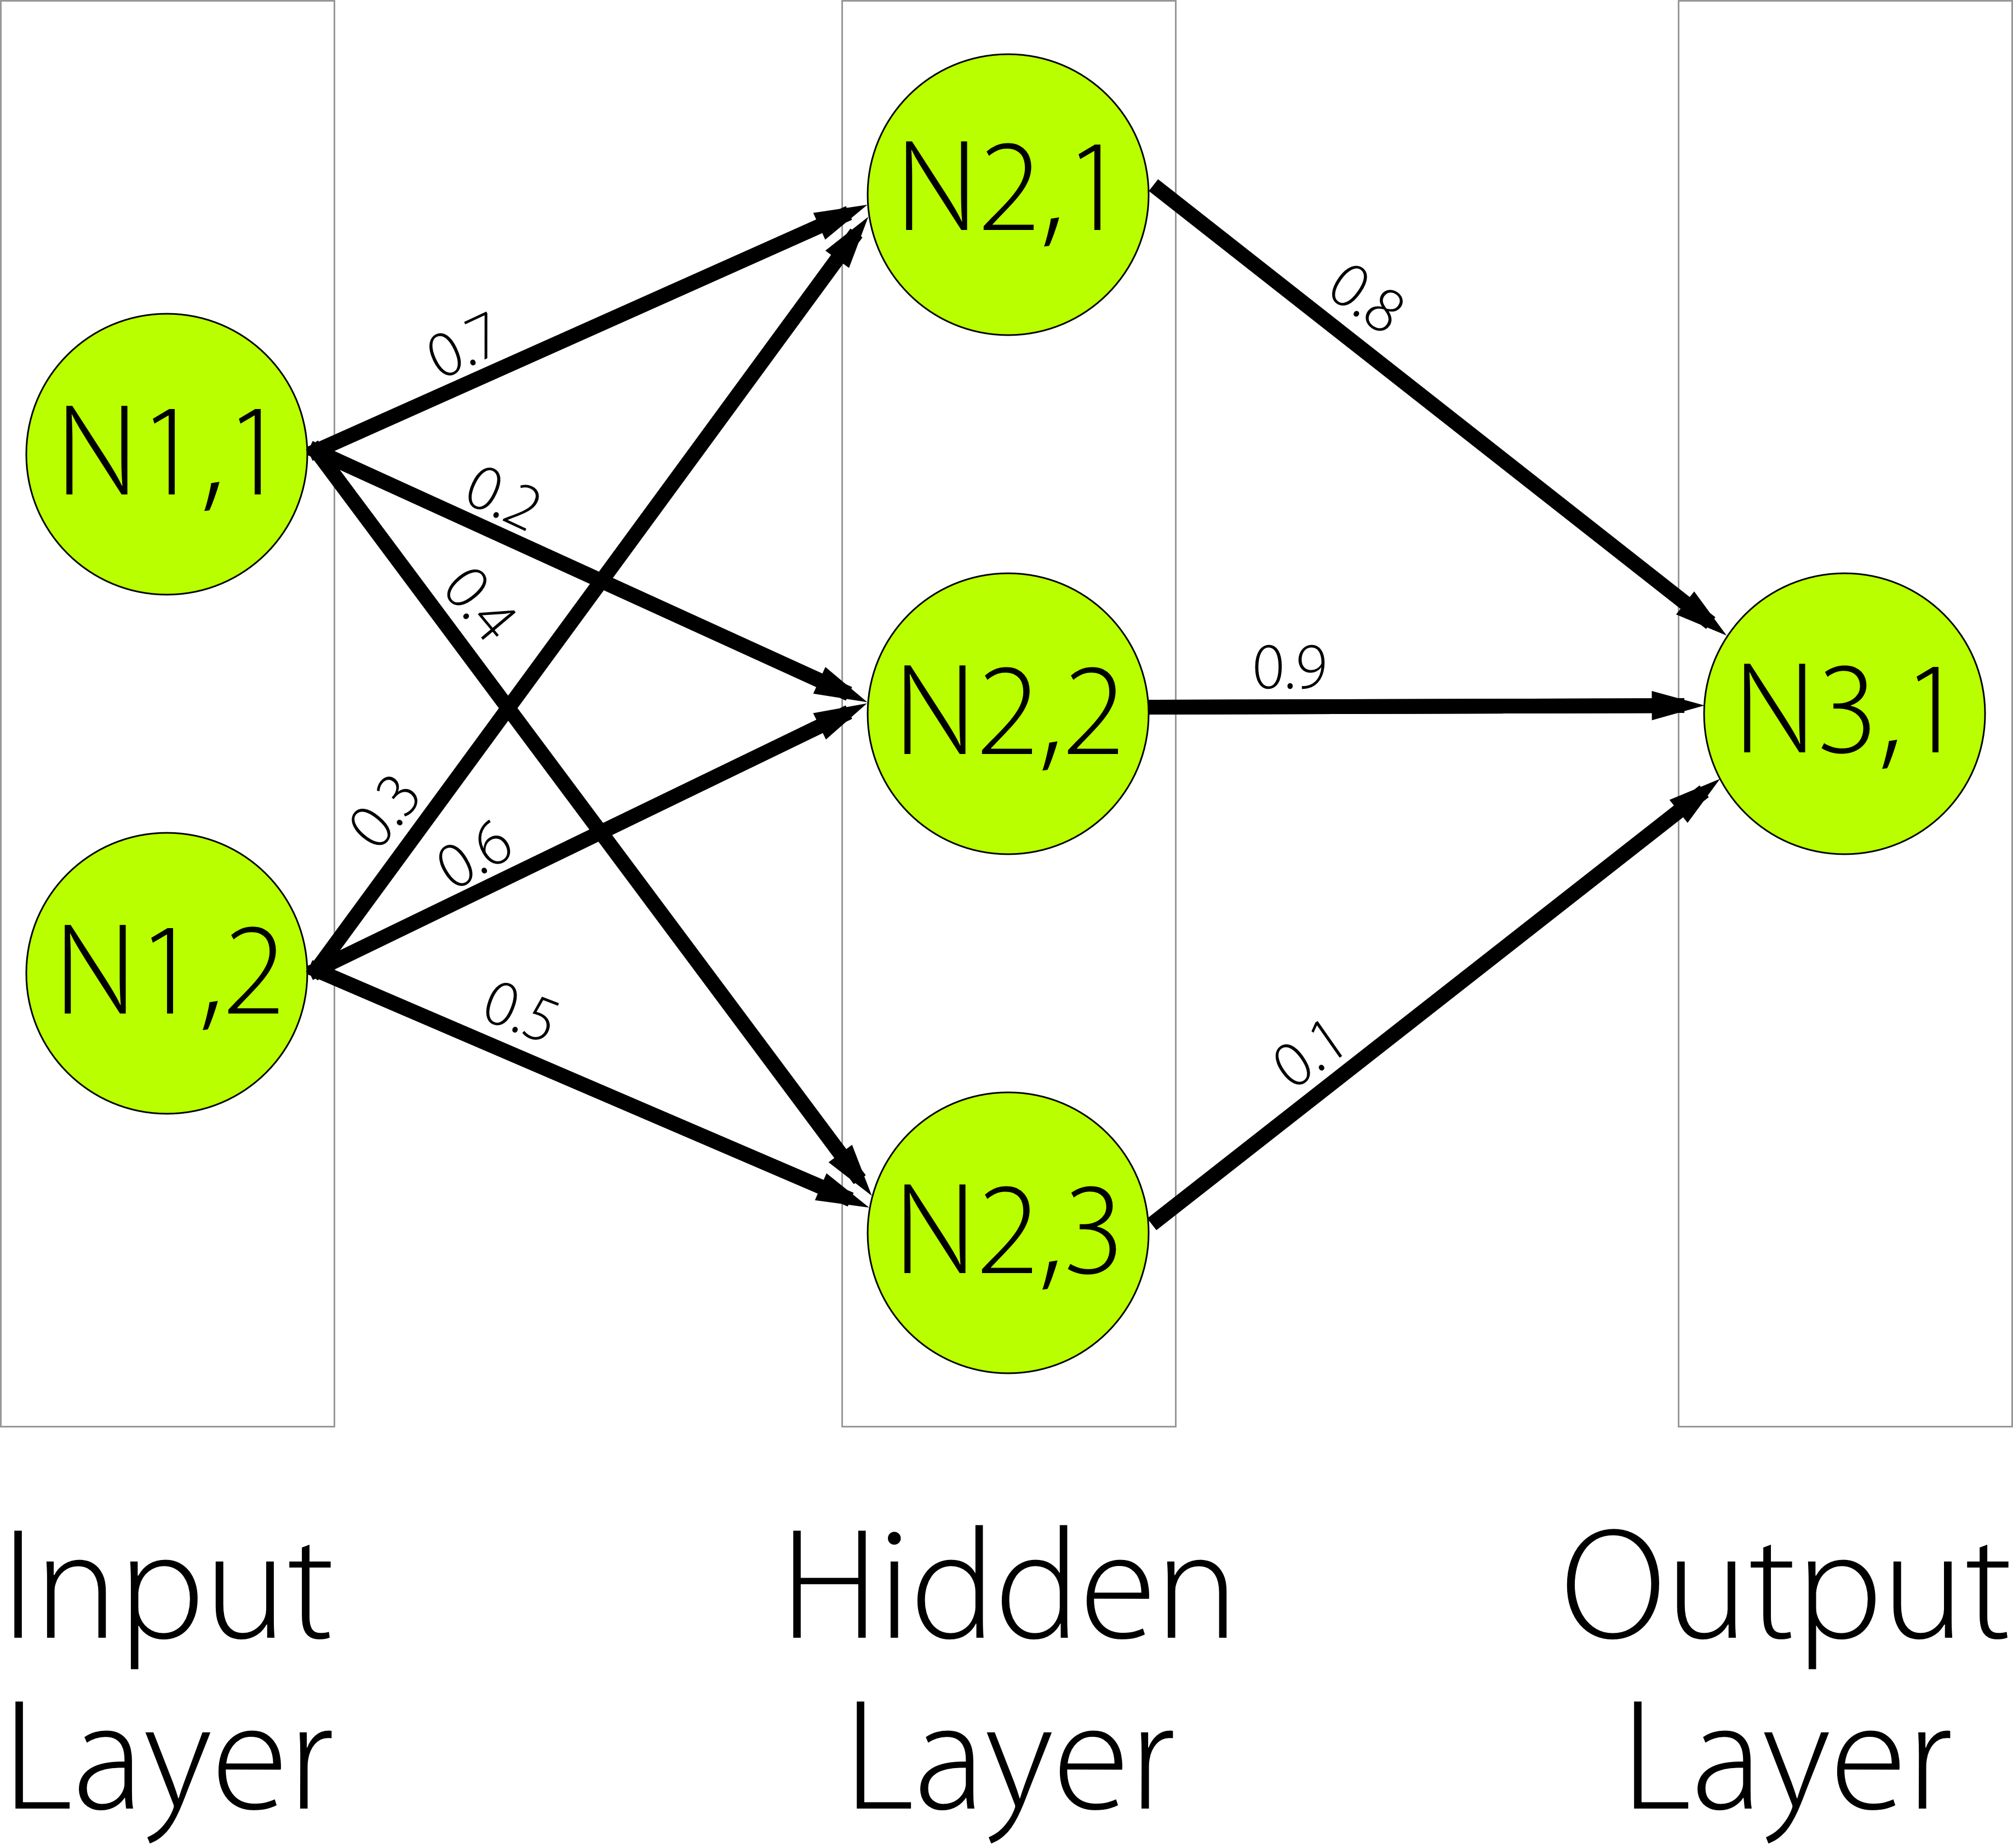

Slide 16
FFNN: Ground Rules

Slide 17
Each Neural Network must have at least 2 layers:
Input & Output

Slide 18
Each layer contains at least 1 Neuron

Slide 19
A neuron is a very simple
entity which performs
small calculations
on the input it’s given.

Slide 20
A neuron’s value is equal to
the activated sum of its weighted inputs.

Slide 21
Each neuron’s value is always
between -1 and 1.
(except the input neurons)

Slide 22
Each neuron in a layer
is connected to
every other neuron
in the next layer.
(typically)

Slide 23
Every connection from
one neuron to another
has a weight.

Slide 25
When you give input
to the neural network,
you are setting the values
of the input neurons.

Slide 26
When you receive output
from the neural network,
you are grabbing the values
of the output neurons.

Slide 27
FFNN to
approximate the
XOR function.

Slide 28
XOR Truth Table

Slide 29
Input #1 | Input #2 | Output #1
0 | 0 | 0
1 | 0 | 1
0 | 1 | 1
1 | 1 | 0

Slide 30


Slide 32
Banking Classification Tasks using Feed-Forward Neural Networks

Slide 33
Banking chatbot using IBM Watson

Slide 34
IBM Watson

Slide 35
Watson was an intelligent computer that played Jeopardy! and won in 2011.

Slide 36
Watson is a set of tools developers can leverage to create intelligent apps.

Slide 37
Vision
Natural Language
Analytics

Slide 38
Our Expertise
Artificial Intelligence and Machine Learning
Big Data Design and Architecture
Big Data Analytics
Ultra Low Latency Design and Architecture
Performance Tuning
Reviewing and Designing Applications
Database Consulting
Security
UI/UX based Technologies
Vendor based Technologies

Slide 39
Our Expertise
Programming in R/SAS/Tableau and other tools
Data exploration and data visualization using R/SAS/Tableau and other tools
Data mining using R/SAS/Tableau etc
Data Analytics using R/SAS/Tableau etc
Data Analytics with Python
Machine Learning with Scikit and other tools
NLP in Python /Java
Data Science at Scale - Apache Spark
Tensorflow for Advanced MI
Deep Learning

Slide 40
Technologies and Software Covered
Analytics
Artificial Intelligence
Machine Learning
Data Science
Android and iOS
IoT
Big Data
Cloud Computing
Emerging Technologies
Microsoft
Adobe
SAP
Oracle
Java
Cisco
Green Plum
Smart Client
Tableau
SAS
Qlikview

Slide 41
Consulting Services
Talent Search- We help organizations find talent - Entry level to Senior Officers in the technology space.
Contract Consultants- We assist companies in providing experts for leading, mentoring, development and consulting as per the need of the client.
Training - We have courses on all various technologies to train your existing
employees by leading experts. Our training’s can increase productivity of employees by more than 200%.
Cutting Edge Tools - We have experts in all the latest cutting edge tools in Analytics , Machine Learning and other technologies.

Slide 42
Contact Us
We look forward on partnering with you and sharing your vision to ensure your success.
Pune Branch:
A2/11, Ujwal Park, NIBM Road,
Kondhwa Khurd, Pune – 411048.
Bangalore Branch:
191/519, 10C Main, Jayanagar
1st Block, Bangalore-560011.
Website: www.anikatechnologies.com
Sales and Support:
Email: anand@anikatechnologies.com
Phone: +91 7719882295 ; +91 9730463630

Slide 43



@TajyMany
tajymany@gmail.com
tanmayb123
tanmay bakshi
Tanmay Bakshi

