Slide 1
DOCUMENT CLASSIFICATION USING TENSORFLOW

Slide 2
Agenda
Problem statement
What is TensorFlow?
Gathering and pre processing of data
Models used for classification
Verification
Challenges
Future Scope

Slide 3
Problem statement
Inside HSBC domain, we have hundreds of documents being uploaded on SharePoint . It is difficult for humans to manually classify these documents into different classes such as Public, Internal, Restricted or Highly Restricted .
So we have tried to solve this problem using AI using sophisticated Machine Learning techniques .
Why?
To correctly classify important documents without much human intervention
To protect confidential information
Corporate information integrity prevention

Slide 4
What is TensorFlow?
Google’s open source Machine Learning framework .
Uses DataFlow programming model . It represents :
1) Data as tensors , a typed multi-dimensional array
2) Computations as graphs
3) Nodes in the graphs are called operations
Tensorflow API’s are available to use with C++ and Python languages.

Slide 5
Gathering Data
We start with a collection of sample documents (i.e. text corpus) . In this corpus , each document has already been labeled as Public, Internal, Restricted and Highly Restricted .
Label the input data.
The X-matrices (i.e. feature matrices) have the shape (number of rows,number of columns). Each row represents an email . Each cell in the matrix contains an integer between 0 to N which is the count of how many times a given word occurred in a document .
Similarly , we have a matrix which holds label for our data .

Slide 6
Preprocessing on data
Tokenization
Removed stop words
Removed numerical data
Removed special characters
Applied TF-IDF

Slide 7
Models
Supervised / Unsupervised
Logistic regression
Softmax (Multinomial logistic regression)
DNN (applied on softmax cross entropy with logits)
CNN(future application)

Slide 8
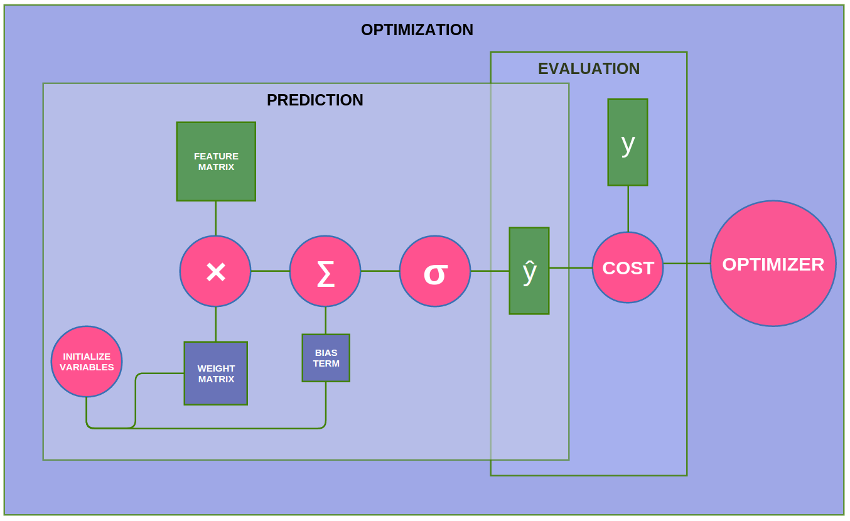
Models : Logistic Regression

Slide 9
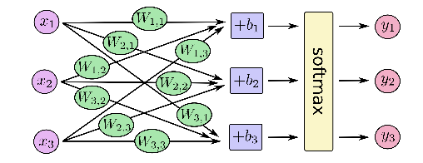
Models : Softmax

Slide 10
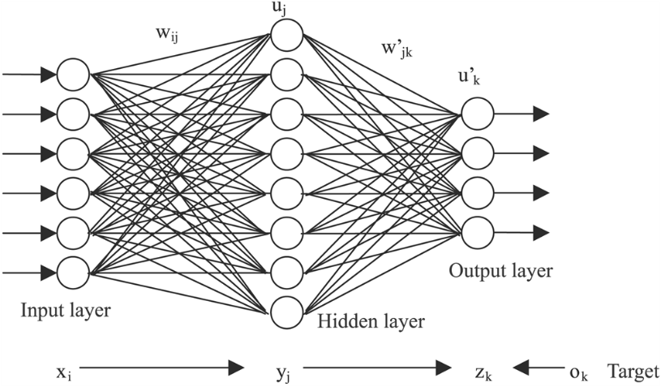
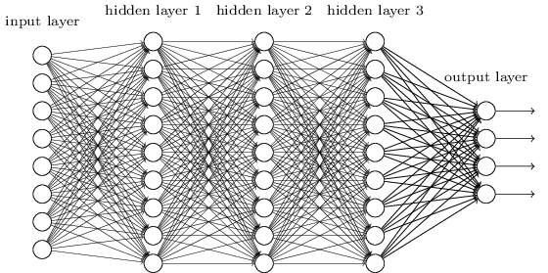
Models : Deep Neural Network

Slide 11
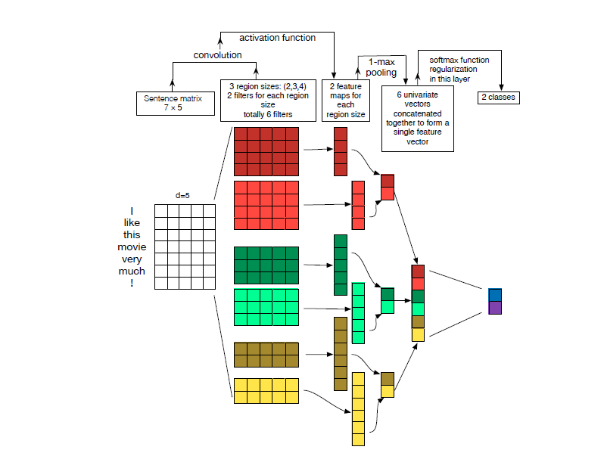
Models : Convolutional Neural Network

Slide 12
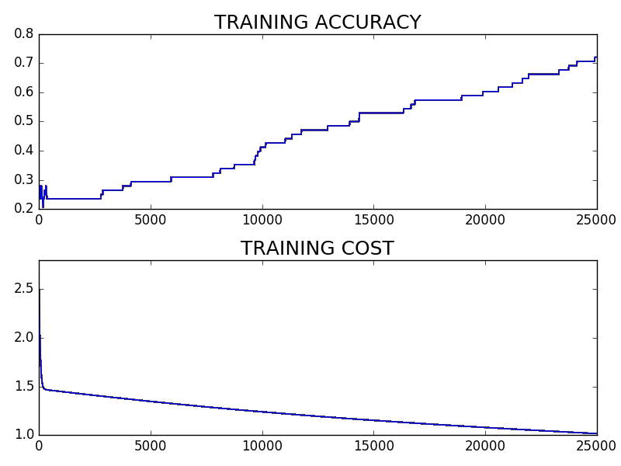
Performance of models
Softmax Regression model

Slide 13
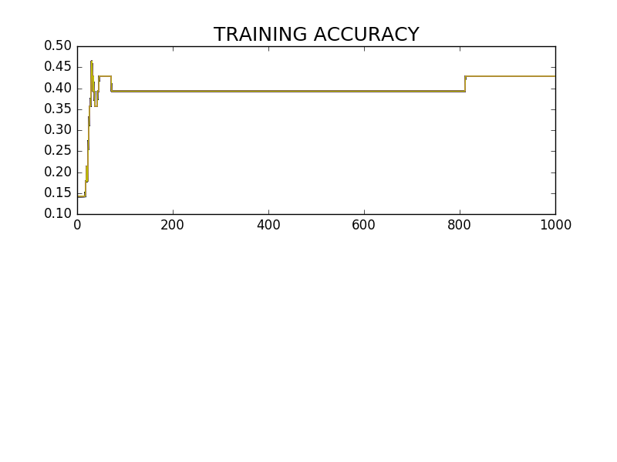
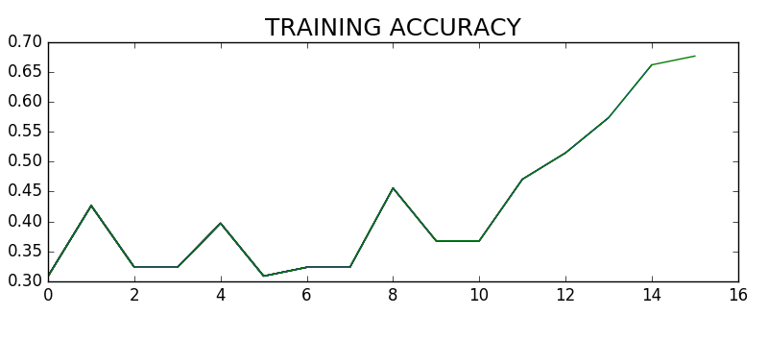
Performance of models
DNN model

Slide 14
Challenges faced
The volume of the data we had was not enough to train our model efficiently .
Neural network needs a lot of data .
Neural network needs computational power .

