Slide 1
DOCUMENT CLASSIFICATION USING TENSORFLOW

Slide 2
Agenda
Problem statement
What is TensorFlow?
Gathering and pre processing of data
Models used for classification
Challenges
Future Scope

Slide 3
Problem statement
Inside HSBC domain, we have hundreds of documents being uploaded on SharePoint . It is difficult for humans to manually classify these documents into different classes such as Public, Internal, Restricted or Highly Restricted .
So we have tried to solve this problem using AI using sophisticated Machine Learning techniques .
Why?
To correctly classify important documents without much human intervention
To protect confidential information
Corporate information integrity prevention

Slide 4
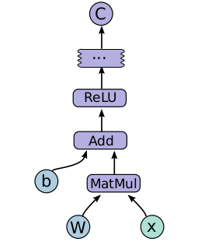



What is TensorFlow?
Google’s open source Machine Learning framework .
Uses DataFlow programming model . It represents :
1) Data as tensors , a typed multi-dimensional array
2) Computations as graphs
3) Nodes in the graphs are called operations
Tensorflow API’s are available to use with C++ and Python languages.

Slide 5

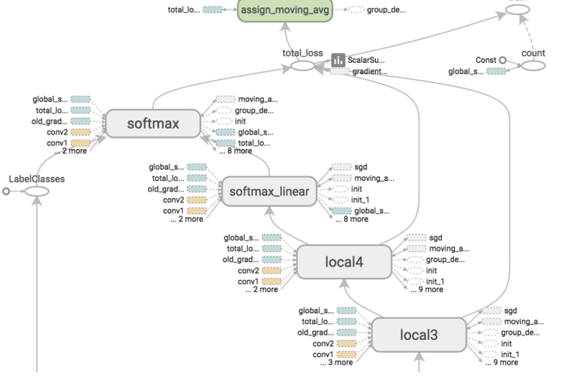
Why TensorFlow?
Easy to use
Distributed computing across different platforms with minimal code changes
Internals can be customized
Provision for using GPUs
Computational graph visualizations
Notes:
Documents are crisp and clear. We were able to create a model within few weeks.
When you create a model running in a single mode it could be made to run in distributed mode across different platforms such as Mobiles with very minimal code changes
If you’re a researcher and you want to try something crazy TensorFlow is the best option. You could have your own internal functions, for example Error metric.
A decade back GPUs are mostly used for Gaming. These days GPU plays a vital role in the field of ML as it reduces the running time by a larger extent.
TF has an utility called Tensor Board which provides visualizations of the graphs that you create. This comes handy when debugging your model.

Slide 6

Gathering Data
We start with a collection of sample documents (i.e. text corpus) . In this corpus , each document has already been labeled as Public, Internal, Restricted and Highly Restricted .
Label the input data.
The X-matrices (i.e. feature matrices) have the shape (number of rows,number of columns). Each row represents an email . Each cell in the matrix contains an integer between 0 to N which is the count of how many times a given word occurred in a document .
Similarly , we have a matrix which holds label for our data .

Slide 7
Preprocessing on data
Tokenization
Removed numerical data
Removed special characters
Remove stop words
Applied TF-IDF

Slide 8
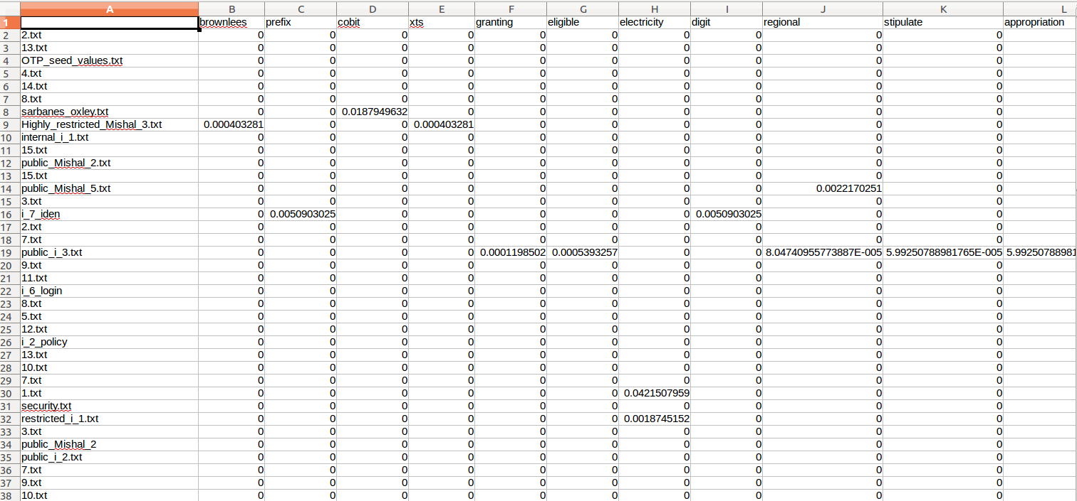
Preprocessing on data

Slide 9
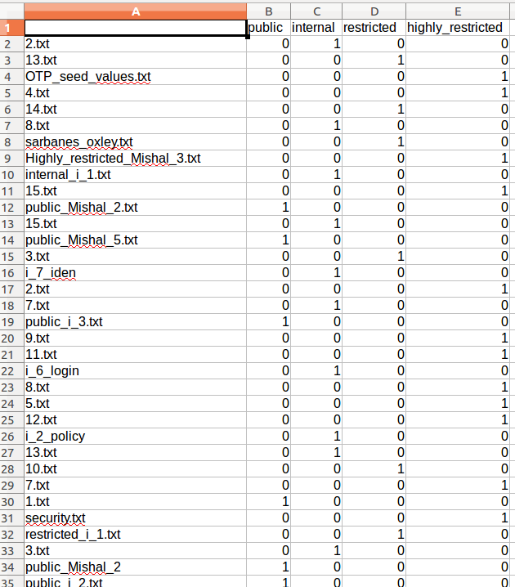
Preprocessing on data

Slide 10
Models
Supervised / Unsupervised
Logistic regression
Softmax (Multinomial logistic regression)
DNN (applied on softmax cross entropy with logits)
CNN(future application)

Slide 11
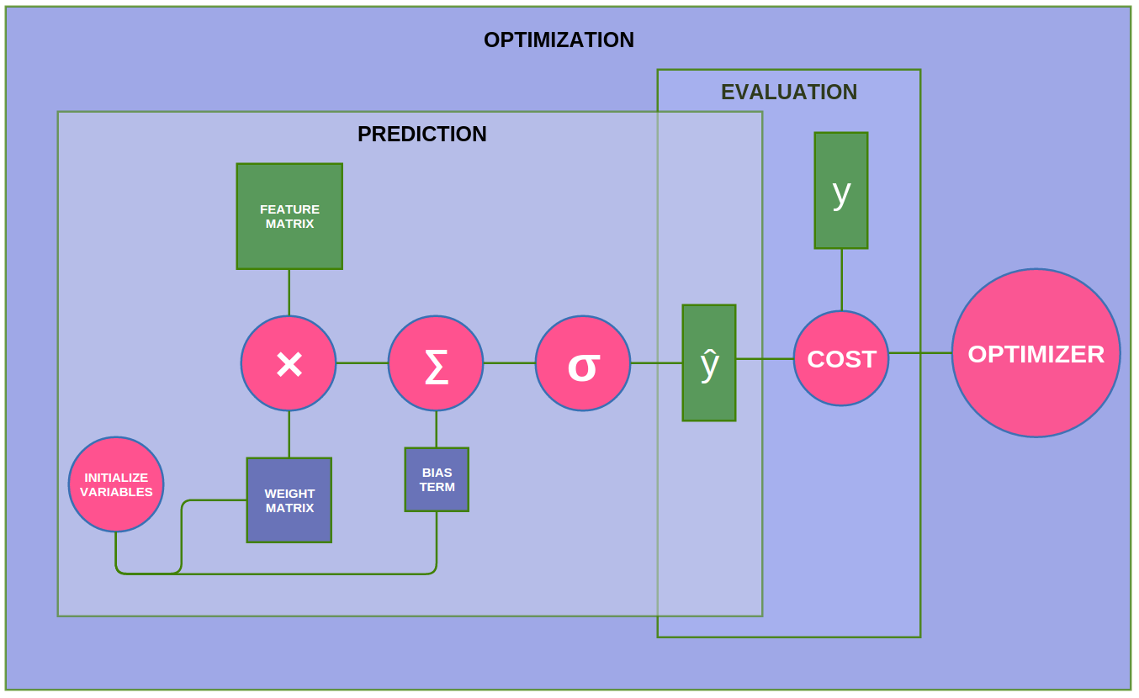
Models : Logistic Regression

Slide 12
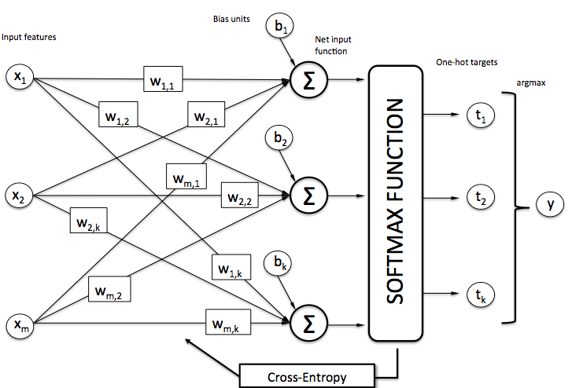
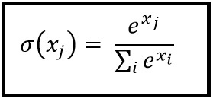
Models : Softmax
Notes:
>cross entropy
>

Slide 13
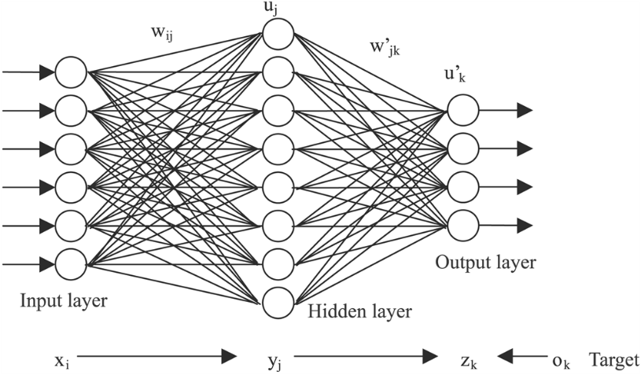
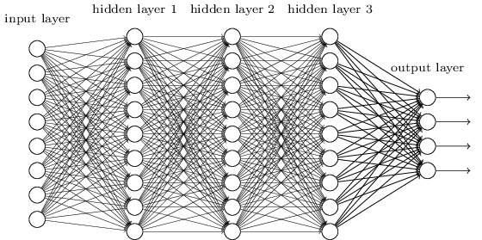
Models : Deep Neural Network

Slide 14
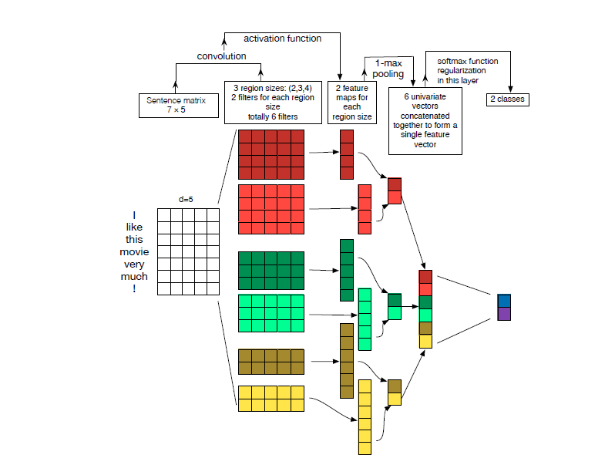
Models : Convolutional Neural Network

Slide 15
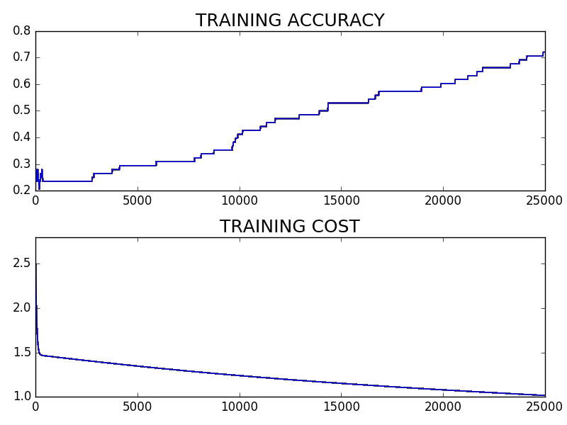
Performance of models
Softmax Regression model

Slide 16
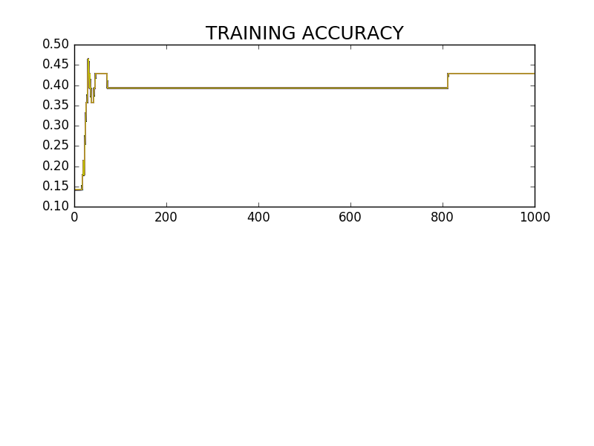
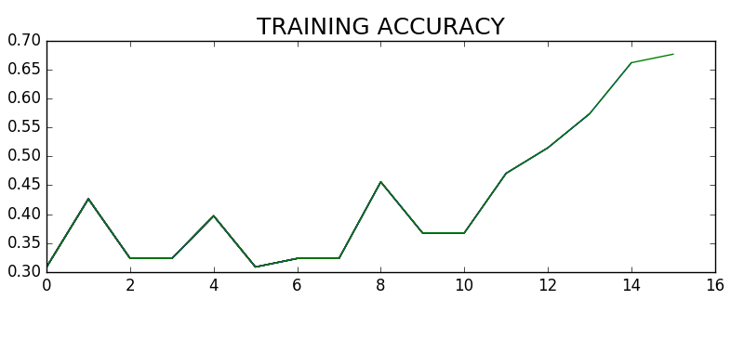
Performance of models
DNN model

Slide 17
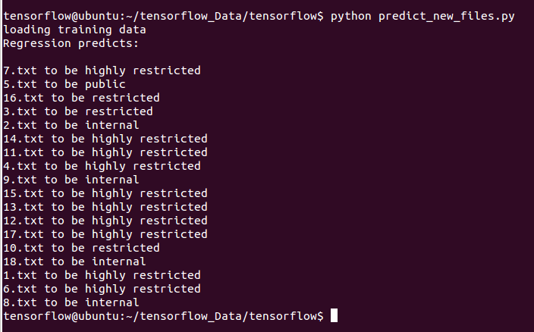
Performance of models
DNN model

Slide 18
Challenges faced
The volume of the data we had was not enough to train our model efficiently .
Neural network needs a lot of data .
Neural network needs computational power .

Slide 19

Thank you

