Slide 1
Document segmentation in document recognition flow
Author: Maksym Marushkevych

Slide 2
Motivation
Banks
Airports
KYC providers
etc.

Slide 3
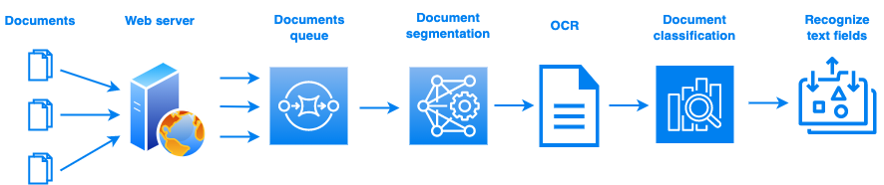
High-level architecture

Slide 4
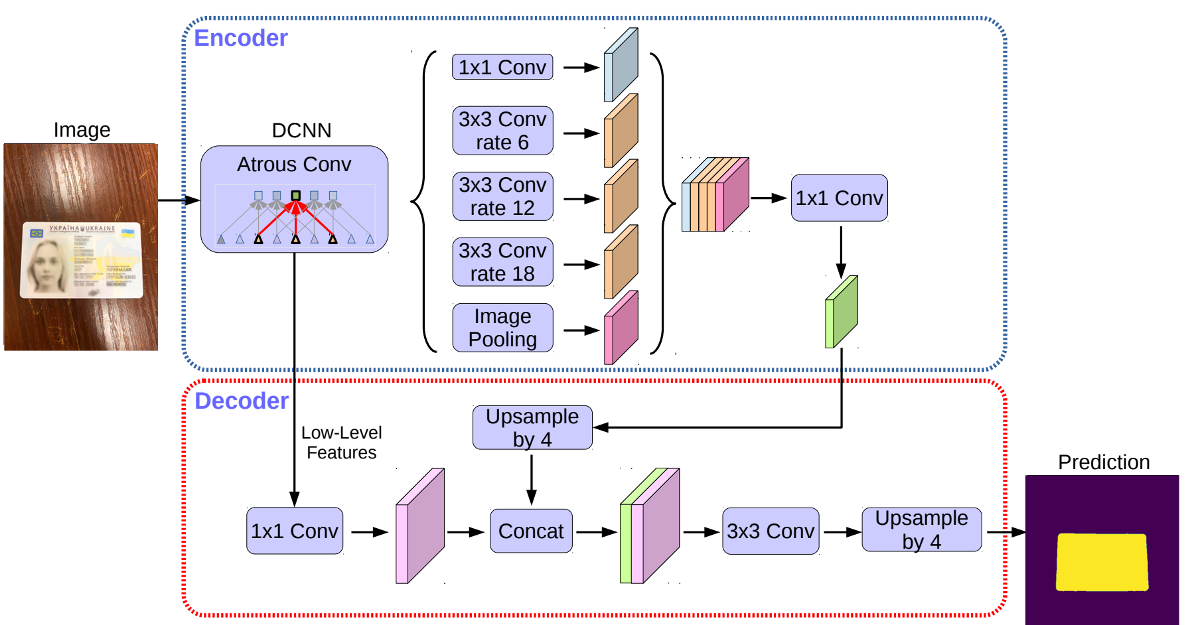
DeepLabV3Plus

Slide 5
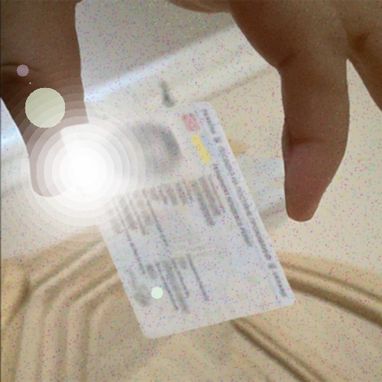
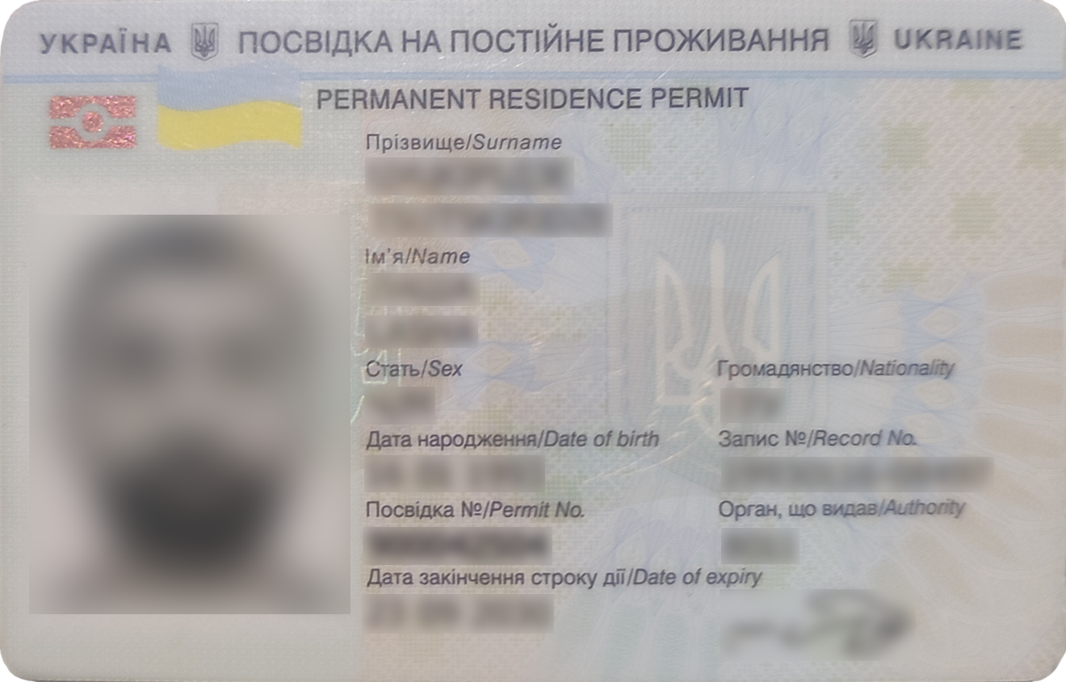
Data augmentation
Resizing
Rotation
Random document position
8 backgrounds modes
Image colors shifting
Noising
Bluring
Gamma correction
Sun flare
Random document perspective
Random shadows

Slide 6
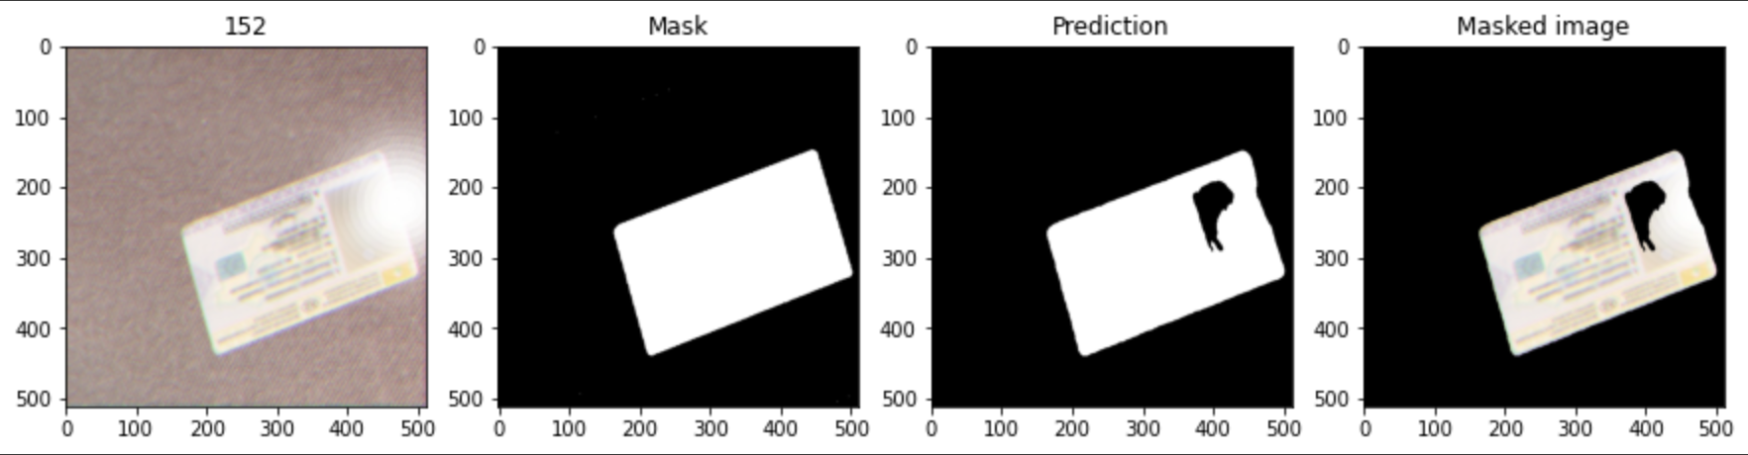
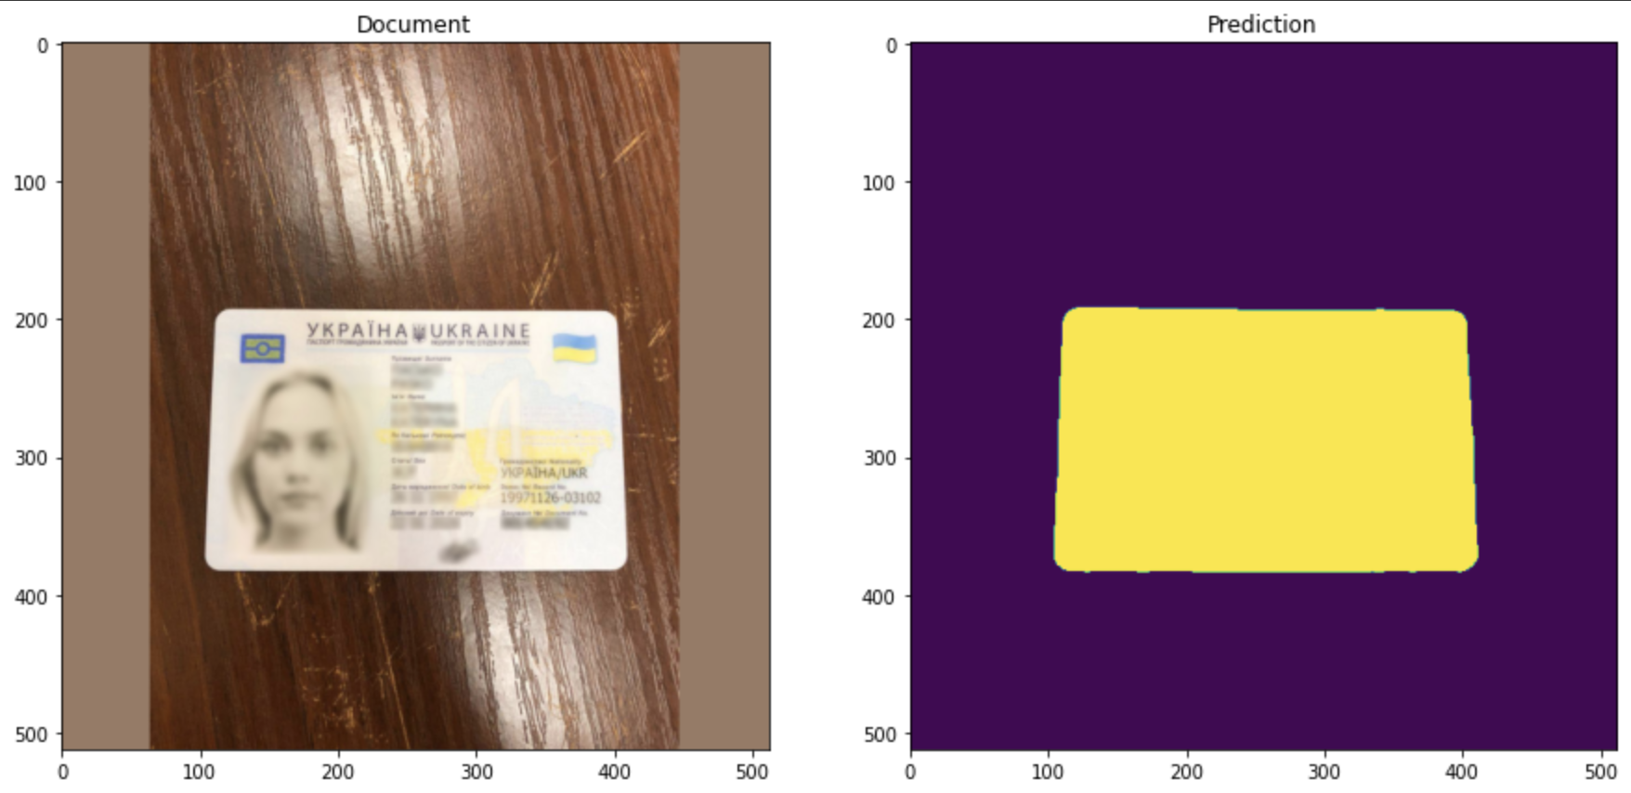
Prediction

Slide 7
Conclution
Real use cases
Advantages
Disadvantages

