Slide 1
Text Analysis on Covid-19 Tweets
Data Analytics Capstone Project
Amy Hong

Slide 2
Project Purpose
The purpose of my capstone project is to apply text analysis techniques on Covid-19 tweets to provide my potential customers the useful insights, public sentiment and concerns during the outbreak.

Slide 3
Potential Customers
Policy makers
Knowing public concerns and sentiment will help them to set priorities and health guidelines to reduce the public stress and to relieve burdens due to the outbreak
Health Professions
Mental health professions may implement effective therapy strategies based on general concerns and sentiment during the outbreak
Educators
Teachers can be more proactive and ready to help/guide students by knowing public concerns and sentiment

Slide 4
Technology Used
R, RStudio
Text mining and analysis packages in R: dplyr, tidyr, tidytext, textcat
Visualization packages in R: ggplot2
Excel for creating graphs

Slide 5
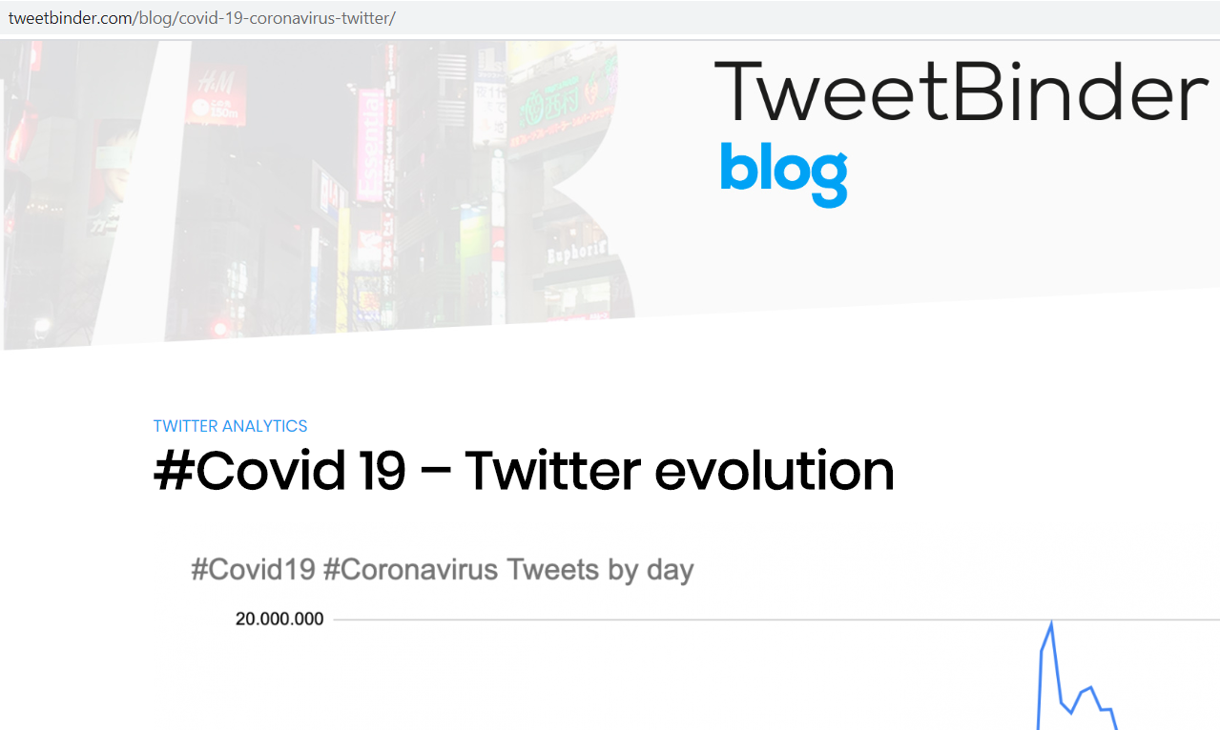
Data Source
A collection of tweets with keywords as Covid19 and Coronavirus
Collection date range from 1/22/2020 to 4/22/2020
Original file format as excel workbook
https://www.tweetbinder.com/blog/covid-19-coronavirus-twitter/

Slide 6
Data Clean-up Process
Convert worksheets to separate csv files
Load csv files to R, convert to data frames, combine data frames to one data frame
Set date data format as “date”
Add new data column, labeled as “week”, so that tweets can be group by week
Use R text mining packages to remove unnecessary characters, numbers and stop words
Finally, tokenize words to ready for text analysis
Detect language of tweet text, omit non-English tweet entries

Slide 7
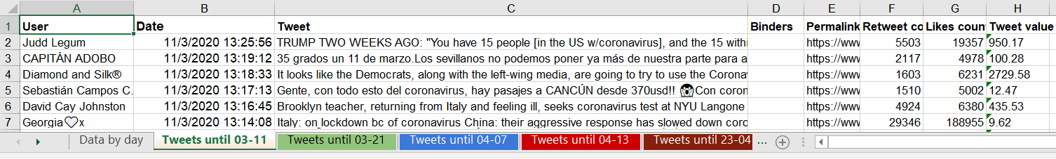

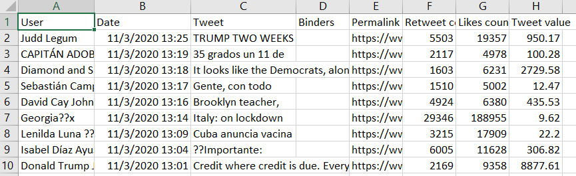
Original Dataset
Converting
Excel to CSV

Slide 8
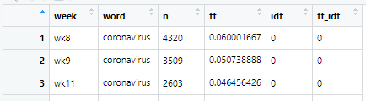

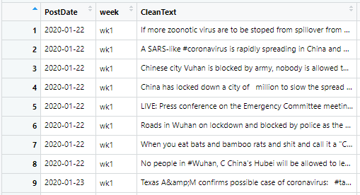
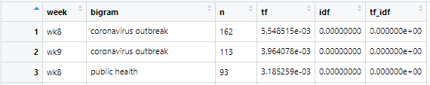
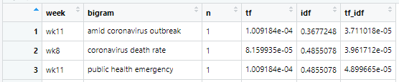
Clean-up Dataset
Datasets for Text and TF-IDF Analysis
Tokenized words with stop word removed; (top) one-word, (middle) 2-words, bigram, (bottom) 3-words, trigram

Slide 9
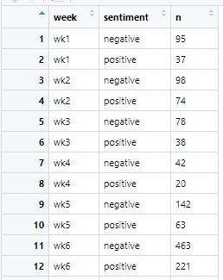
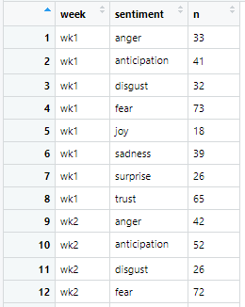
Clean-up Dataset
Datasets for Sentiment Analysis
Emotion Dataset:
8 different emotions
Polarity Dataset:
negative and positive
Word counts belong to each polarity and emotion by week

Slide 10
Model Used
Natural Language Process and N-gram
Computers can’t directly understand text like humans can. Tokenization allows computers to process texts for future analysis; words extracted as tokens. N-gram are sequence of words: bigram refers two words together and trigram refers three words together.
Sentiment Analysis
Techniques to identify and extract subjective information from a piece of text. Applying sentiment analysis helps to reveal the overall tone and mood of texts (author/writer of the texts). It uses sentiment dictionary to identify polarity (bing lexicon) and emotion (nrc lexicon)
Term Frequency- Inverse Document Frequency (TF-IDF)
TF-IDF is a statistical measure that evaluates how relevant a word is to a document in a collection of document. It is the value by multiplying two metric: how many times a word appears in a document, and the inverse document frequency of the word across a set of documents. The higher the TF-IDF score, the more relevant word is in the document.

Slide 11
Unique Tweets Count
91 days, grouped by week for analysis
Total count of 23,645 unique tweets
Three noticeable peaks:
2/29/20- First recorded death in the US
3/11/20- WHO declared Covid-19 outbreak as a pandemic
4/3/20- new face mask guideline by CDC

Slide 12
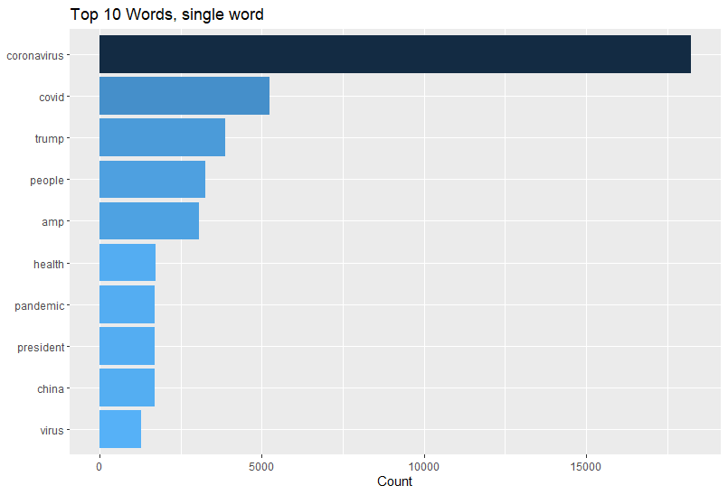
Top 10 Single Word
25,385 unique single words

Slide 13
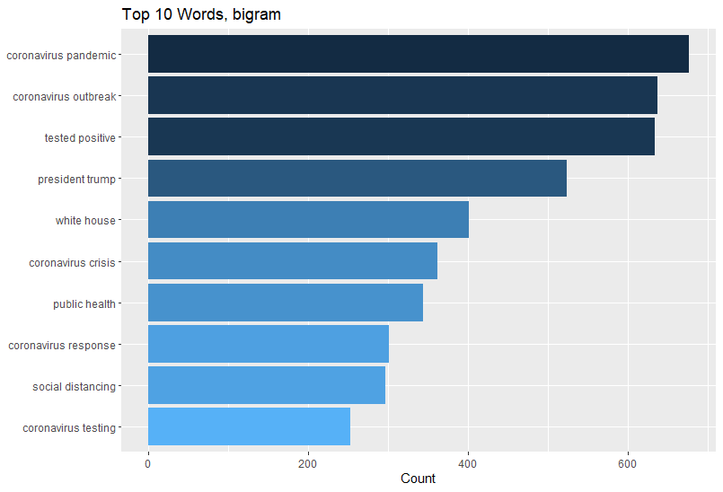
Top 10 Bigram
81,658 unique bigrams (2-words)

Slide 14
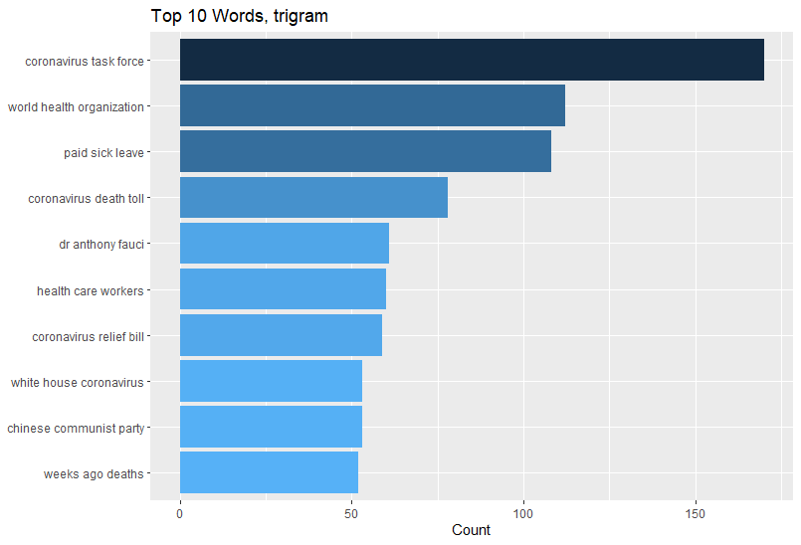
Top 10 Trigram
48,265 unique trigram (3-words)

Slide 15
Overall Sentiment

Slide 16
Polarity Change

Slide 17
Sentiment (Emotion) Change

Slide 18
Word Count and TF-IDF
 | Word Count, n | TF-IDF
coronavirus | 18248 | 0
covid | 5235 | 0.002129
trump | 3886 | 0
people | 3250 | 0
amp | 3071 | 0
health | 1726 | 0
pandemic | 1710 | 0
president | 1704 | 0.000341
china | 1690 | 0
virus | 1290 | 0
deaths | 1271 | 0
breaking | 1182 | 0
testing | 1145 | 0.001144
tested | 1138 | 0.000194
positive | 1105 | 0
spread | 1074 | 0
time | 1068 | 0.00021
americans | 1054 | 0.000243
world | 1031 | 0
crisis | 1017 | 0.00018

Slide 19
Bigram Count and TF-IDF
 | Bigram Count, n | TF-IDF
coronavirus pandemic | 677 | 0.001064503
coronavirus outbreak | 637 | 0
tested positive | 634 | 0.000252535
president trump | 524 | 0.001011901
white house | 401 | 0.001130217
coronavirus crisis | 362 | 0.000337349
public health | 344 | 0
coronavirus response | 301 | 0.000983415
social distancing | 296 | 0.001292453
coronavirus testing | 253 | 0.000867914
coronavirus covid | 242 | 0.000417896
donald trump | 242 | 0.000493204
coronavirus deaths | 232 | 0.00033279
task force | 229 | 0.000797866
weeks ago | 221 | 0.000265577
south korea | 220 | 0.000234996
death toll | 217 | 0.000255274
coronavirus patients | 204 | 0.000301583
trump administration | 203 | 0.000471776
coronavirus relief | 201 | 0.000644789

Slide 20
Trigram Count and TF-IDF
 | Trigram Count, n | TF-IDF
coronavirus task force | 170 | 0.001430605
world health organization | 112 | 0.000640086
paid sick leave | 108 | 0.001222155
coronavirus death toll | 78 | 0.001091694
dr anthony fauci | 61 | 0.000532863
health care workers | 60 | 0.000655123
coronavirus relief bill | 59 | 0.00074127
chinese communist party | 53 | 0.000729159
white house coronavirus | 53 | 0.000674459
weeks ago deaths | 52 | 0.004481799
deaths weeks ago | 48 | 0.001581681
donated million won | 43 | 0.00348356
public health emergency | 42 | 0.001743415
coronavirus test kits | 42 | 0.000657899
personal protective equipment | 41 | 0.000835572
public health crisis | 40 | 0.00033944
prime minister boris | 40 | 0.00127602
amid amid amid | 39 | 0.008313224
ago deaths weeks | 39 | 0.003363774
breaking italy reports | 39 | 0.000819555

Slide 21
Meaningful Terms based on TF-IDF
Meaningful terms found in Bigram TF-IDF:
Coronavirus pandemic
Coronavirus response
President Trump
Social distancing
Task Force
Coronavirus testing

Slide 22
Meaningful Terms based on TF-IDF
Meaningful terms found in Trigram TF-IDF:
Coronavirus task force
Paid sick leave
Coronavirus death toll
Coronavirus relief bill
Coronavirus test kits
Personal protective equipment

Slide 23
Finding Summary
Overall public mood for three months period (Jan22 to April 22) was more toward to negative sentiment. Fear was the dominant emotion public felt. Yet, public still felt trust during the outbreak. Anger and sadness were other dominant mood traits found in the tweet text data.
Fear, trust and anticipation were the public moods that increased during the first 4 weeks, started decreasing at week 5, then flattened out afterward.
Surprise was the public mood that did not fluctuate much.
Anger, disgust and sadness were the public moods that slowly but steadily increased over time
Meaningful terms were peaked at the different week; this implies that public concerns (or topic of interests) changed over time. Different peak time also indicates that specific incidents or announcement acted as contributing factors that triggered public’s interest toward the certain concerns.

Slide 24
Limitation
Although Twitter is the popular social media platform where people share their opinions as what is happening in real world at real time scale, opinions shared in Twitter may not be the perfect representation of the population. But, made an assumption that tweets collected for the project as the sample to represent the general public population.
Words can have different meaning based on contexts. Same context can be interpreted differently when, where and how we look at it.
Sentiment dictionaries that used for the project may interpret sentiment of words differently than what we think the mood of words based on current context (based on what we consider norm at the moment), so analyzed sentiment may not be the best representation. Yet, findings should be still reliable since bing and nrc sentiment dictionaries are robust and widely used for text sentiment analysis.

Slide 25
Possible Improvement
Use of commercial web sentiment api may help to improve the sentiment analysis since the library is constantly updating thru machine learning system (i.e. Amazon aws, Google, IBM Watson)
For further study, we can apply this text analysis to analyze other topic as well, also apply to text sources other than twitter. Bigger pool may give the better representation of public reaction during the outbreak. (collect public reaction not only from twitter, but also from facebook, Instagram, reddit; the social media platform people like to use)
Last, building an own customized sentiment dictionary for words relevant to Covid-19 outbreak by applying machine learning algorithm would be the next and complex level project that I can further develop as the potential future project

Slide 26
Thank you!

