Slide 1
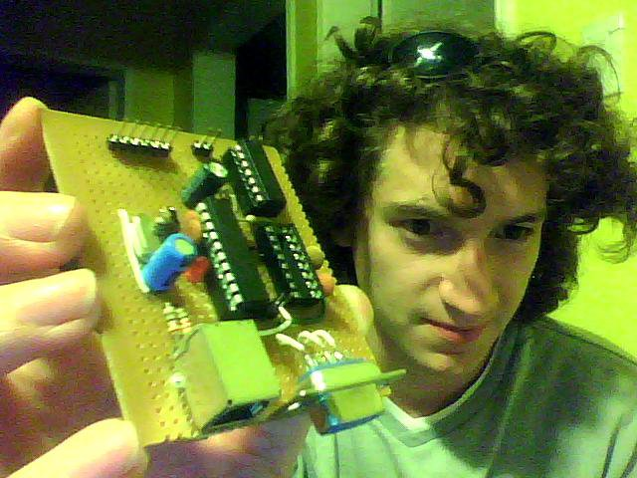




Hi, I'm
Marcos Ariel Chaparro

Slide 2

Each day I believe less in formal CVs and big grades, and more in practical skills and good team work.
Also, this resume is aimed to save you valuable time, showing everything you need to know abut me (even if you skim it!)

Slide 3

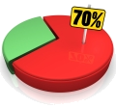

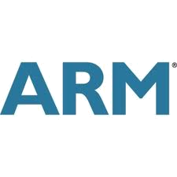
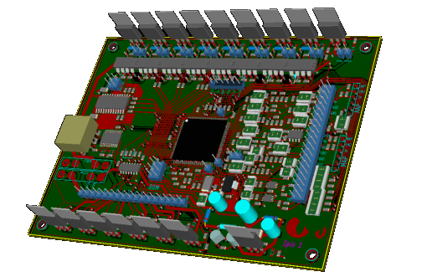
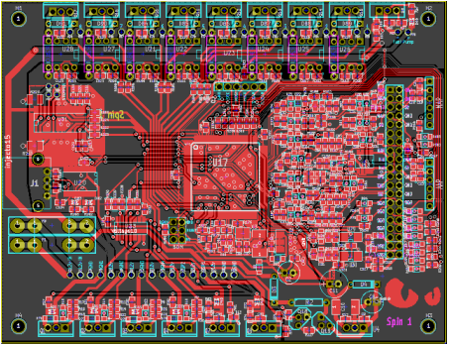

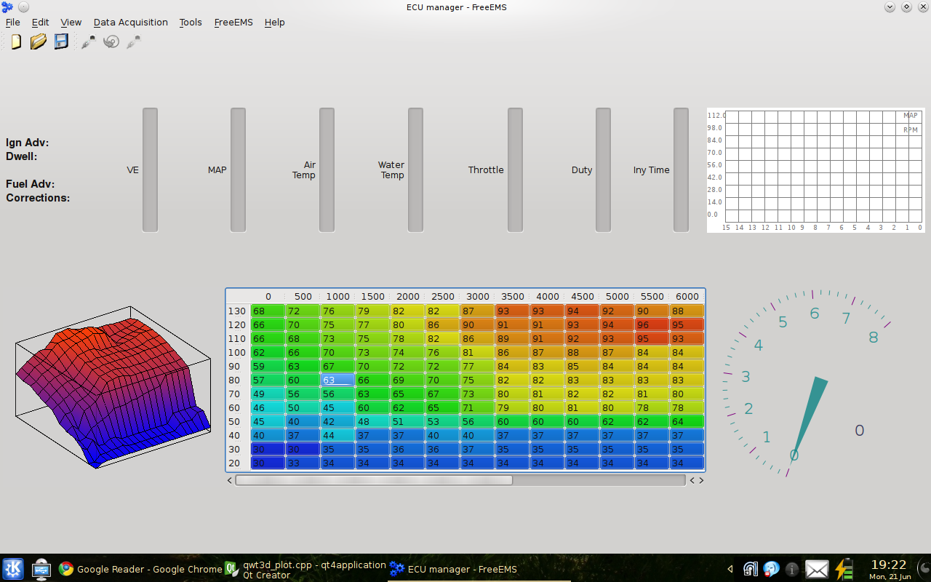
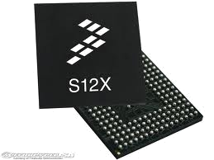

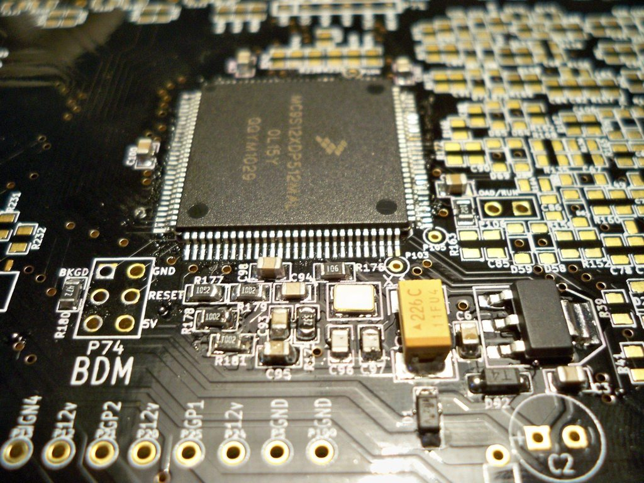
I do electronics stuff, and I'm this ( ) close to become an Electronic Engineer:
However, I've became interested in many topics, so you'll find me developing:
C++ software
Circuit design, layout and assembly
C firmware for a variety of MCUs

Slide 4


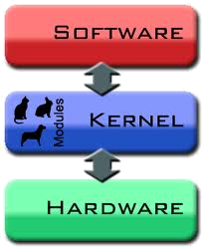
All my big projects and designs were developed under Debian GNU/Linux, ensuring a 100% free toolchain.
Created Debian-packaged software
Wrote a small piece of code, now present in the Linux source
Designed HW for use with *nixes, Mac, and Windows

Slide 5

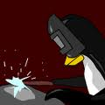



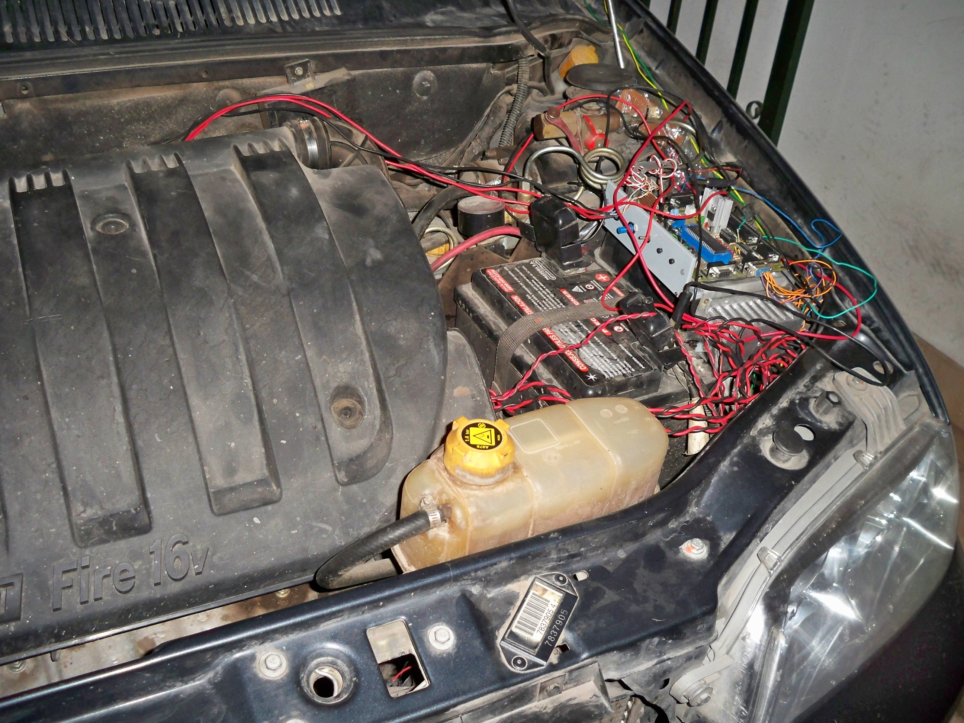
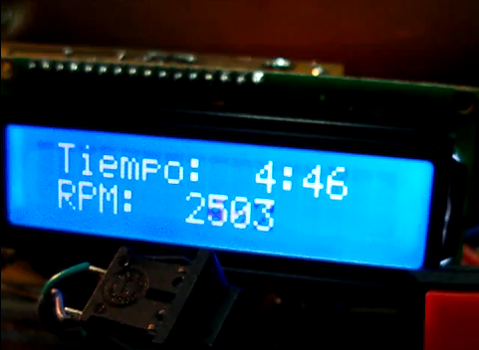
My experience in RTOS
Preempt-rt
Plus, I've a big experience developing hard real time firmware for microcontrollers
used in speed regulators and engine management systems.

Slide 7
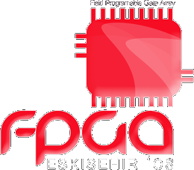

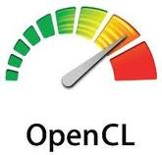
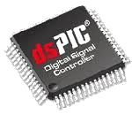


Along these years, I've tried many things

Slide 8
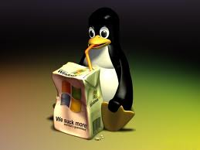
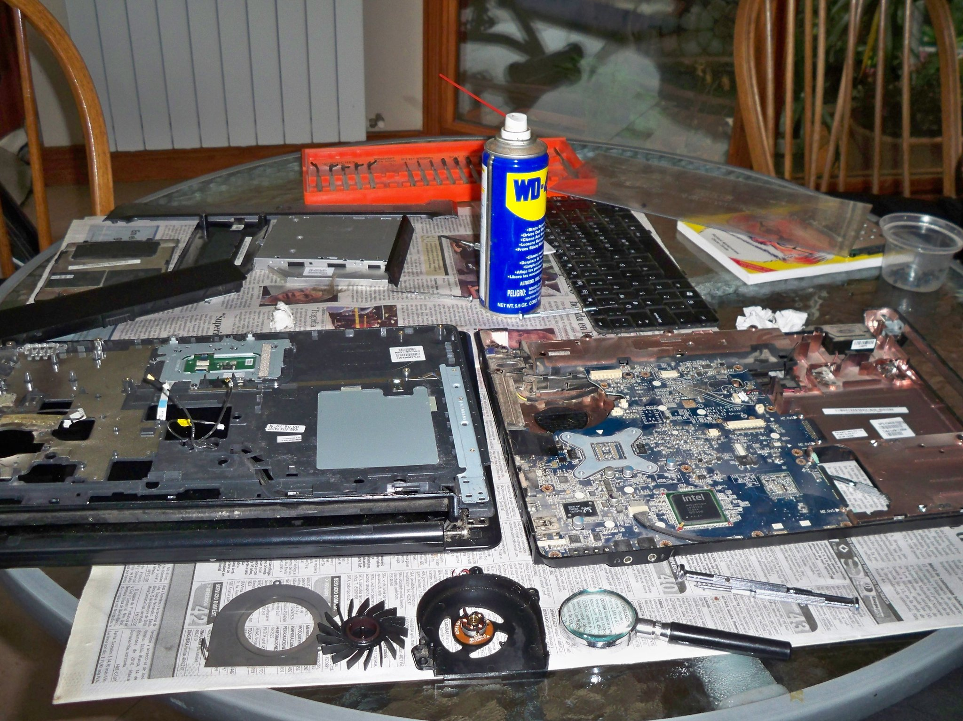
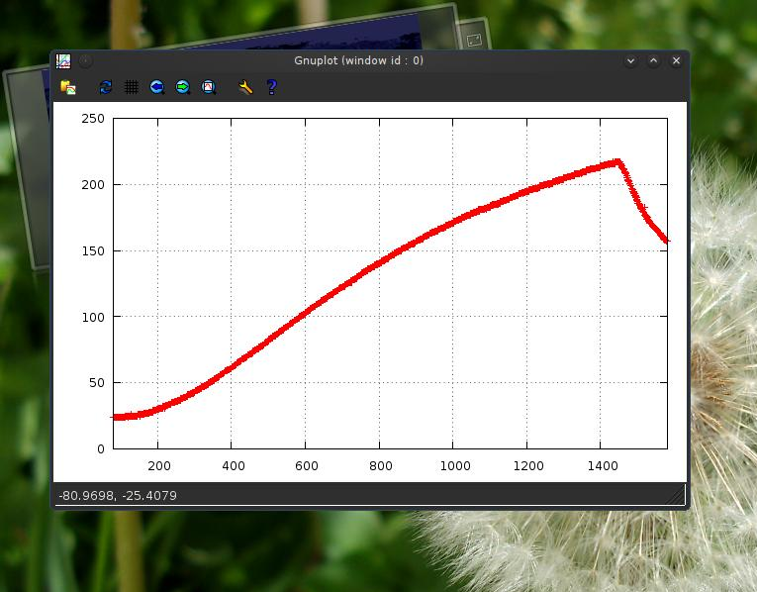
I find Windows horrid, but I know how to use it, and all my software is multiplatform
Not a big fan of creating my own tools, but this is my home made reflow oven
I don't like to repair things designed by others, but I can:

Slide 9
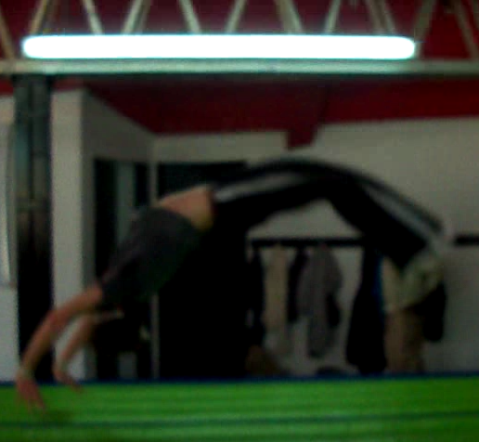
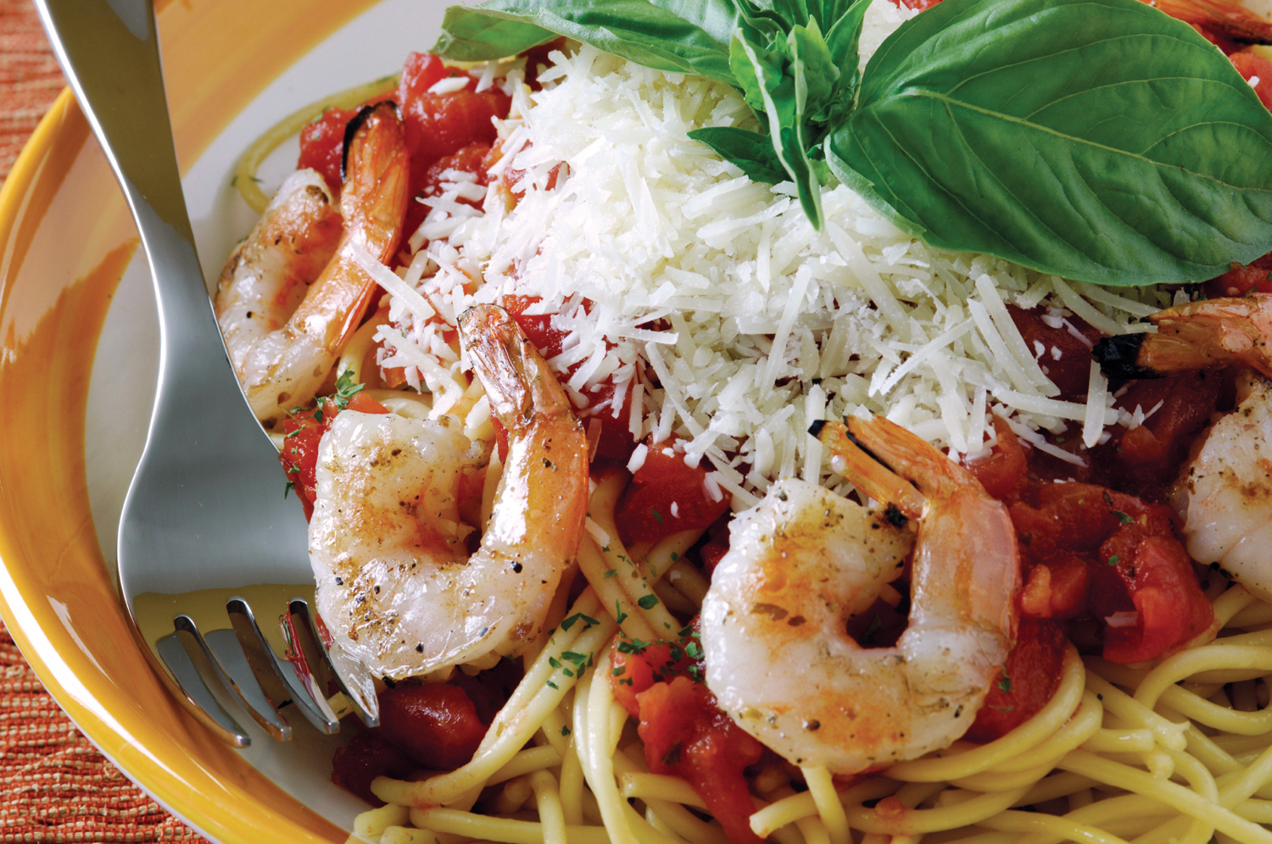
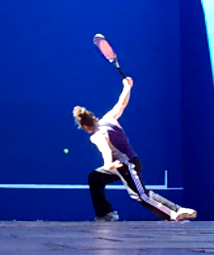
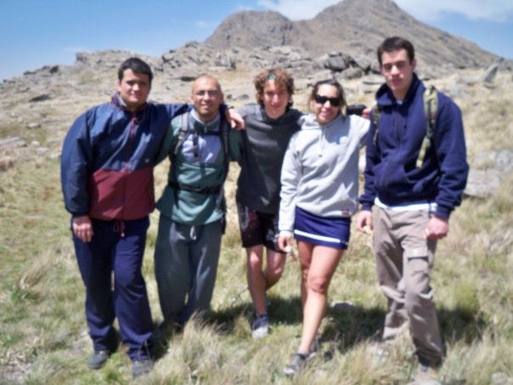
Finally, on my spare time I keep a healthy life :-)

