Slide 1








GAME DEVELOPMENT METHODOLOGIES AND TECHNOLOGIES

Slide 2


METHODOLOGIES
A methodology is the set of procedures followed during game development. It provides a structured process that helps the team work efficiently, especially on larger projects where coordination is important.

Slide 3






METHODOLOGY
CODE AND FIX
WATERFALL
ITERATIVE
AGILE

Slide 4
METHODOLOGY
A game development team starts creating a game without a design document or development plan. As new bugs and missing features appear, they stop to fix them before continuing. This cycle repeats until the project is finished.
EXAMPLE:
Little or no planning before development.
Developers begin coding right away.
Bugs and issues are fixed as they occur ("firefighting").
The process is reactive rather than proactive.
CODE AND FIX

Slide 5
METHODOLOGY
EXAMPLE:
A game development team starts creating a game without a design document or development plan. As new bugs and missing features appear, they stop to fix them before continuing. This cycle repeats until the project is finished.
CODE AND FIX

Slide 6
METHODOLOGY
DISADVANTAGES:
DISADVANTAGES:
Produces more bugs and technical issues.
Difficult to maintain and improve the game.
Can delay project completion.
May lead to a death spiral, where bugs accumulate faster than they can be fixed.
Often results in employee burnout due to long working hours ("crunch time").
Produces more bugs and technical issues.
Difficult to maintain and improve the game.
Can delay project completion.
May lead to a death spiral, where bugs accumulate faster than they can be fixed.
Often results in employee burnout due to long working hours ("crunch time").
CODE AND FIX
WHY WAS IT COMMON?
It worked for small teams and simple games in the past.
Modern game development projects are much larger and more complex, making this approach ineffective.

Slide 7
METHODOLOGY
is a development methodology where the team plans the entire game before development begins. Detailed documents are created to guide the implementation process.
HOW IT WORKS
Extensive planning is done before coding starts.
Teams prepare detailed technical documents, design documents, and art bibles.
Development follows a planned schedule with milestones and target deadlines.
Each stage is completed according to the original plan.
WATERFALL

Slide 8
METHODOLOGY
EXAMPLE
A game studio developing a sports game sequel spends several months creating the game design document, technical specifications, art guidelines, and development schedule before writing any code. The team then follows this plan throughout development.
WATERFALL

Slide 9
METHODOLOGY
ADVANTAGES
Encourages careful planning before development.
Helps identify possible challenges early.
Makes it easier to create schedules, milestones, and estimated completion dates.
Works well for sequels, expansion packs, or projects with little innovation.
DISADVANTAGES
Difficult to adapt when unexpected changes occur.
Plans can become outdated if requirements change.
Delays in technology or design can disrupt the entire schedule.
In some cases, it may eventually turn into a Code-and-Fix environment as teams rush to meet deadlines.
WATERFALL

Slide 10
METHODOLOGY
WHY IS IT NOT ALWAYS SUITABLE FOR GAME DEVELOPMENT?
Game development is often unpredictable. Changes in hardware, technology, or gameplay ideas can make the original plan ineffective, requiring the team to revise or abandon the initial schedule.
WATERFALL

Slide 11
METHODOLOGY
is a development approach where the game is built in small development cycles (iterations). After each cycle, the game is improved by adding new features and making necessary changes.
HOW IT WORKS
Development is divided into short periods (usually 1–2 months).
Each iteration has a specific set of goals.
At the end of each cycle, the game reaches a playable or stable state.
The process repeats by adding new features and improvements in the next iteration.
Each iteration often matches the publisher's milestones.
ITERATIVE

Slide 12
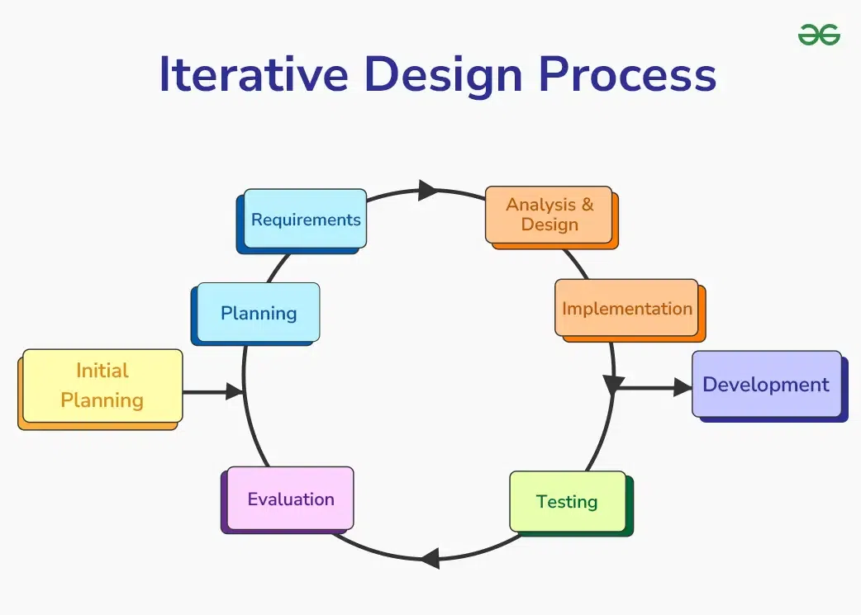
METHODOLOGY
ITERATIVE

Slide 13
METHODOLOGY
EXAMPLE
A game development team spends two months creating the basic gameplay. After testing and feedback, they begin the next iteration by adding enemies, levels, and new features while improving the existing game.
ITERATIVE

Slide 14
METHODOLOGY
ADVANTAGES
Allows planning while remaining flexible.
Encourages a proactive development process.
Makes it easier to adjust the game based on progress or feedback.
Changes can be made without restarting the entire project.
DISADVANTAGES
ITERATIVE
Requires careful management of each iteration.
Without proper planning, repeated changes may extend the development schedule.

Slide 15
METHODOLOGY
is a development approach that accepts change as a normal part of game development. Instead of planning everything in advance, teams work in short development cycles and continuously adapt based on progress and new requirements.
HOW IT WORKS
Development is divided into short iterations (usually a few weeks).
Teams plan only for the current iteration instead of the entire project.
The game is continuously improved through frequent testing and updates.
Changes can be made at any stage of development.
AGILE

Slide 16
METHODOLOGY
EXAMPLE
A game development team plans features for the next three weeks. During development, a competing game introduces a popular feature. Instead of waiting until the next project, the team adjusts its plans and adds a similar feature in the next iteration.
AGILE

Slide 17
METHODOLOGY
ADVANTAGES
Easily adapts to changing requirements.
Encourages continuous improvement.
Keeps the team aware of project progress and priorities.
Flexible when unexpected events occur, such as new technology or changes in the team.
Well-suited for the unpredictable nature of game development.
DISADVANTAGES
AGILE
Some publishers or stakeholders may find it difficult to accept because planning is less rigid.
Requires a flexible mindset from the entire team.
Long-term schedules and milestone dates are less predictable.

Slide 18
GAME DEVELOPMENT LIFE CYCLE (GDLC)

Slide 19
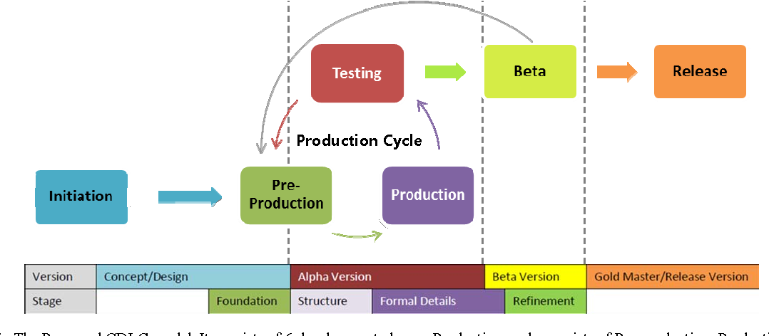

Slide 20

GAME DEVELOPMENT LIFE CYCLE (GDLC)
INITIATION
The first step in game development is creating a game concept. The output is a basic game concept and a brief game description.

Slide 21
GAME DEVELOPMENT LIFE CYCLE (GDLC)
TYPES OF PROTOTYPES
PRE-PRODUCTION
Foundation Prototype – Demonstrates the core gameplay and overall game concept. It is evaluated for its fun factor through discussions or questionnaires.
Structure Prototype – Expands the foundation by including core mechanics, game rules, and functionality. It is evaluated through playtesting and user feedback.
is the phase where the game is planned, designed, and tested before full development begins.
KEY ACTIVITIES
OUTPUT
Create and refine the Game Design Document (GDD).
Define the game's genre, gameplay, mechanics, storyline, characters, challenges, and technical requirements.
Develop prototypes to evaluate and improve the game design.
The phase ends when the game design is finalized, approved, and documented in the Game Design Document (GDD).

Slide 22
GAME DEVELOPMENT LIFE CYCLE (GDLC)
TYPES OF PROTOTYPES
PRODUCTION
Formal Details – A more complete version of the game with refined mechanics and assets. It focuses on game balance, functionality, and performance.
Refinement – The final prototype where the game is polished by improving gameplay, challenge, accessibility, and overall player experience. Only minor changes are made during this stage.
is the main development phase where the game is built by creating assets, writing source code, and integrating all game components.
KEY ACTIVITIES
OUTPUT
Create game assets (graphics, audio, animations, etc.).
Develop and integrate source code.
Balance gameplay to ensure appropriate difficulty.
Add new features and improve game performance.
Test and fix bugs.
The phase ends with a fully functional and polished game that is ready for final testing and release.

Slide 23
GAME DEVELOPMENT LIFE CYCLE (GDLC)
TYPES OF PROTOTYPES
TESTING
Formal Details Testing – Focuses on functionality, game balance, and identifying bugs through playtesting.
Refinement Testing – Focuses on the game's fun factor and accessibility by observing players and collecting feedback.
is the phase where the game is evaluated internally to ensure it is functional, balanced, enjoyable, and easy to use before release.
KEY ACTIVITIES
OUTPUT
Conduct playtesting to evaluate gameplay and usability.
Test game features and functionality.
Identify, document, and fix bugs, errors, and gameplay issues.
Evaluate game balance, fun, and accessibility.
Gather feedback from testers and developers.
The phase produces bug reports, change requests, and development decisions, which determine whether the game is ready for the Beta phase or requires another production cycle.

Slide 24
GAME DEVELOPMENT LIFE CYCLE (GDLC)
TYPES OF PROTOTYPES
BETA TESTING
Closed Beta – Only invited participants are allowed to test the game.
Open Beta – Anyone who registers can participate in the testing.
is the phase where the game is tested by external testers to identify remaining issues and gather user feedback before release.
KEY ACTIVITIES
OUTPUT
Conduct beta testing with external users.
Identify and report bugs and errors.
Collect player feedback on gameplay and user experience.
Evaluate the game's functionality, fun, and accessibility.
The phase produces bug reports and user feedback, which determine whether the game returns to the Production phase for further improvements or proceeds to the Release phase.

Slide 25
GAME DEVELOPMENT LIFE CYCLE (GDLC)
RELEASE
It is time when the game build has reach final stage and ready to be released to public. Release involves product launching, project documentation, knowledge sharing, post-mortems, and planning for maintenance and game expansion.

Slide 26
INTRODUCTION TO 2D GAME DEVELOPMENT

Slide 27
WHAT IS 2D GAME?
is a game that uses a two-dimensional coordinate system to represent gameplay and visuals. It typically involves sprites, which are two-dimensional images that can be moved and animated on a flat plane. Some examples of 2D games include platformers, side-scrolling shooters, and puzzle games.
EXAMPLES:
Super Mario Bros
Tetris
Plants vs. Zombies

Slide 28
KEY COMPONENTS: 2D GAME DEVELOPMENT
DESIGN OF SPRITES, BACKGROUNDS, AND ANIMATIONS. THIS COMPRISES SPRITE SHEETS, VECTOR ART, AND PIXEL ART.
GRAPHICS AND ART
SOFTWARE TOOLS THAT OFFER THE FRAMEWORK FOR GAME DEVELOPMENT, SUCH AS UNITY, UNREAL ENGINE, AND GAMEMAKER.
GAME ENGINES
CREATING STAGES OR LEVELS THAT CHALLENGE THE PLAYER BY INCLUDING OBSTACLES, OPPONENTS, COLLECTIBLES, AND PUZZLES.
LEVEL DESIGN

Slide 29
KEY COMPONENTS: 2D GAME DEVELOPMENT
CREATING AUDIO FEATURES SUCH AS BACKGROUND MUSIC, SOUND EFFECTS, AND VOICE ACTING TO IMPROVE THE PLAYER EXPERIENCE.
SOUND DESIGN
SCRIPTING IS THE PROCESS OF WRITING CODE THAT REGULATES GAME LOGIC, SUCH AS CHARACTER BEHAVIOR, ENEMY AL, SCORING, AND USER INTERFACE ELEMENTS.
SCRIPTING

Slide 30
PROS AND CONS OF 2D GAME DEVELOPMENT
PROS
CONS
Limited Depth and Realism: While some 2D games have stunning art styles, they inherently lack the depth and perceived realism of 3D graphics.
Complexity in Animation: Smooth animation in 2D often requires a lot of artwork. Each animation frame might need hand-drawn, especially for complex movements or multi-directional characters.
Accessibility: Simpler controls make 2D games more approachable for casual gamers.
Cost-effective: Development is typically faster and less expensive.
Simplicity: Quick, engaging gameplay experiences like hyper-casual mobile games are ideal

Slide 31
INTRODUCTION TO 3D GAME DEVELOPMENT

Slide 32
WHAT IS 3D GAME?
3D gaming refers to interactive computer entertainment games with characteristics of three-dimensional graphics: height, width, and depth. 3D gaming is believed to create immersive experience in a virtual worlds with realistic representations.
EXAMPLES:
Minecraft
Grand Theft Auto V
Cyberpunk 2077
The Witcher 3: Wild Hunt.

Slide 33
WHAT IS 3D GAME DEVELOPMENT?
is the process of creating video games where objects, characters, and environments exist in a three-dimensional space using length, width, and depth (the X, Y, and Z axes). It requires a blend of programming, 3D modeling, animation, and sound design to build immersive worlds.
KEY COMPONENTS: 3D GAME DEVELOPMENT
Game Engine
3D Assets (meshes, rigs, textures)
Physics/Collisions
Gameplay Mechanics
Lighting & Audio
User Interface (UI/UX)

Slide 34
PROS AND CONS OF 2D GAME DEVELOPMENT
PROS
CONS
Immersion: Offers a more realistic and engaging player experience.
Visual Quality: Can achieve stunning, high-definition graphics.
Versatility: Suitable for various genres and gameplay styles.
Increased Development Time and Cost: 3D games require more complex asset creation (modeling, texturing) and processing power. This translates to longer development times and potentially higher costs, especially for smaller teams.

Slide 35
GAME DEVELOPMENT TOOLS
Unity: A versatile engine supporting both 2D and 3D development.
Unreal Engine: Powerful for creating high-quality 3D games.
GameMaker Studio 2: Excellent for 2D game creation.
Godot: An open-source engine supporting both 2D and 3D development.
These tools cater to different skill levels and project requirements, from indie developers to large studios.
Programming Languages: C#, C++, GDScript, Lua

Slide 36
GAME OVER
THANK YOU

