Slide 1
IAP Use Cases
By,
Nitin Shetty

Slide 2
Language Translation: Translates text between languages.
Sentiment Analysis: Detects sentiment from text or document.
Image Classification: Identify food or beverage items from an uploaded image.
Agentic Product Search :Allows users to search or purchase sports products.
Use case Description

Slide 3
Services/Tools Used
Backend:
FastAPI
SQLite
HugginFace Transformer
EasyOCR,PyMuPDF,OpenCV,Groq
PDF,DOCX parsing:PyPDF2,python-docx,fitz

Slide 4
Sentiment Analysis - Flow
Input:
Text or File(PDF,DOCX,TXT)
Processing:
If file, extract and clean text
Check DB for Sentiment Label
If match found:
Calculate percentage for label
If no match:
Use Groq fallback
Output:
Summary sentiment + % breakdown

Slide 5
Sentiment Analysis –Input/Output Examples
Input Example 1:
Text: “Service was too slow”
Output:
"summary": "Negative",
“positive”:0
"Negative": 100
“Neutral”: 0
Input Example 2:
Text: “I am happy today ”
Output:
"summary": "Positive",
"positive": 100
“Negative”:0
“Neutral”:0

Slide 6
Language Translation - Flow
Input:
Input & Output language
Text or file(PDF,DOCX,TXT with OCR for images)
Processing:
Extract text(OCR if needed)
Search DB(LanguageTranslation table)
If DB match:
Return stored translation
If no match:
Use HuggingFaceHelsinki-NLP/opus-mt-{input}-{output}model
Output:
Translated text
Download as .docx or .txt

Slide 7
Language Translation - Input/Output Examples
Input Example 1:
Text: “hello”
Input Language: english
Output Language: hindi
Translated Output : "नमस्ते”
Input Example 2:
Text: how are you?
Input Language: en
Output Language: de
Translated Output : "Wie geht es dir?"

Slide 8
Image Classification-Flow
Input:
Uploaded image file(.jpg or .png)
Process flow:
Read and decode the uploaded image.
Extract text using EasyOCR.
Tokenize OCR text and search for product match in database.
If no match found:
Groq is used to search for product .
Output:
Return product names with their categories.

Slide 9
Image Classification- Input/Output Example
Input Example 1:
image_name: red.jpg
Output :
[
{
"product_name": "Red Bull",
"category": "beverage“
}
]
Input Example 2:
image_name: mutli.png
Output :
[
{
"product_name": "apple",
"category": "food"
},
{
"product_name": "broccote",
"category": "food"
}
]

Slide 10
Agentic Product search- Flow
Input:
“action”: ”search”,
“query”: “ I want a sports shoes”
Process Flow:
Extract keyword/noun phrases using TextBlob.
Search local database for product name.
If no match found:
Generate suggestion using Groq based on prompt.
For action “purchase”:
Validate product ID .
Return purchase success message.
Output:
Return the product along with 2-3 suggestions based on the search.
If a purchase action is performed, validate the ID and generate a success message.

Slide 11
Agentic Product search- Input/Output Example
Input Example 1:
{
"query": "running shoes",
"action": "search",
"product_id": 0
}
Output :
{
"message": "Based on your query: 'running shoes', here are some product suggestions:",
"products": [
{
"id": 2,
"name": "Running Shoes",
"category": "Footwear",
"price": "$80",
"in_stock": 20
}
],
"purchased": false
}

Slide 12
Agentic Product search- Input/Output Example
Input Example 2:
{
"query": "running shoes",
"action": “purchase",
"product_id": 2
}
Output :
{
"message": "Successfully purchased: Running Shoes",
"products": [],
"purchased": true
}

Slide 13
Challenges Faced & Solutions
Challenges | solutions
Fallback logic | Used conditional logic: try DB, Fallback to transformers
Ensuring input validation | Used checks to allow only one of text or file
Making the result downloadable | Used FastAPI’S FileResponse + tempfile
Role/License access for endpoints | Used decorator-based access control
No exact match found in local db | Used Groq to suggest products dynamically
Handling mixed file type with OCR | Used EasyOCR + PyMuPDF + OpenCV to extract embedded text

Slide 14
Key Learnings
Understood importance of fallback logic using Groq.
Learned how to extract text from DOCX,PDF and OCR images.
Realized how to securely restrict API routes.
Gained hands-on with FileResponse, Plaintext Response and Form/File.
Combining OCR, Groq.
Integrating Groq.

Slide 15
Dockerized FastAPI with SQLite Integration
Overview
FastAPI backend is containerized using Docker.
Integrated SQLite as the local database.
Verified DB functionality inside the Docker container.
How It Works
Base Image: python:3.12-slim
Database URL: sqlite:///./app.db
SQLite DB file is created inside /app directory in the container.
ORM: SQLAlchemy used for database operations.
Validation Performed
Performed Signup and Login API calls using Postman.
User data (username, password hash) stored successfully in SQLite.
Retrieved stored data during login → Confirmed read/write working.
DB file (app.db) created and accessed inside Docker.
Conclusion
Successfully integrated and tested SQLite in a Dockerized FastAPI app.
Database works fully inside the isolated Docker environment.

Slide 16
API Testing with Postman — FastAPI Authentication & AI Usecases
User Signup
Used POST /signup endpoint to register new users
Collected required fields: email, password, role, and license
Validated request body using Pydantic schema (UserCreate)
Password hashed securely using bcrypt before saving
Used SQLAlchemy ORM to insert the user into the database
Committed data using db.add() and db.commit()
Configured database using .env (sqlite:///./test.db)
Tested the endpoint using Postman with raw JSON
Verified successful creation with 200 OK
Confirmed user persisted in the database

Slide 17
API Testing with Postman — FastAPI Authentication & AI Usecases
User Login & Token Handling
Used POST /login endpoint with username and password
Implemented OAuth2 Password Flow in FastAPI
Response returns access_token and token_type
Used token in Bearer Authorization for protected usecases
Stored token dynamically in Postman using pm.environment.set()
Verified login success and failure scenarios
Used test scripts to assert status and token presence

Slide 18
API Testing with Postman — FastAPI Authentication & AI Usecases
Forgot Password Request
Used POST /forgot-password endpoint
Accepts only user email in JSON body
Validates email format using Pydantic
Used Postman to test valid and invalid emails
Verified response and handling of missing email

Slide 19
API Testing with Postman — FastAPI Authentication & AI Usecases
Reset Password Flow
Used POST /reset-password endpoint
Requires: email, token, and new_password
Validates token and updates password in database
Password re-hashed before saving
Tested flow via Postman using JSON
Checked both success and invalid/expired token cases

Slide 20
API Testing with Postman — FastAPI Authentication & AI Usecases
Sentiment Analysis Usecase
Endpoint: POST /usecase/sentiment-analysis
Input via form-data: text OR file
Returns sentiment summary and confidence scores
Powered by GROQ API (LLM)
Token-protected route (Bearer token required)
Tested in Postman with both text and file inputs
Verified model output and response format

Slide 21
API Testing with Postman — FastAPI Authentication & AI Usecases
Language Translation Usecase
Endpoint: POST /usecase/language-translation
Input via form-data: text_input, input_lang, output_lang, or file
Can return translated text or downloadable file
Uses the HuggingFace Transformers pipeline for translation
Requires access token in Authorization header
Tested in Postman with multiple language pairs
Verified form handling and correct output file type

Slide 22
API Testing with Postman — FastAPI Authentication & AI Usecases
Image Classification Usecase
Endpoint: POST /usecase/image-classification
Input: Image file (via multipart/form-data)
Returns product name and category
Model used via GROQ Vision API
Protected route — tested with token in Postman
Validated image uploads and multi-label classification
Verified correct predictions for food/beverage images

Slide 23
API Testing with Postman — FastAPI Authentication & AI Usecases
Agentic Product Search Usecase
Endpoint: POST /usecase/agentic-product-search
Input: query, action, and product_id
Returns response message and a list of matching products
Implements an agentic search workflow using LLMs (via GROQ)
Protected route — token required
Tested with different queries via Postman JSON body
Verified multiple result outputs and dynamic product suggestions

Slide 24
API Testing with Postman — FastAPI Authentication & AI Usecases
Postman Test Scripts & Validation
Used the “Tests” tab in postman to write test scripts for each request
Wrote JavaScript-based assertions using pm.test() and pm.expect()
Validation response status code(e.g. 200 ok)
Checked for expected fields like access_token, message, summary, etc.
Used console.log()for debugging and viewed logs in Postman Console
Ensured automated and consistent response validation
Enabled repeatable, reliable and scripts driven testing across all APIs

Slide 25
FRONTEND

Slide 26
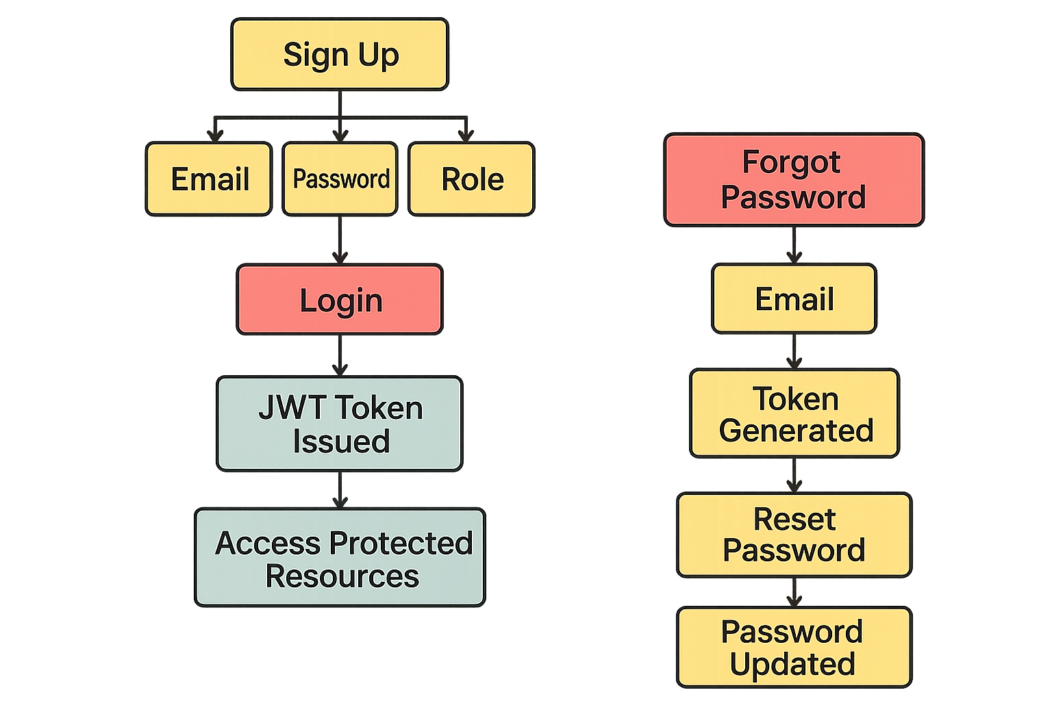

Slide 27
Login
Purpose:
Allows users to log in using email and password to access protected routes.
Required Input:
Email
Password
Backend Route:
POST /login
Auth Response:
Returns access_token (JWT)
Token is used for authenticated API requests

Slide 28
Signup
Purpose:
Registers a new user with name, email, password, and role.
Required Input:
Email
Password
Role (user/admin, etc.)
Backend Route:
POST /signup

Slide 29
Forgot Password
Purpose:
Generate an access token using registered email.
Required Input:
Email
Backend Route:
POST /forgot-password

Slide 30
Reset Password
Purpose:
Allows user to reset their password using the token sent by email.
Required Input:
Email
Token
New Password
Backend Route:
POST /reset-password

Slide 31
Image Classification
Context:
A wholesale food company wants to auto-classify product images into categories like Food, Beverage, or both, and also identify the product name if possible.
Step-by-Step Workflow:
Upload image (.jpg, .png)
System analyzes the image
System returns:
Product name (if applicable)
Category: Food / Beverage
Input Type(s):
Image file: .jpg, .png
Output Type(s):
Product name (string)
Category label(s): Food / Beverage

Slide 32
Language Translation
Context:
A multinational company needs to translate documents (containing both text and images) into multiple languages for operations across different regions.
Step-by-Step Workflow:
Select input language
Select target (output) language
Upload document or enter text
System translates the content
User views the translated output
Option to download translated document
Input Type(s):
Text input
File upload: .pdf, .doc
Output Type(s):
Translated text
Downloadable file (optional)

Slide 33
Agentic Product Search
Context:
A sports accessories company wants to allow users to search for products via a conversational interface. Users can describe what they need, and the system will recommend relevant products and allow purchasing through an agentic flow.
Step-by-Step Workflow:
User interacts via a chatbot-style interface
User describes needs (e.g., “Socks for marathon training”)
System interprets input and recommends products
User receives tailored product suggestions
Optionally, user proceeds to purchase via agent flow
Input Type(s):
Text input via chat interface
Output Type(s):
Product recommendations
Agentic purchase flow (optional)

Slide 34
Sentiment Analysis
Context:
A client has a large volume of help desk data. They want to analyze user feedback to understand the general sentiment (Positive, Negative, Neutral), along with sentiment breakdowns by feedback categories and percentages.
Step-by-Step Workflow:
Upload document (PDF, DOC) or enter text directly
System processes the data
Display:
Individual feedback sentiment
Overall sentiment summary
Category-wise sentiment breakdown
Sentiment percentages
Input Type(s):
Text input
File upload: .pdf, .doc
Output Type(s):
Sentiment label (Positive/Negative/Neutral)
Percentage breakdown
Summary of results

Slide 35
Thank you

