Slide 1
Flutter App with Back4App Integration
Nitin Ubale
2022mt93638

Slide 2
Create a flutter app that connects to Back4App, a Backend-as-a-service (BAAS) platform to manage tasks

Slide 3
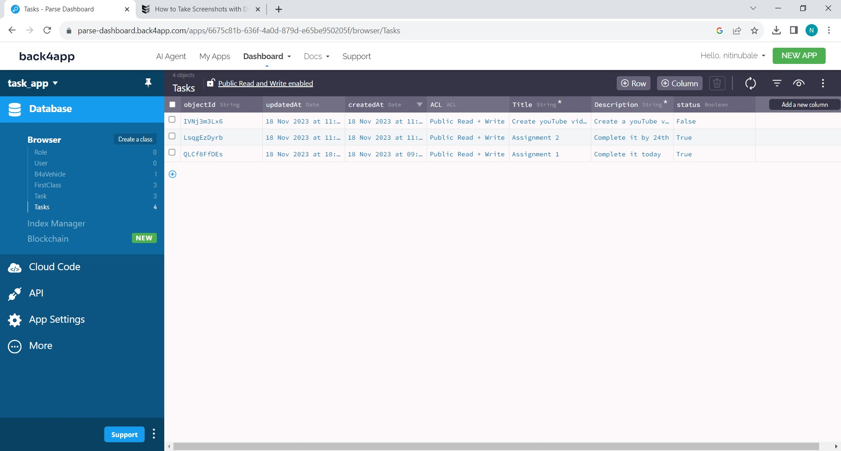
Step 1 - Setup Back4App
Sign up for a Back4App account
Create a class names Tasks with columns
Title
Description
Status

Slide 4
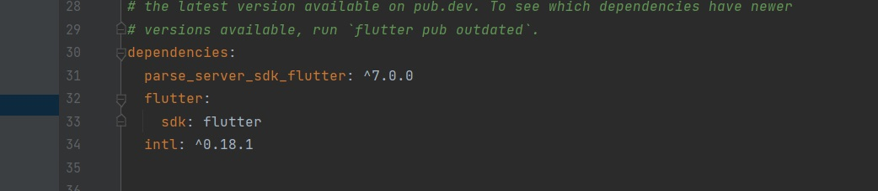
Step 2 – Flutter setup
Create a new flutter project - cpad_assignmnt_task_app
Add required dependencies to the pubspec.yaml.file

Slide 5
Application Details
The tasks application is made of 3 pages
Home Page
Task Detail page
Create new task page
Tasks are saved in Back4App and are fetched from the same

Slide 6
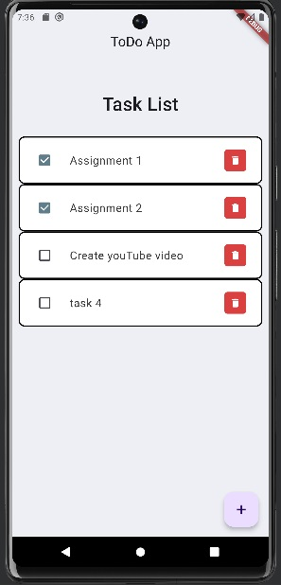
Home Page
Home Page consists of
List of tasks
checkboxes on each task to check when complete
Every task has a delete button to delete any tasks from the database
Add button at the bottom which takes us to the “Create New Task” page to add new tasks

Slide 7
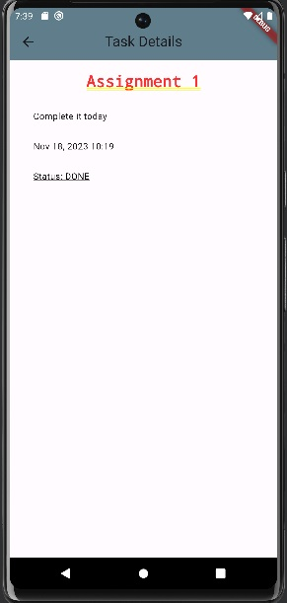
Tasks DetailPage
On clicking on any individual task, we are directed to the details page which includes
Title
Detailed description
creation date
status of the task

Slide 8
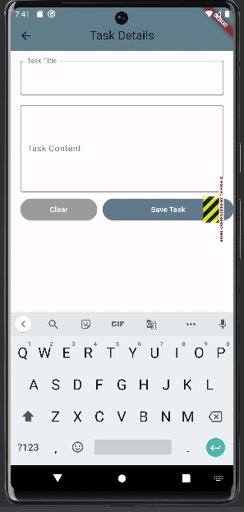
Create New task Page
On this page, User can add
Task Title
Task Content (Description)
User can save the task to database by hitting the ‘Save Task’ button. By default, the status is false

Slide 9
DEMO

Slide 10
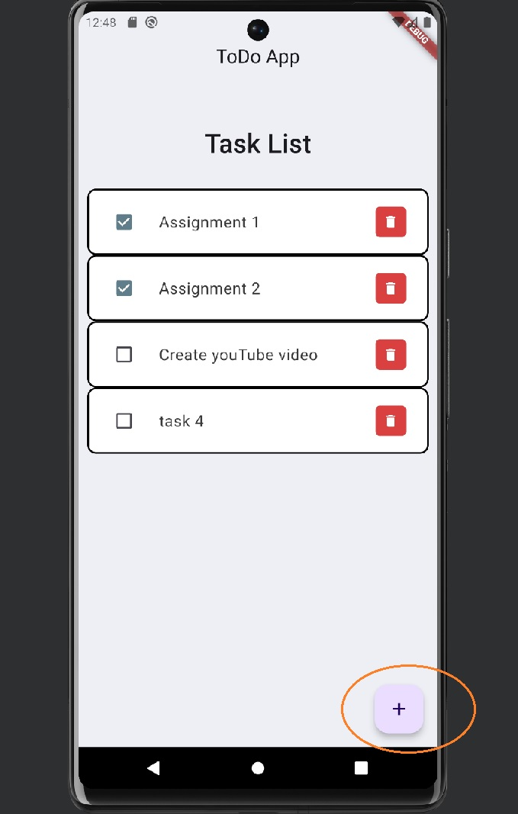
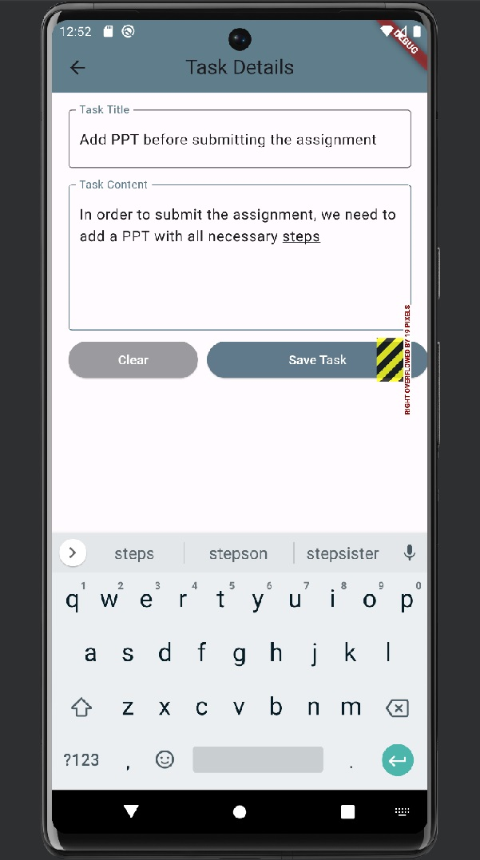
Step 1 – Create new Task
On home page, hit the Add new task button
User is navigated to the create new task page
Add title and content in their appropriate boxes and hit Save task button.

Slide 11
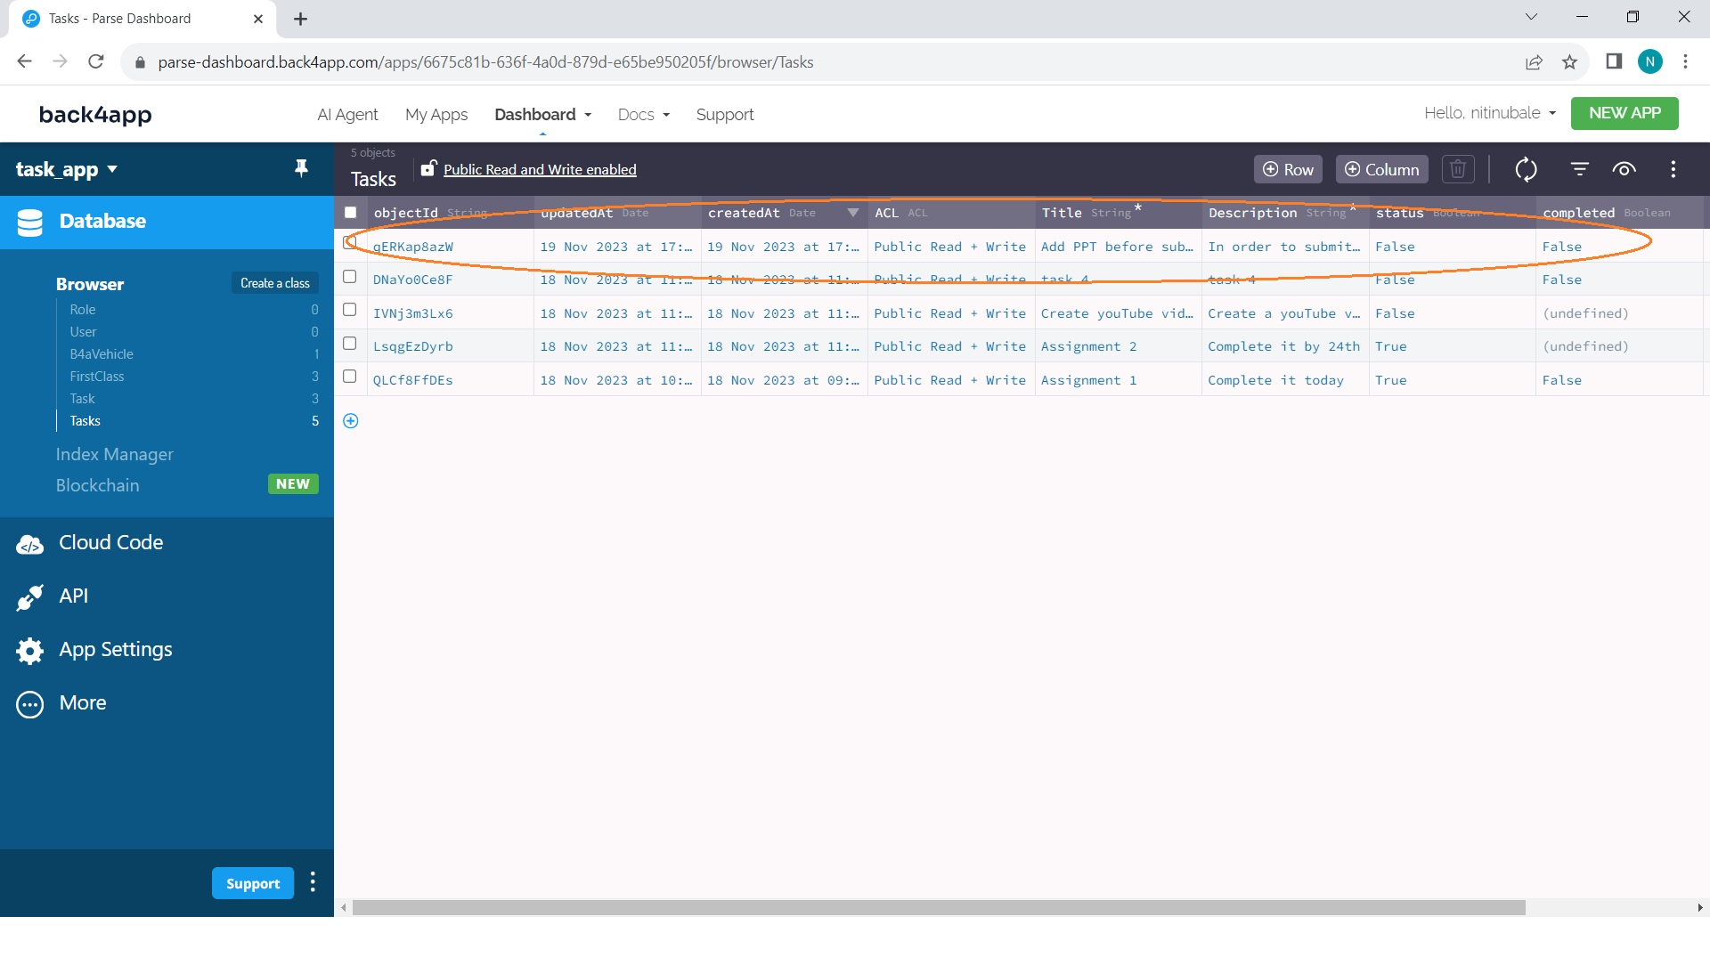
Task gets saved to back4app database

Slide 12
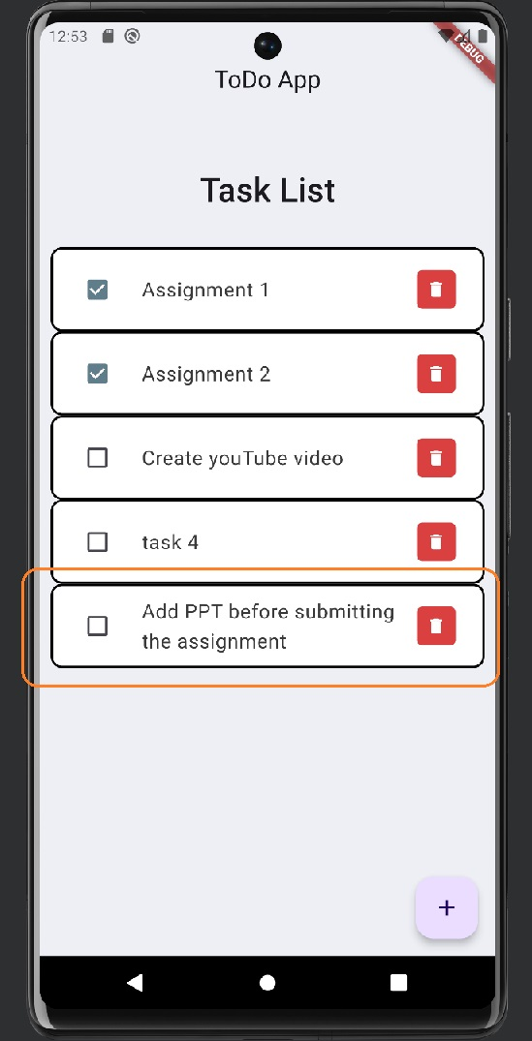
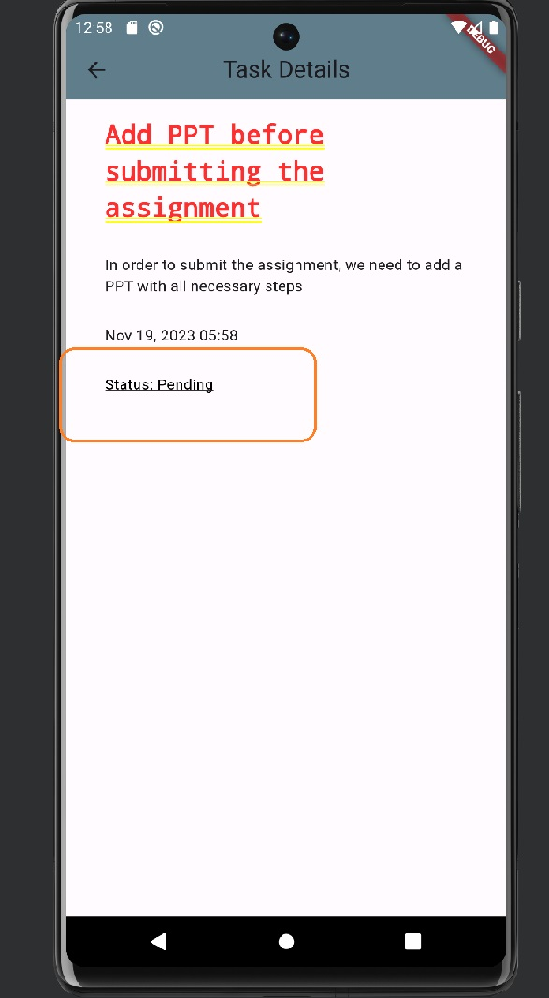
Home page gets refreshed, and the new task is added to the page
The checkbox is unchecked by default
On hitting the task, user is navigated to the details page
Status is in Pending state

Slide 13
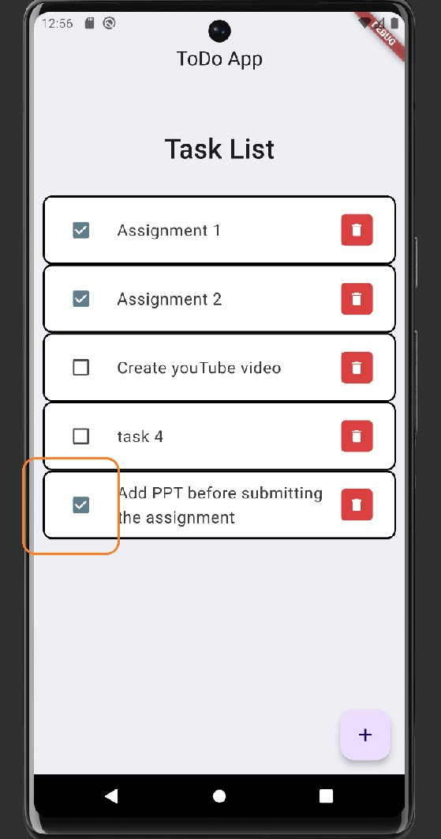
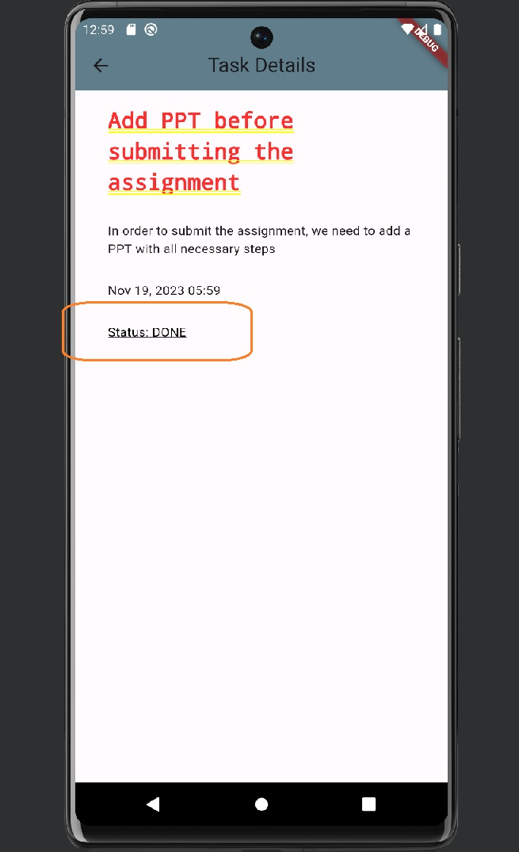
Check box is checked after completing the task
On the details page the status is changed to Done

Slide 14
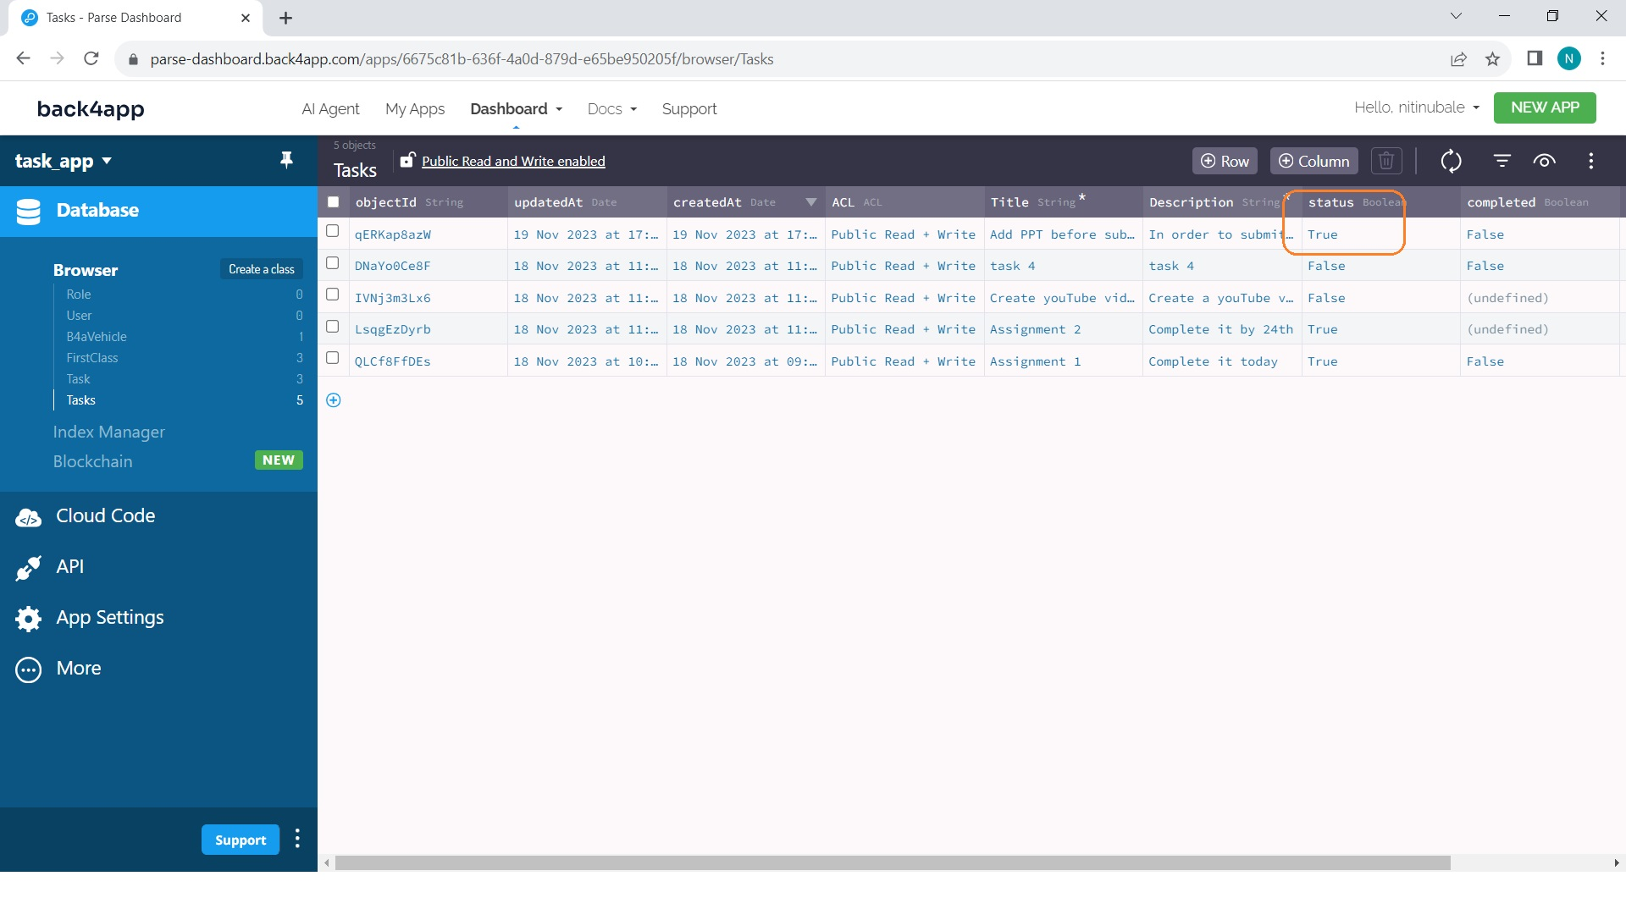
Status in database also changes to true

Slide 15
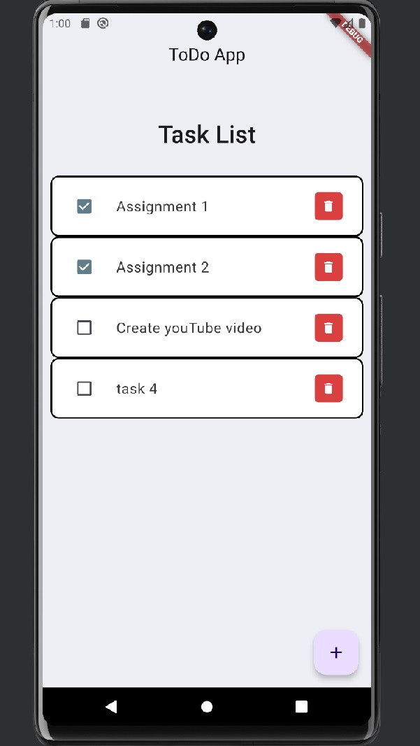
On completion, hit the delete button
Task gets removed from the home page

Slide 16

Task gets removed from database

Slide 17
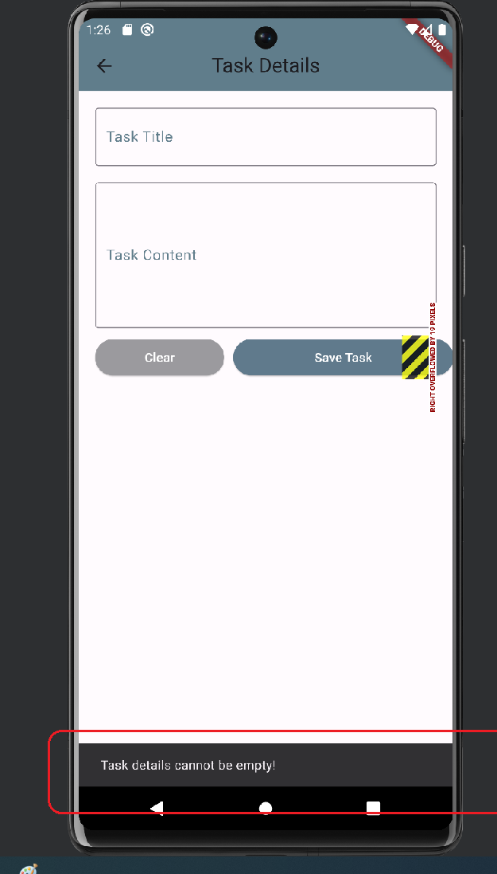
Bonus features
Clear button on the task detail page to clear contents and start fresh
Exception handling on the tasks detail page when Save button is clicked without entering any task details

Slide 18

Thank you

