Slide 1


SIMATS ENGINEERING SAVEETHA INSTITUTE OF MEDICAL AND TECHNICAL SCIENCES
TITLE : Number of Valid Move Combinations On Chessboard
NAME : NITTA PAVAN KALYAN KURMA
REG.NO : 192210109
BRANCH : CSE
GUIDE BY: Dr.K.V.Kanimozi
Professor/CSE
SSE, SIMATS

Slide 2
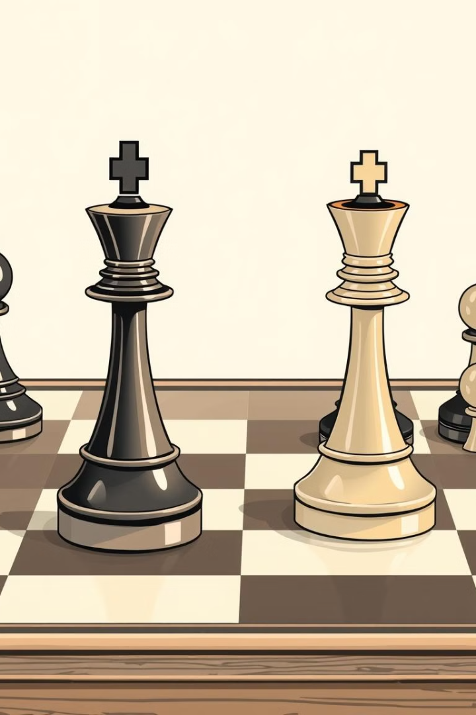
The N-Queens Problem: A Classic Puzzle
The N-Queens problem is a classic puzzle in computer science that challenges us to place N chess queens on an N x N chessboard so that no two queens threaten each other. This means no two queens can share the same row, column, or diagonal.

Slide 3

Understanding the N-Queens Algorithm
The N-Queens algorithm uses a systematic approach to find all possible solutions to the puzzle. It involves exploring different placements of queens on the board, backtracking when a conflict arises, and ultimately finding all valid configurations.
1
Recursive Backtracking
2
Conflict Detection
3
Solution Tracking
The algorithm uses a recursive backtracking approach, where it systematically explores all possible placements for queens.
At each step, the algorithm checks for conflicts with previously placed queens on the same row, column, or diagonal.
The algorithm keeps track of all valid configurations of queens, allowing us to find all possible solutions to the N-Queens problem.

Slide 4



Visualizing the Chessboard
The chessboard is a fundamental element of the N-Queens problem. It serves as the canvas for placing the queens and testing their positions against the rules of the game. Each square represents a potential location for a queen.
Initial State
Placement and Conflict
Valid Configuration
The initial state of the chessboard represents the starting point of the algorithm, with no queens placed on the board.
As the algorithm progresses, queens are placed on the chessboard, with each placement evaluated for conflicts with other queens.
When all queens are placed on the board without conflicts, a valid configuration is achieved, indicating a successful solution to the N-Queens problem.

Slide 5
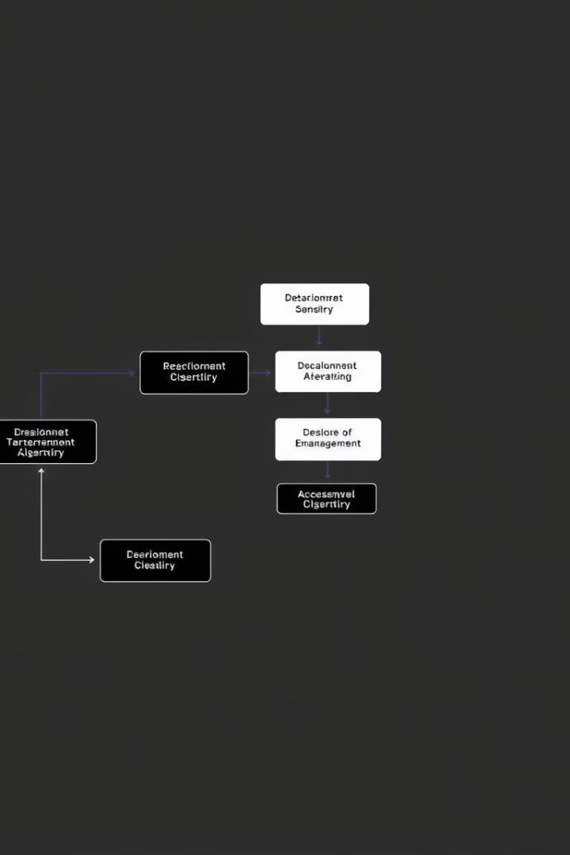




Backtracking: The Core Strategy
Backtracking is a crucial part of the N-Queens algorithm. It allows the algorithm to systematically explore all possible placements for queens, checking for conflicts, and retreating when a conflict is found. This iterative process ensures that all potential solutions are explored.
Placement
A queen is placed on a specific square on the chessboard.
Conflict Check
The algorithm checks if the placed queen creates conflicts with previously placed queens.
Backtrack
If a conflict is detected, the algorithm backtracks to the previous queen and tries a different placement.
Continue
If no conflict is found, the algorithm proceeds to place the next queen.

Slide 6

Possible Rook Placements
To understand rook placements, we need to consider the constraints of the game. Rooks can move horizontally and vertically, which limits where they can be placed on the board.
Rook 1
A1
Rook 2
B2
Rook 3
C3
Rook 4
D4

Slide 7
Constraints for Rook Placement
There are specific constraints for rook placement that must be followed to ensure no two rooks threaten each other. Rooks cannot be placed in the same row or column as another rook.
Row Constraint
Column Constraint
Diagonal Constraint
Only one rook can occupy a specific row on the chessboard, to prevent conflict.
Only one rook can occupy a specific column on the chessboard, to avoid creating a conflict.
Rooks do not have a diagonal constraint. They can share the same diagonal without creating conflict.

Slide 8
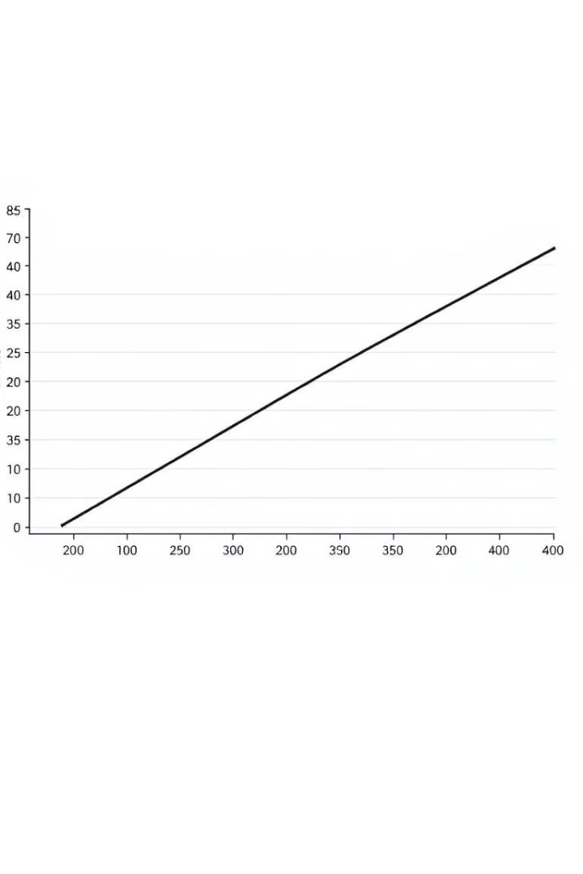
Complexity and Optimization
The time complexity of the N-Queens algorithm is exponential, as the number of possible queen placements increases rapidly with the size of the chessboard.
1
Brute Force
A brute force approach would check all possible placements for each queen.
2
Backtracking
Backtracking reduces the number of potential placements by eliminating invalid placements early on.
3
Optimization
Various optimization techniques can be applied to further reduce the search space.

Slide 9
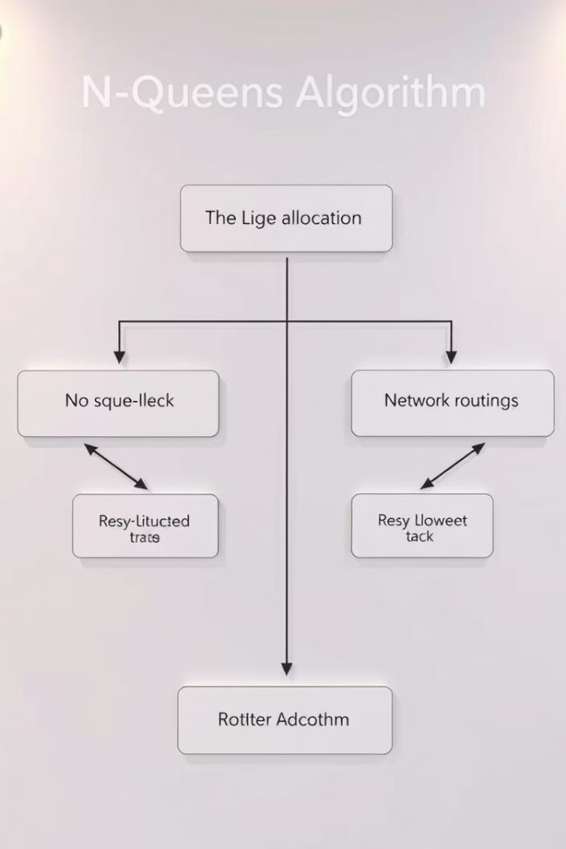




Applications of the N-Queens Algorithm
The N-Queens problem, despite its seemingly simple nature, has applications in various domains, from resource allocation and scheduling to network routing and game development. The underlying principles of the algorithm can be applied to solve complex real-world problems.
Network Routing
Task Scheduling
Finding optimal paths for data packets in a network.
Scheduling tasks to minimize conflicts and maximize efficiency.
Resource Allocation
Game Development
Allocating resources to different users or tasks in an optimal way.
Developing game mechanics and AI algorithms for strategy games.

