Slide 1

CSA0501-Database Management System
Smart Rental Property Management and House Discovery System Using Relational Database Management System (RDBMS)
PRESENTED BY
Nitthyendren JS (192421180)
GUIDED BY
Dr. Jaya Mabel Rani

Slide 2


INDEX
ABSTRACT
INTRODUCTION
PROBLEM STATEMENT AND OBJECTIVES
EXISTING SYSTEM AND PROPOSED SYSTEM
METHODOLOGY
MODULES
RESULTS
IEEE STANDARDS
SDG CONTRIBUTION
CONCLUSION
REFERENCES

Slide 3
INTRODUCTION
🔹 Rental markets in India are fragmented, broker-driven, and lack a single verified source of truth for pricing and availability
🔹 Most listing portals store data informally (spreadsheets, unstructured web forms) leading to duplication and stale listings
🔹 Proposed system replaces this with a fully relational, database-backed platform where every input — property, owner, tenant, booking — is captured through structured forms and persisted in normalized tables
🔹 Goal: demonstrate how core RDBMS principles (keys, constraints, joins, transactions) can power a real, usable application end-to-end
🔹 Emphasis on the complete input → validation → storage → retrieval pipeline, not just the UI

Slide 4
PROBLEM STATEMENTS AND OBJECTIVES
No centralized, verified record of rental data for a locality; information exists in silos across broker networks
Manual or loosely structured record-keeping causes redundant, inconsistent, and orphaned data (e.g., a property record surviving after its owner is deleted)
Absence of defined relationships between owners, properties, tenants, and bookings creates update and deletion anomalies
Searching/filtering is slow and inaccurate without indexed, structured storage
Need: a system where every piece of incoming data is validated, related correctly, and stored in a query-optimized relational structure

Slide 5
LITRATURE REVIEW
Author / Year | Focus Area | Methodology | Key Finding / Gap Identified
Kumar & Singh (2021) | Online rental portals in India | Survey-based analysis of existing platforms | High broker dependency, lack of price transparency
Sharma et al. (2020) | RDBMS-based real estate systems | Relational schema design with normalization | 3NF designs reduce redundancy but rarely applied in commercial listing sites
Patel & Verma (2022) | Geo-tagged property search | PostGIS/spatial extension on relational DB | Spatial indexing improves search speed but adds schema complexity
Roy (2019) | Trust and fraud in rental listings | Case study of fake listing complaints | Verified/structured data entry reduces fraudulent listings
Anand et al. (2023) | Database triggers for automation | Implementation of stored procedures/triggers | Automating status updates reduces manual admin overhead
Menon & Iyer (2022) | Tenant-owner matching systems | Rule-based filtering on relational data | Simple SQL-based filters perform well without needing AI/ML for small datasets
This Project | Rental discovery on pure RDBMS | Normalized schema + SQL-driven modules | Combines listing, search, and booking lifecycle in one relational model without external dependencies

Slide 6
Module 1: Property Listing & Owner Management
Input capture: Owner registration form (name, contact, ID proof reference) and Property listing form (address, rent, BHK, deposit, amenities, images)
Validation before storage: rent and BHK checked against CHECK constraints; mandatory fields enforced via NOT NULL; duplicate owner emails prevented via UNIQUE constraint
Storage design: Owner table (owner_id PK) → Property table (property_id PK, owner_id FK) → separate PropertyImages and Amenities tables to avoid multi-valued fields
Relationship: One owner can list many properties (1:N)
Operations supported: Insert new listing, update availability status, soft-delete (is_active flag) instead of hard delete to preserve booking history

Slide 7
Module 2: Tenant Search & Property Discovery
Input capture: Tenant search form (locality, rent range, BHK, furnishing type) — read-only input, converted directly into SQL predicates
Storage design: Tenant table stores registered seeker profiles; SearchPreference table optionally logs saved filters for repeat use (tenant_id FK)
Query mechanism: filters map to a parameterized query using WHERE, BETWEEN (rent range), and ORDER BY (relevance/price); JOIN with Owner table pulls contact/listing detail into results
Performance: indexes created on locality and rent columns in Property table to speed up frequent filter queries
Output: ranked, de-duplicated property list rendered to the tenant with no broker layer involved

Slide 8
Module 3: Booking, Matching & Feedback
Input capture: Booking request (tenant_id, property_id, preferred visit date), owner's accept/reject response, post-visit rating and comment
Storage design: Booking table (booking_id PK, tenant_id FK, property_id FK, status); Match table models tenant ↔ property many-to-many links; Review table (property_id FK, rating, comment)
Automation on storage: a trigger updates Property.status to "Occupied" automatically once a booking is confirmed
Aggregation: AVG() and COUNT() computed over Review rows to display property rating summaries
Transaction safety: booking confirmation wrapped in a transaction so partial writes cannot occur

Slide 9
DBMS Concepts Used in This Project
Keys & Constraints: Primary Keys, Foreign Keys, NOT NULL, UNIQUE and CHECK constraints used across Owner, Property, Tenant and Booking tables to enforce entity integrity
Normalization (up to 3NF): PropertyImages, Amenities and Match kept as separate tables to eliminate multi-valued attributes and redundant data
Relationships & Joins: 1:N (Owner → Property) and M:N (Tenant ↔ Property via Match table); JOIN queries combine Owner, Property and Booking data for search results
Indexing: Indexes on locality and rent columns in the Property table speed up frequent filter queries
Triggers: An automated trigger updates Property.status to “Occupied” once a booking is confirmed
Aggregate Functions: AVG() and COUNT() computed over Review rows to generate property rating summaries
Transactions: Booking confirmation is wrapped in a transaction so partial writes cannot occur
Views & Soft Delete: is_active flag used instead of hard deletes to preserve booking history and referential integrity

Slide 10
Alignment with UN Sustainable Development Goals (SDGs)
SDG 11 – Sustainable Cities and Communities: promotes transparent, affordable housing access and reduces information asymmetry in urban rental markets
SDG 9 – Industry, Innovation and Infrastructure: demonstrates a resilient, structured digital infrastructure (RDBMS) replacing informal record-keeping
SDG 10 – Reduced Inequalities: removes broker gatekeeping and paywalls, giving equal, direct access to rental data
SDG 16 – Peace, Justice and Strong Institutions (partial): structured, auditable records support accountability and reduce fraudulent listings

Slide 11
IEEE Standards Followed
IEEE 830-1998 — Software Requirements Specification (SRS) Used to document functional requirements (property listing, search, booking) and non-functional requirements (data integrity, response time) before schema design
IEEE 1016-2009 — Software Design Description (SDD) Used to structure the system's design documentation, including ER diagrams, table schemas, and module-level design for the three modules
IEEE 829-2008 — Software and System Test Documentation Used to define test cases for CRUD operations, constraint validation (NOT NULL, FK, CHECK), and referential integrity checks during testing
ISO/IEC/IEEE 12207-2017 — Software Life Cycle Processes Followed for the overall development life cycle: requirements → design → implementation → testing → deployment of the database-driven application

Slide 12
Advantages & Limitations
✅ Advantages: ✔️ Centralized, consistent, and de-duplicated rental data ✔️ Reduced broker dependency; direct owner-to-tenant visibility ✔️ Fast, indexed search and reliable multi-table reporting ✔️ Data integrity guaranteed by constraints, not just application logic
❌ Limitations: ✖️ No native geolocation/spatial querying in the base RDBMS ✖️ Scalability under very high concurrent load depends on further tuning/caching ✖️ Currently handles structured data only; no image/document content analysis

Slide 13
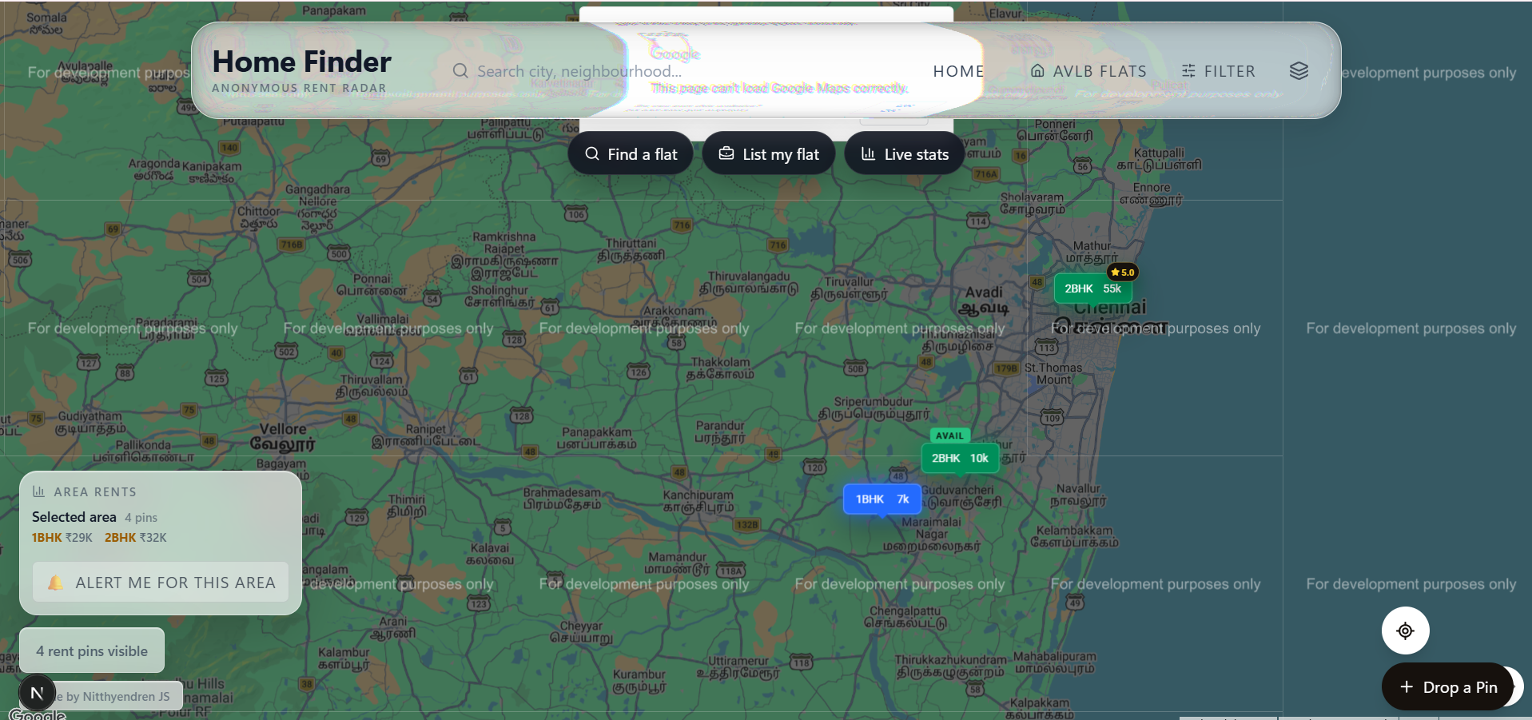
Results & Sample Outputs

Slide 14

Deployed Output

Slide 15
Future Enhancements
Integrate spatial extensions (e.g., PostGIS) for proximity-based property search
Add a caching layer (e.g., Redis) in front of frequent read queries to reduce database load
Introduce a verified-listing workflow backed by a document-proof table (rent receipts, ID proof)
Extend the matching module with a scoring algorithm considering budget, commute distance, preferences
Mobile application built on the same relational backend for wider accessibility

Slide 16
Conclusion
The project successfully designed and implemented a normalized relational database system covering the full rental lifecycle — listing, discovery, booking, and feedback — demonstrating practical application of keys, constraints, joins, views, triggers, and transactions, while supporting broader goals of housing transparency and equitable access

Slide 17
Reference
Kumar, A. & Singh, R. (2021). Online Rental Platforms in India: A Survey. Journal of Digital Commerce.
Sharma, P. et al. (2020). Relational Schema Design for Real Estate Systems. Intl. Conf. on Database Systems.
Patel, N. & Verma, S. (2022). Spatial Extensions in Relational Databases for Property Search. Journal of GeoInformatics.
Roy, M. (2019). Fraud and Trust Issues in Online Rental Listings. Consumer Tech Review.
Anand, K. et al. (2023). Database Triggers and Stored Procedures for Workflow Automation. Intl. Journal of Computer Applications.
United Nations. (2015). Sustainable Development Goals. sdgs.un.org

Slide 18


