Slide 1






Online Bus Booking System
Submitted by:
Kishan Dwivedi
(205120043)
Submitted to:
Dr. Jitendra kumar

Slide 2
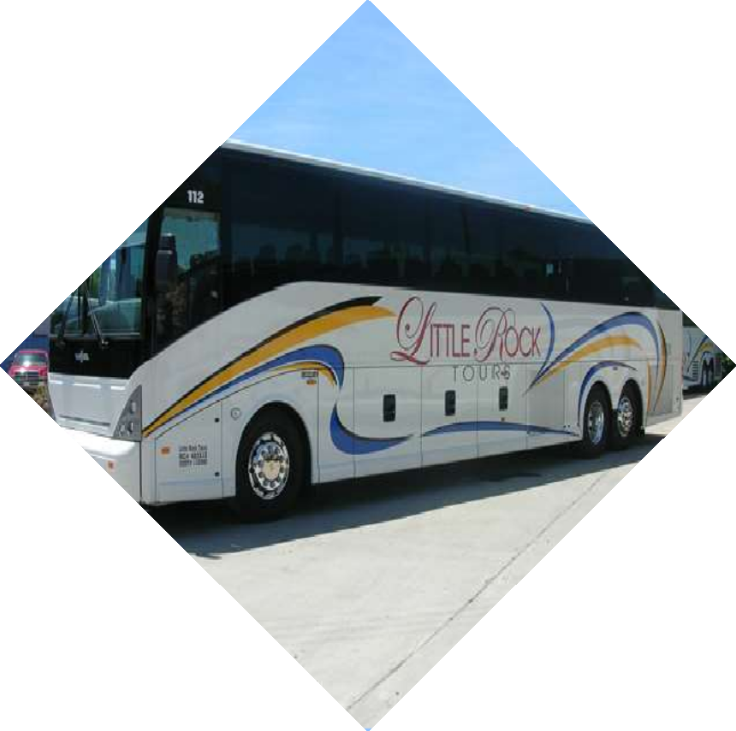
About Project
Online bus ticketing system is a web based system which will help bus owner and passenger to easy the ticketing process.

Slide 3
Key features of the system
▰Admin can add bus owner and user.
▰Bus owner can add travel, bus and route.
▰Bus owner can schedule bus to route.
▰User can search bus and book tickets for available buses.

Slide 4
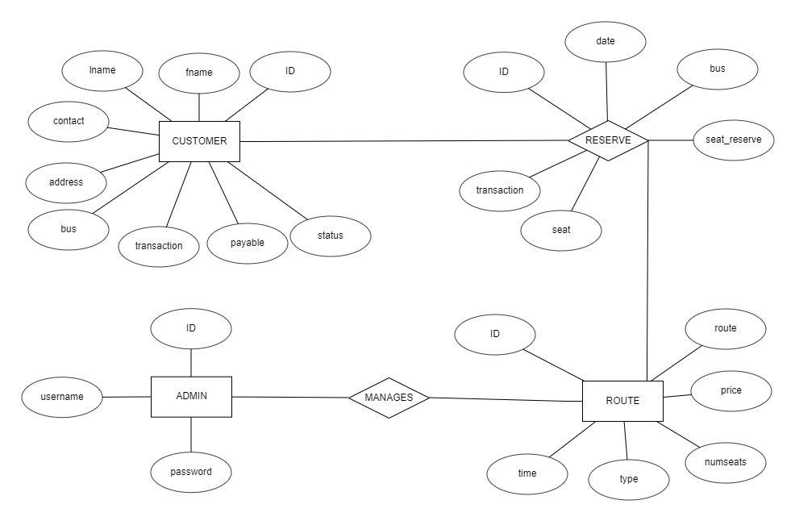
ER Diagram

Slide 5
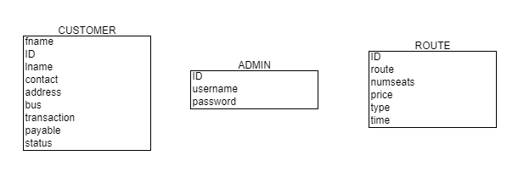
Relational Schema

Slide 6

thankyou

