Slide 1
The D Programming Language

Slide 2
Objectives
Understand the evolution of programming languages
Understand where D is situated
Intro to D

Slide 3
The history of programming languages in 5 minutes

Slide 4
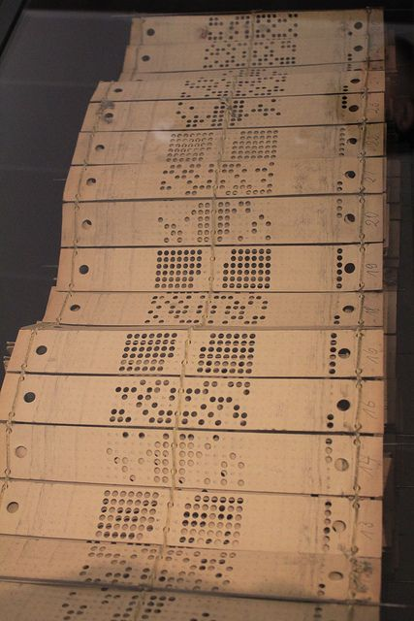
First programming language

Slide 5
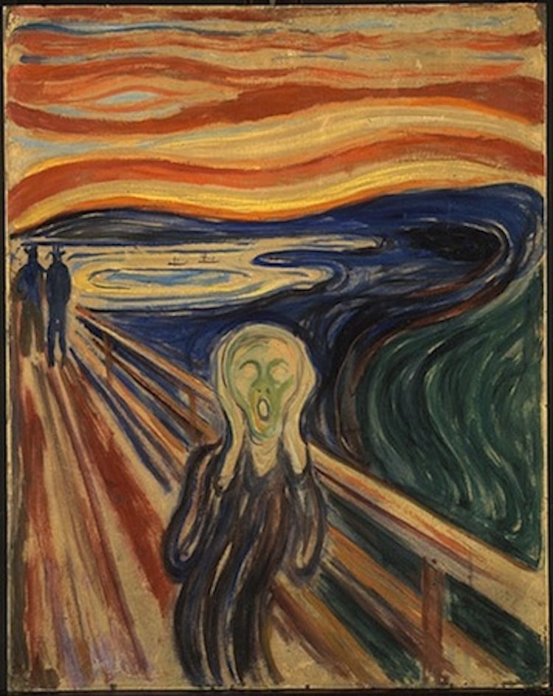

Slide 6
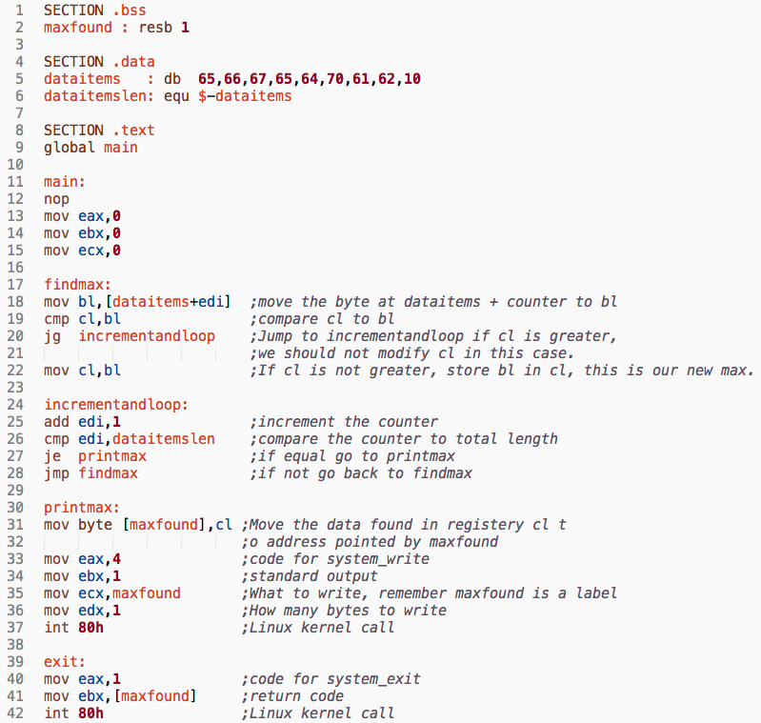
Assembly

Slide 7
The C era
A more expressive assembler
Main concern: performance

Slide 8
The world after C
Java
C++
Python

Slide 9
Today
D
Rust
Scala
Lua
TypeScript

Slide 10
Observations
Shift from performance to safety
Simplicity/Expressiveness
Interoperability/Portability
Maintenance
Automate everything

Slide 11
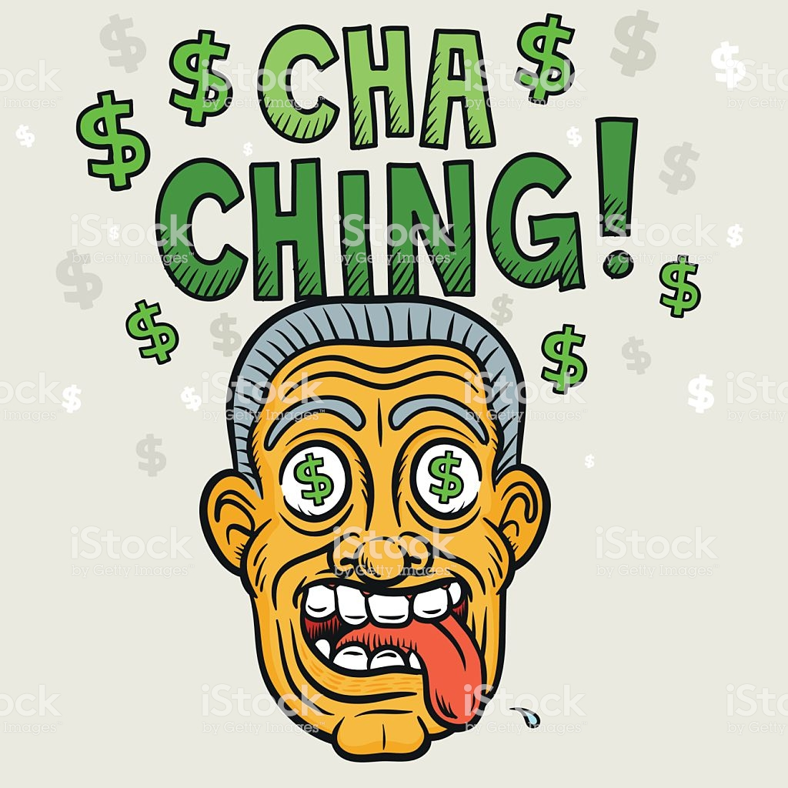

Slide 12
Course 01: Introduction to D

Slide 13
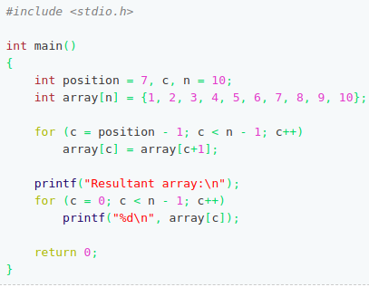
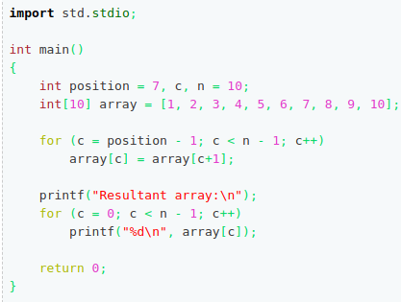
C and D

Slide 14
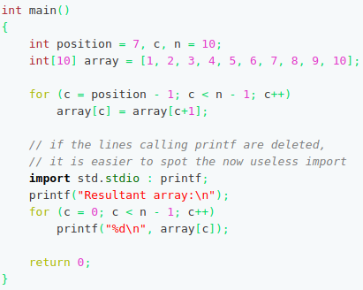
Imports

Slide 15
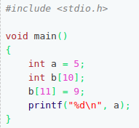
Arrays (C and D)

Slide 16
Static Arrays vs Dynamic Arrays
Static Arrays: length known at compile time; length never gets modified
Dynamic Arrays: length is modifiable during runtime

Slide 17
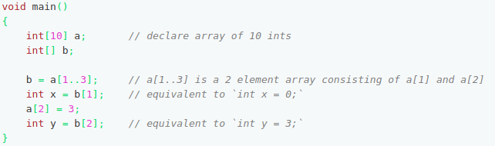
Slicing

Slide 18
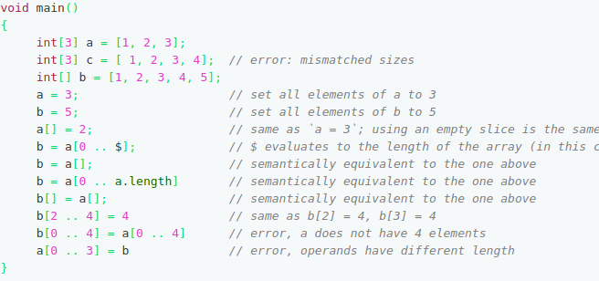
Array Setting

Slide 19
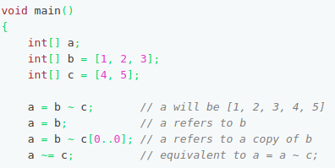
Array Concatenation

Slide 20
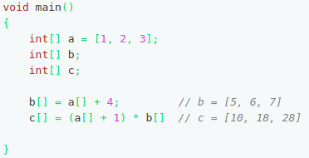
Vector Operations

Slide 21
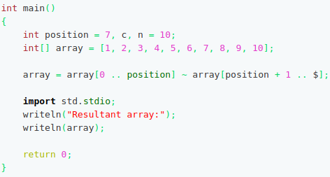
C-idiomatic D vs Idiomatic D

Slide 22
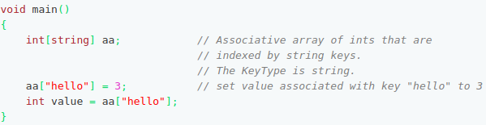
Associative Arrays (AA)

Slide 23
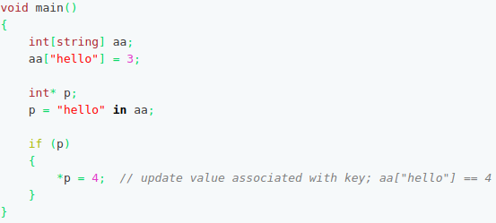
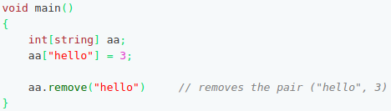
AA – remove/test membership

Slide 24
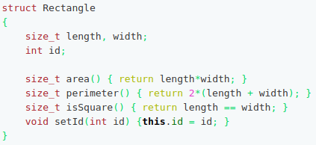
Structs

Slide 25
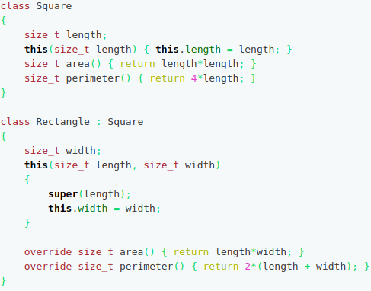
Classes

Slide 26
Functions
Same as C functions, except….

Slide 27

Functions - overloading

Slide 28
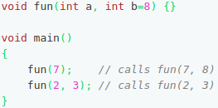
Functions – Default Params

Slide 29
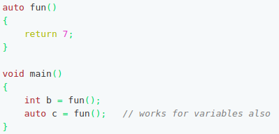
Functions – Auto return type

Slide 30

Functions - UFCS

Slide 31
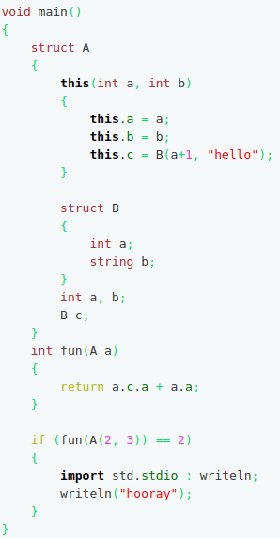
Nested Scopes

Slide 32
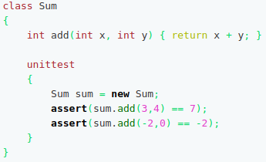
Unittests

Slide 33
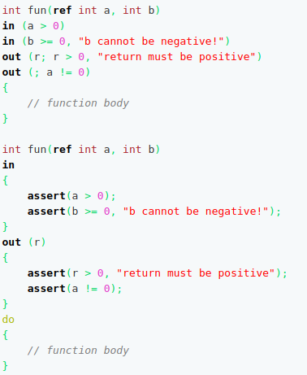
Contract Programming

Slide 34
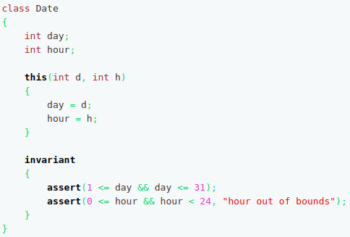
Invariants

