Slide 1



Intelligent Linguistic System for the Grammar of the Romanian Language
Ioan-Florin-Cătălin NIȚU
Thesis advisor:
Conf. Dr. Ing. Traian-Eugen REBEDEA
Notes:
Commission 8
Day 2
Prof.dr.ing. Ștefan Trăușan-Matu (chairman)
Prof.dr.ing. Mihai Dascălu
Conf.dr.ing. Traian Rebedea
Conf.dr.ing. Costin Chiru
As.drd.ing. Dragoș Corlătescu (secretary)

Slide 2
Vision
Motivation. Need. Objectives
Notes:
How many of us didn't make typos?
Personal story.

Slide 3
Motivation
In Romania, the functional illiteracy rate is 39% [1]
Common grammatical errors in all categories of the population [2]
For English language there are applications for text correcting
The Romanian language needs competitive projects
Notes:
However, the serious thing is that there are many people who make mistakes, most of those who make mistakes doing this frequently, without realizing it. Statistics show that in schools, but not only, people have trouble writing correctly.
Grammarly – powerful tool, with free but also paid version; Application issue: Available in English only.

Slide 4
Need
Artificial intelligence has helped a lot in solving some problems
... or in creating technologies that make people's work easier
The proposed application is based on artificial intelligence
Possibility of correcting grammar or writing mistakes
Notes:
However, how can we address this issue? Solution: Artificial Intelligence, Machine Learning and Natural Language Processing. The aim is to correct grammatical errors in written texts.

Slide 5
Objectives
Improving the language of Romanians
Helping citizens whose mother tongue is not Romanian
Using a modern mode (desktop and mobile application)
Useful for both teaching and professional purposes
Improving the language of documents
Notes:
Using the current context, I wanted to find a solution to society's problems.

Slide 6
Technologies Used
Attention. Transformer
Notes:
Many alternatives, the latest ones are based on Attention and Transformers.

Slide 7
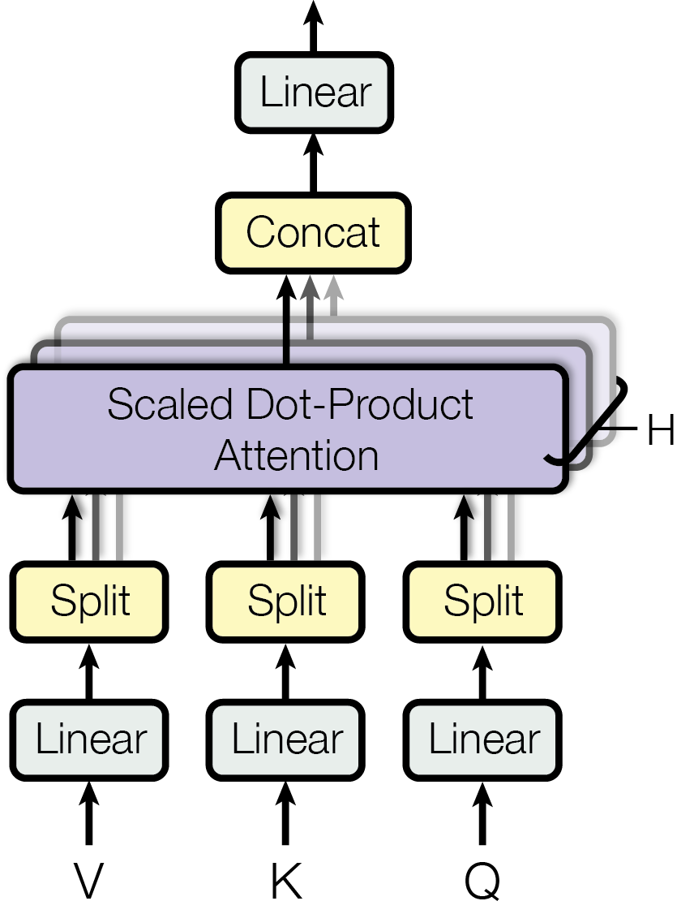
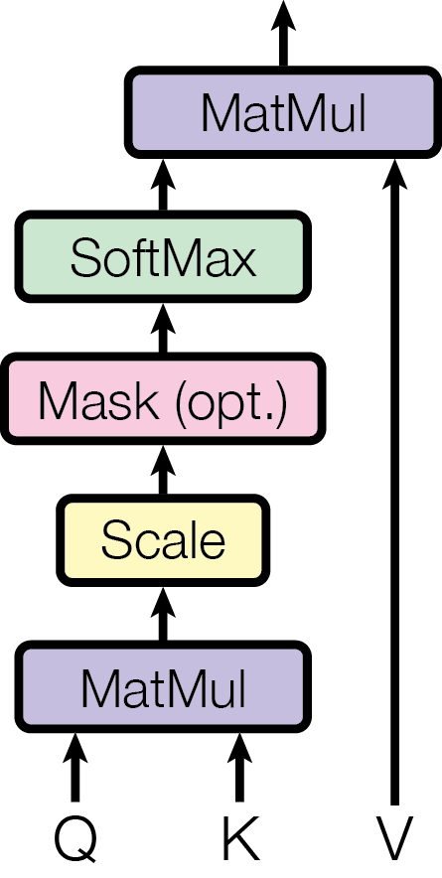
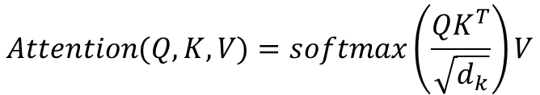
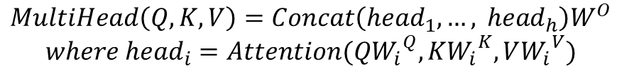
Attention
$$Attention(Q, K, V)=softmax\left(\frac{QK^{T}}{\sqrt{d_{k}}}\right)V$$
$$MultiHead\left(Q, K, V\right)=Concat\left({head}_{1}, …, {head}_{h}\right)W^{O}$$
$$where {head}_{i}=Attention(Q{W_{i}}^{Q}, K{W_{i}}^{K}, V{W_{i}}^{V})$$
Scaled Dot-Product Attention [3]
Multi-Head Attention [3]
Notes:
Attention is a mechanism by which transformers can have an infinite theoretical memory and thus can focus on words generated long before.
To get attention, the entry is distinguished into three layers to create the query, key, and value vectors.
„The key/value/query concepts come from retrieval systems. For example, when you type a query to search for some video on YouTube, the search engine will map your query against a set of keys (video title, description etc.) associated with candidate videos in the database, then present you the best matched videos (values).” – dontloo, „What exactly are keys, queries, and values in attention mechanisms?,” [Answer] Stats StackExchange, 29 August 2019. [Online]. Available: https://stats.stackexchange.com/a/424127. [Accessed 19 June 2020].

Slide 8
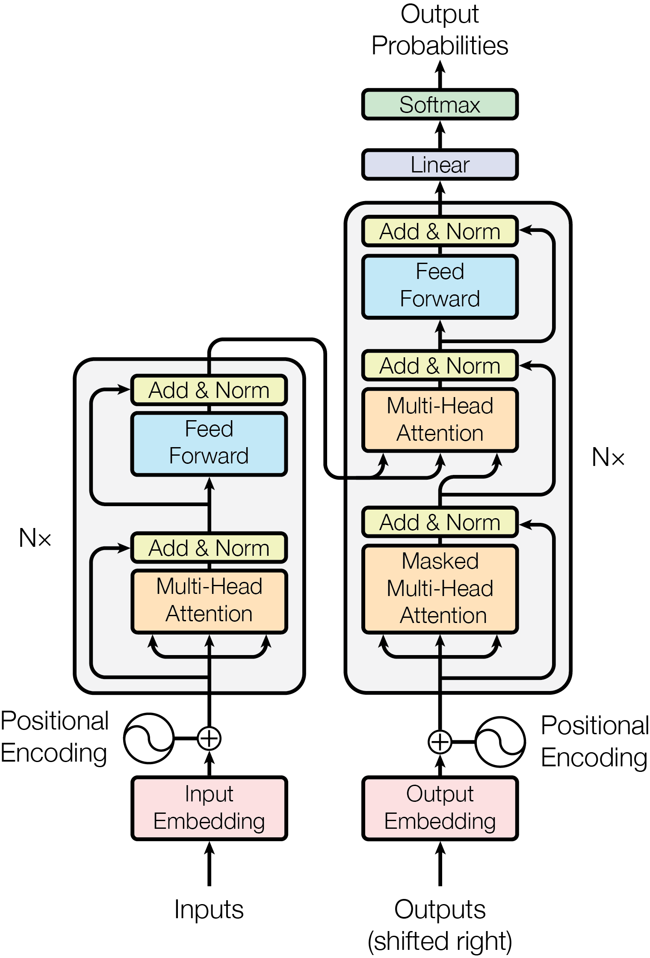
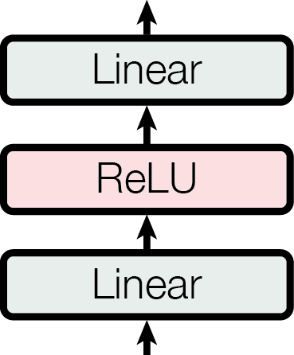
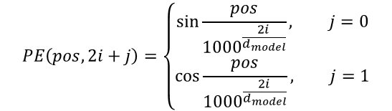
Transformer
Proposed by Vaswani et. al. in „Attention Is All You Need” [3]
Encoder
Input embedding
Positional encoding
Encoding layers
Multi-headed attention sub-layer
Point wise feed forward network
Decoder
Output embedding
Positional encoding
Decoding layers
Multi-headed attention sub-layer
Point wise feed forward network
The output of the decoder passes through a linear final layer acting as a classifier (the number of classes is equal to the size of the vocabulary).
$$PE\left(pos, 2i+j\right)=\left\{\begin{aligned}\sin{\frac{pos}{{1000}^{\frac{2i}{d_{model}}}}}, j=0 \\ \cos{\frac{pos}{{1000}^{\frac{2i}{d_{model}}}}}, j=1\end{aligned}\right.$$
Notes:
Learned embedding
The transformer does not use recurrences and needs information about the positions in the built-in input. For this we use positional coding that has the same size to be able to be added with the incorporation.
Each sub-layer of the coding layers has a residual connection (the output is added to the input) which is then normalized. Residual connections help the model to drive, with gradients being able to pass directly through the network, while normalization is used to stabilize the network, which implies a significant reduction in training time.
The point wise forward transmission network is used to project the attention of the output, which can give it a richer representation.
The attention layers allow each position to participate in all positions in the decoder up to this position. To preserve the self-regression property [8], the positions beyond the current one must be masked (set to $−∞$).
In the attention layer that connects the encoder to the decoder (the second layer - the middle layer) the queries come from the previous decoder layer, while the keys and values ​​come from the output of the encoder. This allows each position in the decoder to participate in each position in the input, similar to other attention mechanisms in sequence-to-sequence models.

Slide 9
Proposed Method
Description of the Method. RONACC
Notes:
The model used is based on Attention and Transformer.

Slide 10
Description of the Method
Transformer based model [3]
Encoder: wrong sentences
Decoder: correct sentences
The model is not pre-trained
Training
auto-regressive [4]
teacher forcing [5]
RONACC – corpus for grammatical corrections in Romanian [6]
Romanian National Audiovisual Council Corpus
Notes:
It can be seen either as a noise elimination system, or as a translation system from the wrong Romanian language to the correct Romanian language.

Slide 11
RONACC
Correct Sentence | Wrong Sentence
Acoperișul din șindrilă nu se mai păstrează, fiind înlocuită cu țiglă în 1936, fapt ce a necesitat sprijinirea acoperișului cu structuri improvizate. | Acoperișul din șindrilă nu se mai păstrează, fiind înlocuită cu țiglă în 1936, fapt ce a necesitat sprijinirea acoperișului cu structuri inprovizate.
Alte mărci comerciale utilizate vreme îndelungată sunt Löwenbräu, deținătorii căreia spun că este folosită din 1383, și Stella Artois din 1366 | Alte mărci comerciale utilizate vreme îndelungată sunt Löwenbräu, deținători căreia spun că este folosită din 1383, și Stella Artois din 1366.
Cea mai importantă este cea surprinsă asupra lunii Noiembrie. | Cea mai importantă este ceea surprinsă asupra luni Noiembrie.

Slide 12
Results
Metrics. Evaluation. Examples

Slide 13
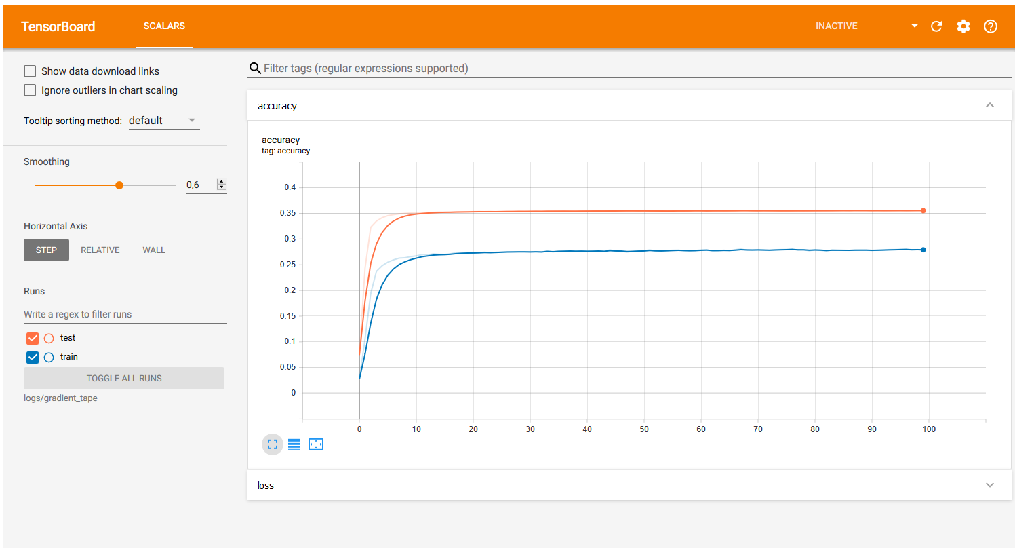
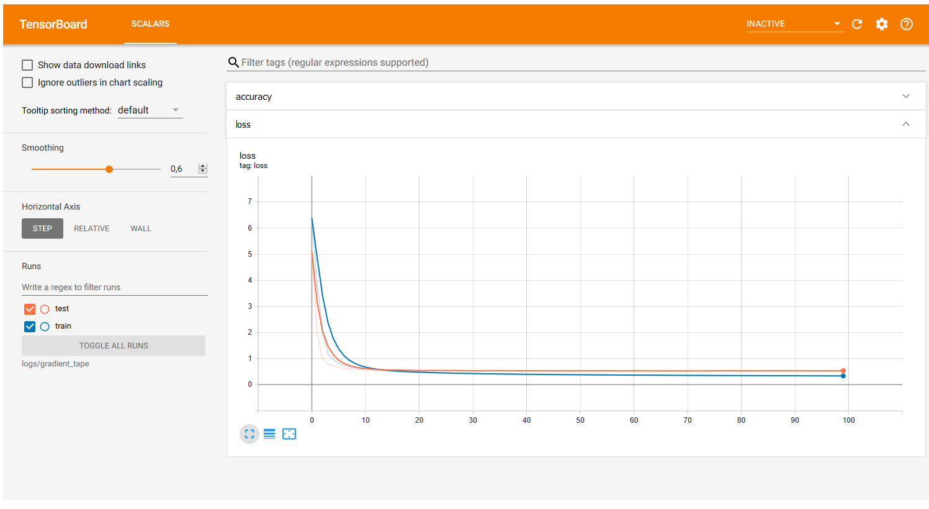
Metrics: Accuracy. Loss

Slide 14
Evaluation
Data sets for
training
small: 7082 pairs of sentences
medium: 7082 + 50000 pairs of sentences
large: 7082 + 1000000 pairs of sentences
testing: 1519 pairs of sentences
validation: 1518 pairs of sentences
The data loading time was not taken into account (for the large data set it is about one hour).
BLEU (bilingual evaluation understudy) – method of evaluating machine translations [7].
Data set | Epochs | BLEU Score | Training time
Small | 100 | 20.56 | 9.66 seconds / epoch
Medium | 100 | 33.29 | 99 seconds / epoch
Large | 5 | 45.29 | 1032 seconds / epoch
Notes:
Improve the BLEU score using a larger data set.

Slide 15
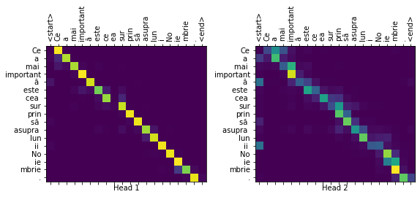
Example Attention (1)
correct("Cea mai importantă este ceea surprinsă asupra luni Noiembrie.",
real_sentence="Cea mai importantă este cea surprinsă asupra lunii Noiembrie.",
plot="decoder_layer2_block2")
Input: Cea mai importantă este ceea surprinsă asupra luni Noiembrie.
Predicted correction: Cea mai importantă este cea surprinsă asupra lunii Noiembrie.
Real correction: Cea mai importantă este cea surprinsă asupra lunii Noiembrie.
BLEU score: 1.0000
Notes:
Horizontal – the wrong sentence;
Vertical – the correct sentence.

Slide 16
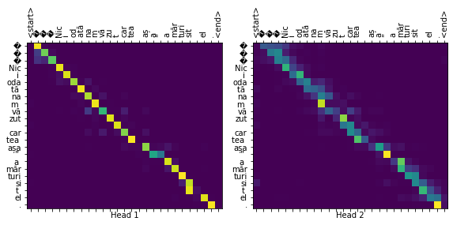
Example Attention (2)
correct("„Nici odată nam văzut cartea așa” a mărturisit el.",
real_sentence="„Niciodată n-am văzut cartea așa”, a mărturisit el.",
plot="decoder_layer2_block2")
Input: „Nici odată nam văzut cartea așa” a mărturisit el.
Predicted correction: „Nici odată nam văzut cartea așa” a mărturisit el.
Real correction: „Niciodată n-am văzut cartea așa”, a mărturisit el.
BLEU score: 0.2741
Notes:
Horizontal – the wrong sentence;
Vertical – the correct sentence.

Slide 17
Conclusions
Further developments

Slide 18
Conclusions. Further developments
Semi-functional proofreader
Starting point in the development of other projects
Improving the model
larger data sets
greater number of epochs
new technologies
Creating user interfaces
Notes:
The field needs to be developed, and applications and tools of this kind need to be extended beyond mathematical models. User interfaces are required.

Slide 19
Bibliography
Digi24, „39% dintre elevii români sunt analfabeți funcțional. Cum îi va afecta pe viitor,” 24 January 2019. [Online]. Available: https://www.digi24.ro/stiri/actualitate/educatie/39-dintre-elevii-romani-sunt-analfabeti-functional-cum-ii-va-afecta-pe-viitor-1070140. [Accessed: 9 October 2019].
R. Paraschivescu, Interviewee Cei care vorbesc corect vor forma un soi de trib, de sectă, care se va refugia undeva în păduri, [Interview]. 26 July 2018. Available: http://www.contributors.ro/cultura/interviu-radu-paraschivescu-”cei-care-vorbesc-corect-vor-forma-un-soi-de-trib-de-secta-care-se-va-refugia-undeva-in-paduri”.
A. Vaswani, N. Shazeer, N. Parmar, J. Uszkoreit, L. Jones, A. N. Gomez, Ł. Kaiser și I. Polosukhin, „Attention Is All You Need,” 12 June 2017. [Online]. Available: https://arxiv.org/abs/1706.03762. [Accessed: 10 June 2020].
A. Graves, „Generating Sequences With Recurrent Neural Networks,” 4 August 2013. [Online]. Available: https://arxiv.org/abs/1308.0850. [Accessed 20 June 2020].
TensorFlow, „Transformer model for language understanding,” 22 August 2019. [Online]. Available: https://www.tensorflow.org/tutorials/text/transformer. [Accessed 10 June 2020].
Romanian National Audiovisual Council Corpus. Available: https://nextcloud.readerbench.com/index.php/s/9pwymesT5sycxoM. [Accessed: 10 June 2020].
K. Papineni, S. Roukos, T. Ward și W.-J. Zhu, „Bleu: a Method for Automatic Evaluation of Machine Translation,” in Annual Meeting of the Association for Computational Linguistics, Philadelphia, Pennsylvania, USA, 2002.

Slide 20
Thank you for your attention!
ioan_florin.nitu@stud.acs.upb.ro

