Slide 1
Generative AI Project Report
Name : Nitish Bhardwaj
Register No : 71772117128
Naan Muthalvan ID : au71772117128
Class : 3rd year B.E CSE
College Name : Government College of Technology, Coimbatore.

Slide 2
Meal Measure Monitor

Slide 3
AGENDA
Problem Statement
Project Overview
Implementation Details
Results and Findings
Screenshots of Testing & Results

Slide 4
Problem Statement
In today's fast-paced world, maintaining a healthy lifestyle is crucial. A significant aspect of this lifestyle is monitoring dietary intake, including calorie consumption. However, manually calculating the calorie content of every meal can be time-consuming and challenging, especially for individuals with busy schedules or limited nutritional knowledge. To address this challenge, there is a need for a convenient and efficient tool that can analyze images of food items and provide detailed information about their calorie content.

Slide 5
Project Overview
The aim of this project is to develop a Meal Measure Monitor, an innovative tool that utilizes advanced technology to analyze images of food and calculate the total calories, as well as provide detailed information about the calorie content of individual food items.
Tools Used: Streamlit for app development, Google Gemini Pro Vision API for image analysis.

Slide 6
Implementation Details
Environment Setup: The project utilizes Python programming language and various libraries such as dotenv, streamlit, google.generativeai, and PIL. Environment variables are loaded using dotenv for secure configuration.
Google Gemini Pro Vision API Integration: The Gemini Pro Vision API is configured with the provided API key to enable image analysis and content generation.

Slide 7
Continues…
Function Definitions: Custom functions are developed to interact with the Gemini Pro Vision API and process image data. These functions include get_gemini_response and input_image_setup.
Streamlit App Development: The Meal Measure Monitor is developed as a Streamlit web application. The app interface includes input fields for user prompts and file uploaders for images. Upon submission, the app displays the uploaded image and provides a detailed analysis of the calorie content.

Slide 8
Results & Findings
The Meal Measure Monitor successfully analyzes images of food items and calculates their total calorie intake.
Integration with the Google Gemini Pro Vision API ensures accurate image analysis and reliable results.
The Streamlit interface offers a seamless user experience, making it easy for users to interact with the application.

Slide 9
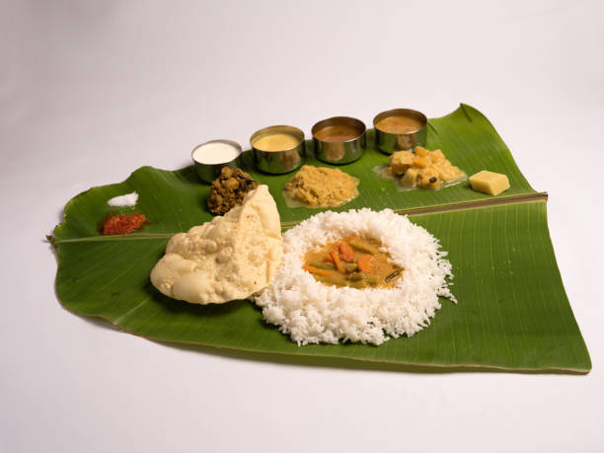
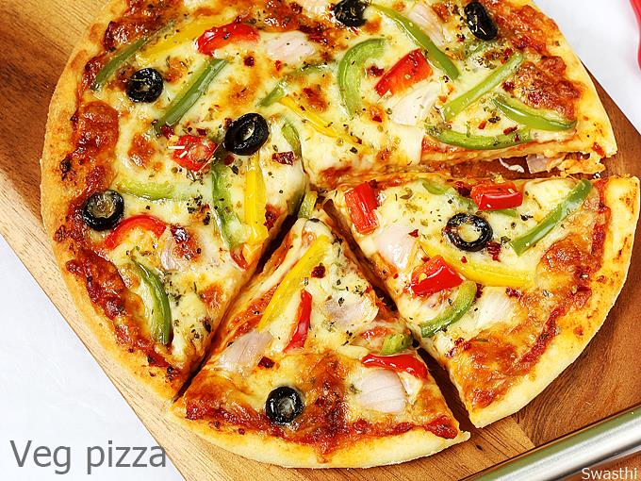
ScreenShots of Testing & Results
Input Images with Prompt:
Food1
Prompt:why the food is liked by vegetarians?
Food2
Prompt: is that food good for gut health?

Slide 10
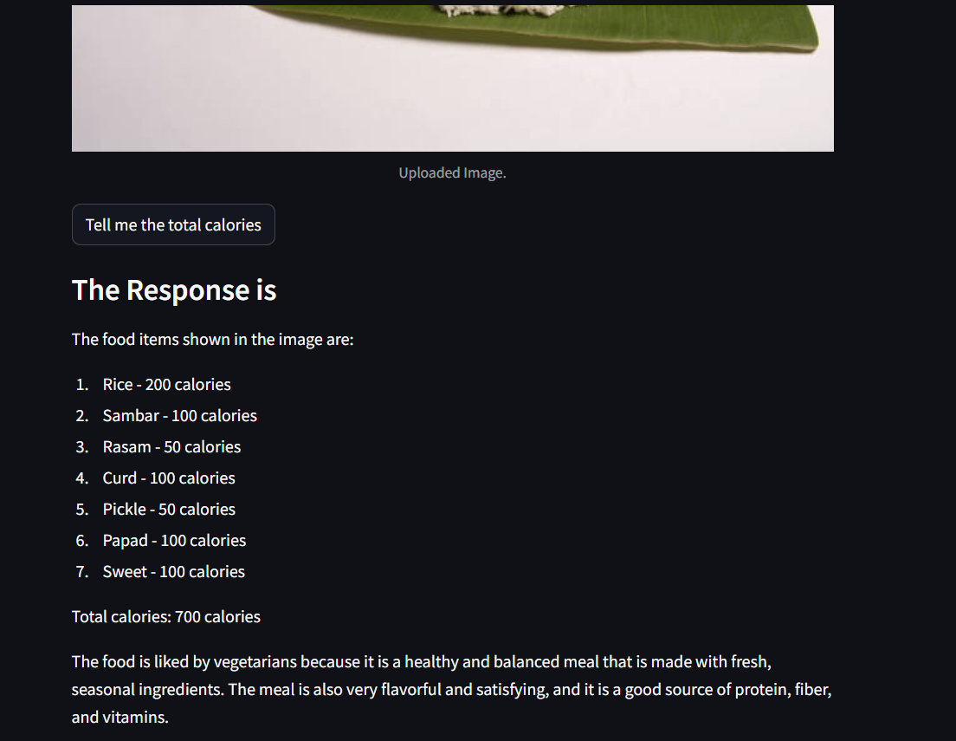
Response food1

Slide 11
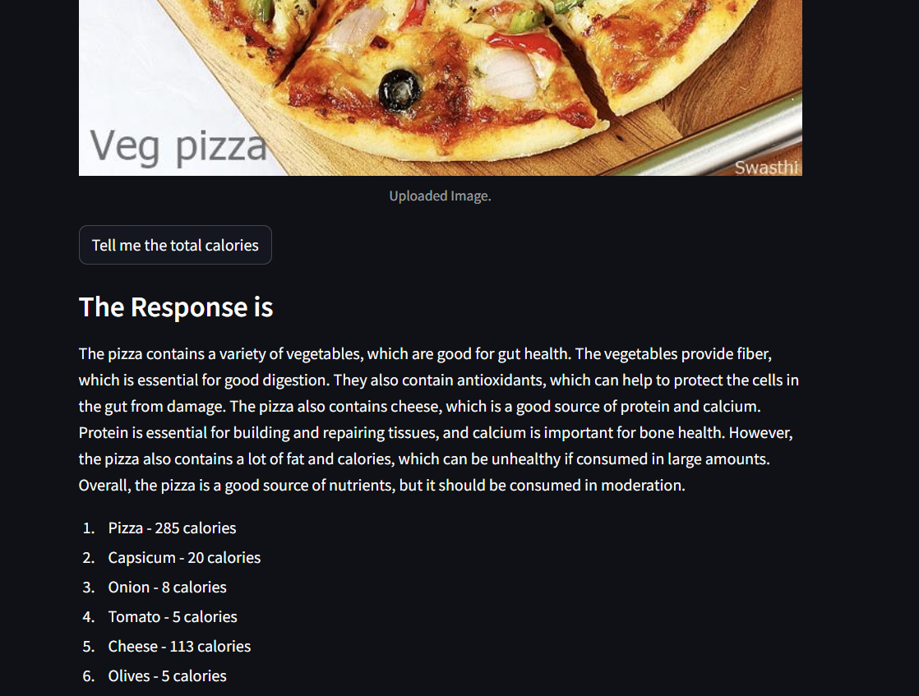
Response food2

