Slide 1
MAANG historical stock market price simulator: A Machine Learning Approach and Simulator Development
Farjana Alam (20101022)
Soumik Deb Niloy (20301207)
Abdullah Jamil Sifat (20301386)
Kaushik Datta (23341060)
Course Code: CSE474
Section: 01
Team: 32
ST: Farah Binta Haque
RA: Md Sabbir Hossain

Slide 2
Objectives
To develop a comprehensive predictive model for analyzing and forecasting stock market trends across multiple companies
To implement a robust and reliable stock market prediction model
To ensure our model’s efficacy in real-world financial scenarios.
01

Slide 3

Introduction
The stock market’s unpredictable nature poses a challenge for investors and analysts seeking to make informed decisions. This research addresses this challenge by employing advanced LSTM neural networks to model and predict stock market trends. The significance lies in the potential for a unified model capable of providing insights across various companies. The study not only contributes to the field of predictive analytics but also explores the nuances of training models on distinct stock datasets.
02

Slide 4
Related Works
The paper introduces NeuralSim, a novel approach to augmenting differentiable simulators with neural networks, reducing modeling errors and computational time. The dataset used includes real-robot experiments, demonstrating a significant reduction in inference time. By combining analytical models with data-driven residual models, NeuralSim achieves improved accuracy in sim-to-real transfer and efficient computation of gradients, resulting in an order of magnitude speed-up in computation
The paper utilized artificial market simulations to address the limitations of historical financial data for investment strategies. Employing deep reinforcement learning, the study developed an effective trading strategy that maximizes capital accumulation without excessive risk. The results demonstrated that the proposed model's action probability distributions aligned with real market investment strategies, showcasing its potential for real-world application.
03

Slide 5
Dataset
The The dataset is sourced from Kaggle, encompassing stock market information for companies including Amazon, Apple, Google, Microsoft, and Netflix. Columns include Open (Opening Price), High (Highest Price), Low (Lowest Price), Close (Closing Price), Adj Close (Adjusted Closing Price), Volume (Volume of Stock), and Date.
04

Slide 6
Methodology
Model Construction:
For each company, build an LSTM-based neural network model using TensorFlow and Keras.
Construct a Sequential model with two LSTM layers and a Dense output layer.
Compile the model using the Adam optimizer and Mean Squared Error (MSE) as the loss function.
05

Slide 7
Training loop
Split the dataset into training and testing sets (80% training, 20% testing).
Train the LSTM model for a specified number of epochs (e.g., 50) using the training data.
Monitor the training and validation loss during each epoch.
Implement Early Stopping to prevent overfitting, with a patience of 10 epochs and restoring the best weights.
06

Slide 8
Evaluation and Visualization
Plot the training and validation loss curves to assess model performance.
Make predictions on the test set using the trained model.
Monitor the training and validation loss during each epoch.Convert predicted and true values to binary form (1 if closing price increased, 0 otherwise).
Calculate and display the MAE, MSE to evaluate binary classification performance.
07

Slide 9
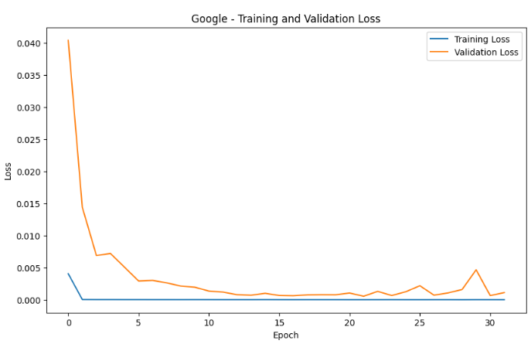
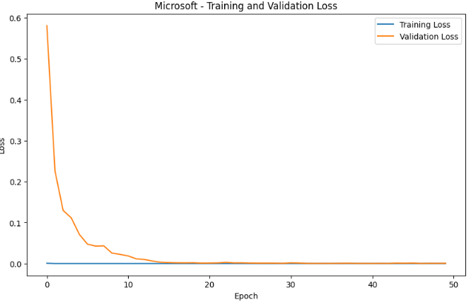
08

Slide 10
Results
The training loop for each dataset revealed a consistent pattern of decreasing training loss over epochs
Notably, the validation loss consistently surpassed the training loss, indicating a potential issue of overfitting. This phenomenon suggests that the model might be overly tuned to the training data, limiting its ability to generalize to new, unseen data.
Implementation of Early Stopping helps to prevent overfitting, with a patience of 10 epochs and restores the best weights.
MSE, MAE suggests excellent predictive accuracy on the test set, it may also indicate overfitting.
09

Slide 11
Challenges
Incomplete or noisy data, as well as sudden market changes, can affect the model's ability to generalize.
Stock market data often has a limited historical timeframe, which may impact the LSTM model's ability to capture long-term dependencies and trends.
Financial time series data can exhibit non-stationary behavior
Financial markets are influenced by complex interactions of various factors, including economic indicators, geopolitical events, and market sentiment.
LSTM models, especially when deep and complex, are prone to overfitting, especially if the dataset is small.
10

Slide 12
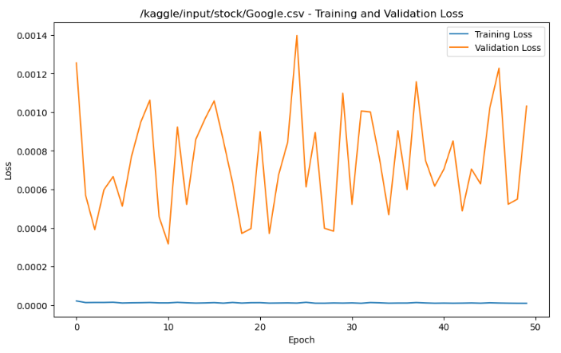
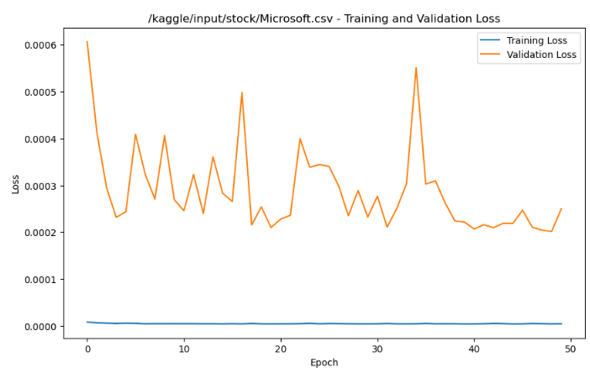
After Overfitting: Graph scenario
11

Slide 13
Conclusion
In conclusion, while the LSTM model demonstrated promise in capturing training patterns, addressing overfitting remains a critical priority. The pursuit of a robust and reliable stock market prediction model necessitates iterative improvements, a deeper understanding of market dynamics, and the incorporation of advanced techniques to enhance generalization capabilities. Future work should focus on refining the model architecture, exploring regularization methods, and implementing comprehensive evaluation strategies to ensure the model’s efficacy in real-world financial scenarios.
12

Slide 14
Limitations
Overfitting
Model Complexity
Evaluation Metrics
Hyperparameter Sensitivity
13

Slide 15
Future works
Refining the model architecture.
Exploring regularization methods.
Implementing comprehensive evaluation strategies to ensure the model’s efficacy in real-world financial scenarios.
14

Slide 16
References
1. Heiden, E., Millard, D., Coumans, E., Sheng, Y., & Sukhatme, G. S. (2021, May). NeuralSim: Augmenting differentiable simulators with neural networks. In 2021 IEEE International Conference on Robotics and Automation (ICRA) (pp. 9474-9481). IEEE.
2. Maeda, I., DeGraw, D., Kitano, M., Matsushima, H., Sakaji, H., Izumi, K., & Kato, A. (2020). Deep reinforcement learning in agent based financial market simulation. Journal of Risk and Financial Management, 13(4), 71.
15

Slide 17
Thank You
reallygreatsite.com

