Slide 1
Title: Train Accident Prevention Using IOT
PHASE-1 Project Presentation(2023-2024)
Under the Guidance of
Prof. Jagadish N
Assistant Professor
Department of ISE
Acharya Institute Of Technology
Batch No:- 14
Project Team Members:
Nitu Moni (1AY20IS060)
Manjunath N U (1AY21IS402)
Shireen (1AY21IS404)
1

Slide 2


Slide 3
Agenda
Introduction
Literature Survey
Summary Table
System Requirements
System Design
Possible Outcomes
References

Slide 4
Abstract
Railway transport is the most cost- effective and best mode of passenger transportation in India, as well as for long-distance and suburban traffic.In Railway track crossings due to unseen cracks in railway tracks are the leading to severe railway accidents. Arduino microcontrollers control and coordinate the activities of this device. We use IR sensors that are used for crack detection ,we collect data and use computational analysis to identify cracks in railway tracks. The collected data is stored in the cloud using IOT for analysis and aids in the detection of cracks, allowing for the avoidance of catastrophic accidents. Here ultrasonic sensor is used to detect the obstacles on the railway track by measuring distance from track to sensor, if the distance is greater than the assigned value the microcontroller identifies there is a crack, also it tells the exact location of the crack by gps.

Slide 5
INTRODUCTION
India, which has the world's fourth-largest railway community, relies heavily on the railway as a mode of transportation. Seasonal changes cause the tracks to contract and expand. The main issue that is faced here is that there is no reliable and affordable equipment to diagnose train track issues and the lack of proper maintenance. This project will help improve the rail industry and many people will be benefited from this. It is the most economical and efficient solution provided to achieve good results of railways of our country to minimize the stats of accidents caused.

Slide 6
Literature Survey
1] INTELLIGENT RAILWAY TRACK CRACK AND OBSTACLE DETECTION USING IOT[2022]
AUTHORS : Bhoomika BN*1, Harsha V*2, Sneha S*3, Tejaswini CS*4, Mallamma CG*5
METHODOLOGY:Railway is one of the most significant transport modes of our country. However, the railway tracks in our country are very vulnerable, and as a result, a large number of accidents occur every year, leading to the loss of many lives. These incidents have motivated us to take necessary steps to protect people's lives. Currently, there is no technology available that can detect cracks on the tracks, so we are exploring ways to do so. In addition, natural disasters can throw objects on the railway track, which may not be quickly removed, especially in remote areas. Therefore, we propose developing a system that can detect obstacles or barriers and alert the
control room so that they can take appropriate steps to avoid accidents.
ADVANTAGE :Early detection of defects,Predictive maintenance,Automation
LIMITATION:Long distance of the sensor from the tracks can make the echo weak and lead to noisy readings.

Slide 7
2] IOT BASED RAILWAY TRACK CRACK DETECTION AND ALERT SYSTEM
[2023]
AUTHORS :T. Dedeepya,A. Kalyani,D. Niranjan Reddy,Ms. S. Sushma
METHODOLOGY:The proposed system outperformed the current system limitations for identifying defective railroad tracks. In this proposed system, we employ an Arduino UNO board. Arduino is a built-in open_x0002_source programming environment that dramatically simplifies coding. The suggested system comprises an infrared sensor designed to detect fractures. The motor controller L293D assists in the powering of the DC motors. The Arduino controller is largely used to manage sensor outputs and to
communicatedata. The GPS module is utilized to pinpoint the precise latitude and longitudinal direction of the erroneous track,using of respberry pi module and camera module.
ADVANTAGE :All crack locations detected by the system are saved inthe cloud.
LIMITATION :This method can’t detect very fine fractures because to detect an abnormality the feature should be larger than the wavelength of the sound waves so that it can reflect the sound waves,clear photo is not able to captured

Slide 8
3] Railway Track Crack Detection Using GPS and GSM [2020]
Authors:Nanda Kishore1,Ruhejadhav J2,Aishwarya K S V3,Pallavi
METHODLOGY: “Railway track crack detection using IR sensor”, there are two set of IR sensor units fixed to the front side of the vehicle with the microcontroller to check the crack present in the track of the railway line. When the vehicle is switched on, it moves forward along the track. The IR sensors check the condition of the tracks. In normal condition the motor, LDR,GSM,Serial transmission is in initial stage. When the power supplies the microcontroller then it starting the motor in forward direction and sends the messages to the microcontroller using serial transmission.
Advantage:Examining the railroad track for cracks, If a gap or crack is detected, gather GPS data.
LIMITATION :The deployment of IoT sensors may not cover the entire railway network comprehensively,Due to GSM only cwrtain number of people is able to send the information.

Slide 9
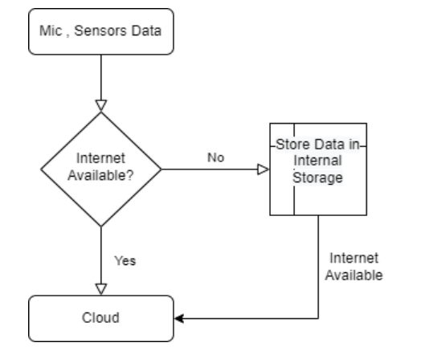

Slide 10
Summary Table
Sl.no | Research Paper Title | Problem specified | Authors access | Results
1 | IOT SMART ENGINE FOR DETECTING RAILWAY CRACK (2023) | The cracks and other problems with the rails generally go unnoticed due to improper maintenance and irregular manual track line monitoring that is being carried out in the current situation. | This system is mainly concerned in identifying the cracks in railway tracks and helps to prevent the accidents without manual power. | The robot starts moving and detecting the cracks by using 2 IR sensors then the robot automatically stops and send the location where the crack is detected through GPS to the server by using IOT. By clicking on the location we can track the location through GPS module.

Slide 11
Sl.no | Research Paper title | Problem specified | Authors Access | Results
2 | A Novel SMS-Based Crack Detection System(2023) | The problem specified faced here is that there is no reliable and affordable equipment to diagnose train track issues and the lack of proper maintenance.. | Authors thought of making the current proposed model that speaks of a proposed test train design for detecting obstacles and cracks in the tracks. | the current system the mean absolute percentage error generated by the sensor is less than 0.4% making it very efficient for surface and sub-surface crack detection.

Slide 12
Sl.no | Research Paper title | Problem specified | Authors Access | Results
3 | Development of location tracking system via short message service (SMS) | One of the devices used is GSM / GPRS SIM is designed on a tracking system using SMS that runs on Android. Android-based devices have become a mobile operating system that is very popular in recent years. But if the android is off it cannot be functioned | Arduino performs some task that the author examines the tracking device system that can be tracked via cell phone using SMS with specific codes that can be read by the device itself. | This tool is tested based on messages sent to cell phones, messages with Google Maps addresses when GPS does not receive signals, messages when GPS receives signals and messages when the tracking device is reset via SMS.

Slide 13
Sl.no | Research Paper title | Problem specified | Authors Access | Results
4 | Iot Based Sensor Network for Crack & Bend Monitoring in Railway Track(2022) | there is no efficient and cost-effective technology to detect problems in the rail tracks and the lack of proper | The system performs two main functions. The first one is detecting the crack on the railway track by using the sensor and the second one is detecting the object by using IR sensor. | This proposed system not only overcomes the problems but also improves accuracy on crack detection in rails and most economical solution provided in order to achieve good results in railways. Also reduces the stats of accidents caused

Slide 14
Sl.no | Research Paper title | Problem specified | Authors Access | Results
5 | A Review On IOT Based Railway Track Crack Detection with Live Video Streaming (2019) | problems with the rails unnoticed due to improper maintenance and irregular manual track line monitoring that is being carried out in the current situation. | It is mainly concerned in identifying the cracks in railway tracks and helps to prevent the accidents without manual power. | The entire data of this model is to ensure that defective rails can be found in time to stop derailment of trains, to save the loss of lives and property.

Slide 15
Sl.no | Research Paper title | Problem specified | Authors Access | Results
6 | Intelligent Railway Track Crack And Obstacle Detection Using IOT(2023) | Most of the accidents within the train are caused due to major cracks or obstacle within the railway track. | It proposes intelligent railway track crack and obstacle detection system using the Internet of Things (IoT). The system is designed to detect cracks and obstacles on railway tracks and alert the railway authorities in real- time, thus ensuring safe and uninterrupted train operations | the most economical solution provided in order to achieve good results of railways of our country in order to minimize the stats of accidents caused. There by possible to save precious lives of passengers and loss of economy.

Slide 16
Sl.no | Research Paper title | Problem specified | Authors Access | Results
7 | IoT Based Railway Track Faults Detection and Localization Using Acoustic Analysis (2022) | Regular maintenance and delayed problem detection, generates severe concerns about the security of rail transit operations in India. As a result, numerous severe incidents have occurred in recent years, resulting in significant human and financial damage. | Authors look forward to put these arrangements based on locomotives rather than railway carts and gather more fault types or data from other terrains such as desert, and mountains, bridges and tunnels | This section focuses on the performance and outcomes of the various classifiers and equipment's that are used in here to perform the functions based on the sources provided.

Slide 17
Sl.no | Research Paper title | Problem specified | Authors Access | Results
8 | IoT Based Railway Track Faults Detection and Localization Using Acoustic Analysis(2022) | Due to human error, manually driven systems are insufficient to monitor the health of tracks routinely, reliably, frequently, and universally; Automatic identification and monitoring of track faults/cracks is vital. | Based on the performed function data can successfully assist in discriminating track defects and localizing these defects in real time. The results show that MLP achieved the best results, with an accuracy of 98.4 percent. | several automated systems have been developed to reduce efforts and boost the efficiency.

Slide 18
Sl.no | Research Paper title | Problem specified | Authors Access | Results
9 | Railway Track Crack Detection Using GPS and GSM (2022) | About a railway analysis is detection of cracks on track. If these damages are not controlled at early stages, they might lead to a number of derailments resulting in a heavy loss of life and property. | The model is designed with a camera which sends pictures and live videos. And send alert in form of SMS messages along with location by using GPS modules. It even includes distance measuring sensor which displays the track distance between the two tracks. | Based on the problem specified the railway crack detection system using IR Sensor is used . This avoids the train accidents by detecting the cracks on railway tracks.

Slide 19
Sl.no | Research Paper title | Problem specified | Authors Access | Results
10 | IOT BASED FAULT DETECTION IN RAILWAY TRACK SYSTEM (2023) | Sometimes crack can not be seen to loco pilot and there could be accidents happened and passengers are dead | The system utilizes a combination of sensors, wireless communication, and data analysis techniques. The system has the potential to significantly reduce the risk of accidents and improve the safety of rail transportation, while also reducing maintenance costs and improving the efficiency of railway operations. | Based on the object detection solution for ensuring the safety and security of railway systems. It uses a combination of sensors and cameras that are installed along the railway track to monitor it for any signs of damage or obstructions.

Slide 20
System Requirements
Software Requirements:
Arduino C(programming Language).
ThingsPeakcloud.
Hardware Requirements:
Arduino Uno.
Motor DriverL293D.
GPS Module.
Internet Of Things(Cloud).
Ultrasonic Sensors.
IR Sensors.
Wi-Fi Device.
4 Wheel(2 free wheel).
12 volt Battery
Jumper Wires.
Buzzer.
Microcontroller(2 types):
atmega micro328P.
atmega16U2.

Slide 21
Feasibility Study of the Project
We use Arduino UNO Board, IR sensor, ultrasonic hc-sr04 sensor and Bluetooth model.
Arduino consist of processor course, memory and several input and output peripherals.
GPS module is used to send the location and mobile network service is used to send alert message to authority,also send the information to cloud through wifi device.
Although it would be quite costly in creating it.
It has ability to predict the maintanance of the particular area alongg with its older history of the accidents,as weather change,derailing and the soil
condition through the information stored in cloud ,before building new infrastructure.

Slide 22
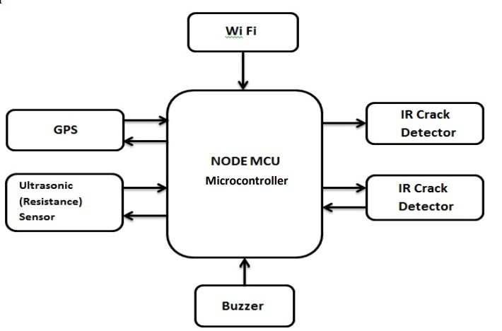
Architecture diagram
Cloud

Slide 23
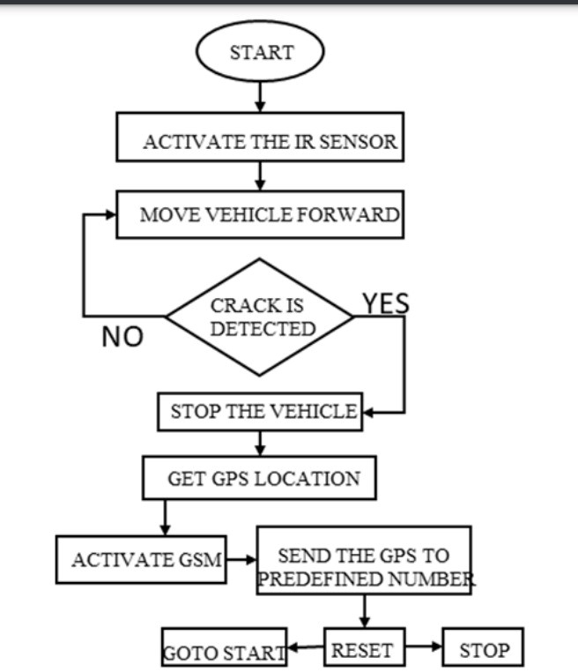
Flow chart of the Project
Wi-Fi
Cloud

Slide 24
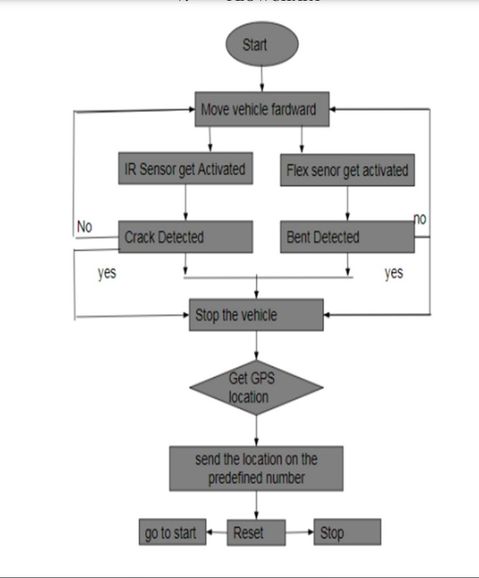
Data Flow Diagram
Move vehicle forward
Ultrasonic sensor activated
Send the data to cloud

Slide 25
Possible Outcomes
It is possible to create a simple yet effective and efficient ultrasonic distance measuring device that can take measurements comparable to any of the existing alternative measuring devices.
It is possible to create the ultrasonic distance measuring device to take measurements with minimal to no errors.
The device may not be cheap to a typical consumer, but the reusability of the device’s components will come in handy especially to tech enthusiasts.
The device’s operation is simple; therefore, it will not be complicated. But an improvement on the device’s portability would make it better.

Slide 26
References
Bongolan, Riyadh Renzo S. ‘ULTRASONIC DISTANCE MEASURING DEVICE’,2019.
Kharisma, O. B., Dzikra, A. A., Vebrianto, R., Novita, R., Novita, Y., Nazir, A., & Andriani, T. ‘Development of location tracking system via short message service (SMS) based on GPS unblox neo-6m and sim 800l module’. In Journal of Physics: Conference Series,pp. 1-7, Nov., 2019.
Pyle, Richard J., et al. ‘Deep learning for ultrasonic crack characterization in NDE’, IEEE Transactions on Ultrasonics, Ferroelectrics, and Frequency Control, pp. 1854-1865, 2020.
Microsonic. (2019). Ultrasonic principle.
https://www.microsonic.de/en/support/ultrasonictechnology/principle.htm.
Akhil N, Dinu Mohan, Fayis P, Sija Gopinath, “Railway Crack Detection System” ISSN 2395 0056 International Research Journal of Engineering and Technology Volume3, Issue-5, May 2016.
Prof.P. Navaraja. “Crack Detection System for Railway Track By Using Ultrasonic and PIR Sensor” ISSN 2348- 9928 International Journal of Advanced Information and Communication Technology Volume- 1, Issue-1, May2014.

Slide 27
A. Rizvi, P. Khan and D. Ahmad, "Crack Detection In Railway Track Using Image Processing", International Journal of Advance Research, Ideas and Innovations in Technology., vol. 3, no. 4, 2017.
S. Srivastava, R. Chaurasia, S. Abbas, P. Sharma and N. Singh, "Railway Track Crack Detection Vehicle", International Advanced Research Journal in Science, Engineering and Technology, vol. 4, no. 2, pp. 145-148, 2017.

Slide 28

13

