Slide 1
Data Acquisition
Orthophotos & Footprints
Model Development
Multi-Class U-Net
Weighted SCCE + Dice Loss
Model Evaluation
Accuracy & Spatial Metrics
Error Map Analysis
Scaling & monitoring
Regional Expansion
Periodic Model Retraining
Data Processing
512 x 512 Tiling
Rasterization
Mask Filtering
Class Weighting
Model Training
70% Training & 30% Validation
Callback & Optimization
Development
Batch Inference Pipeline
GIS Integration

Slide 2
Road
map
Of the Project
Data Acquisition & Preparation
Model Development & Optimization
Model Validation & Evaluation
Model Testing & Retraining
Deployment & Integration
Scaling & Maintenance

Slide 3
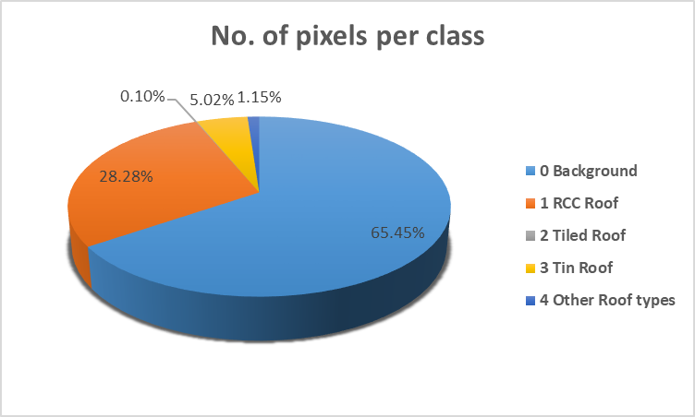
Features Class Distribution in Training Dataset
Values | Class | No. of Pixels per class
0 | Background | 216012504
1 | RCC Roof | 93348733
2 | Tiled Roof | 323656
3 | Tin Roof | 16563012
4 | Other Roofs | 3791391
As per features class distribution, Background noise is very higher throughout the dataset. To overcome this class imbalance, inverse frequency class weights are defined
Class | 0 | 1 | 2 | 3 | 4
Weights | 0.006749 | 0.0156196 | 4.50502233 | 0.0880321 | 0.3845758

