Slide 1
Predictive Auto Scaling
Major Project | Computer Science and Engineering
Dharmendra Kumar Gupta (26CSM1R35)
Satyam Kumar Azad (26CSM1R22)
Mentor: Dr. Manoj Kumar Patra
Academic Year: 2026-27

Slide 2
Problem and objectives
Reactive thresholds can react late to spikes.
Frequent decisions can cause oscillation and unnecessary cost.
Compare reactive control with forecast + safety margin + hysteresis.
Evaluate six workload patterns using latency, SLA, capacity, actions and cost proxy.

Slide 3
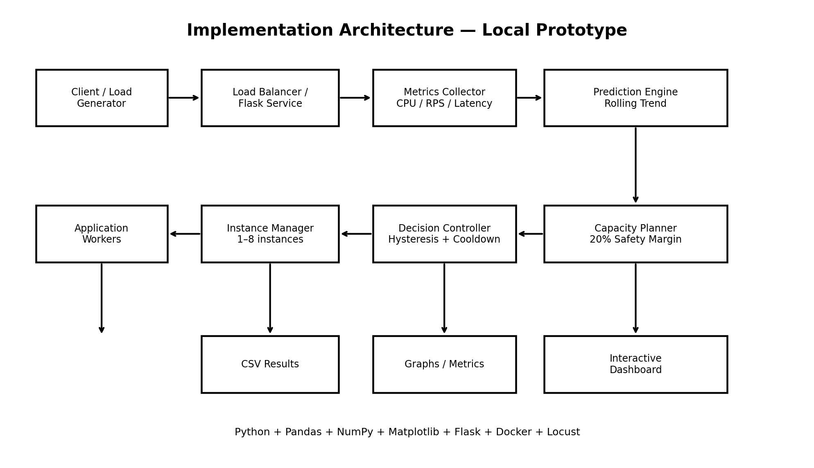
System architecture

Slide 4
Methodology
Generate fixed-seed workloads.
Run both controllers on identical scenario traces.
Model capacity per instance, warm-up delay, cooldown and SLA proxy.
Export raw CSVs, aggregate metrics, graphs and tests.

Slide 5
Benchmark scenarios
Stable demand
Gradual ramp
Sudden spikes
Repeated bursts
Noisy fluctuation
Spike and recovery

Slide 6
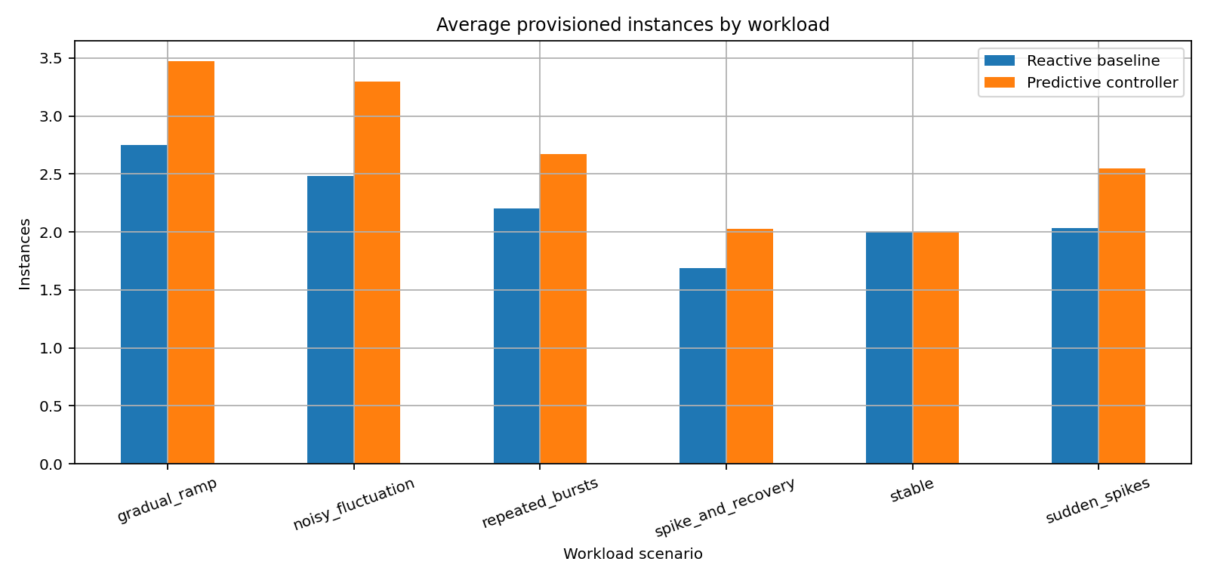
Average capacity comparison

Slide 7
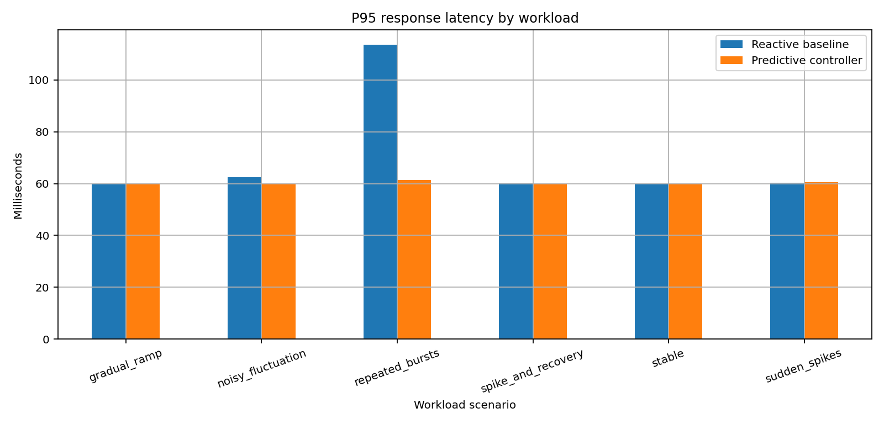
Tail latency comparison

Slide 8
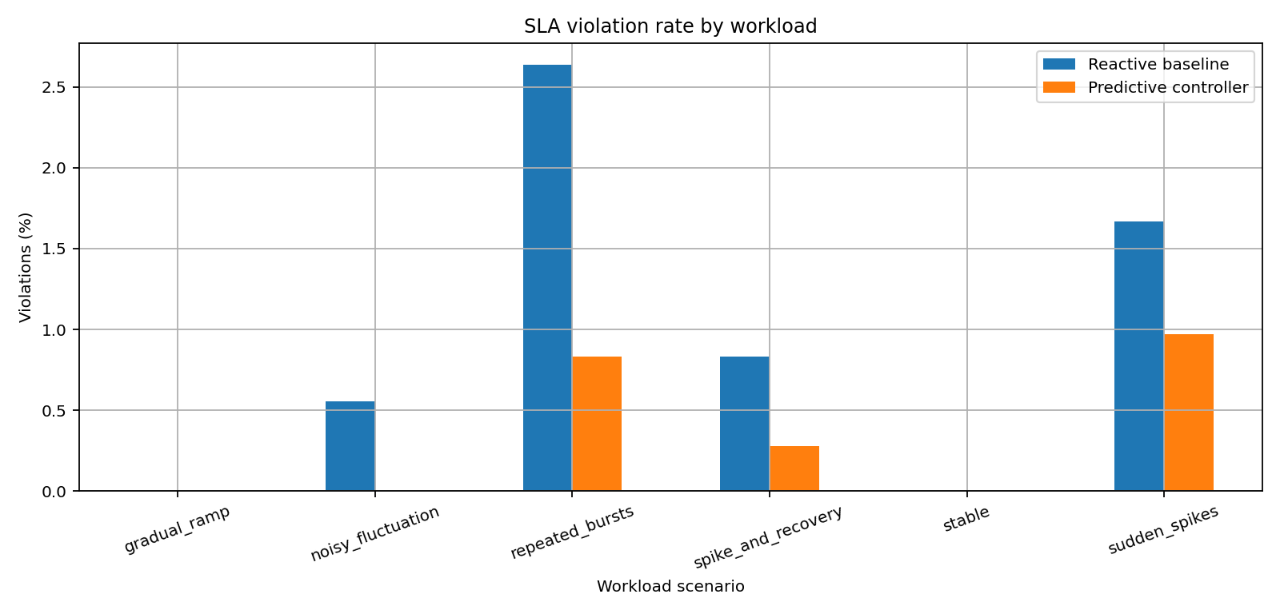
SLA comparison

Slide 9
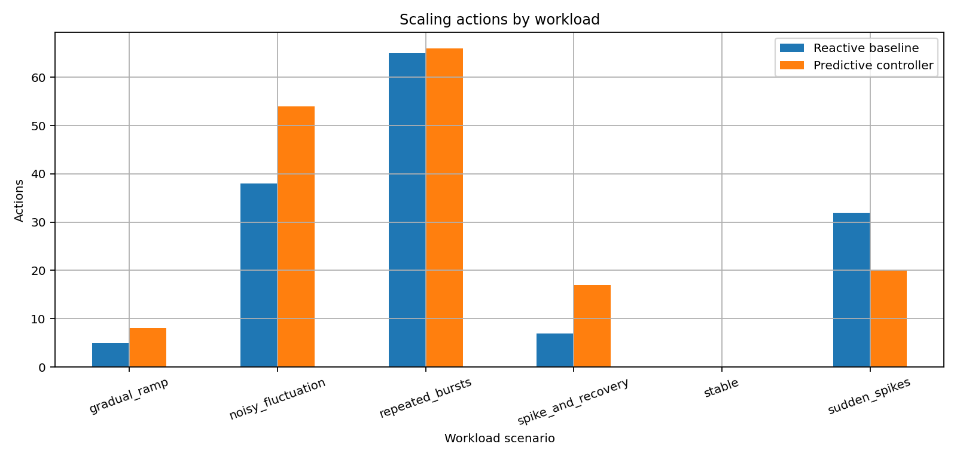
Scaling actions comparison

Slide 10
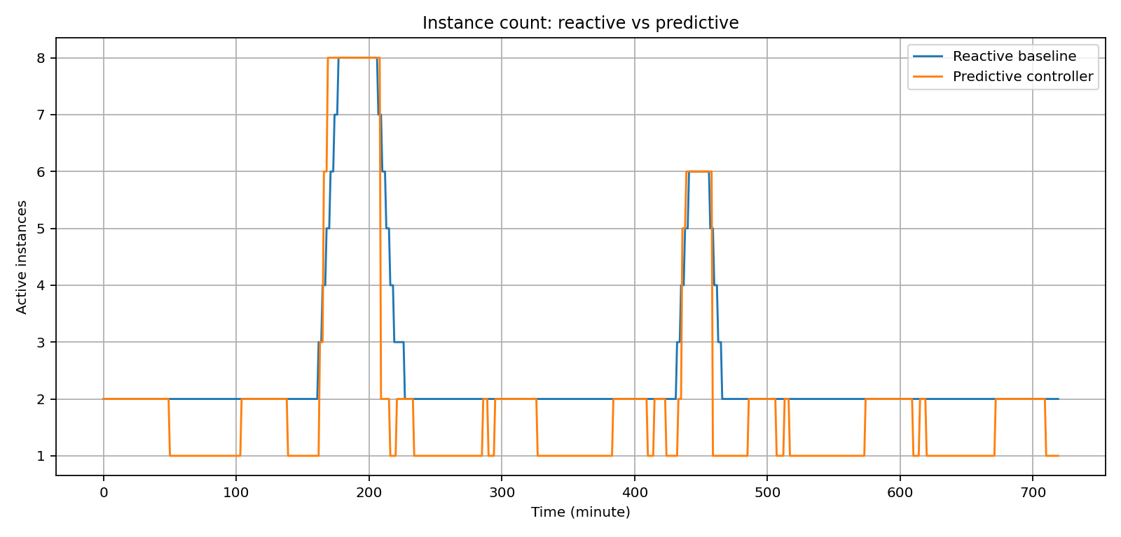
Demand and scaling timeline

Slide 11
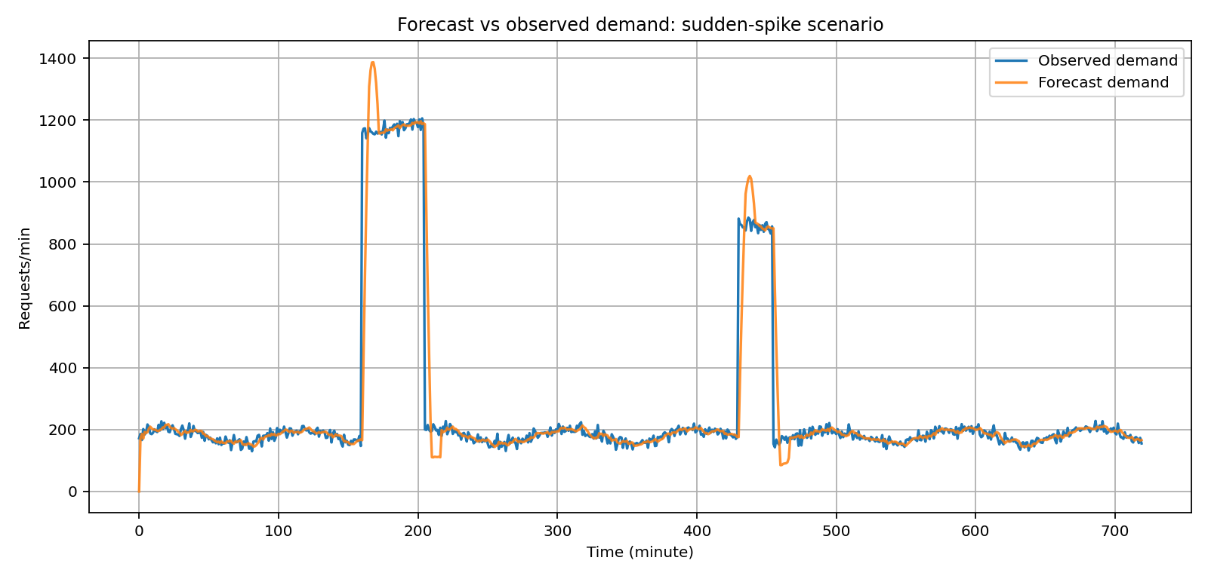
Forecast quality

Slide 12
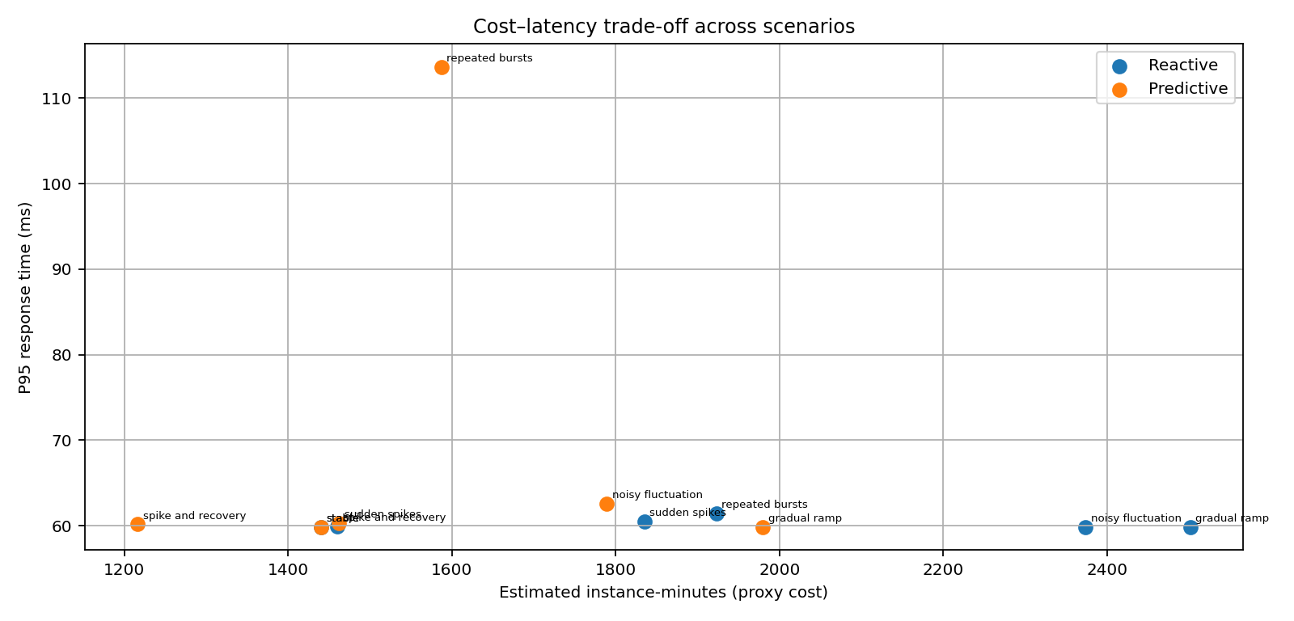
Cost–latency trade-off

Slide 13
Limitations and honest claims
All current benchmark values are simulated.
Synthetic workloads and simplified latency proxy.
Instance-minute count is a relative cost proxy, not billing.
Cloud deployment and real load testing remain future phases.

Slide 14
Roadmap to final major project
Compare additional forecasting models.
Run repeated seeds and report confidence intervals.
Integrate CPU/memory/queue metrics.
Run Locust against a real service.
Deploy to a cloud autoscaler or Kubernetes and measure actual outcomes.

Slide 15
Conclusion
The package now has a broader benchmark, raw traces, tests and graph-rich reporting.
The next quality milestone is same-trace baseline evaluation and real workload validation.

