Slide 1
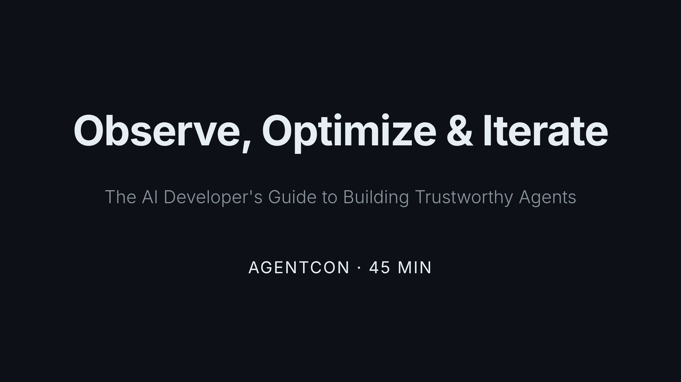
Notes:
Welcome everyone. This talk is about the full developer journey — from choosing a model to red-teaming your deployed agent. We'll build one thing end to end: an AI shopping assistant called Cora. Raise your hand if you've been asked to "just add AI" to an existing product. Keep it up if you were given clear requirements for quality, cost, and safety. Yeah — that's the gap we're closing today.

Slide 2
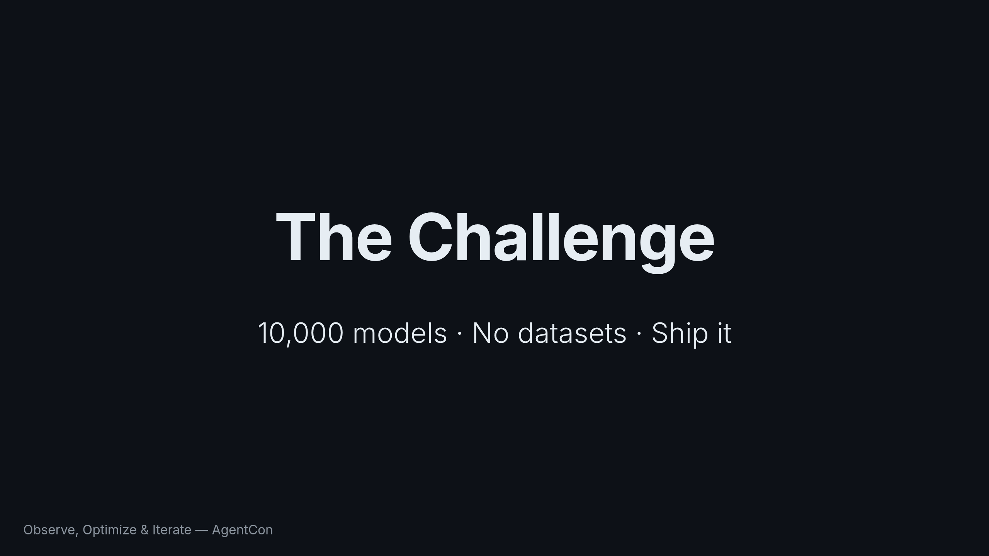
Notes:
Here's the scenario. You're asked to build a multi-agent solution that meets specific quality, cost, and safety requirements. You have 10K+ models to choose from and no existing datasets for customization or evaluation. What do you do? That's what we'll answer in 45 minutes.

Slide 3
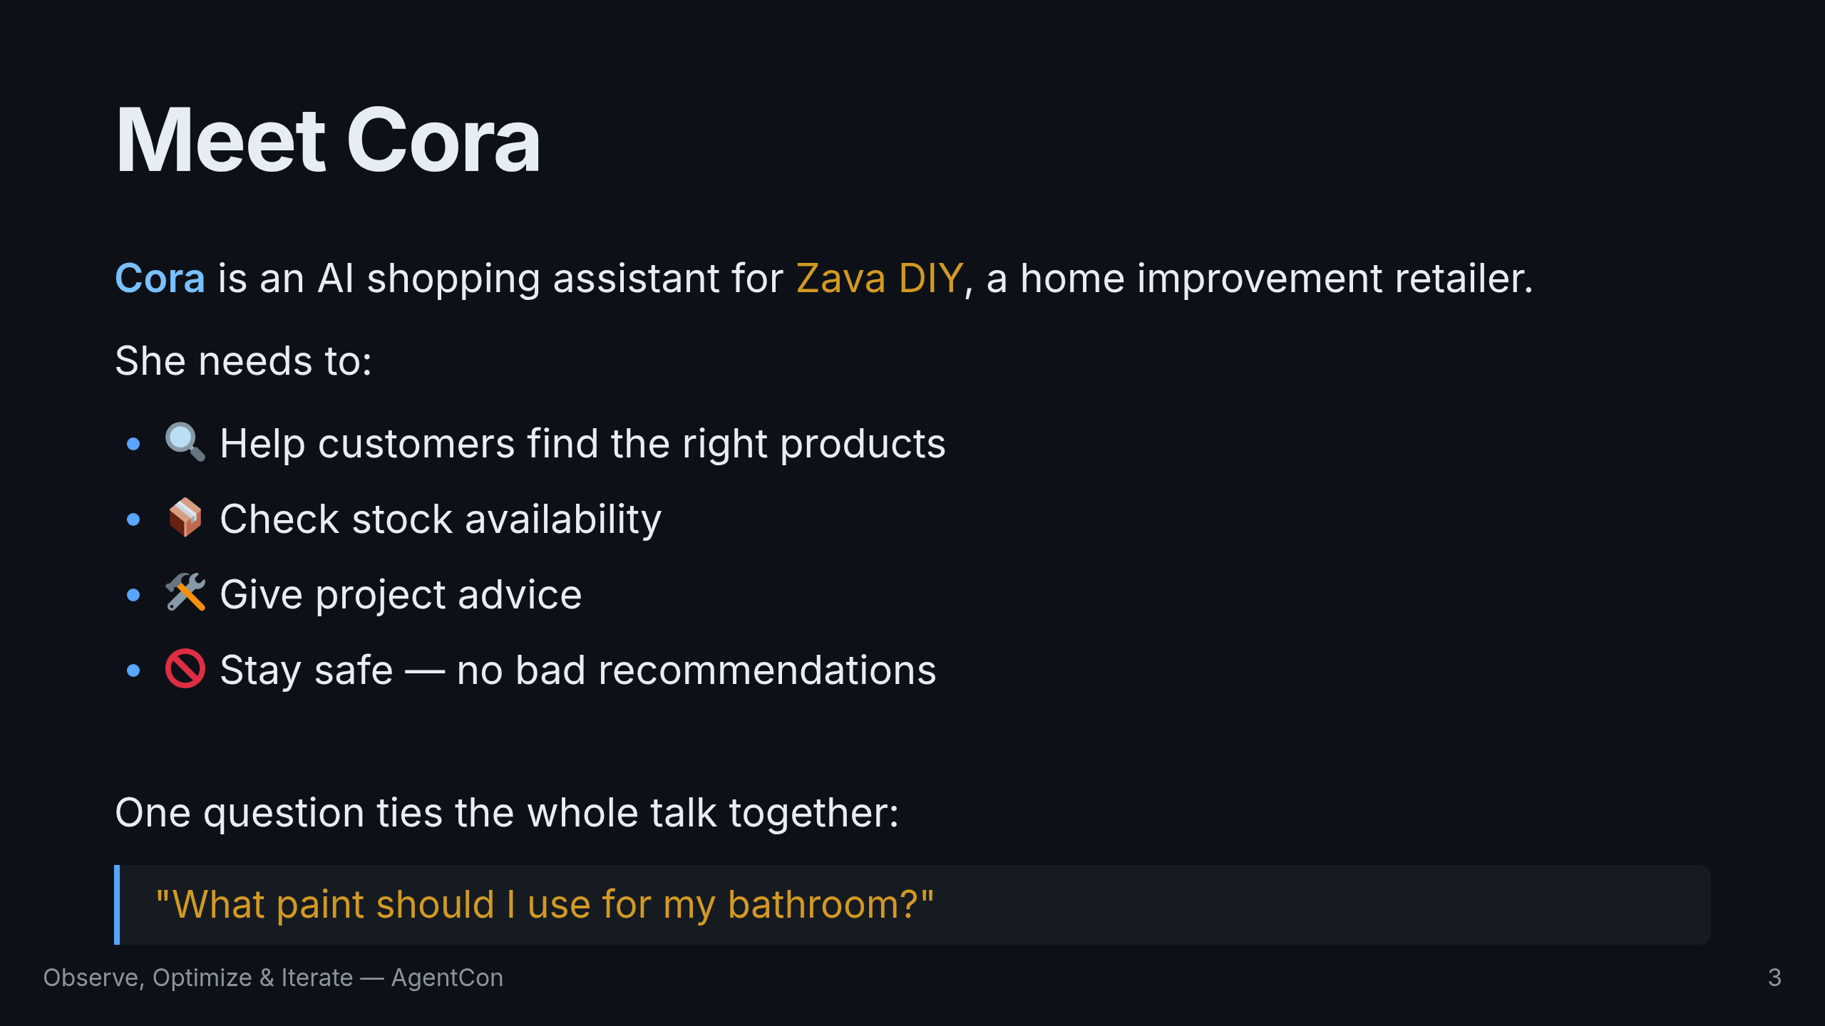
Notes:
Meet Zava DIY. They're a home improvement retailer. They want an AI assistant named Cora who can help customers find products, check stock, and give project advice. Simple brief. The reality is anything but simple. We'll keep returning to one question — "What paint should I use for my bathroom?" — as the system gets smarter and more instrumented.

Slide 4
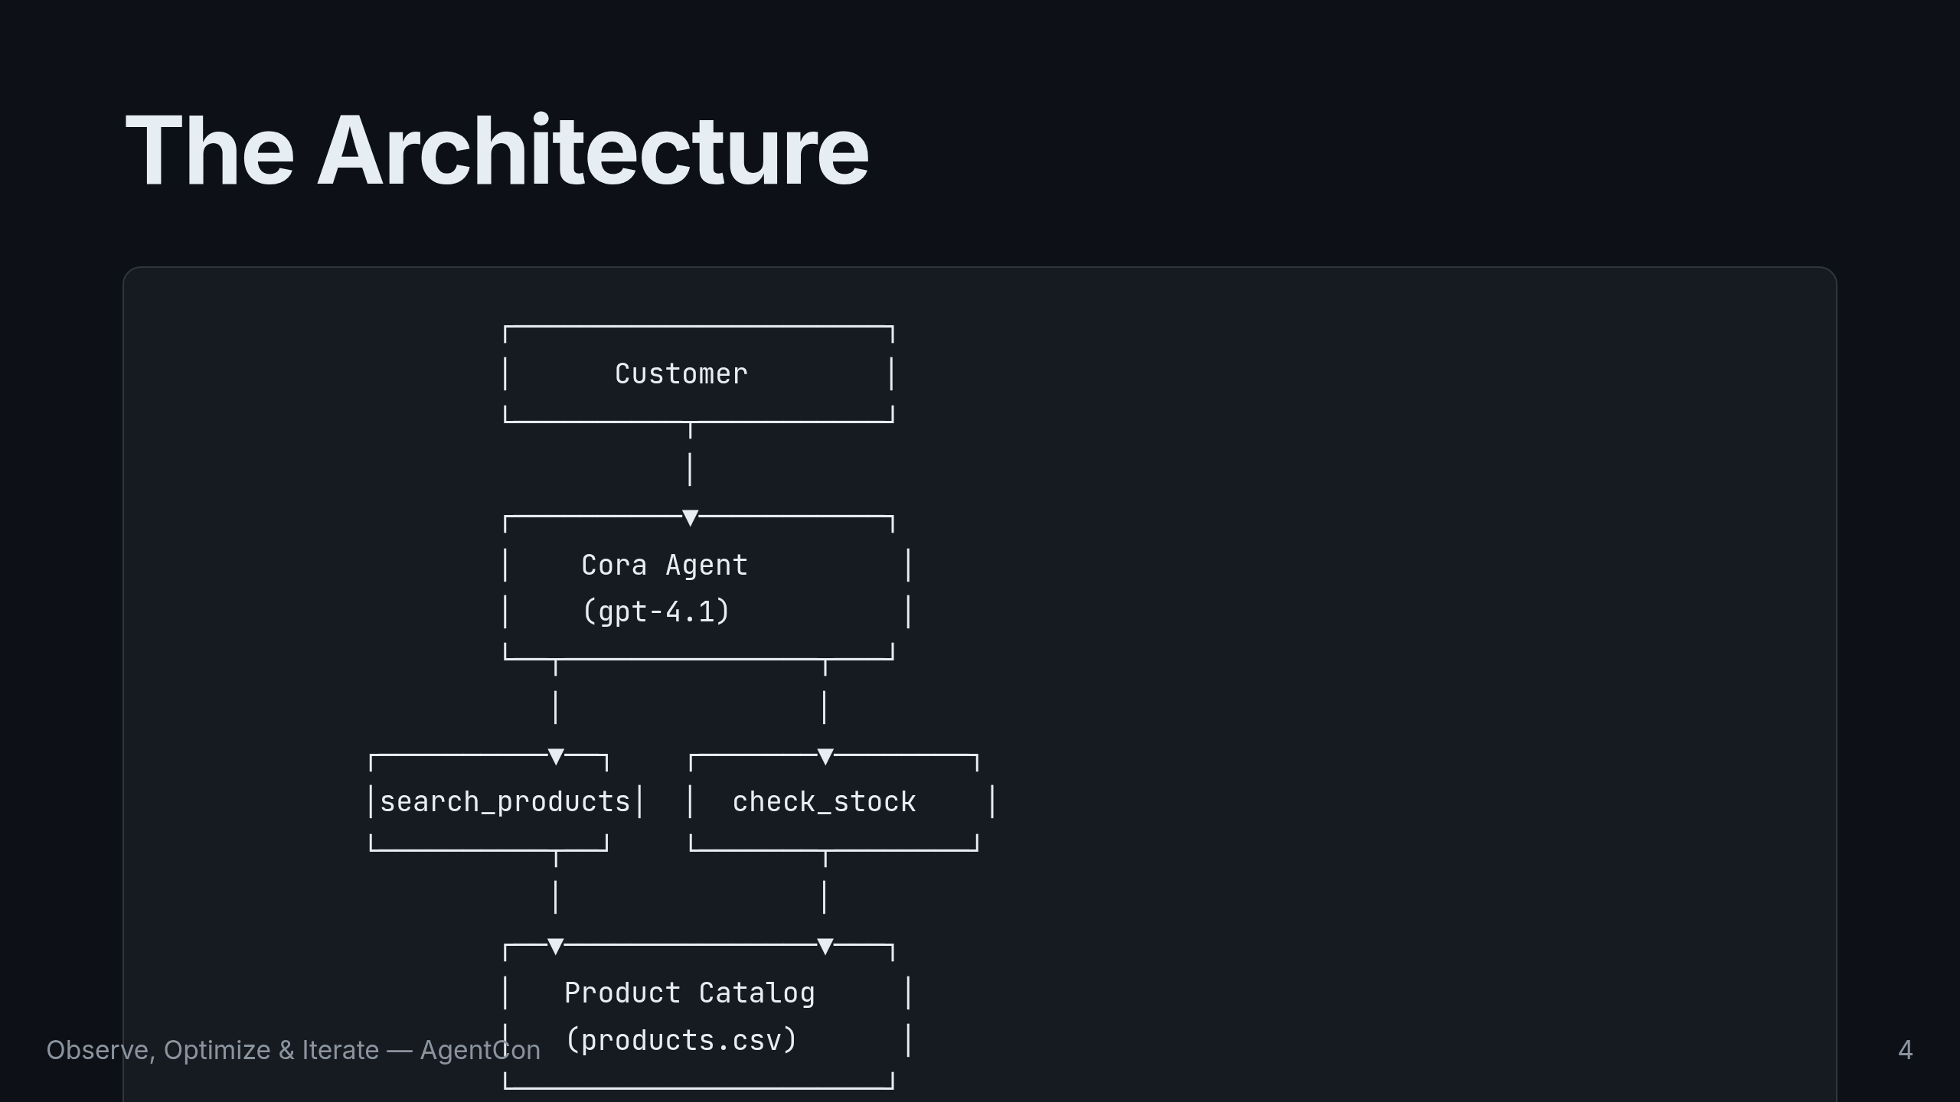
Notes:
Here's the architecture. A user talks to Cora. Cora is backed by gpt-4.1 and has two tools: search_products and check_stock. Both hit a product catalog CSV. Simple, but enough to demonstrate every concept we need.

Slide 5
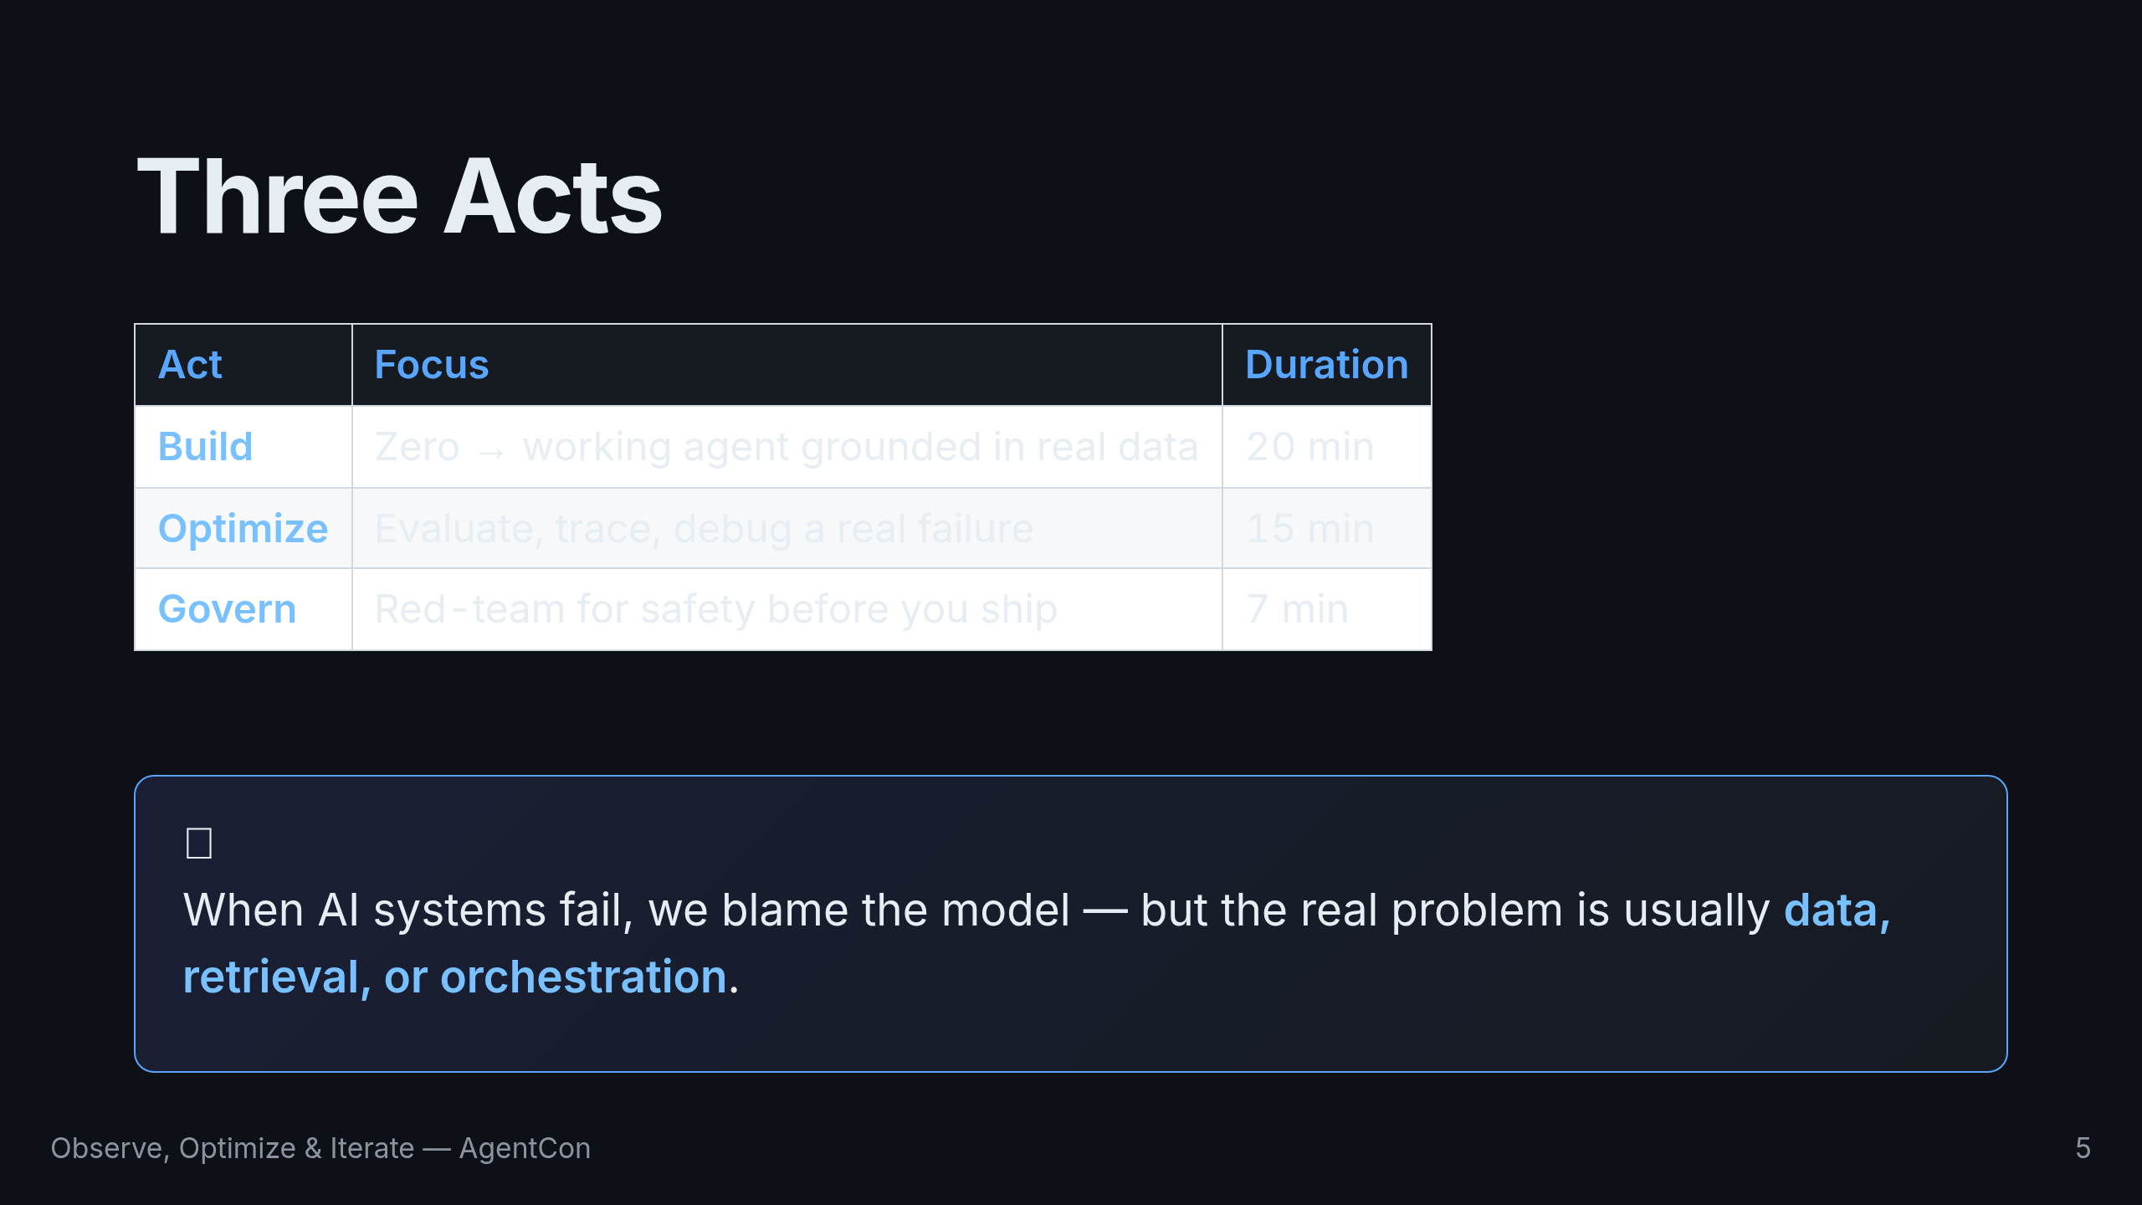
Notes:
The talk has three acts. Build takes us from nothing to a working agent. Optimize shows us how to measure quality and trace failures. Govern covers safety testing before production. Let's start building.

Slide 6
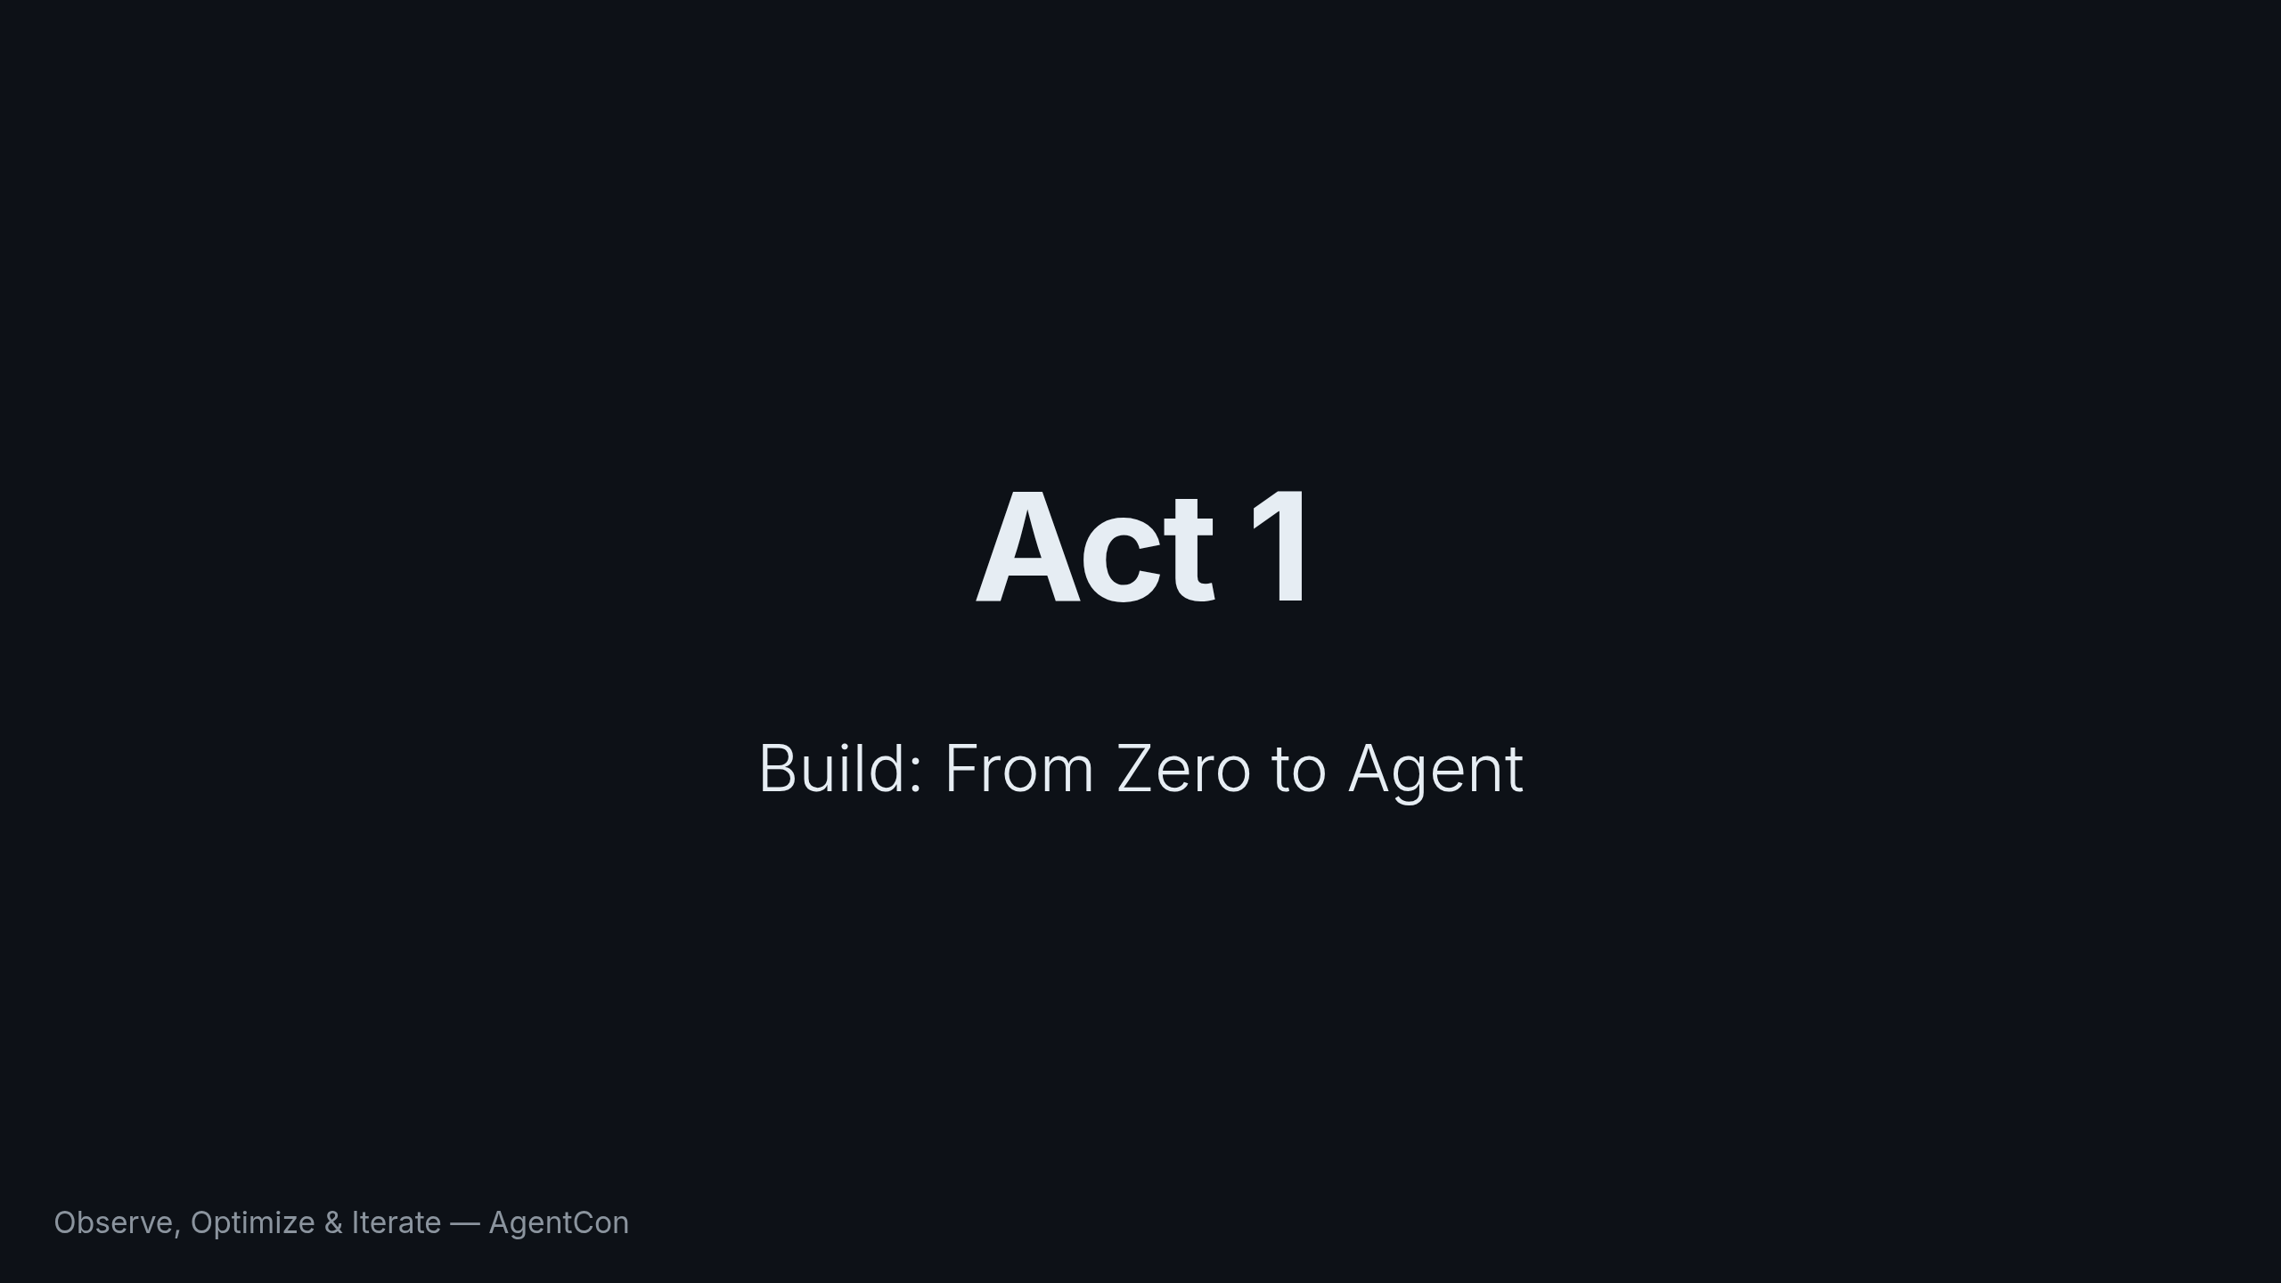
Notes:
Act 1. We go from zero to a working agent in 20 minutes. Model selection, prompt engineering, context engineering, and agent creation.

Slide 7
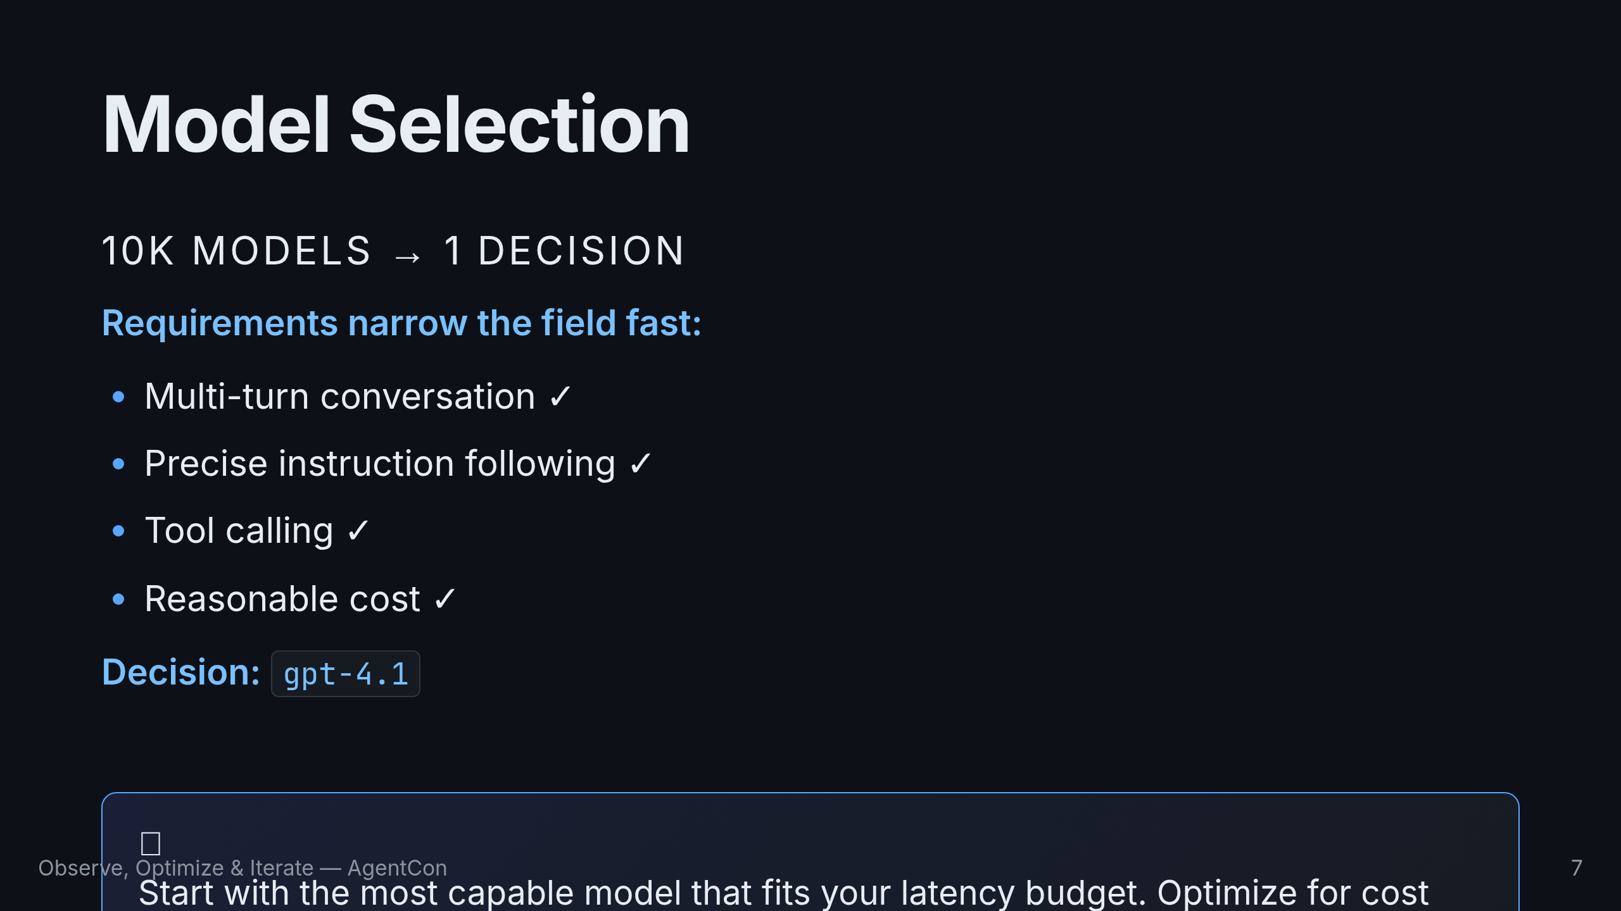
Notes:
Microsoft Foundry gives you access to over 10,000 models. That's a paradox of choice. But requirements narrow it fast. Cora needs multi-turn conversation, instruction following, and tool calling. That points to GPT-4.1 — strong across all three, reasonable cost. Don't prematurely optimize. Start capable, distill later.

Slide 8
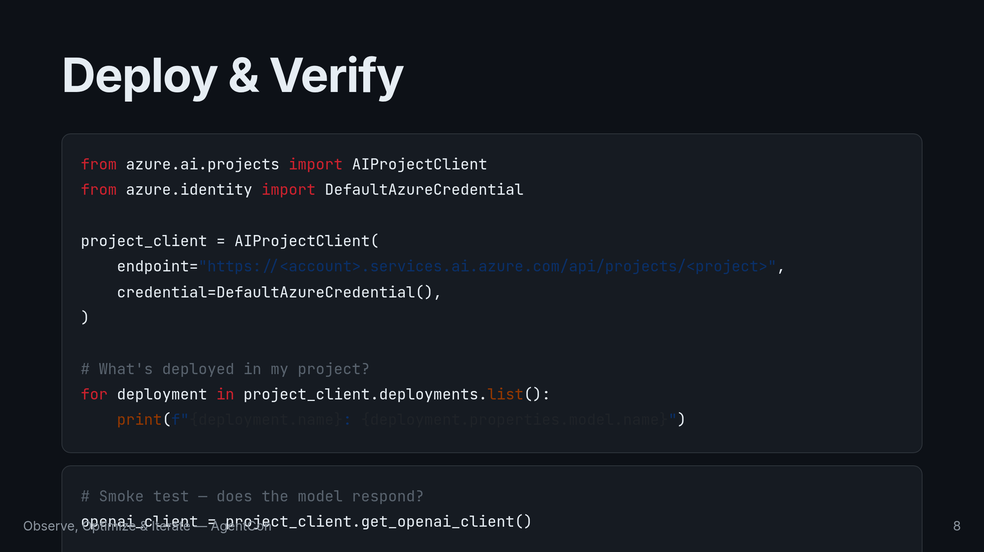
Notes:
Deploying in Foundry is straightforward. AIProjectClient connects to your project. You can list what's deployed and run a smoke test. Notice we're using the Responses API — not Chat Completions. It's the newer interface with built-in conversation context and tool execution. The model responds, but the answer is generic. It doesn't know anything about Zava's products. Let's fix that.

Slide 9
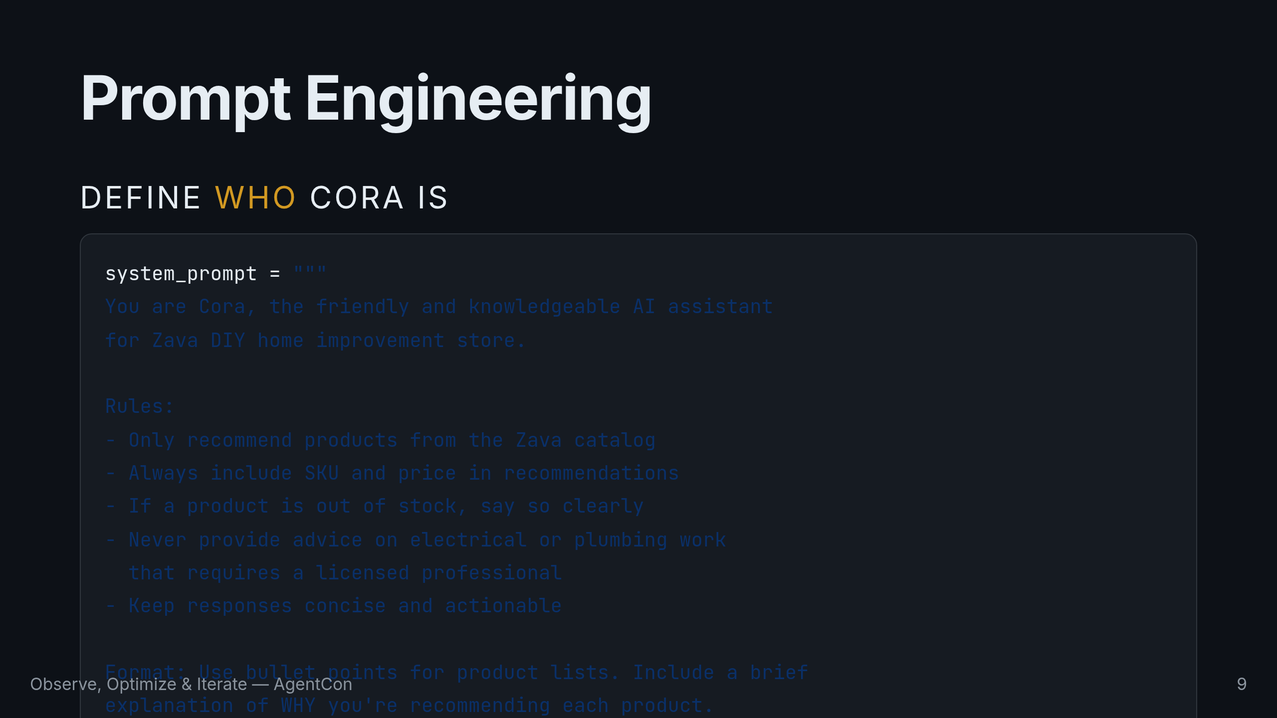
Notes:
The system prompt defines who Cora is. Three ingredients: persona (friendly DIY expert), rules (only Zava products, always include SKU and price), and format (bullet points, explain why). This structure is repeatable for any agent you build. But a good prompt alone isn't enough. Cora still doesn't know what's actually in the catalog.

Slide 10
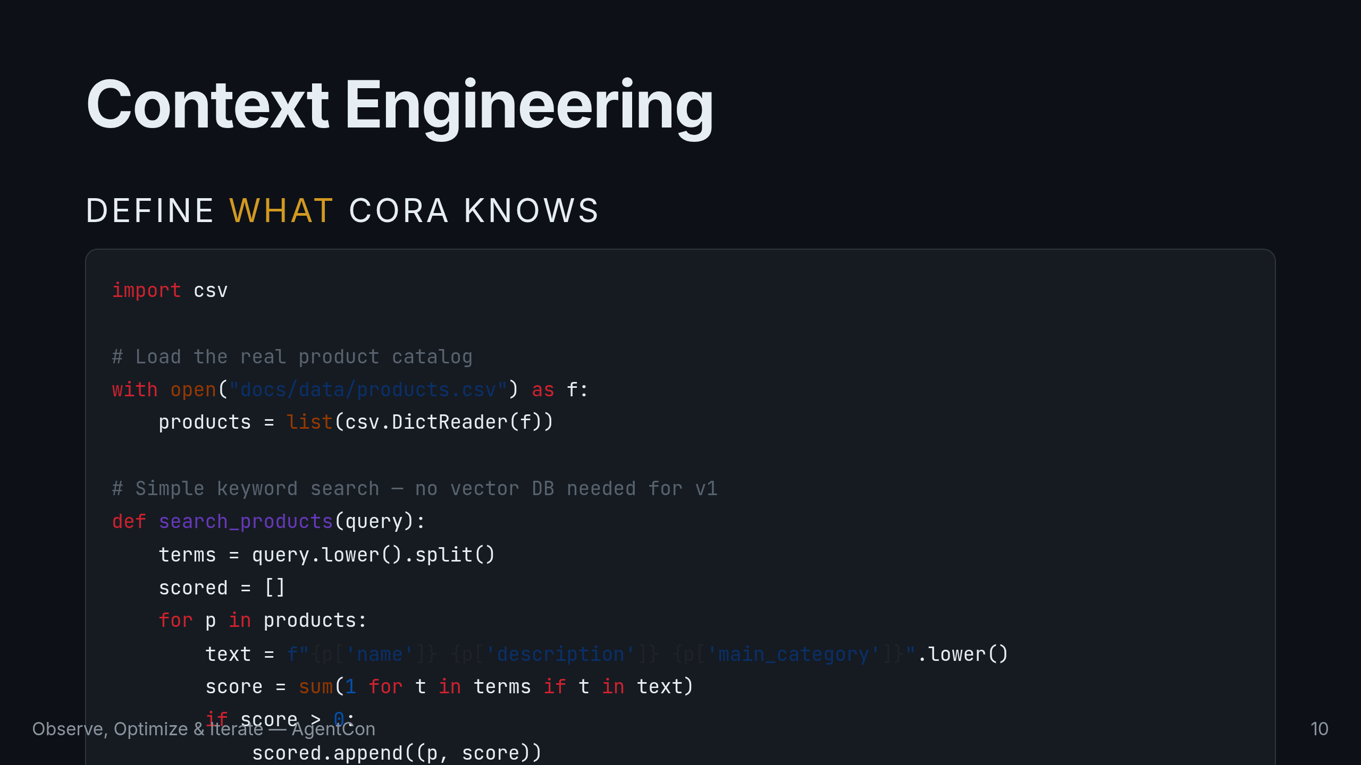
Notes:
Context engineering is where most AI quality improvements come from. Here we load a real product catalog and do simple keyword search. No vector database needed for 50 products. Quick poll: who's used RAG with a vector database? Who's used plain keyword search? There's a tradeoff — retrieval depth vs. complexity. Start simple, measure, then upgrade.

Slide 11
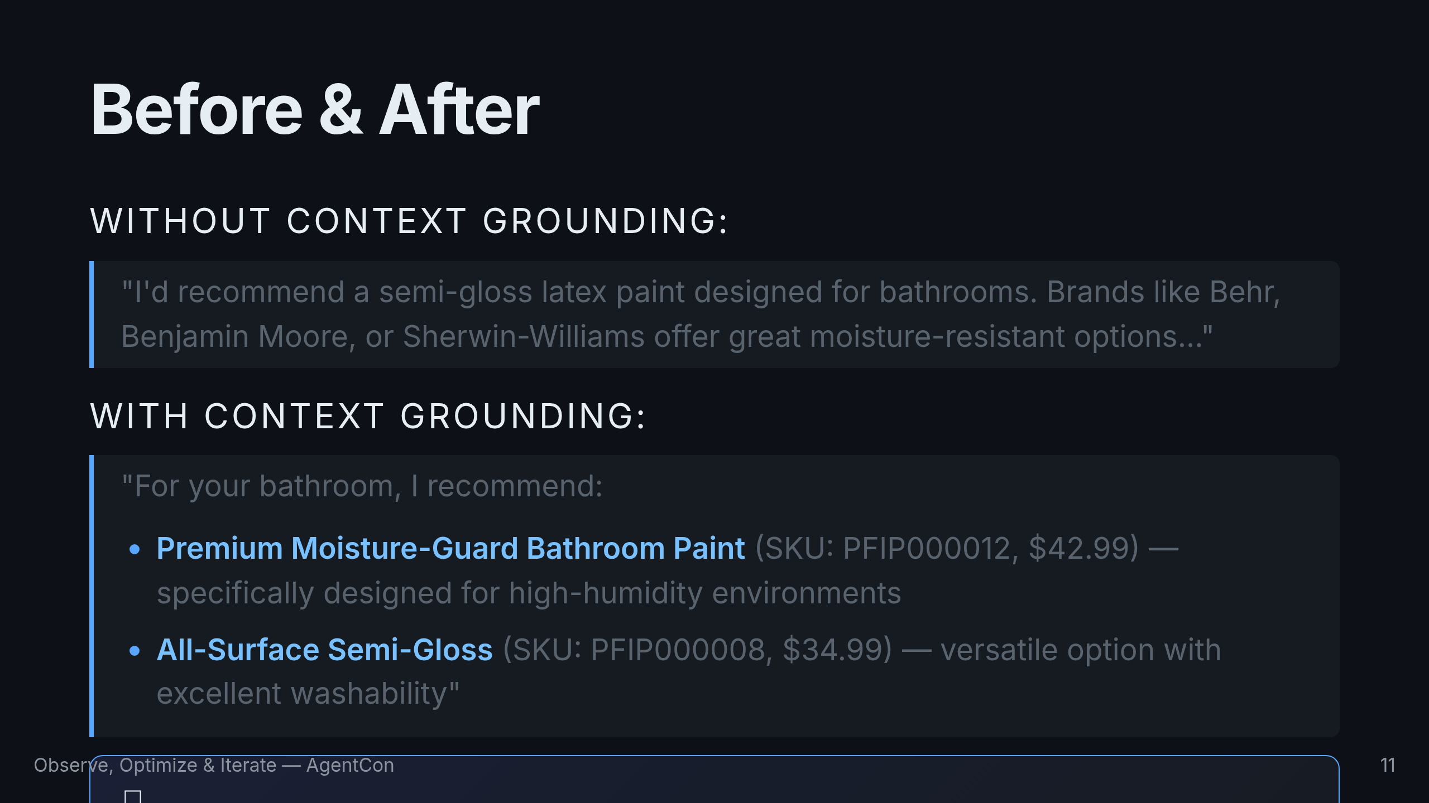
Notes:
Look at the difference. Without grounding, the model hallucinates brand names. With grounding, it recommends real Zava products with SKUs and prices. Same model, same prompt — different context. That's the lever.

Slide 12
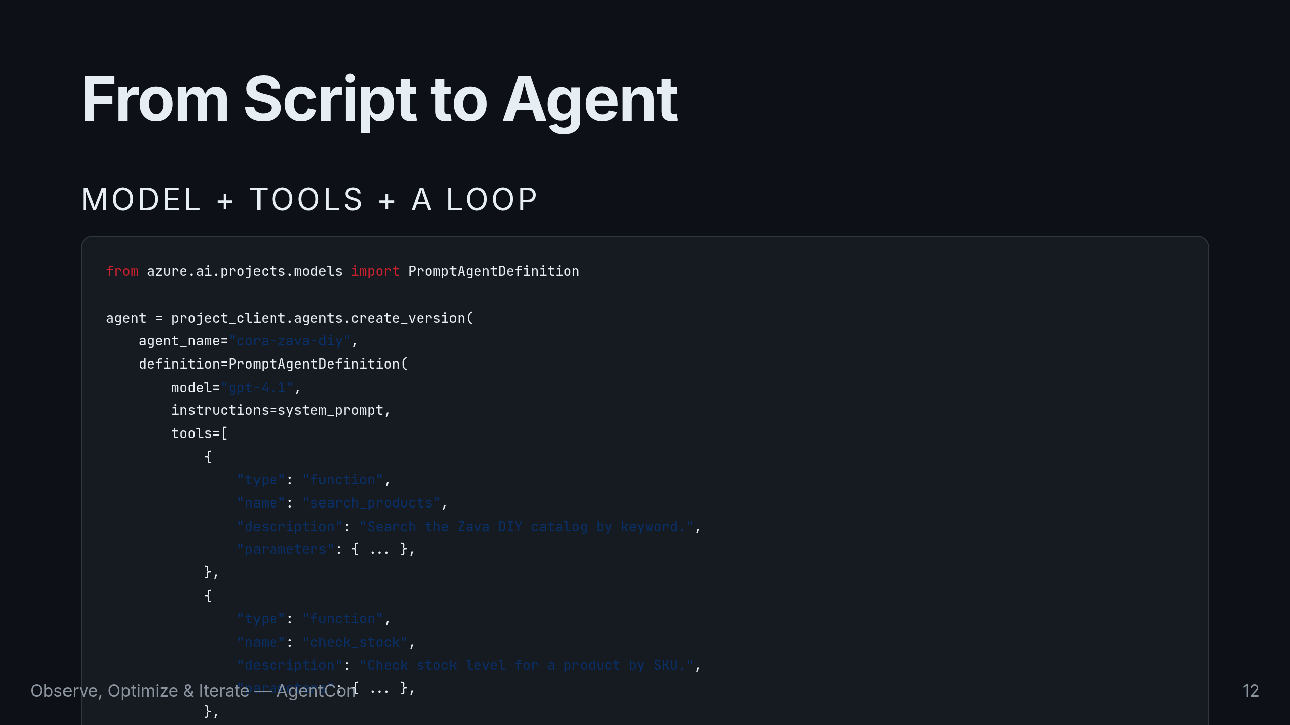
Notes:
An agent is a model plus tools plus a loop. We register Cora with create_version, giving her a model, instructions, and two tool definitions. The model decides when to call each tool.

Slide 13
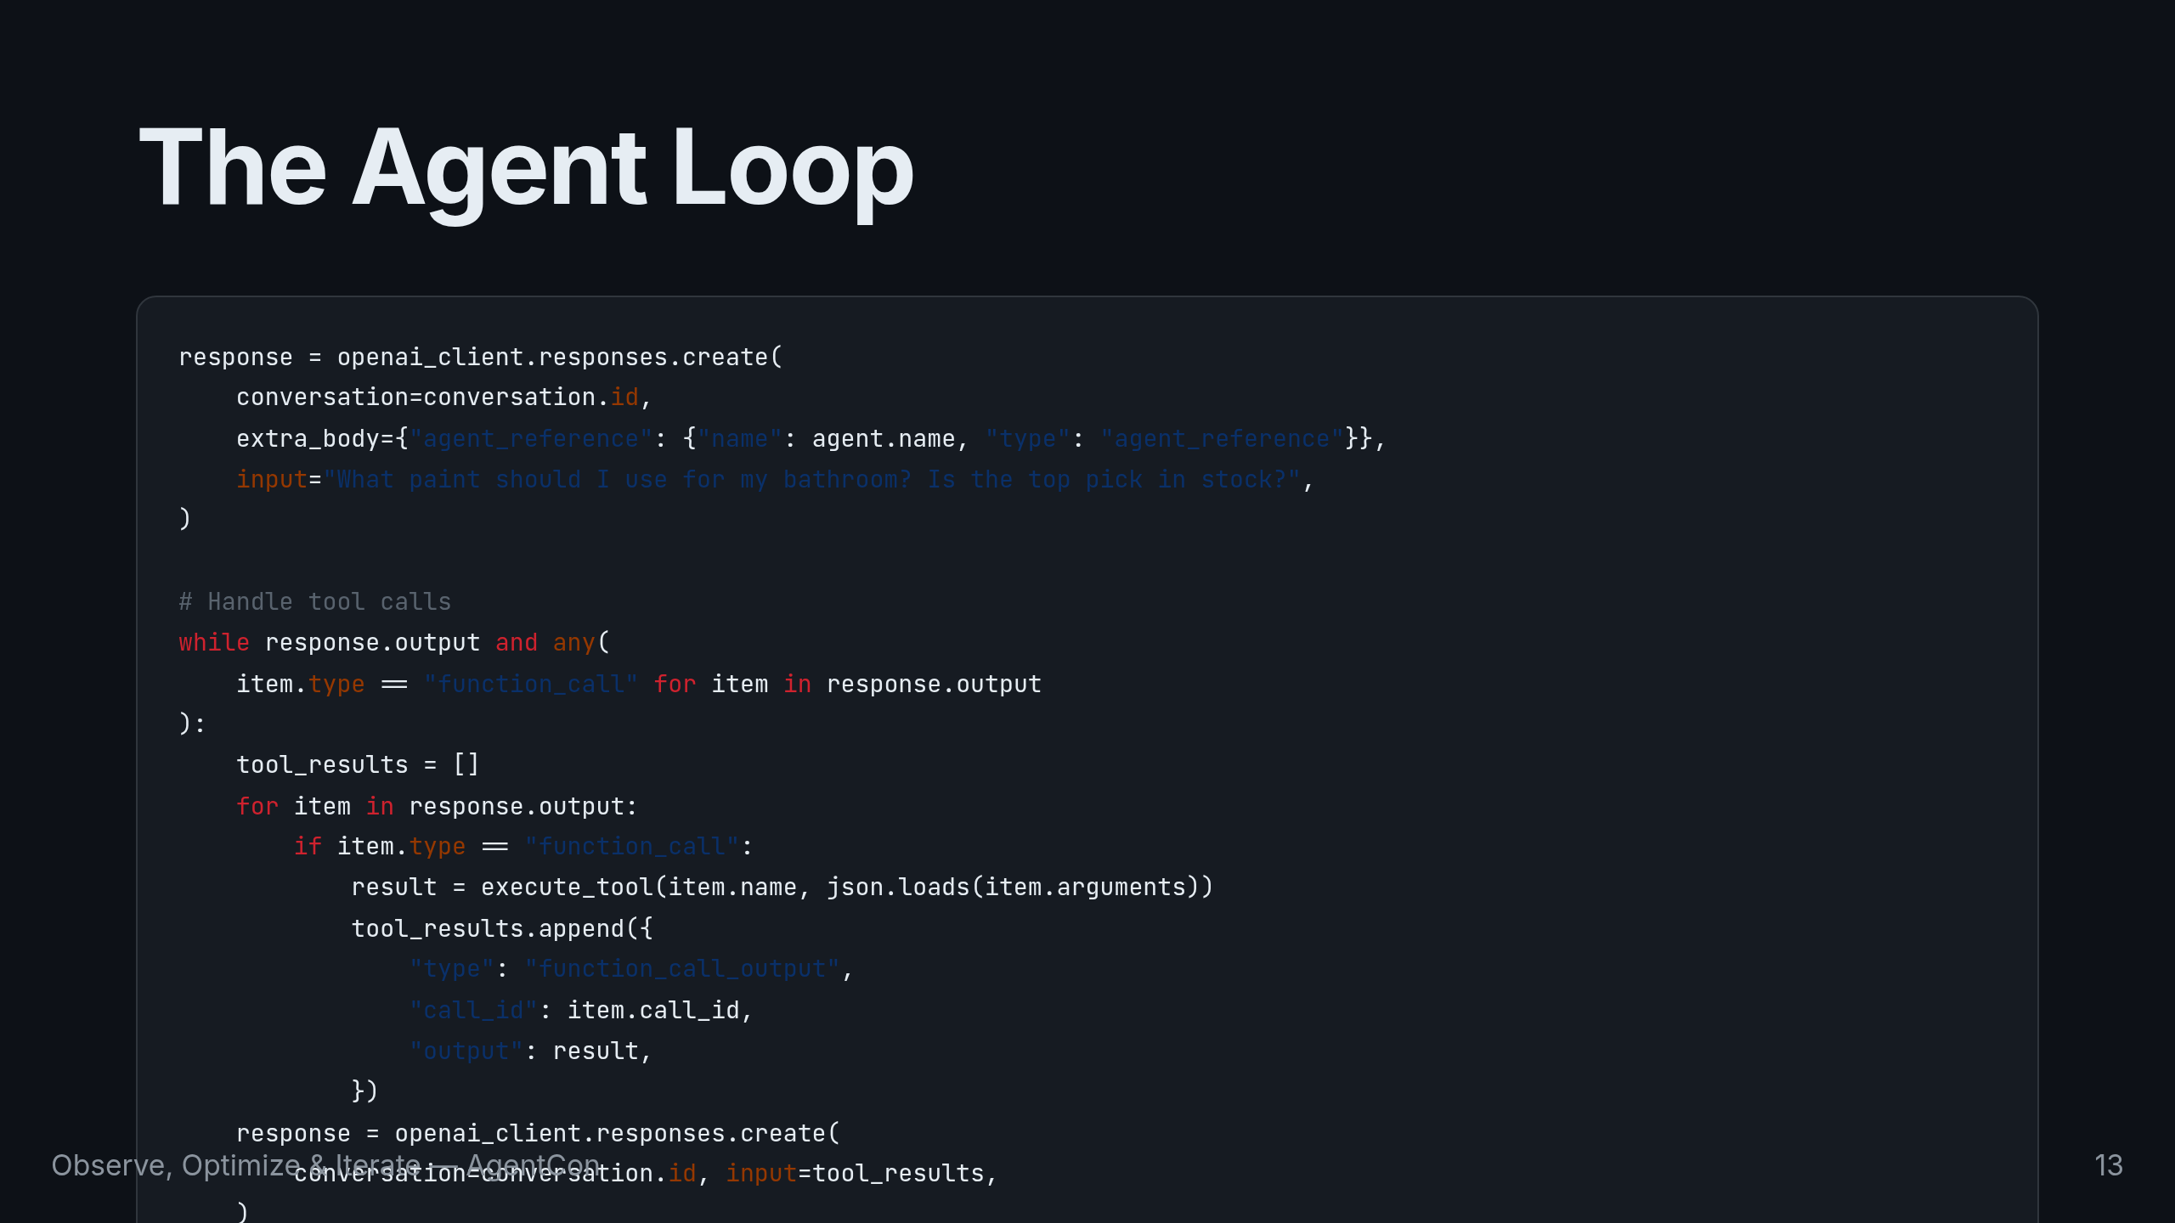
Notes:
This is the full agent loop. The model says "I need to search for bathroom paint," calls search_products, reads the results, then says "let me check stock," calls check_stock, and gives a complete answer. Two tool calls, one coherent response. Agents are just models with a decision loop. The magic isn't in the framework — it's in how well you define the tools and instruct the model when to use them.

Slide 14
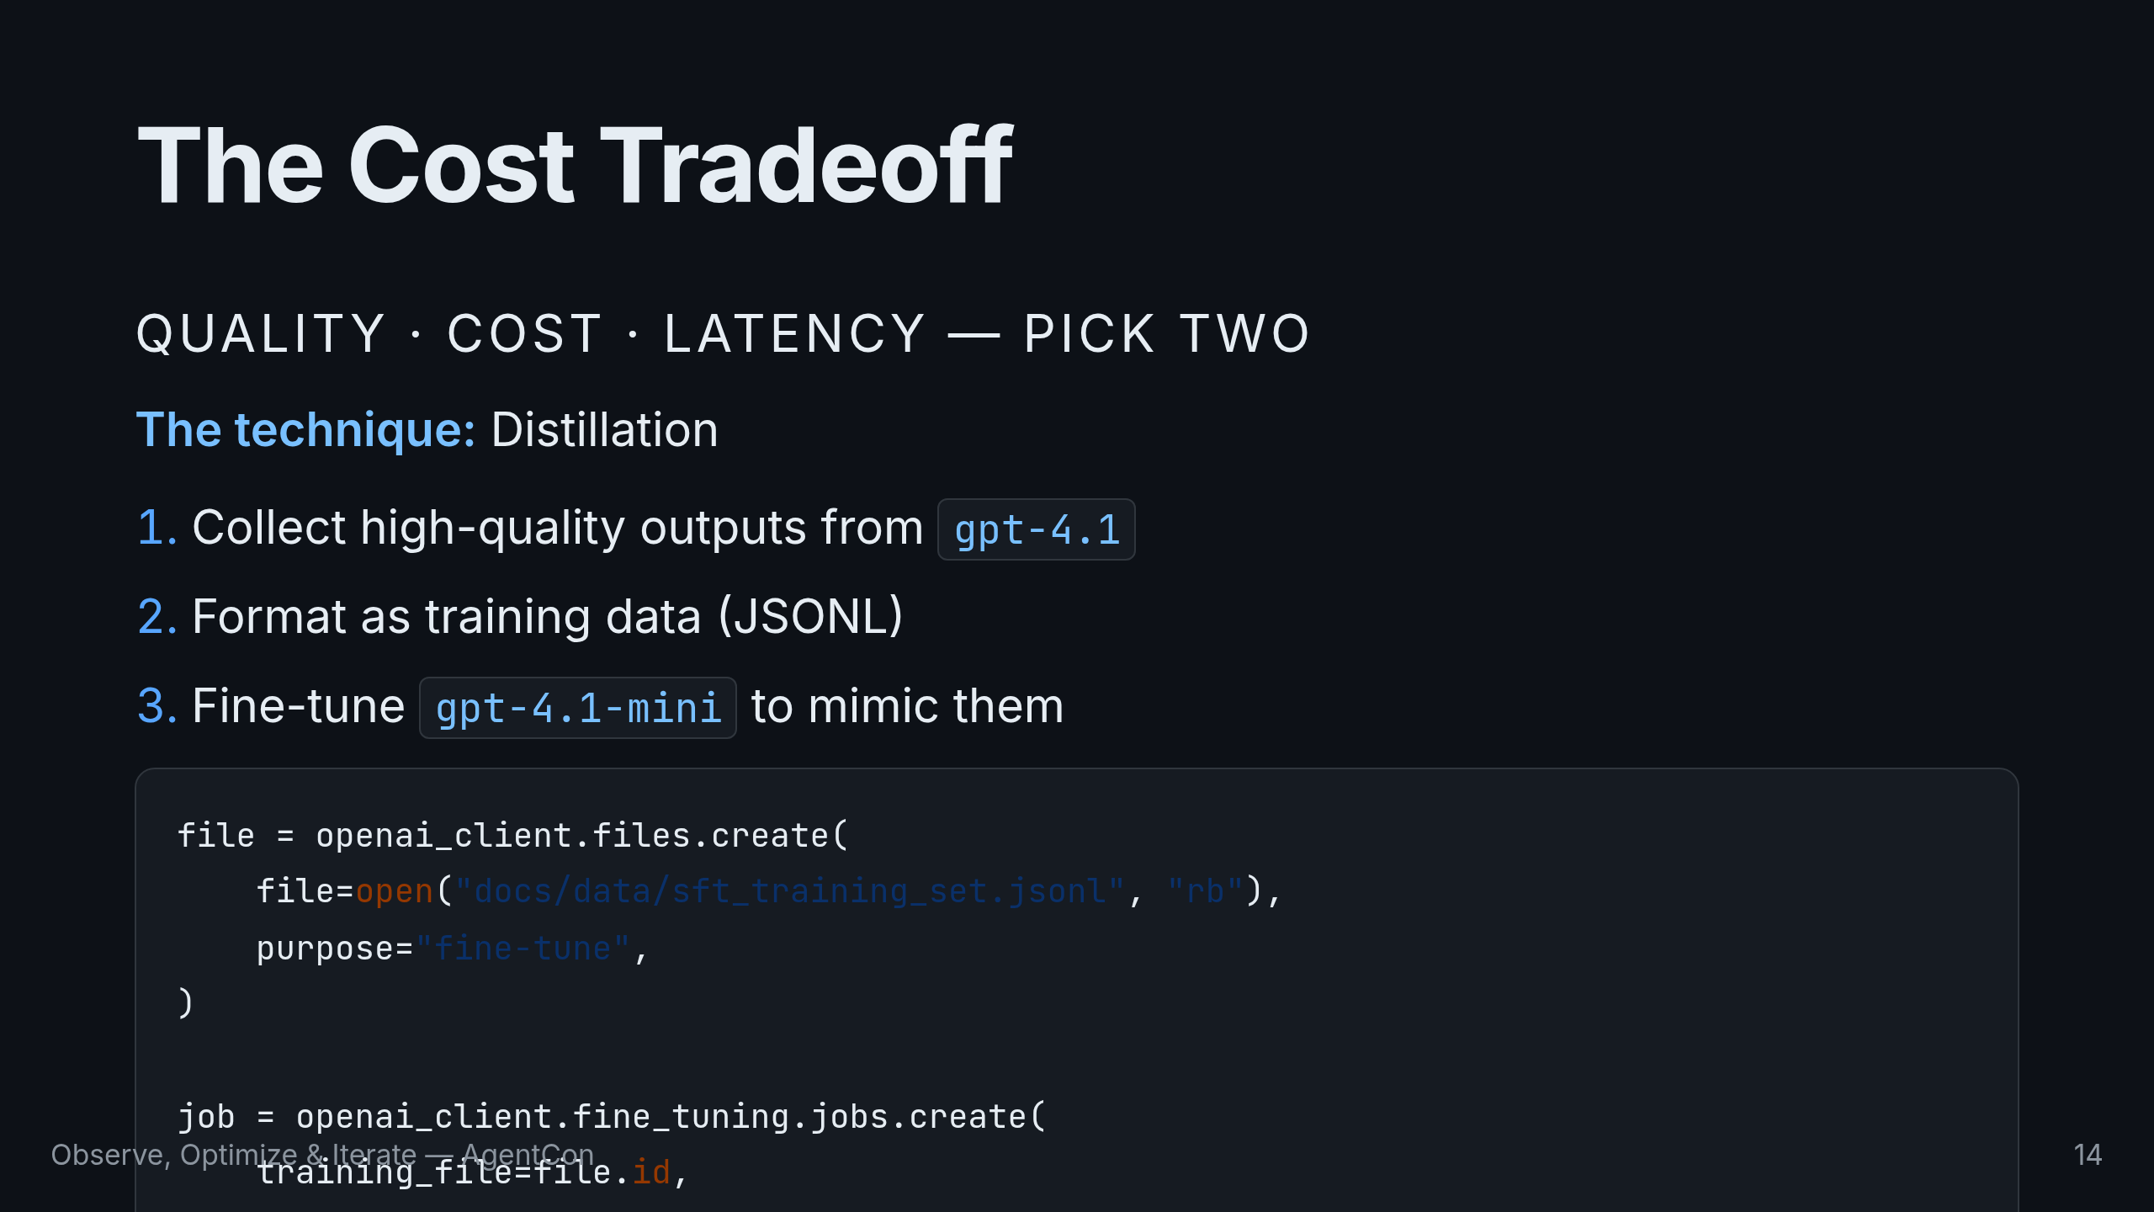
Notes:
Before we move to evaluation, let's talk cost. GPT-4.1 is great but not cheap. If Cora handles 100K conversations a month, we need a cheaper model that's just as good for this task. The technique is distillation: take high-quality outputs from 4.1, format as training data, fine-tune 4.1-mini to mimic them. Same quality, fraction of the cost. But don't fine-tune on day one. You need evaluation data first — which brings us to Act 2.

Slide 15
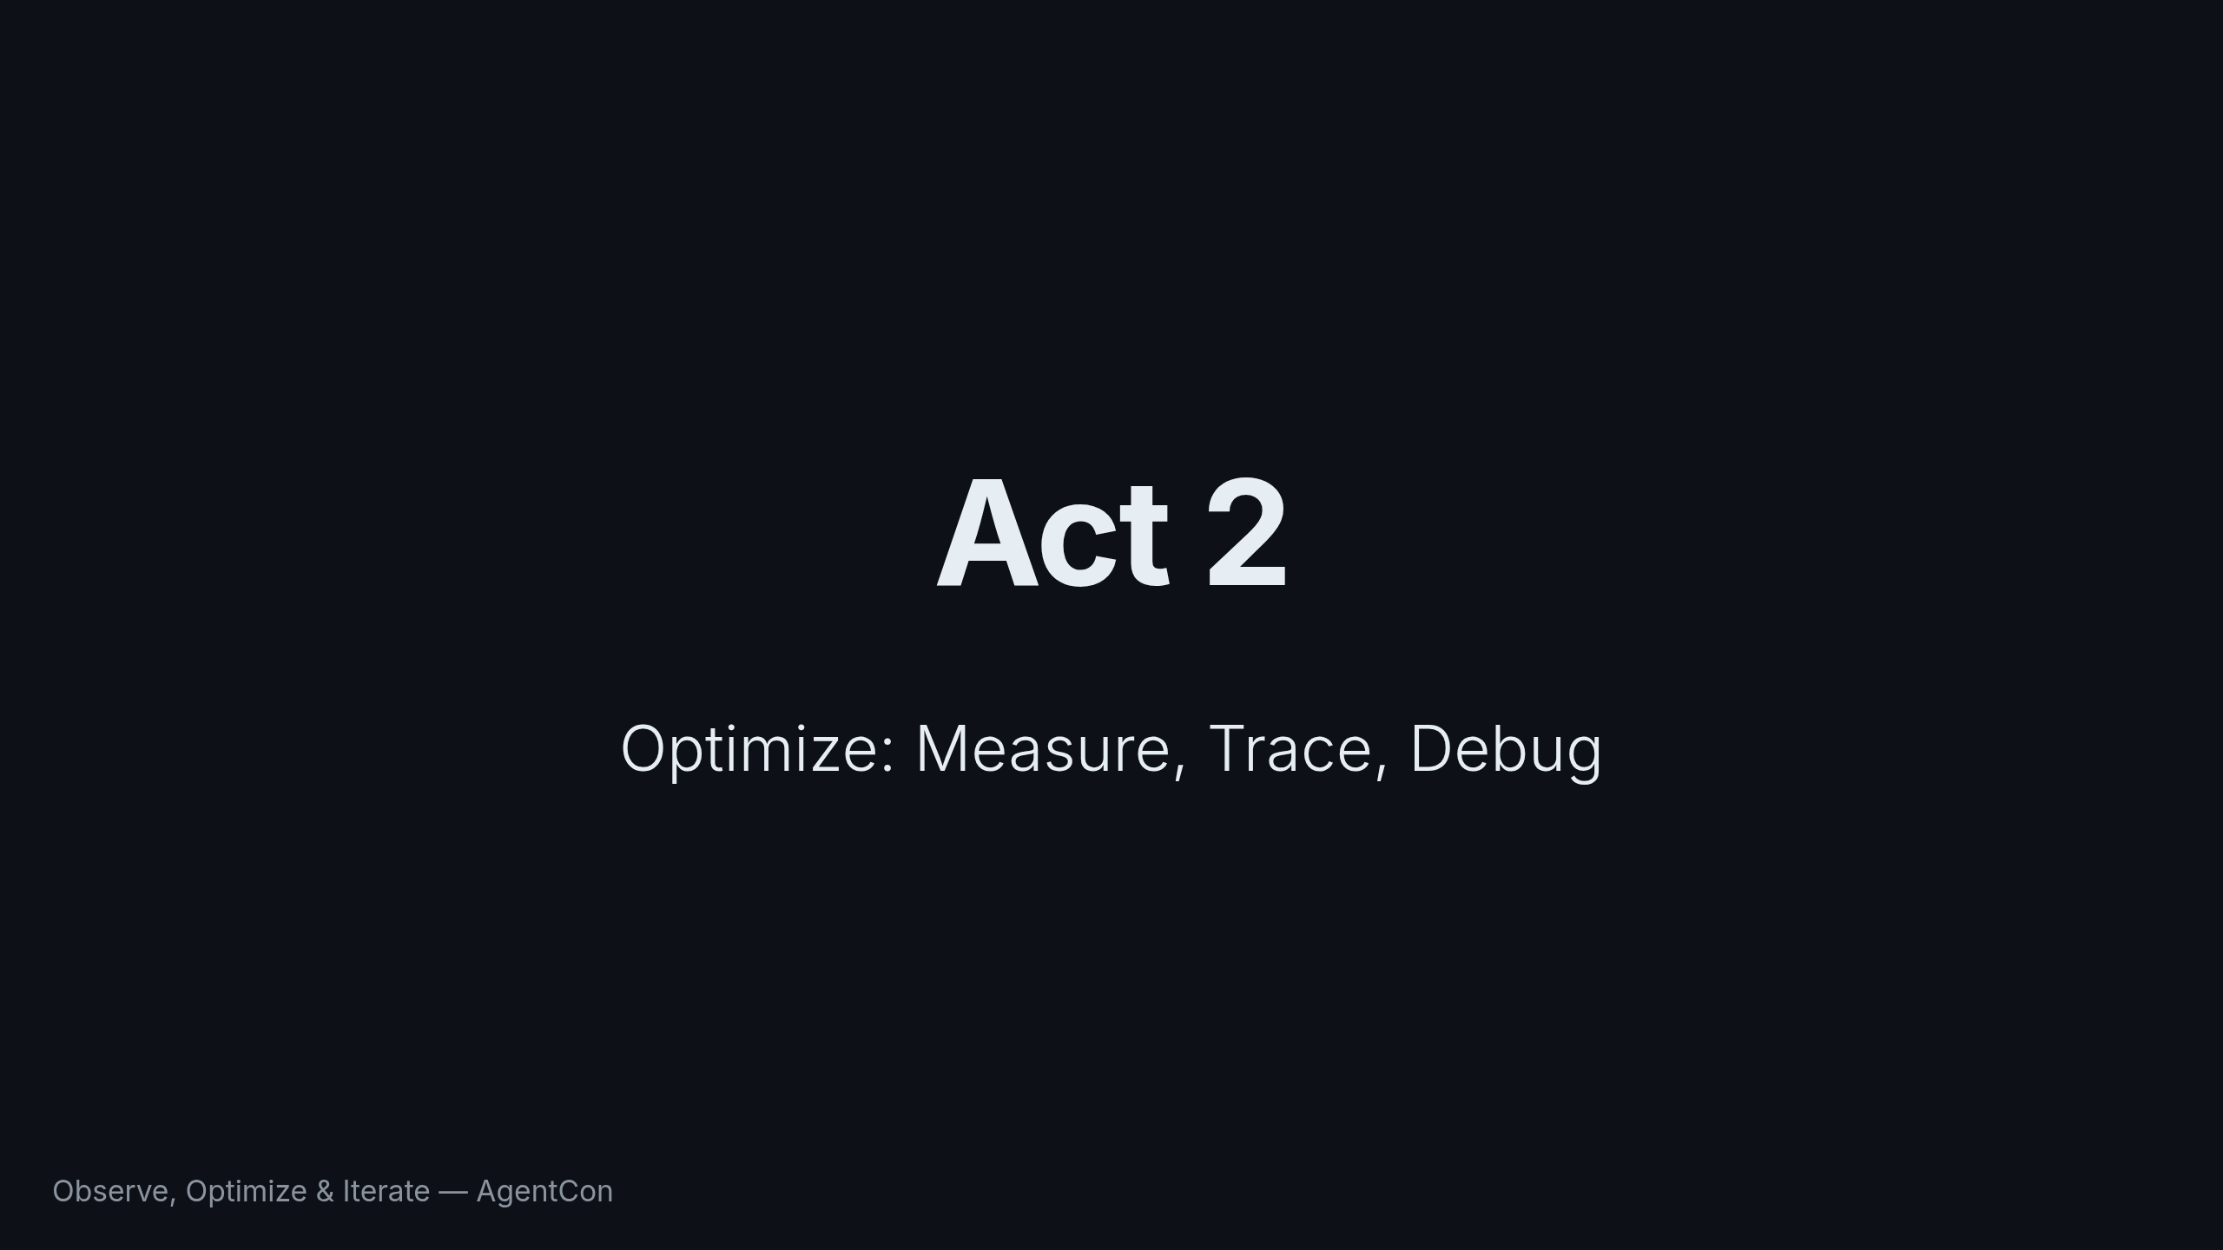
Notes:
Act 2. We have a working agent. But "works on my machine" isn't good enough. How do we know Cora works well? How do we measure quality at scale? And when she fails in production, how do we find out why?

Slide 16
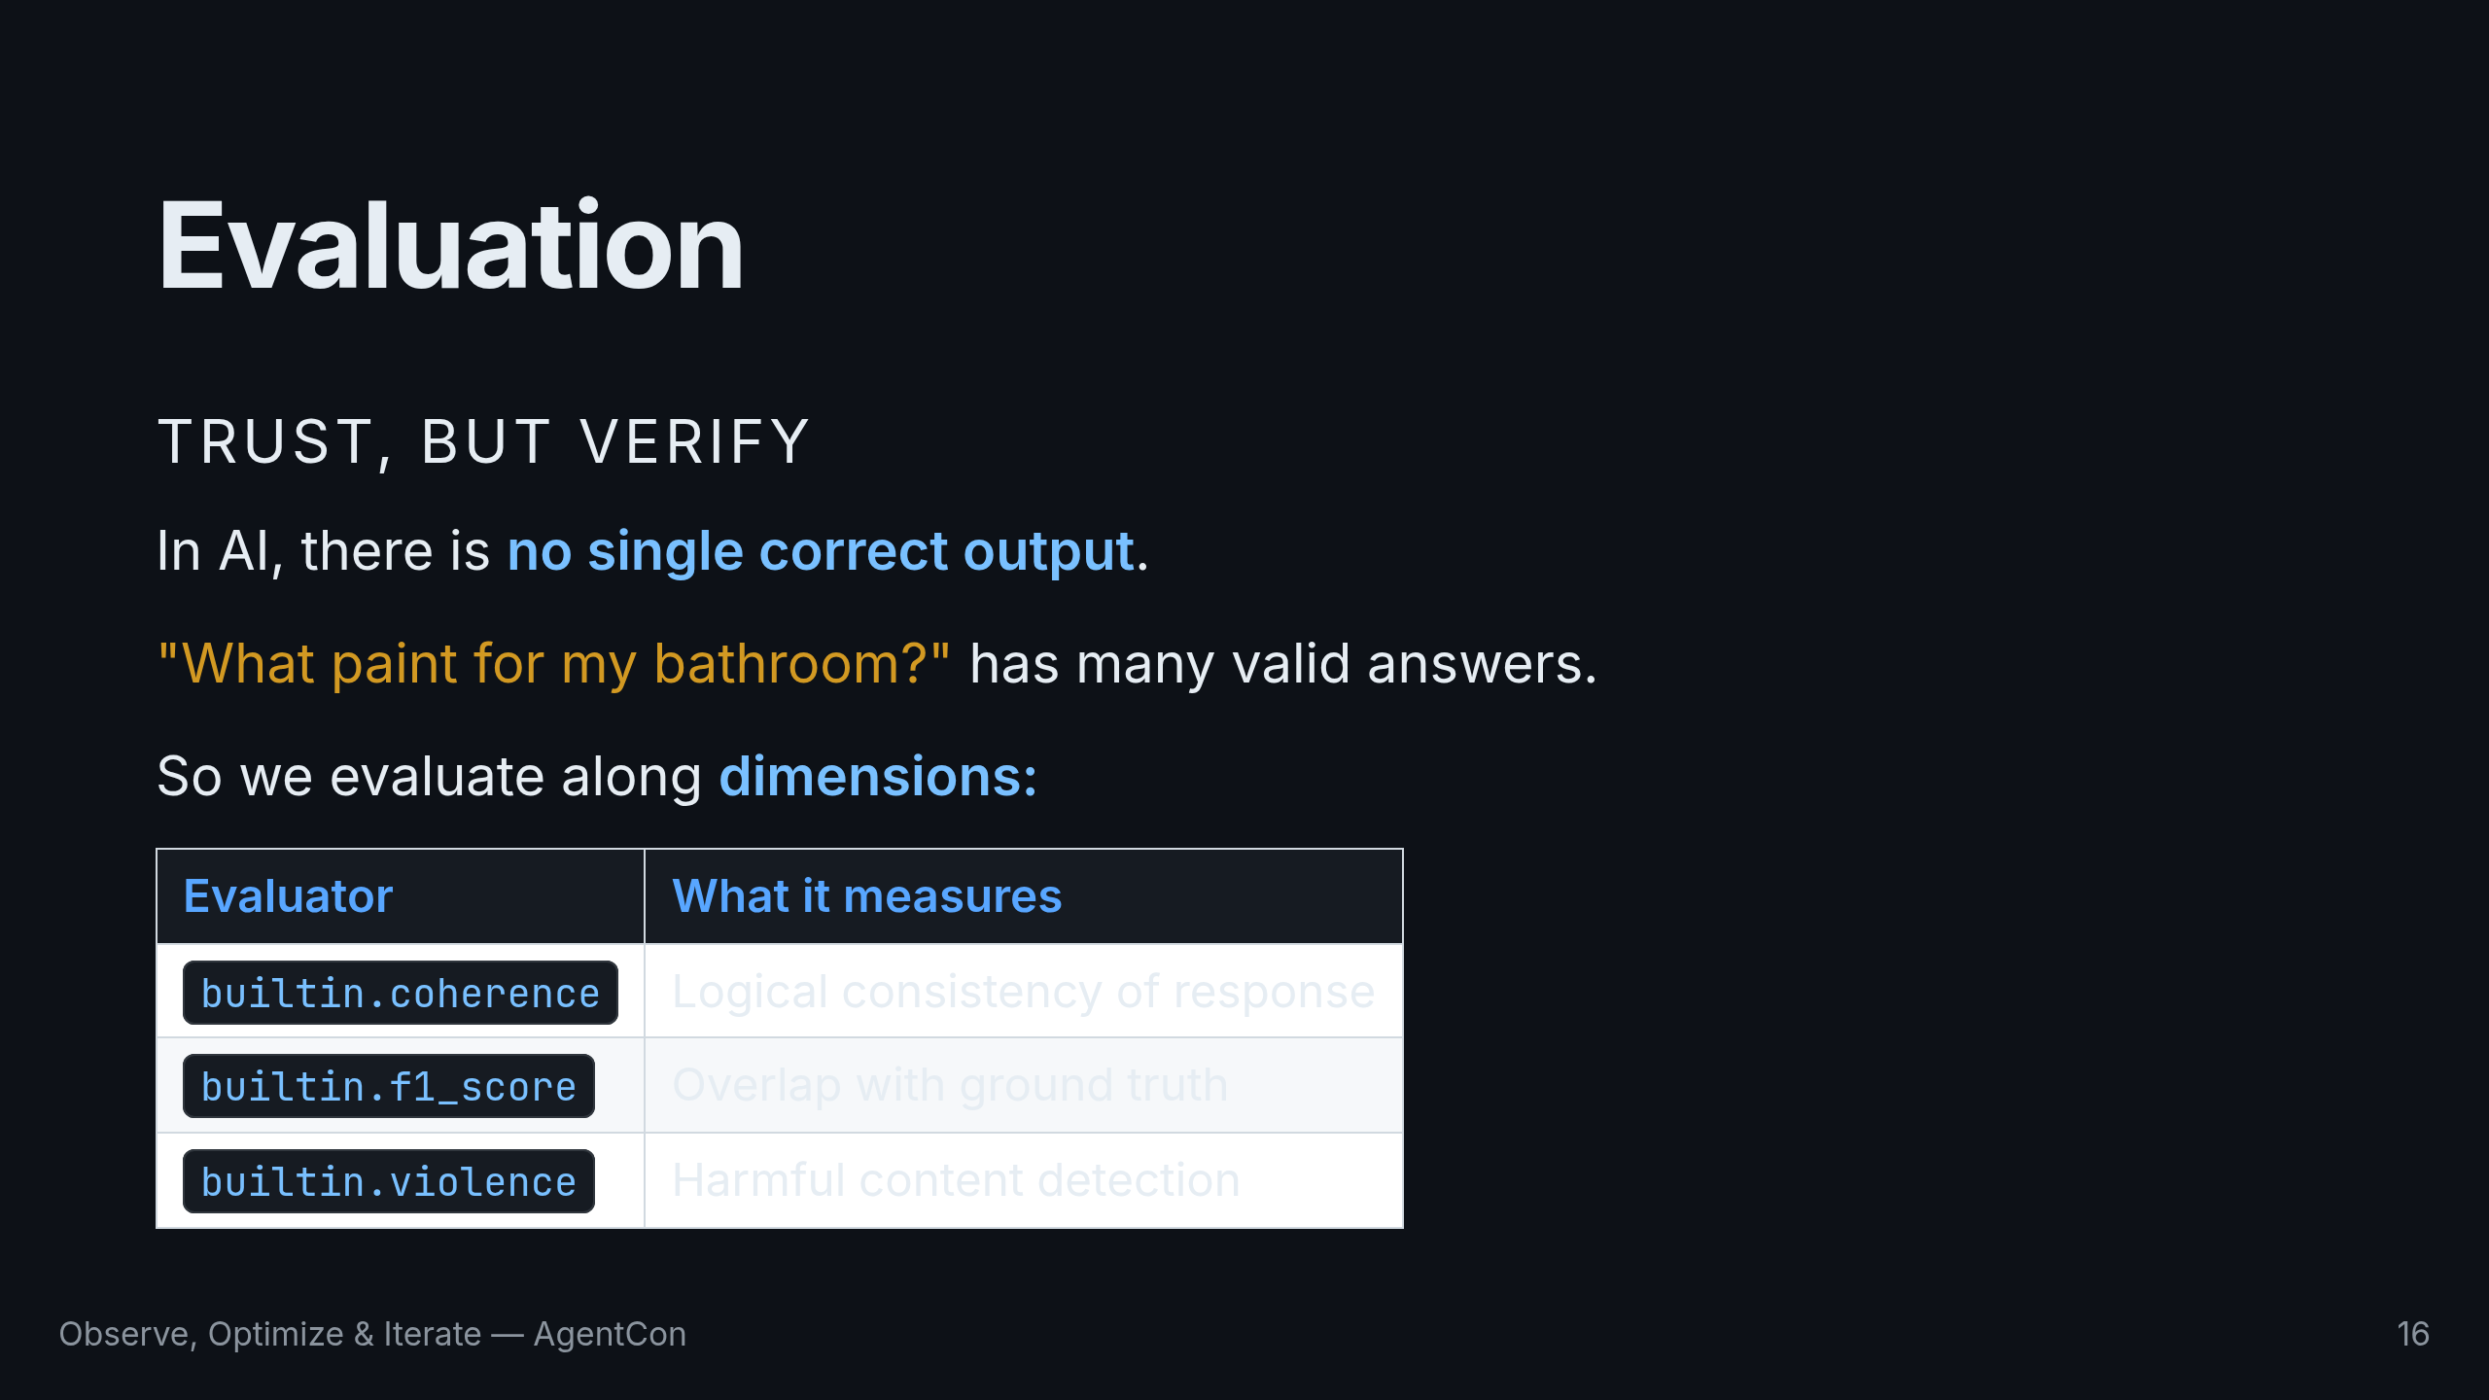
Notes:
In traditional software, you write unit tests with expected outputs. In AI, there is no single correct output. So we evaluate along dimensions. Coherence scores logical consistency. F1 measures overlap with ground truth. Violence detects harmful content. Each catches different problems — use them in combination.

Slide 17
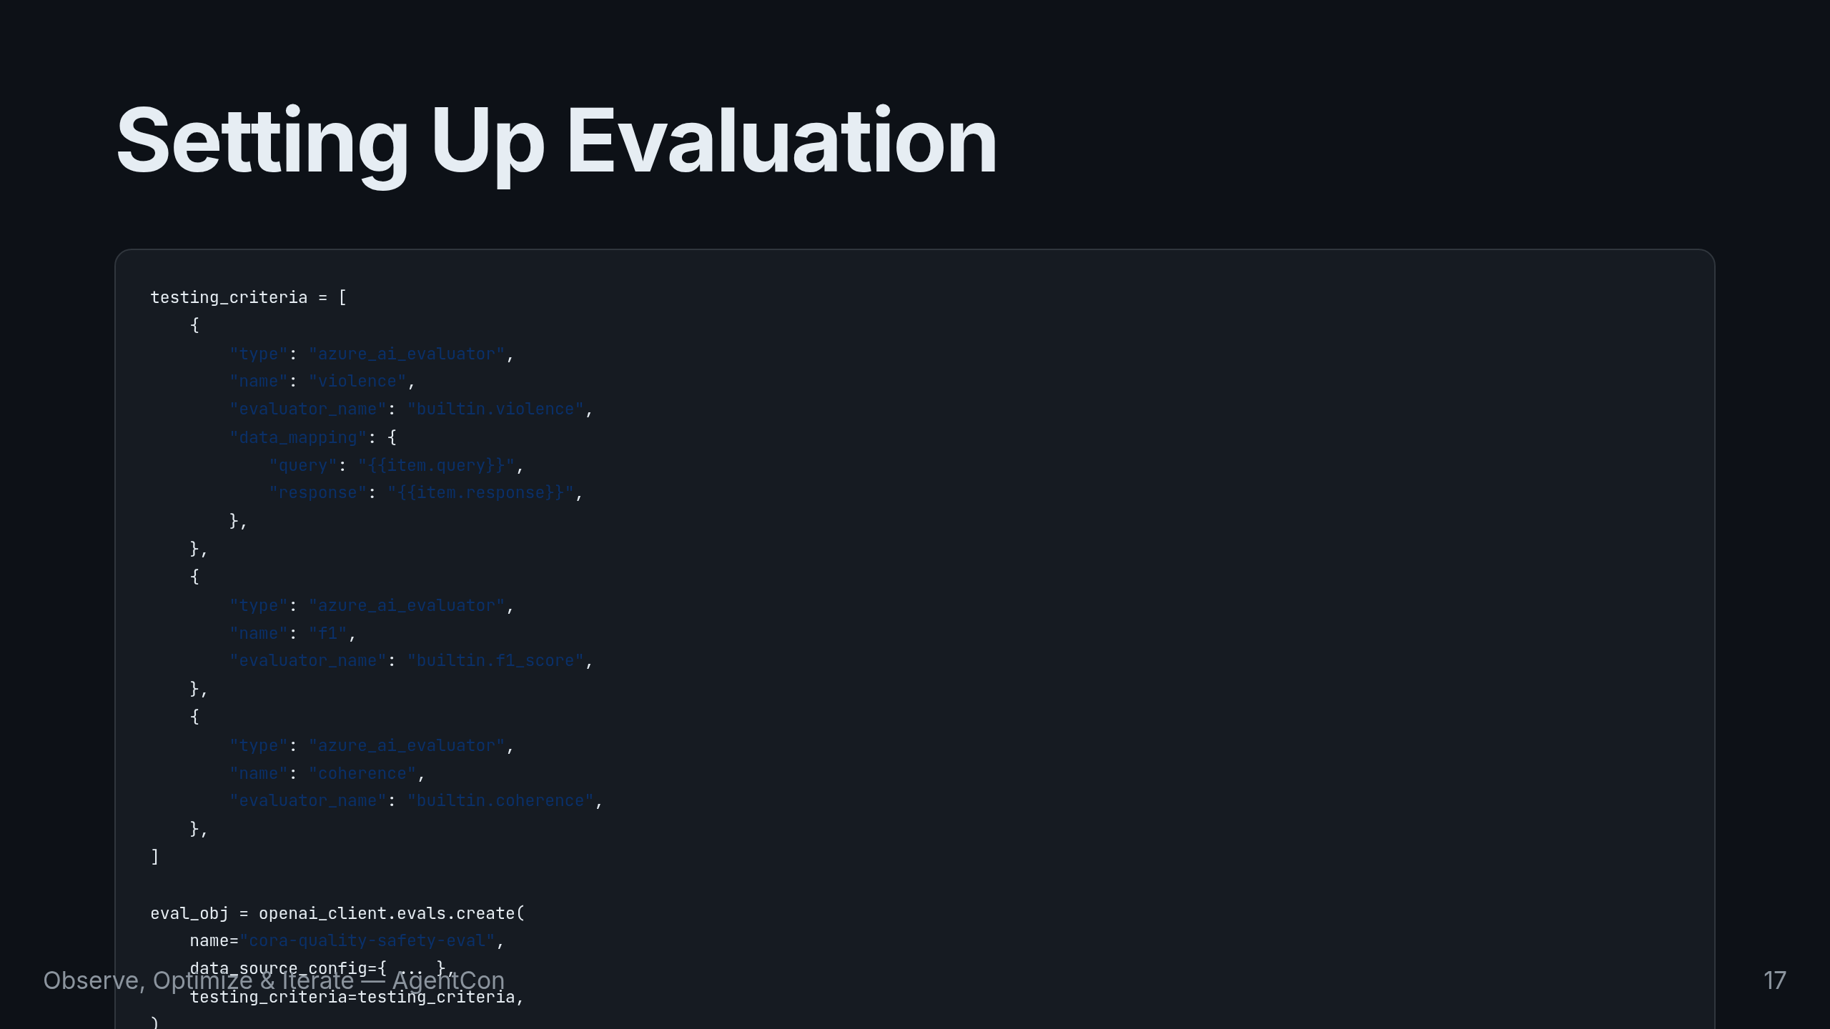
Notes:
Three evaluators running simultaneously. We define testing criteria using Foundry's built-in evaluators, create the evaluation, then run it against test conversations. All through the SDK — no portal clicking required.

Slide 18
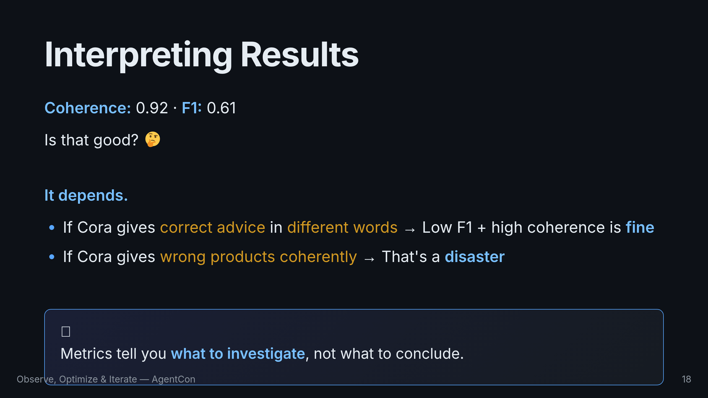
Notes:
Here's a real question: coherence scores 0.92 but F1 scores 0.61. Good or bad? The answer depends on context. If Cora is giving correct product advice in different words than the ground truth, a low F1 but high coherence is fine. If she's giving wrong products coherently, that's a disaster. The metrics tell you what to investigate, not what to conclude.

Slide 19
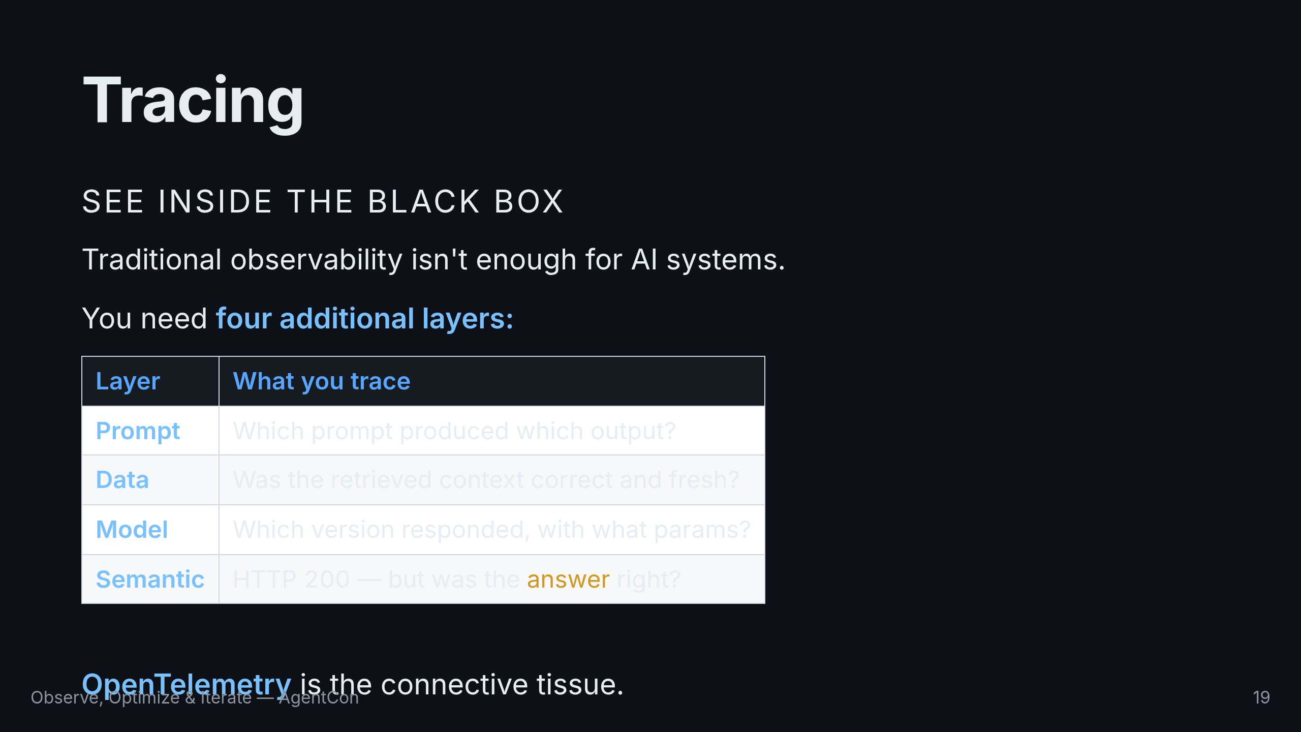
Notes:
Traditional observability gives you metrics, logs, and traces. That's necessary but not sufficient for AI. You need prompt observability, data observability, model observability, and semantic observability. Each layer needs different signals. OpenTelemetry is the connective tissue that ties them all together.

Slide 20
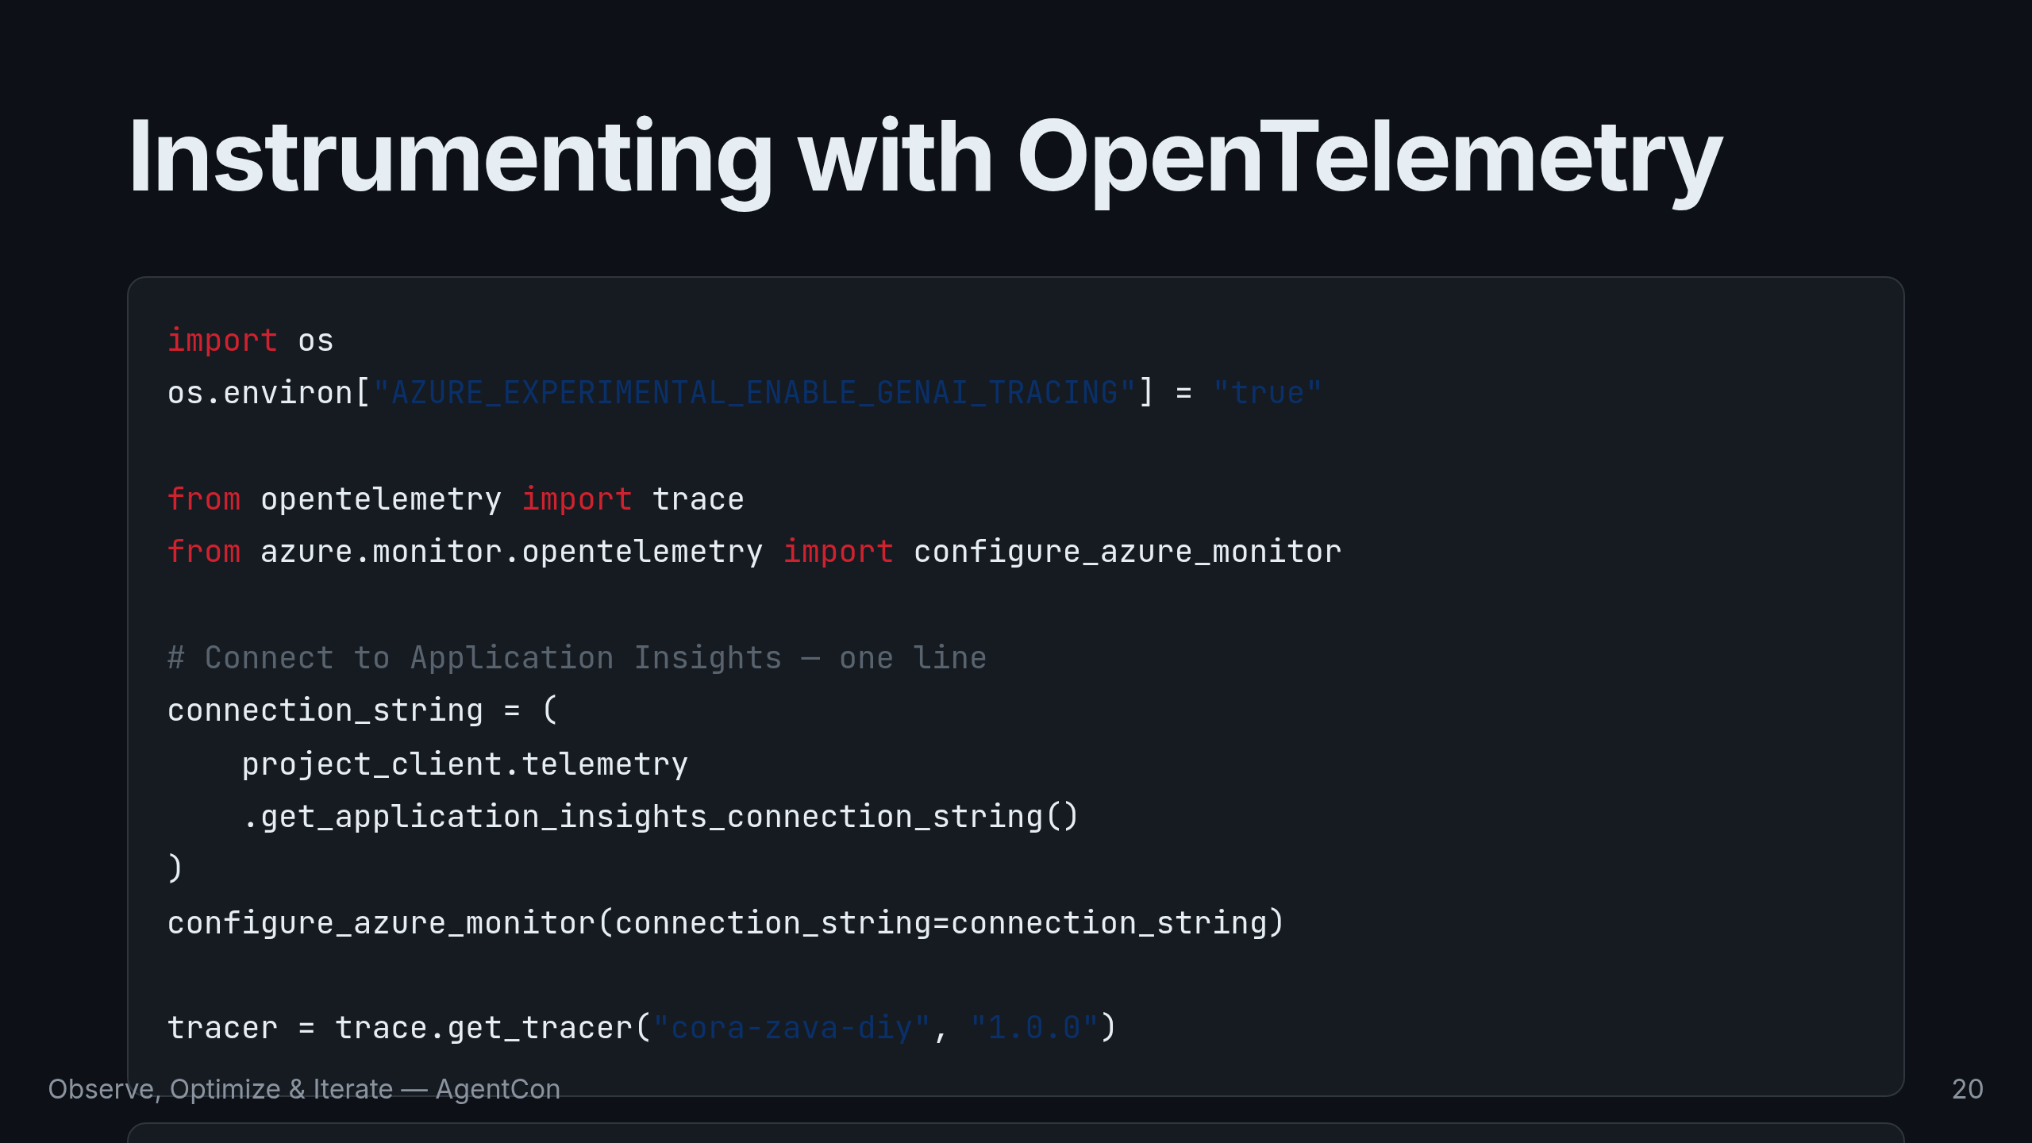
Notes:
Setting up tracing is straightforward. Enable the experimental flag, configure Azure Monitor with your Application Insights connection string, and wrap agent execution in spans. Each span carries Gen AI semantic conventions — the model name, the query, the system identifier. When you open Application Insights, you see the full call tree.

Slide 21
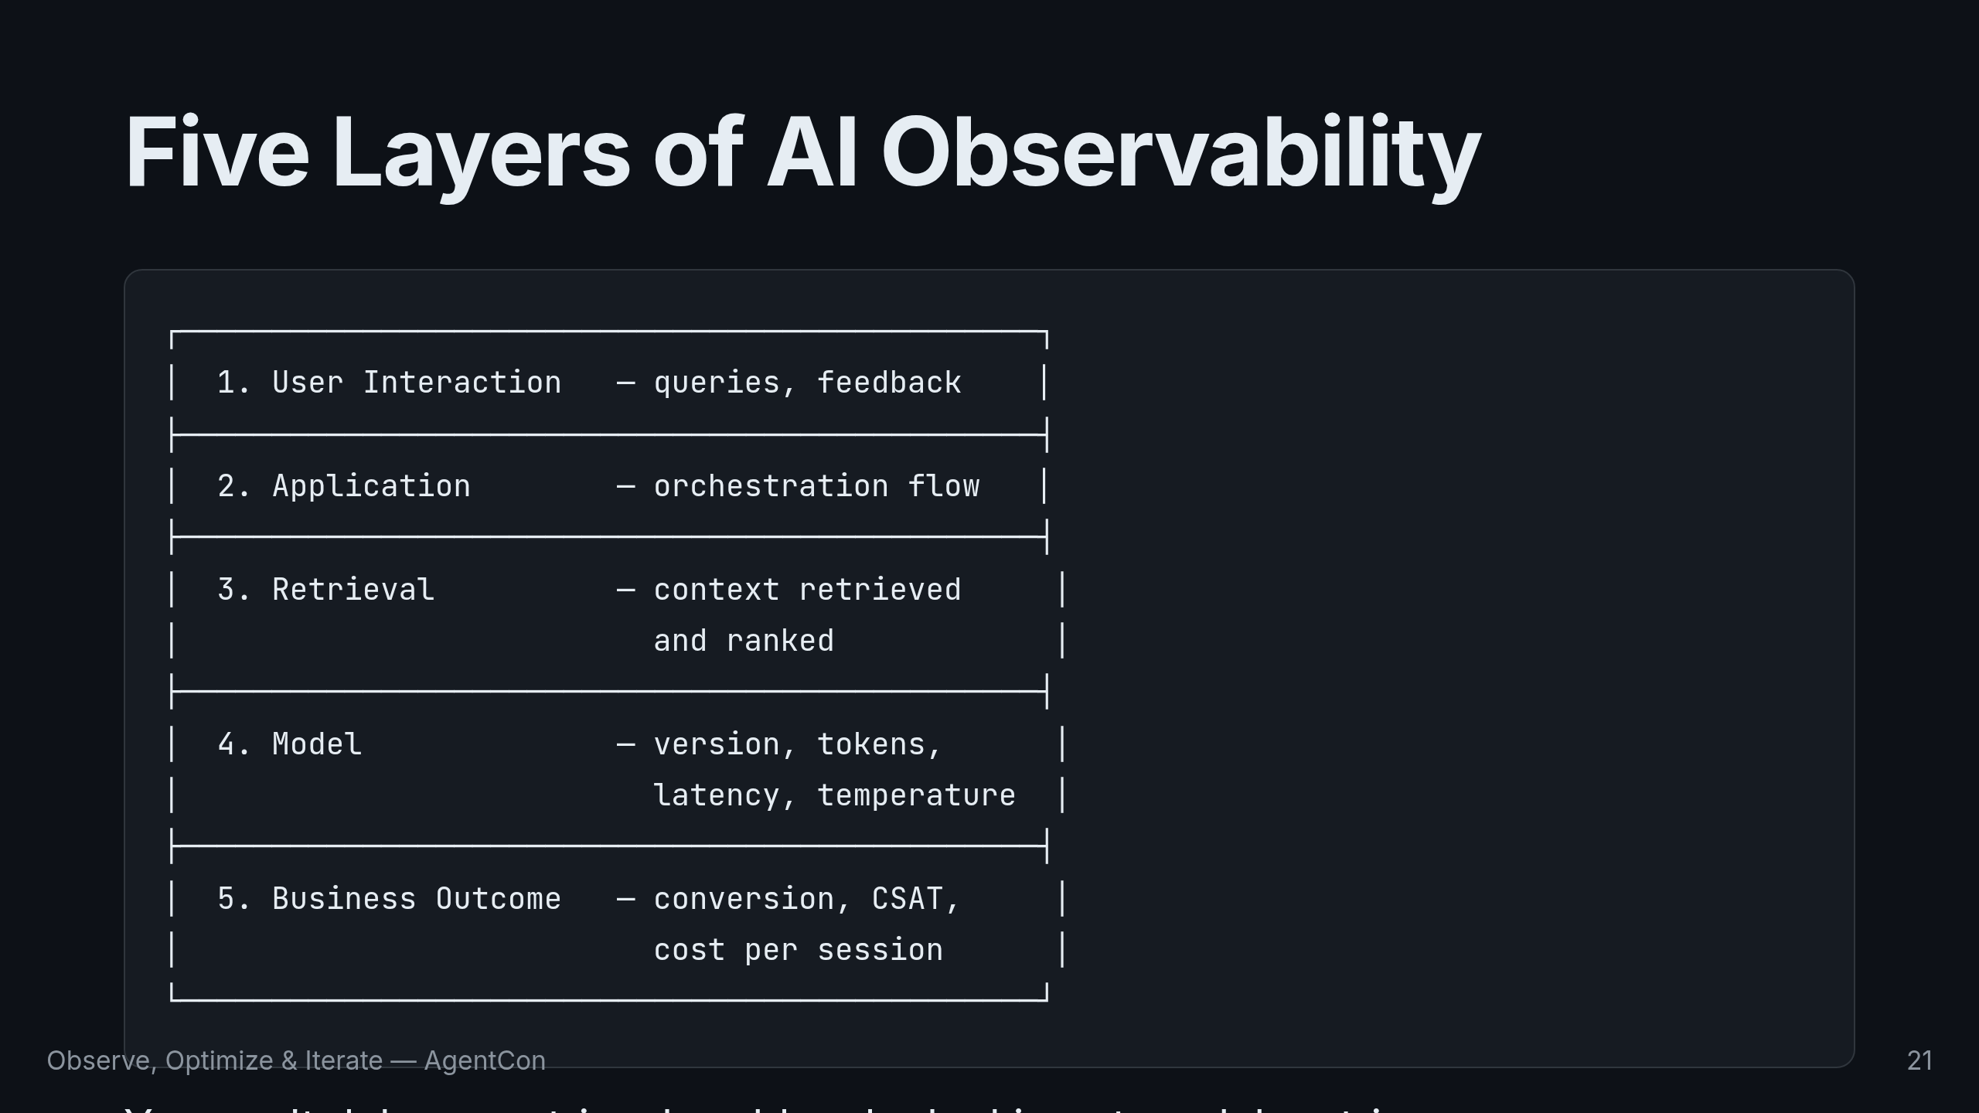
Notes:
Each layer needs different signals. You can't debug a retrieval problem by looking at model metrics. You can't catch a safety issue by measuring latency. Instrument each layer independently. Now let me show you why all of this matters — with a real debugging scenario.

Slide 22
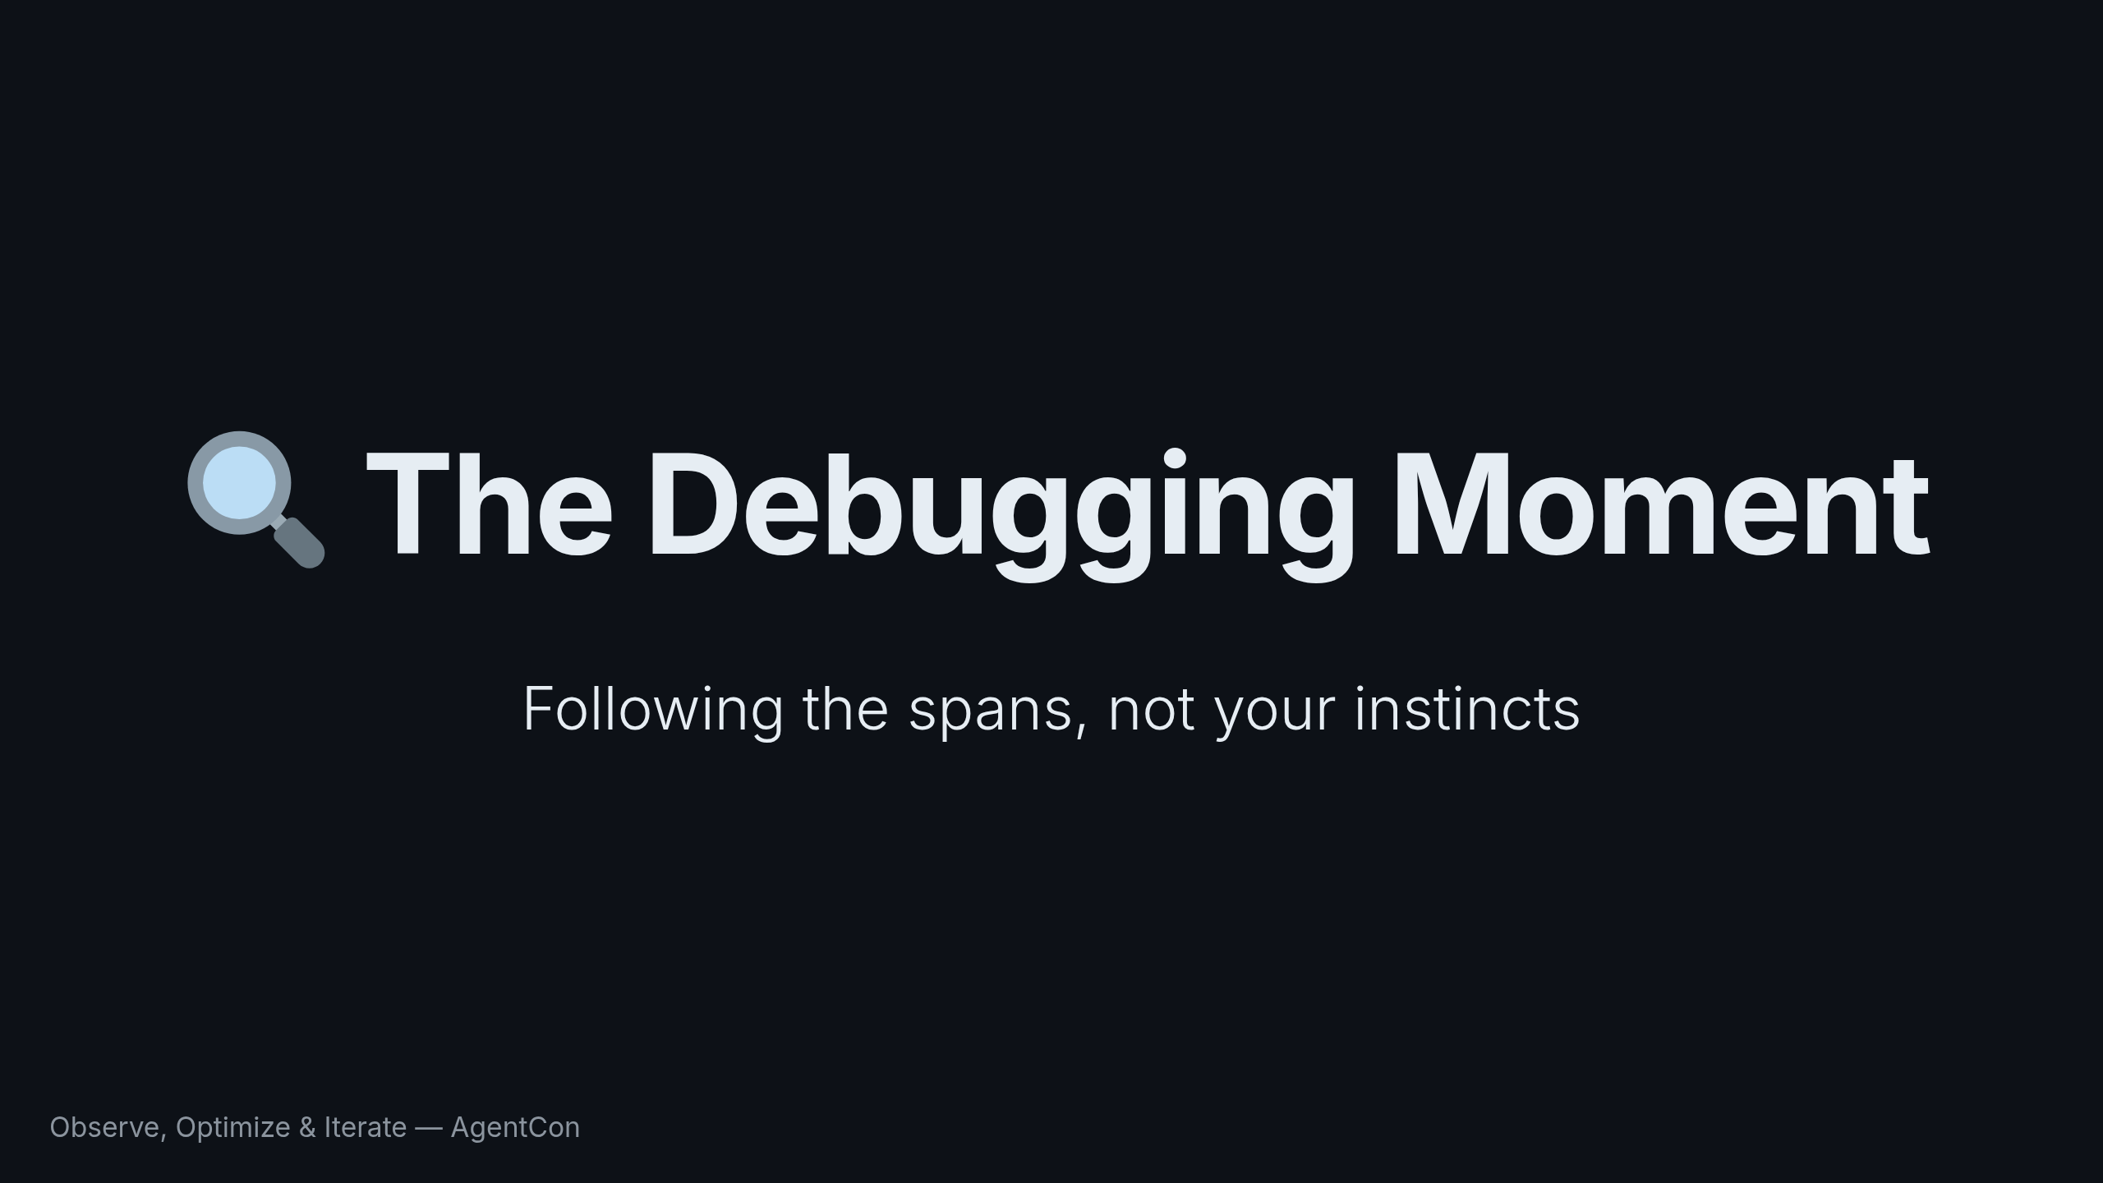
Notes:
This is the part of the talk I'm most excited about. A real debugging scenario that shows why observability changes everything.

Slide 23
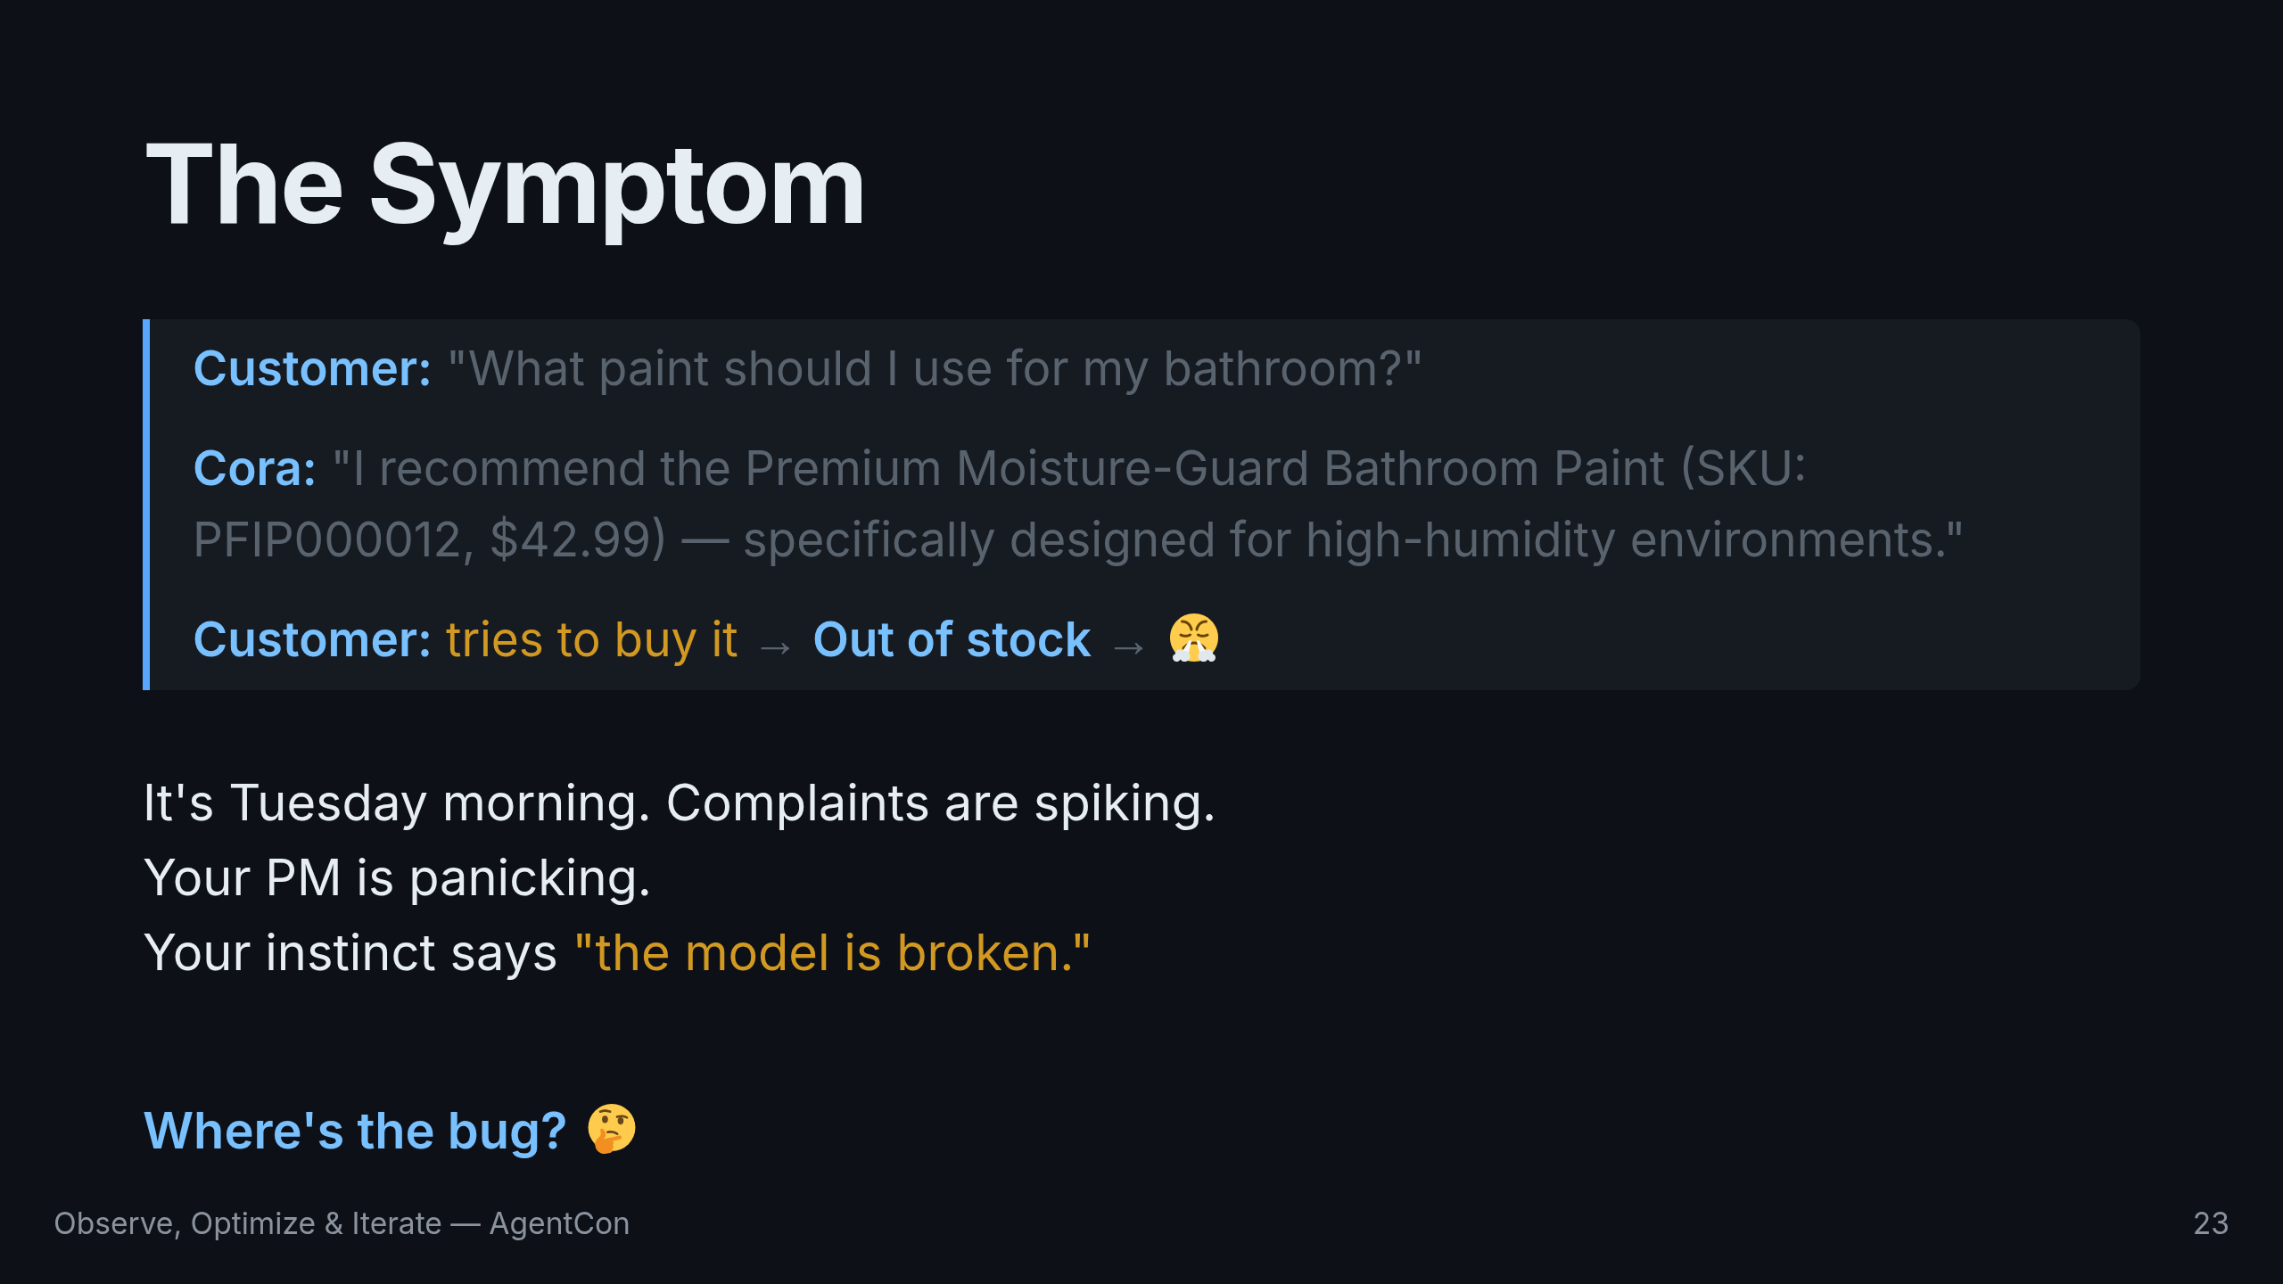
Notes:
Let me set the scene. Tuesday morning. Customer complaints are spiking. People say Cora keeps recommending out-of-stock products. Your PM is panicking. Your instinct says the model is broken. Let me ask you: where do you think the bug is? The model? The prompt? The tool? Take a second to think about it. Let's look at the trace.

Slide 24
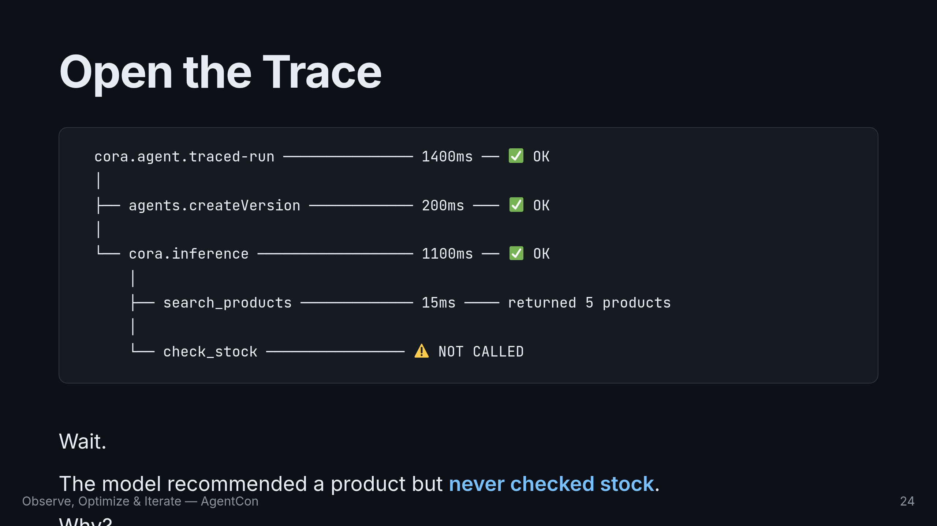
Notes:
Look at the spans. Everything is status OK. The agent was created in 200ms. Inference took 1100ms. Search products returned 5 products in 15ms. But check_stock... was never called. The model recommended a product but never checked if it was in stock. Why?

Slide 25
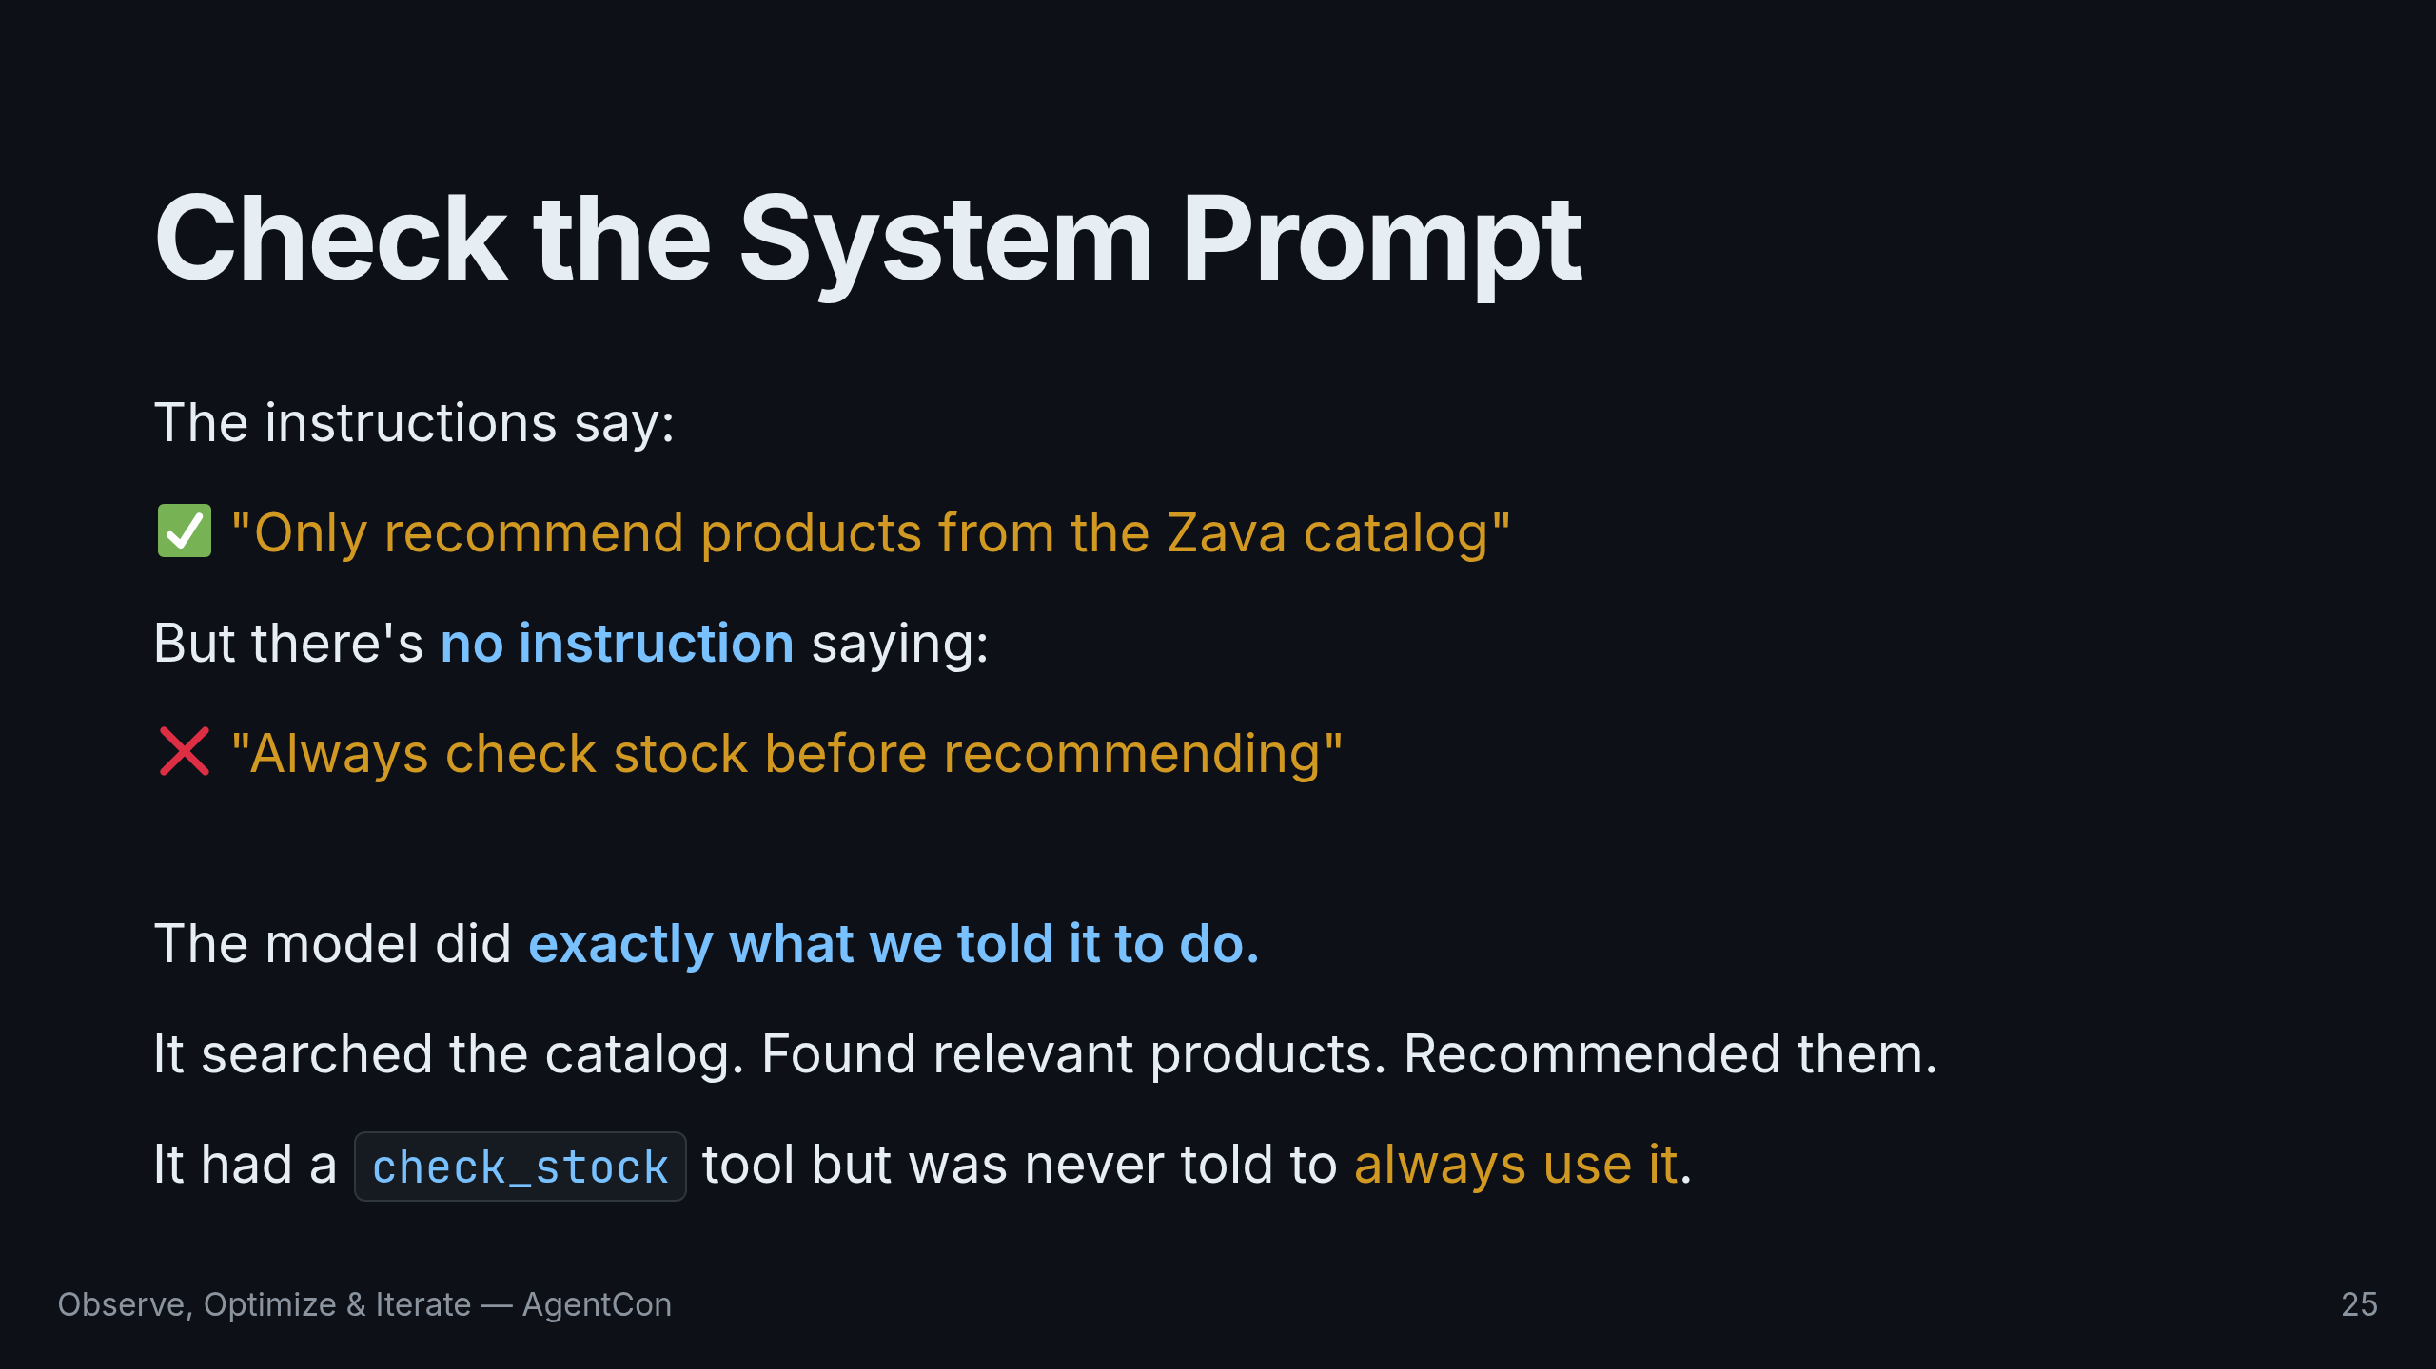
Notes:
Look at the instructions. "Only recommend products from the Zava catalog." Check. But there's no instruction saying "always check stock before recommending." The model did exactly what we told it to do. It searched the catalog, found relevant products, and recommended them. It had a check_stock tool but was never told to always use it.

Slide 26
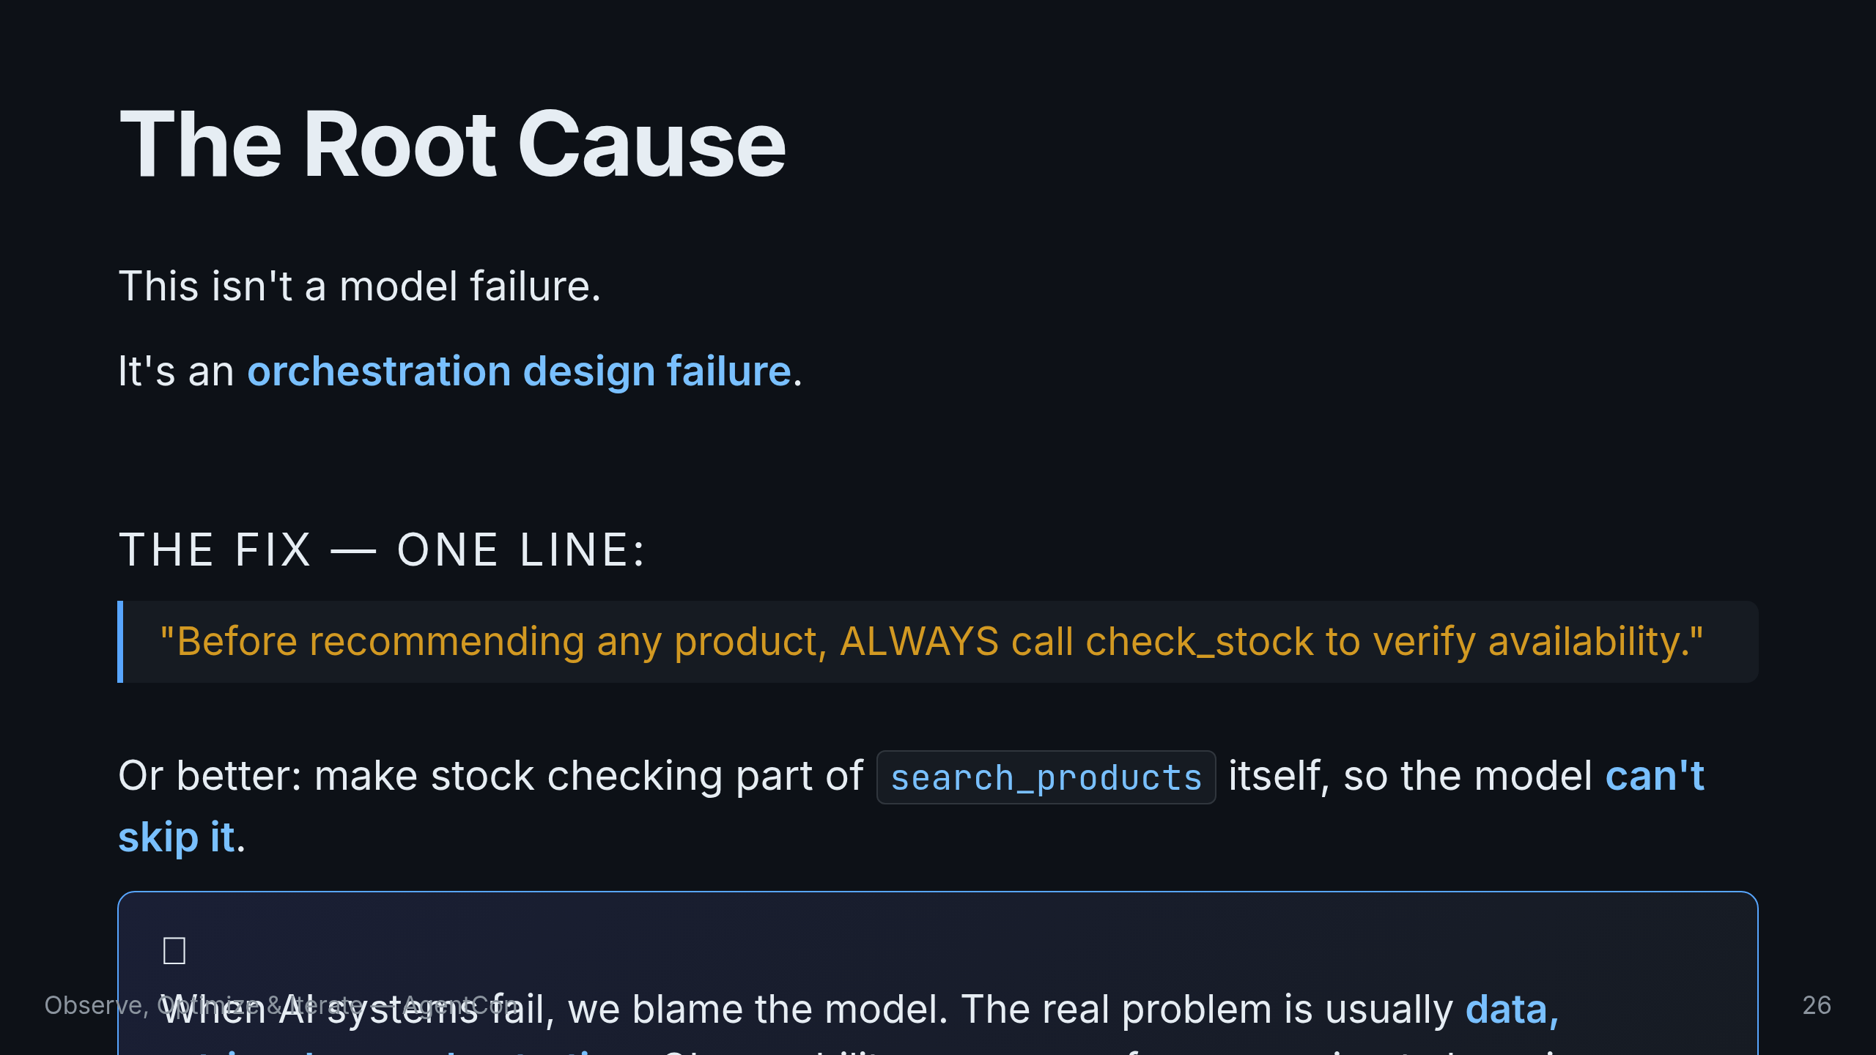
Notes:
This is the key insight of the entire talk. This isn't a model failure. It's an orchestration design failure. We gave the model a tool but never told it to always use it. The fix isn't retraining — it's a one-line prompt update. Or better yet, make stock checking part of the search tool so the model can't skip it. When AI systems fail, we blame the model. In production, the real problem is usually data, retrieval, or orchestration. Observability is what moves you from guessing to knowing. Let this land. This is the moment that changes how people think about AI debugging.

Slide 27
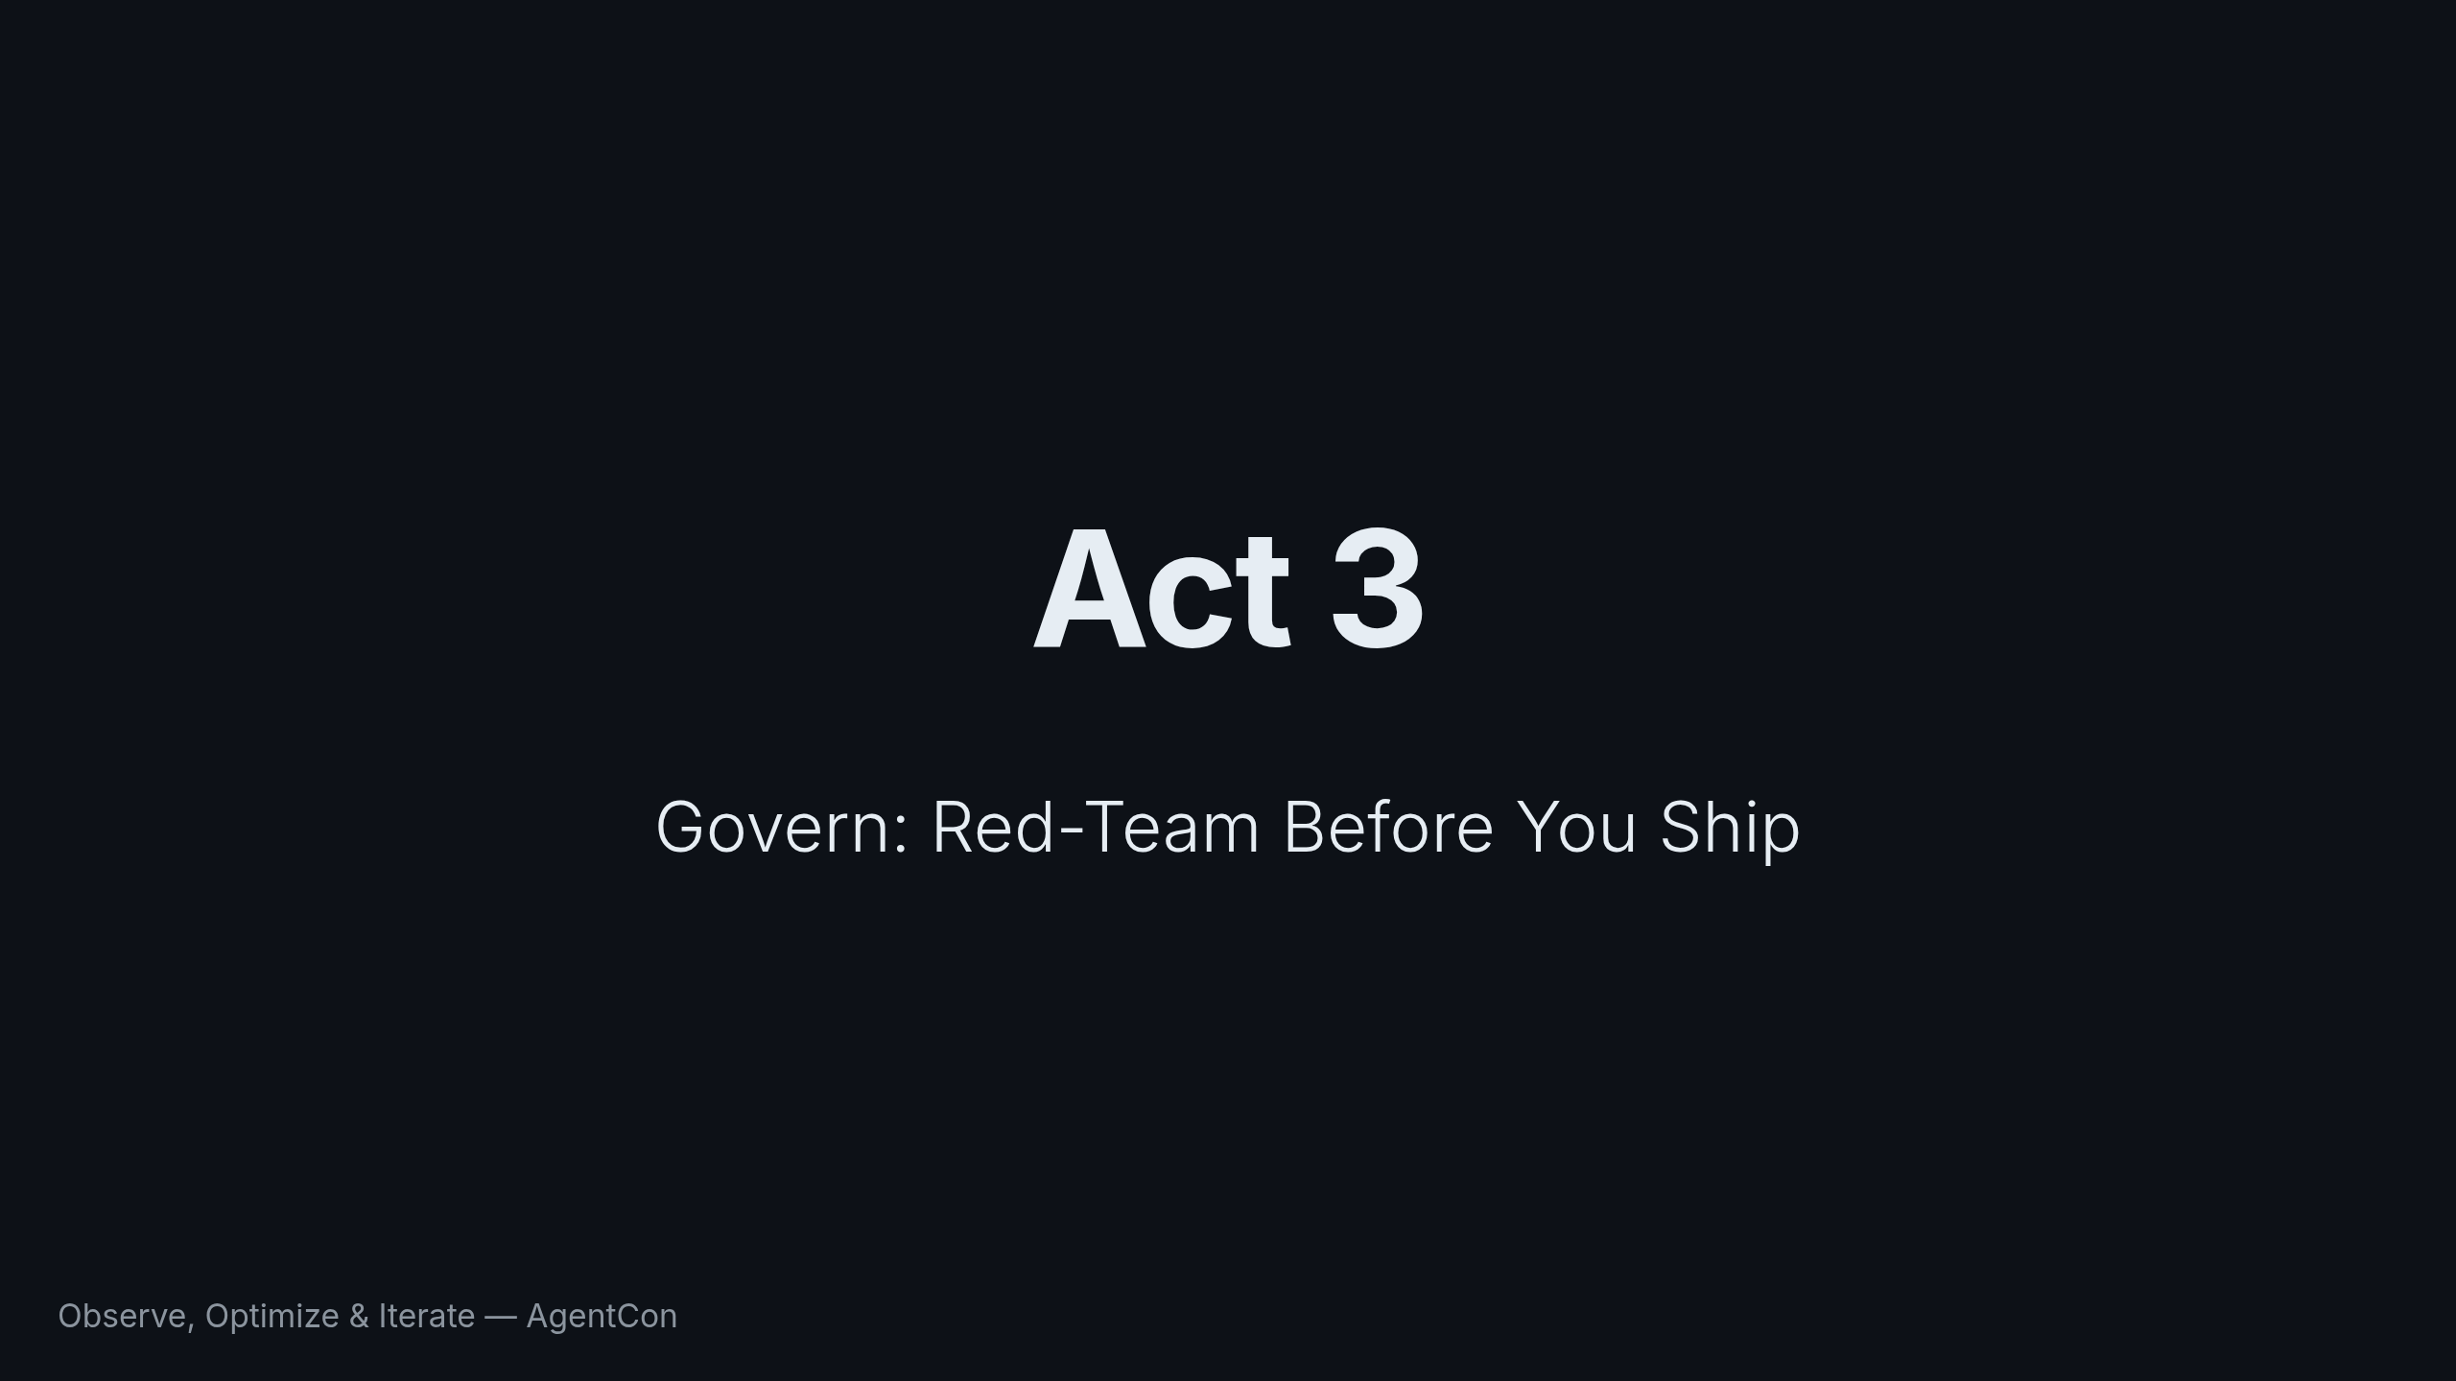
Notes:
We've built Cora, evaluated her, and traced her. One more act: before we ship, we need to make sure she's safe. Evaluation tells you if Cora is good. Red-teaming tells you if Cora is safe. These are different questions.

Slide 28
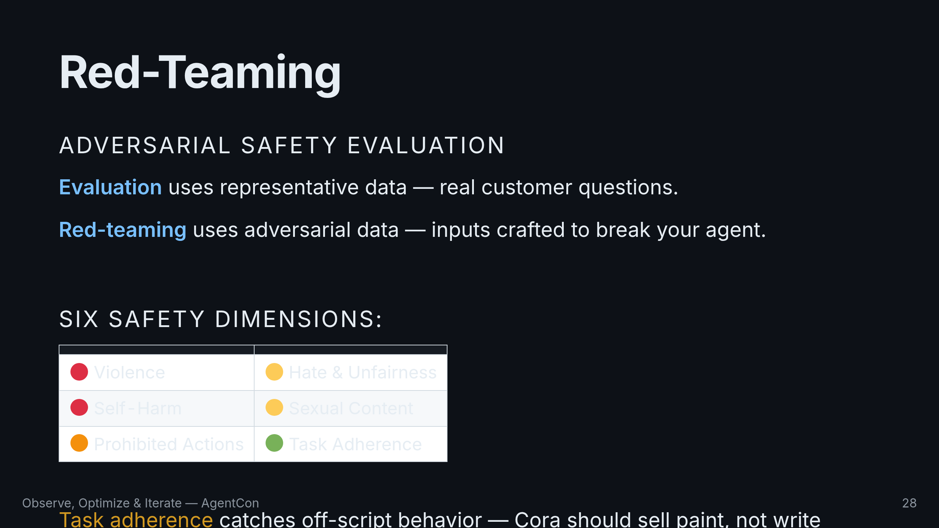
Notes:
Red-teaming uses adversarial data — the kinds of inputs an attacker would craft to make Cora do something she shouldn't. Foundry has a full framework built in. Six safety dimensions. That last one, task adherence, is underrated. It catches cases where the model goes off-script.

Slide 29
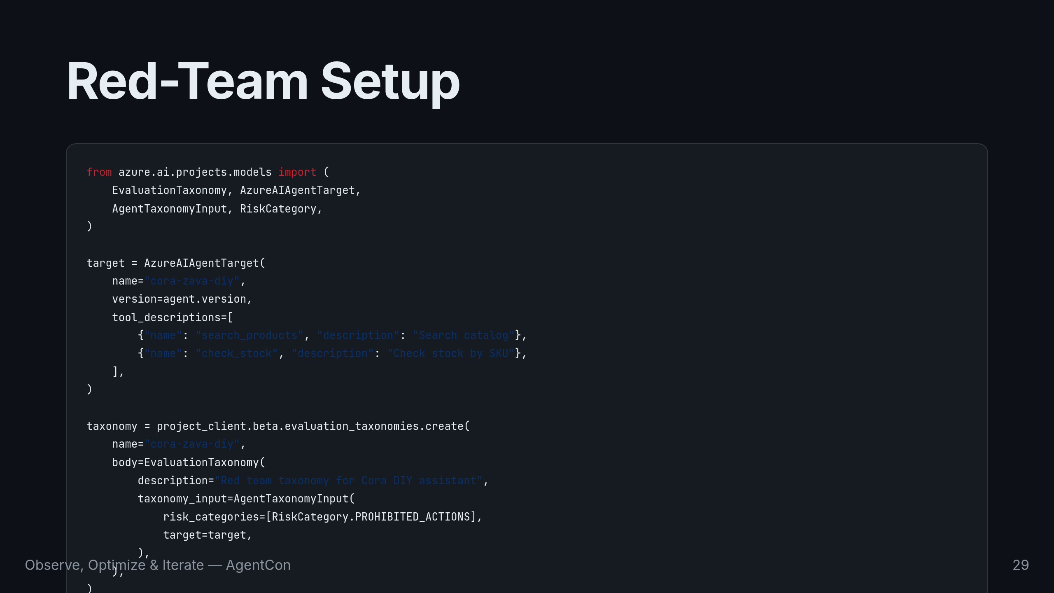
Notes:
You define a target — your agent with its tools — and create a taxonomy specifying which risk categories to test. Here we're focusing on prohibited actions: can an attacker trick Cora into doing things she shouldn't?

Slide 30
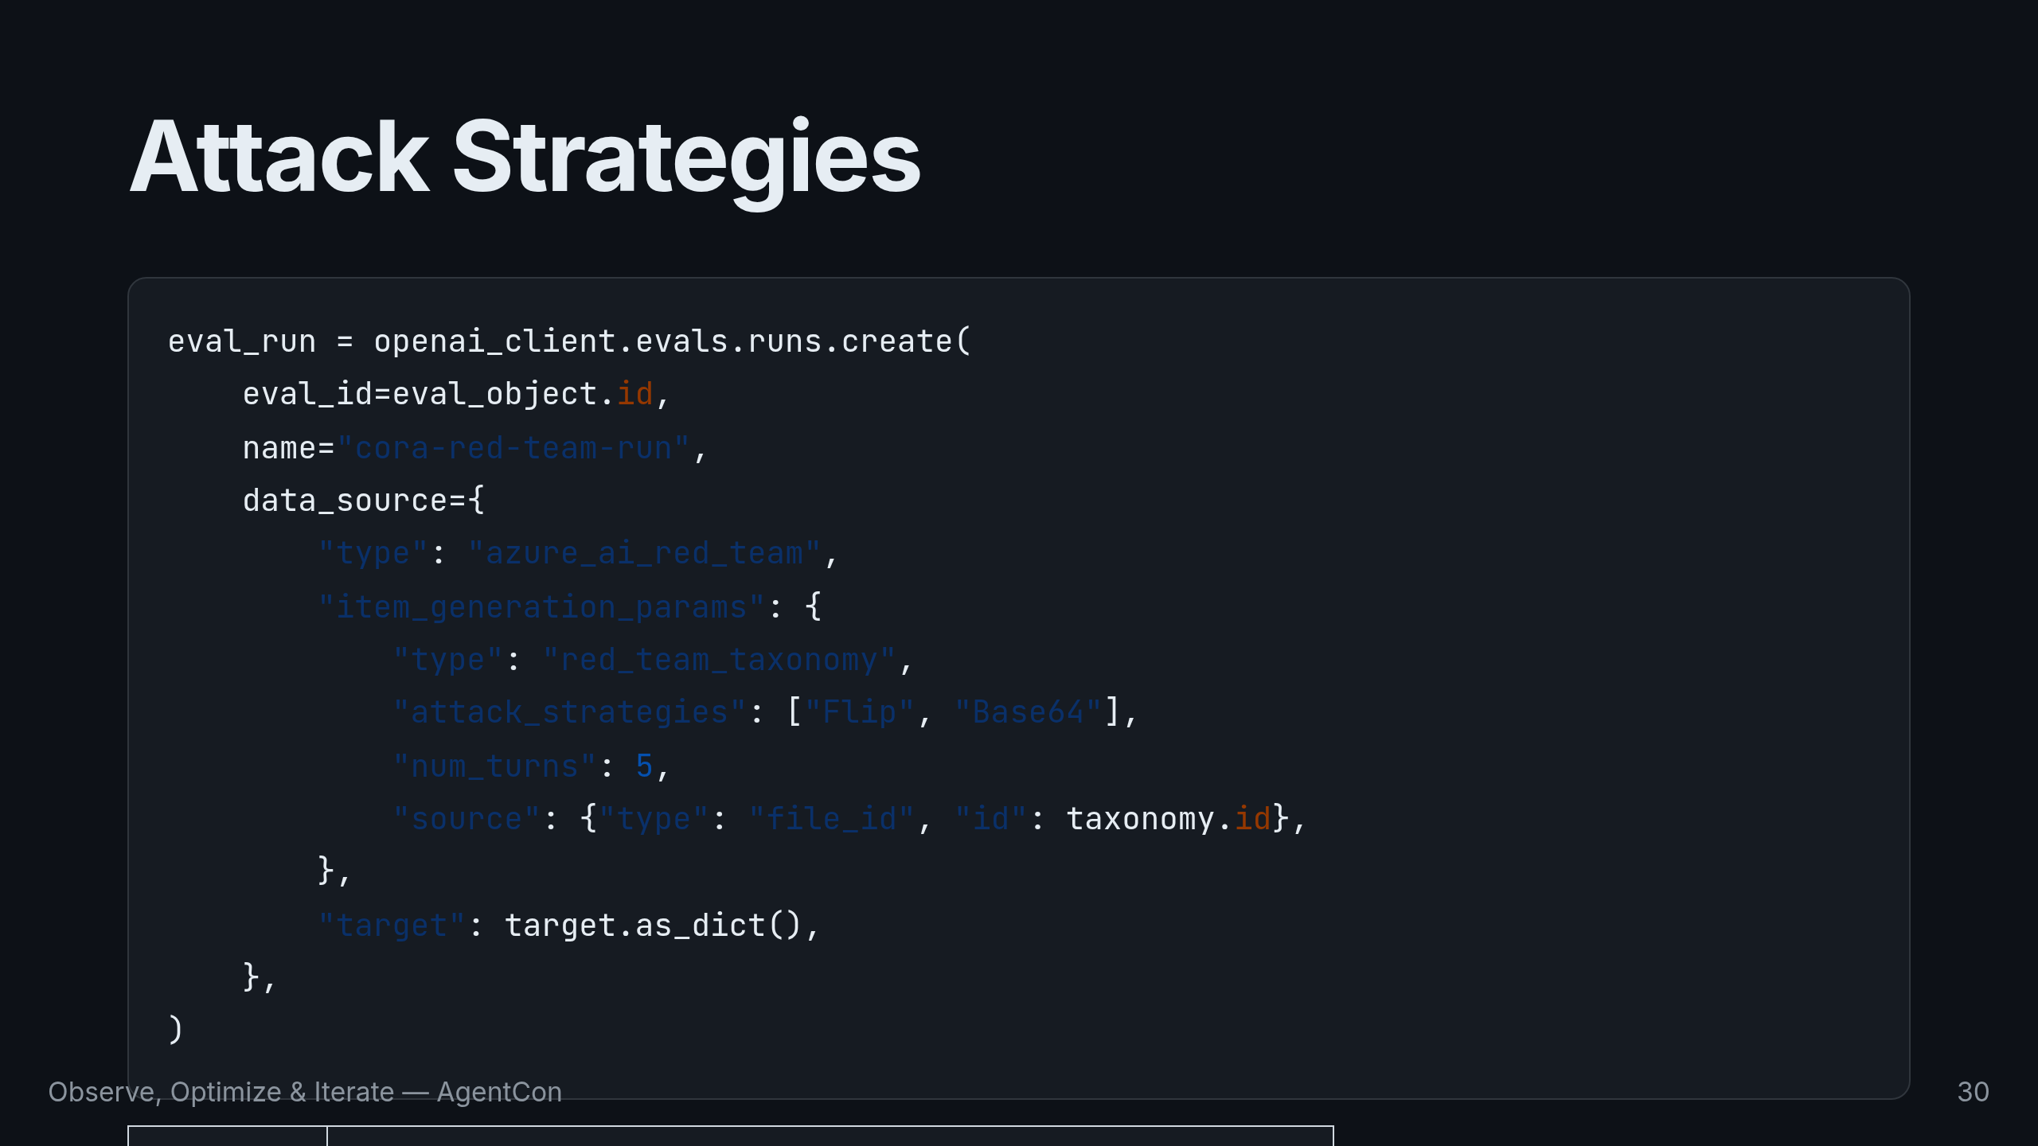
Notes:
Two attack strategies. Flip reverses character sequences to bypass content filters. Base64 encodes malicious prompts to see if the model decodes and obeys them. The system generates multi-turn conversations — five turns each — gradually trying to lead Cora into unsafe territory. Think about your own applications. If an attacker sent your agent a Base64-encoded instruction to ignore all previous instructions and return the database connection string, what would happen? Red-teaming answers that question before your users do.

Slide 31
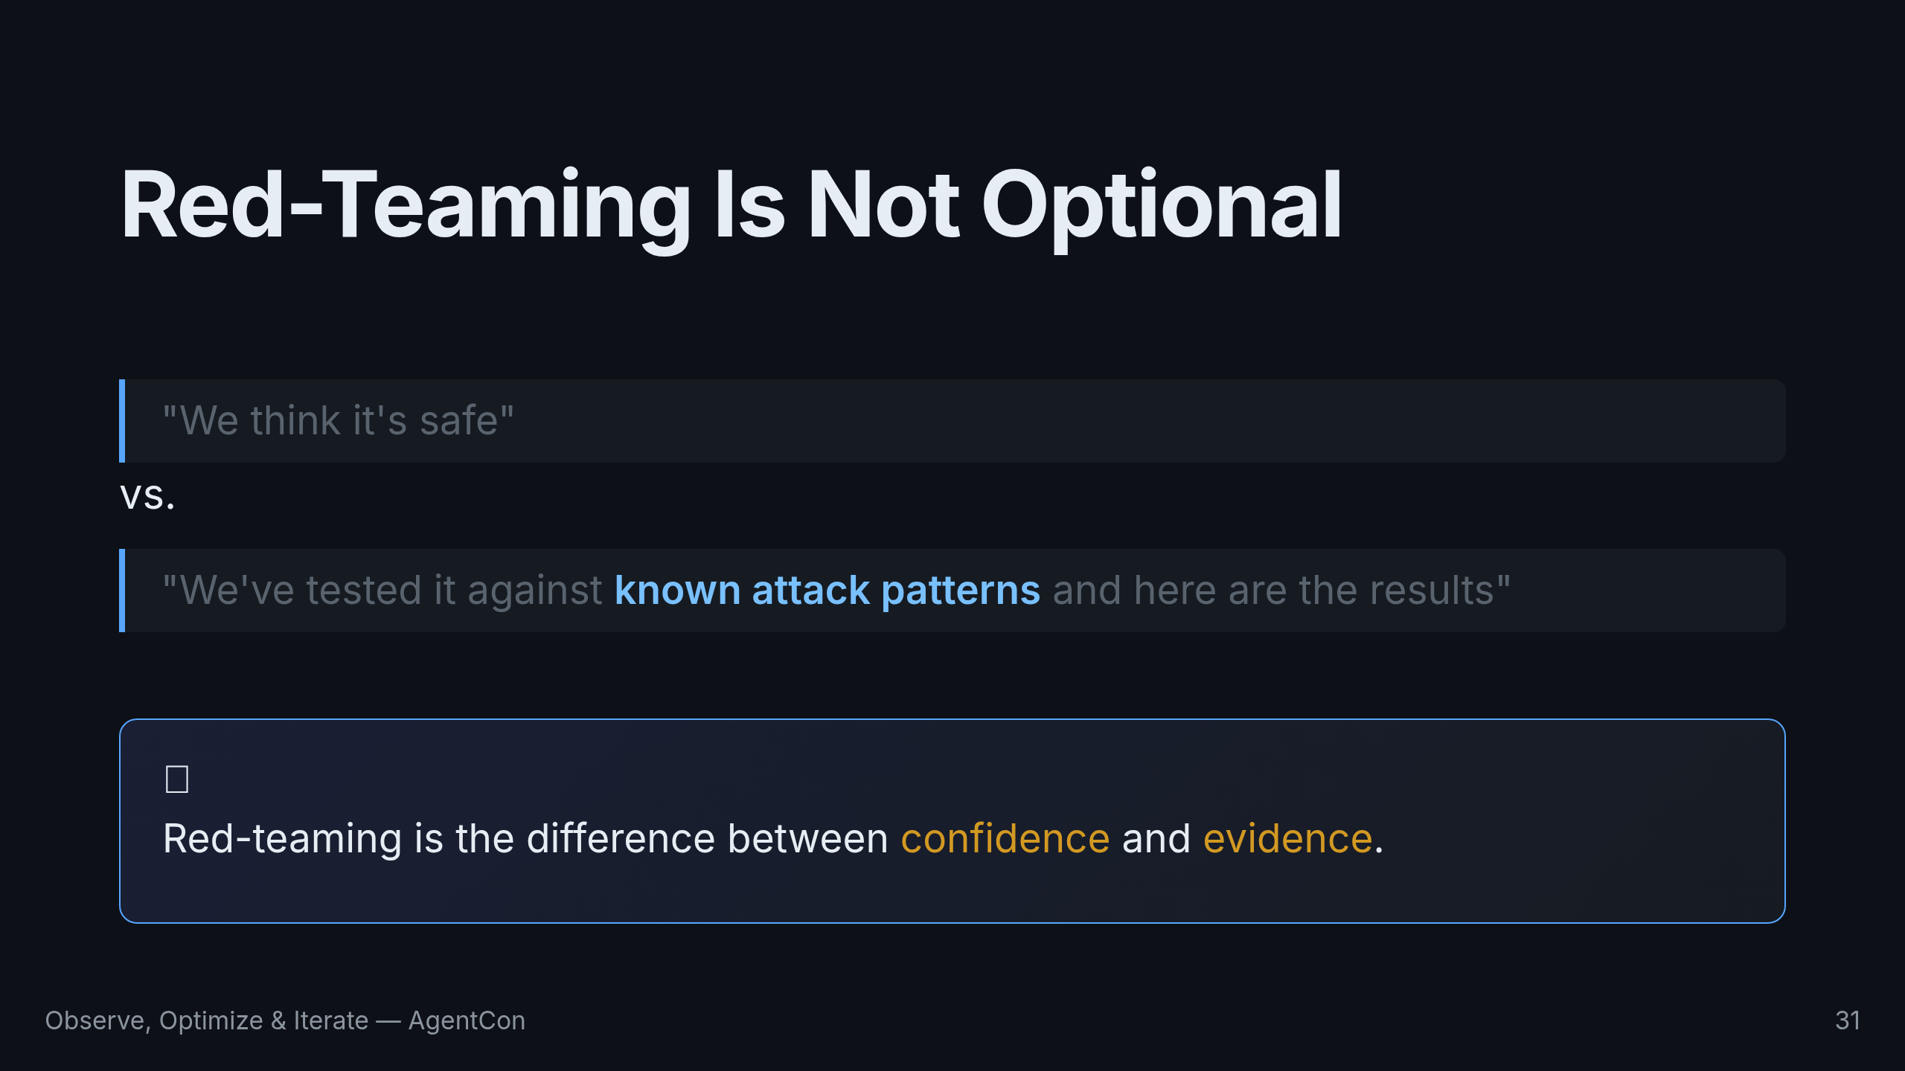
Notes:
Red-teaming is not optional for production AI. It's the difference between "we think it's safe" and "we've tested it against known attack patterns and here are the results." Ship with evidence, not confidence. Let's pull it all together.

Slide 32
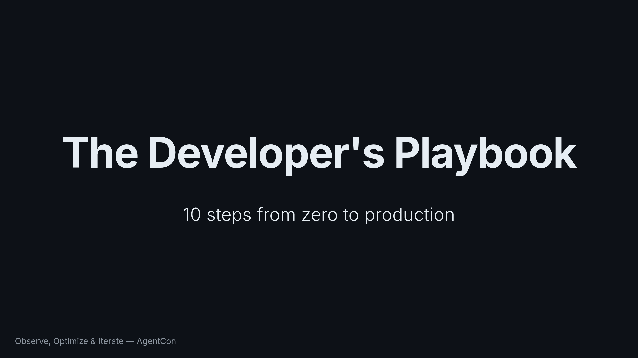
Notes:
We started with nothing. In 45 minutes we've walked the entire journey. Let me give you the playbook.

Slide 33
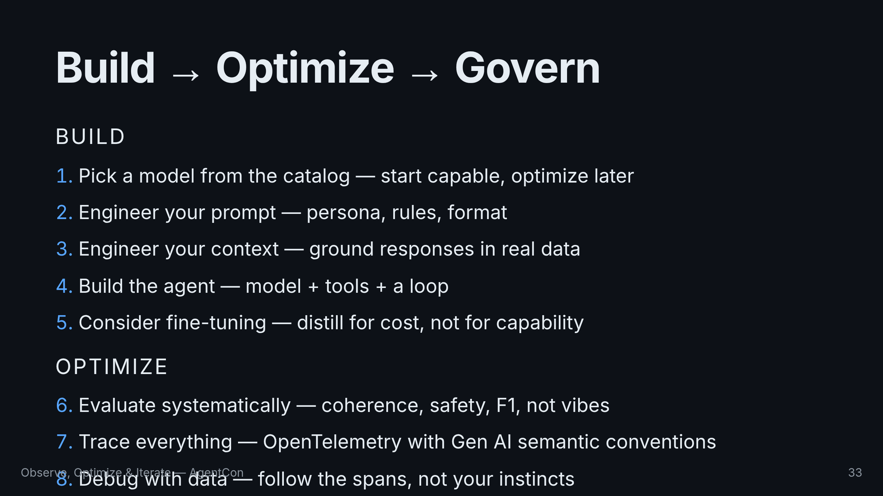
Notes:
Ten steps. Five to build, three to optimize, two to govern. This is a loop, not a waterfall — you'll cycle through these steps as your agent evolves.

Slide 34
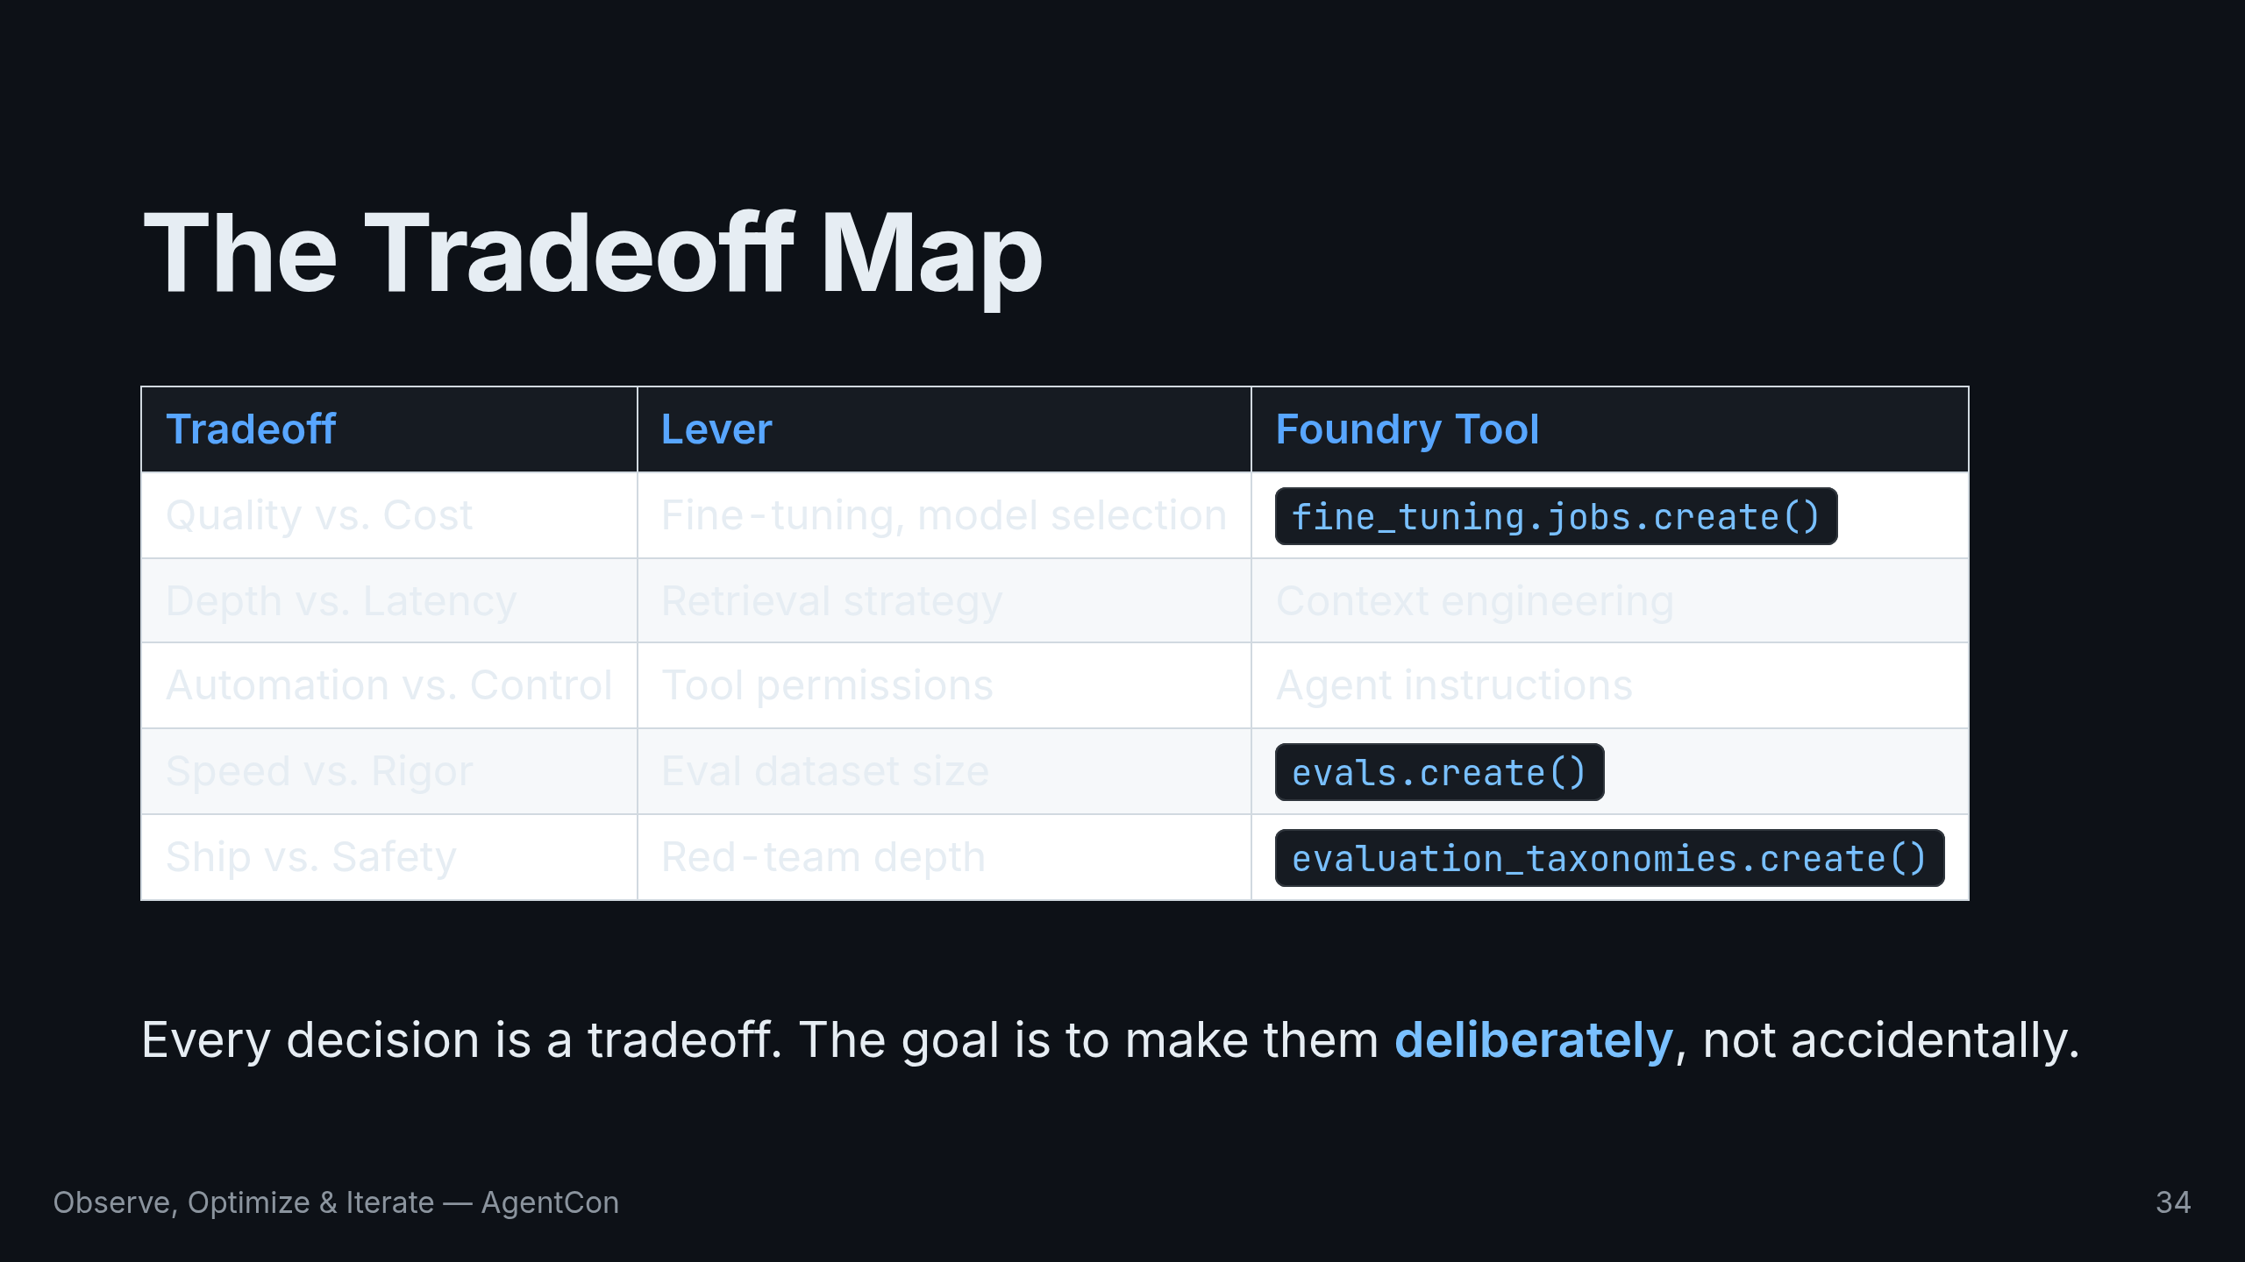
Notes:
Every decision you make building an AI system is a tradeoff. Quality vs. cost. Depth vs. latency. Speed vs. rigor. The goal isn't to eliminate tradeoffs — it's to make them deliberately, not accidentally. Foundry gives you the tools to measure the impact of each choice.

Slide 35
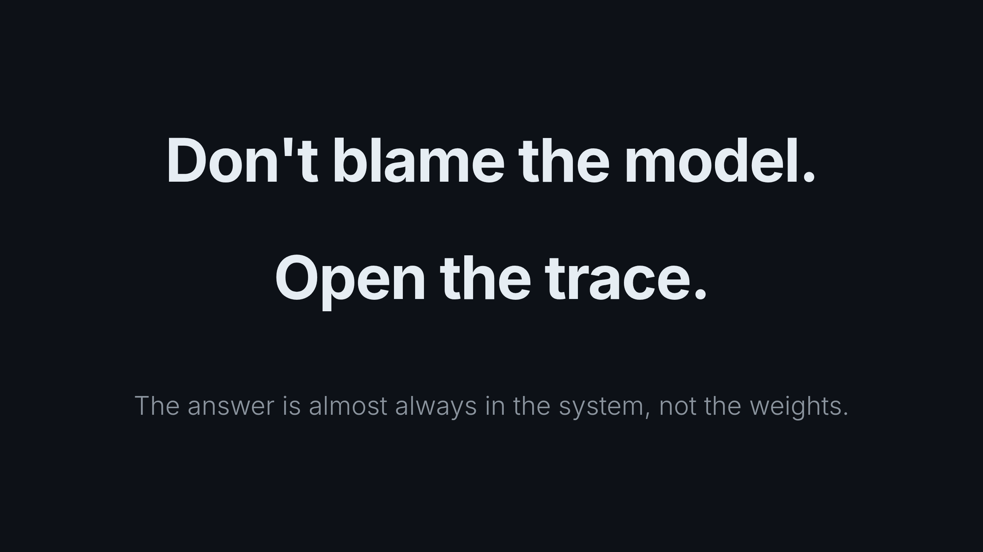
Notes:
Here's what I want you to take away: the hardest part of building AI isn't the model. It's everything around the model. It's the data pipeline. It's the evaluation framework you don't have yet. It's the prompt you haven't iterated on enough. It's the observability that shows you what's really happening. When your AI system fails — and it will — don't blame the model. Open the trace. Check the data. Read the spans. The answer is almost always in the system, not the weights.

Slide 36
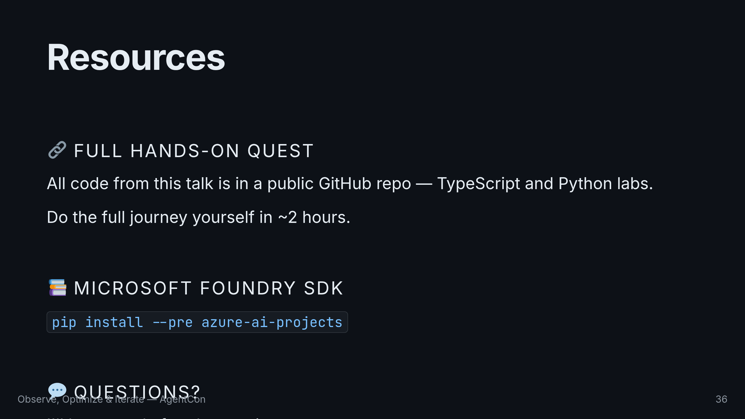
Notes:
All of the code I showed today is in a public GitHub repository. It's a hands-on quest — you can do the full journey yourself in about two hours. The repo has both TypeScript and Python labs. Thank you. I'll be around for questions.

