Slide 1
DATA MINING TECHNIQUES SWE2009 WINTER 2018-19 PROF: Dr.NAGRAJ SV

Slide 2
CHARACTER ANALYSIS OF A PERSON USING BAYES TECHNIQUE
Team Members:
K.Hema Anmisha 17mis1059
R.Aparna 17mis1065
P.Nitya Sree 17mis1007

Slide 3
CONTENTS
TITLE
OBJECTVES
DATA STRUCTURES/ALGORTHMS
LITERATURE SURVEY
DESIGN TECHNIQUES/METHODOLOGY
PLANNNG OF PROJECT WORK(MODULE SPLIT UP AND GANTT CHART)
EXPECTED OUTCOMES
CODNG STYLE FOLLOWED FOR MPLEMENTATON

Slide 4
PROGRAM OUTPUT/RESULTS
REFERENCES

Slide 5
TITLE:
character analysis of a person using baye’s technique
OBJECTVES:
This project's objective is all about predicting and analysing a particular person's character based on their answers for the given set of questions. This process is carried out using the naive baye’s technique used in data mining. The user is asked to answer a set of questions which are helpful for finding their character. This can be done for a large crowd too.

Slide 6
DATA STRUCTURES/ALGORTHMS:
naive baye’s technique
LITERATURE SURVEY:
Ritu Chaturvedi -PERSONALITY CLASSIFICATION

Slide 7
Year : 2005
AUTHORS:
Du, J.; Zheng, Q.; Li, H. and Yuan, W.
TITLE OF PAPER:
The research of mining association rules between personality and behaviour of learner under web-based learning environment
TECHNIQUE
Association rule mining
An improved apriori algorithm that substantially avoids the generation of redundant rules(16 personality and 6 behavioral attributes) , thereby reducing the complexity of the algorithm.

Slide 8
AUTHOR:
Jin, D.; Qinghua, Z.; Jiao, D. and Zhiyong, G.
TITLE OF PAPER:
A Method for Learner Grouping Based on Personality Clustering(2006)
TECHNIQUE:
Clustering
An algorithm that validates the feasibility of using k-means clustering algorithm as the most appropriate method for grouping learners, before applying it to a learner model that consists of attributes that represent student's personality, study style, learning strategy and behaviour on courseware learning to group students with same personality so that an appropriate learning

Slide 9
YEAR:2007
AUTHOR: Huang, J.; Zhu, A. and Luo,
TITLE OF PAPER:
Personality mining method in web based education system using data mining
TECHNIQUE:
Association rule mining An algorithm that uses a data cube to represent personality, behaviour and time as its dimensions(d) to moderate the number of association rules generated by apriori algorithm (using roll-up, if there are no frequent item sets ford and drill-down, if all d's item sets are frequent).

Slide 10
INTRODUCTION
This survey concerns research which attempts to solve the problem of improving learning outcomes in e-learning distance courses by studying the impact of students' personality and learning preferences on his/her learning process.
In such e-learning distance courses, where students do not have a direct interaction with the teacher, it becomes challenging for the teacher to provide individualized assistance to students and to adjust the pace of their teaching appropriately (just like how a teacher in a traditional classroom adjusts) to effectively meet the course's learning outcomes.
Research on correlating students' personality and learning preferences with their performance grades will empower the teachers teaching such distance courses towards meeting the course objectives.

Slide 11
TECHNIQUES USED :
Data Mining techniques
A review of the ten selected papers identifies association rule mining as the most commonly applied data mining technique in the research of personality mining. Clustering using k-means and hierarchical clustering is also used by some researchers to and groups of students that match with a certain learning strategy. Research papers that are presented in this section use these techniques to solve the considered problem.

Slide 12
Association Rule Mining
Du et al. [Du et al. 2005] propose a learner model in 2005 that consists of a personality model (PM) and a behaviour model (BM), where personality model stores the learner's personality using Cattell's 16 personality factors and behaviour model is represented by six different aspects of the sequence of actions that a learner takes while using the web page : behaviour on courseware learning, tests / assignments, postings and interaction among students and teachers through the use of discussion boards, chat rooms etc. Each attribute of PM and BM is mapped to an integer value of 1, 2 or 3 representing high, middle and low. This transformed data is then mined using the apriori algorithm to analyse the relation between personality and behavior and generate association rules of the form Behavior => Personality.

Slide 13
Clustering.
Jin et al. [Jin et al. 2006] present an analysis of the various existing clustering methods to validate the feasibility of using k-means clustering algorithm as the most appropriate method for grouping learners. Then they build a learner model that consists of attributes that represent students' personality (e.g. warmth), motivation (e.g. curiosity), study style (e.g. visual/hands-on, serial/random), study concept (e.g. self-management), strategy (e.g. memorize/ cognize) and behaviour on courseware learning (e.g. average time spent on each login).
Finally, they apply k-means algorithm using Euclidean distance function to ACM Journal Name, Vol. V, No. N, Month 20YY. · 5 group students with same personality into one cluster and match that to a learning strategy appropriate for that group.
The authors also conducted experiments using another clustering method called BIRCH to compare and validate the performance and accuracy of the suggested k-means algorithm

Slide 14
DESIGN TECHNIQUES/METHODOLOGY
The project is mainly done using RStudio and Net Beans. To find what character the person best suits naive bayes algorithm from data mining concept is used . Naive bayes algorithm will be implemented in rstudio. The project is mainly done using RStudio and Net Beans. The implementation part for character analysis is done using Java concepts.
The question for personality quiz and the user's response is done using Java .
And a dataset containing attributes such as age , marital status, introvert , extrovert , practical , creative which determines the character as Caeser or Brutus in Excel format is imported in R studio for implementing naive bayes concept

Slide 15
PLANNNG OF PROJECT WORK(MODULE SPLIT UP AND GANTT CHART)
Naive Bayes(Rstudio code ): Nityasree 17mis1007 ,Hema anmisha 17mis1059
Creating quiz (java code ): Nityasree 17mis1007 , Aparna-17mis1065
Documentation: Nityasree 17mis1007
Architectural diagram: Aparna-17mis1065, Hema anmisha 17mis1059
Detailed design: Aparna-17mis1065, Hema anmisha 17mis1059
Training datasets : Hema anmisha 17mis1059, Aparna-17mis1065
ganttchart: Nityasree 17mis1007, Hema anmisha 17mis1059

Slide 16
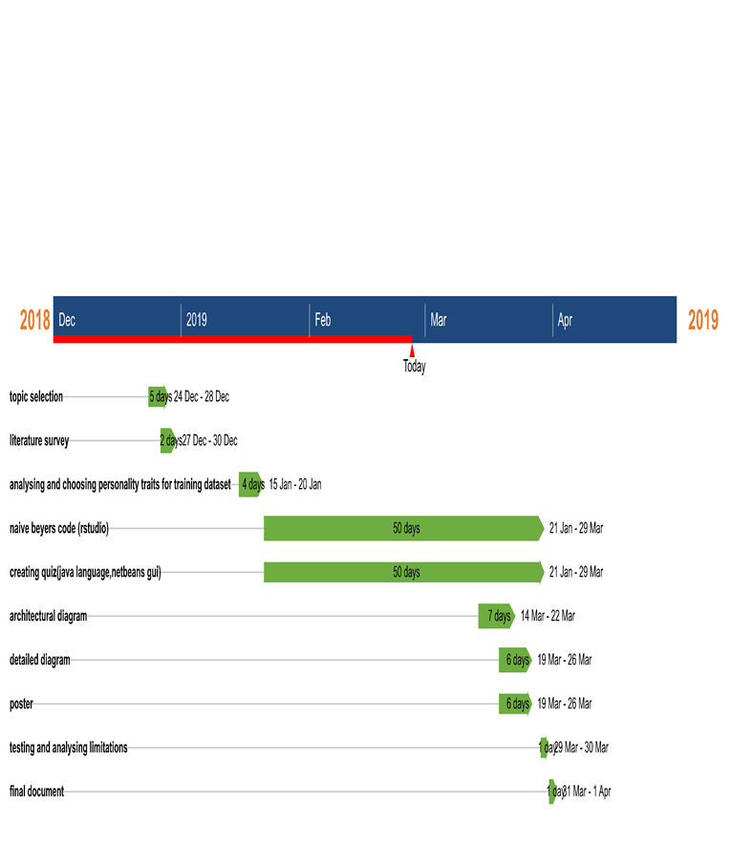

Slide 17
EXPECTED OUTCOMES
The outcome expected is a character of a Person. The user character is examined and which personality of the movie does the user resemble is the expected outcome
Coding style followed for implementation :
And a dataset containing attributes such as age , marital status, introvert , extrovert , practical , creative which determines the character as ceaser or brutus(person character) in Excel format is imported in R studio
In netbeans gui , using java create A class containing variables for variables like age , marital status, introvert , extrovert , practical , creative .
Create Any no of object for the above mentioned class
Use for loop get the values for variables mentioned in the class
Use the given values in naive Baye's in rstudio to predict the character
Get the result and display it in netbeans

Slide 18
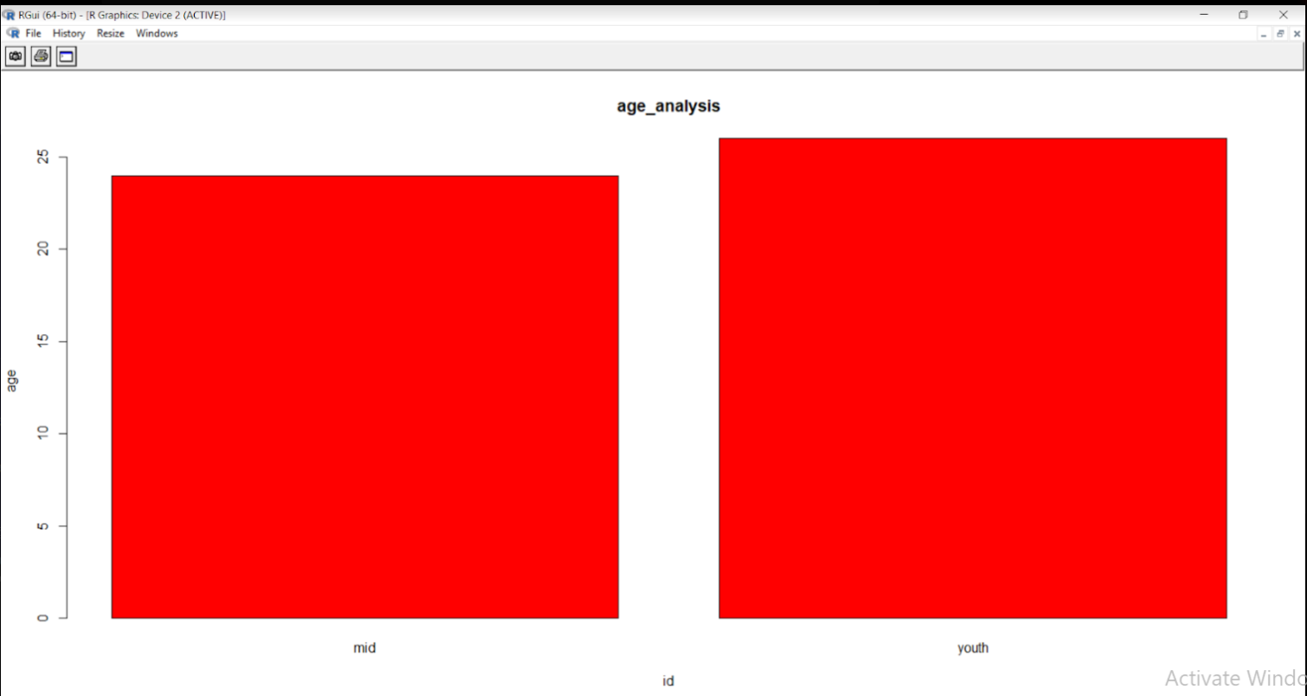
PROGRAM OUTPUTS:

Slide 19
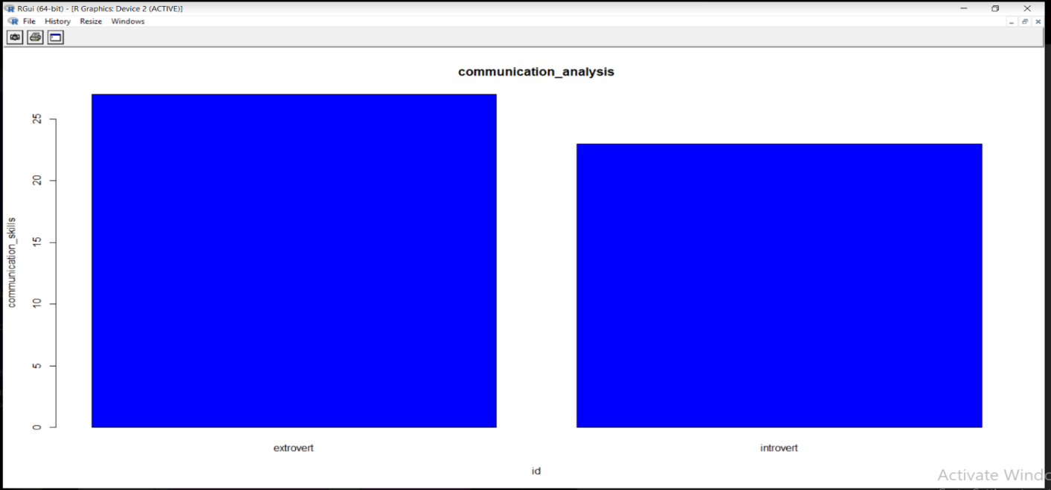
2

Slide 20
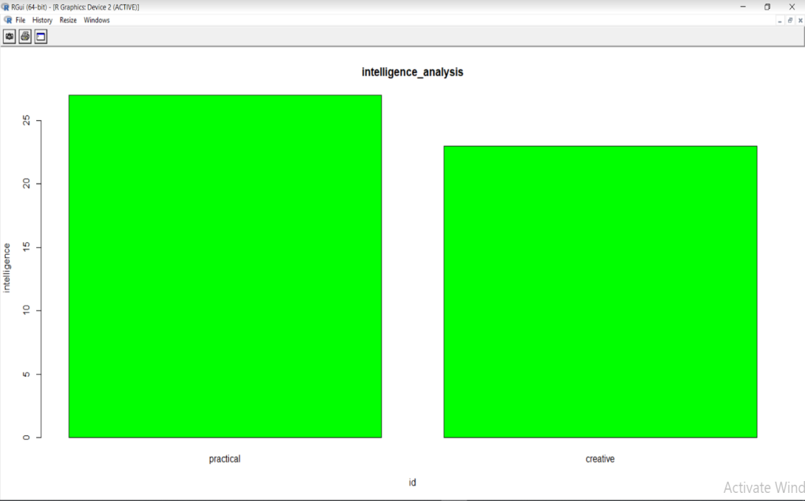
3

Slide 21
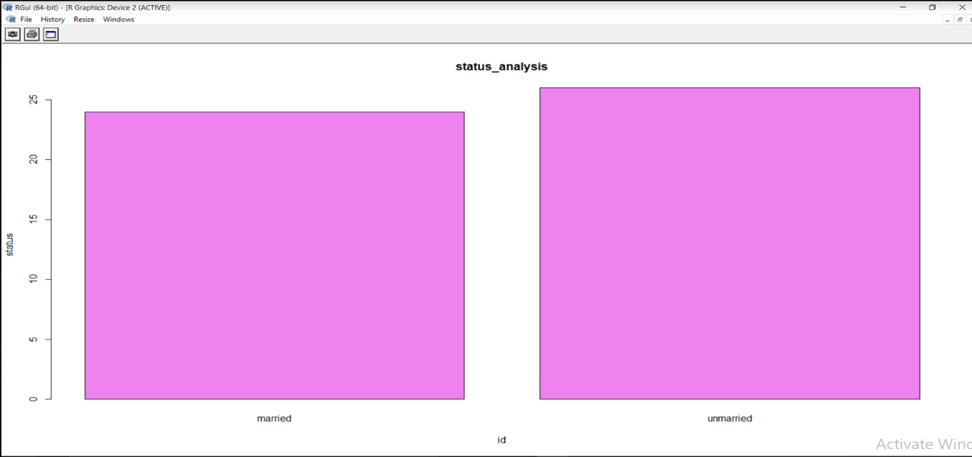
4

Slide 22
REFERENCES
[1]. Pang, Bo, and Lillian Lee. "Opinion mining and sentiment analysis." Foundations and trends in information retrieval 2.1-2 (2008)
[2]. Asur, Sitaram, and Bernardo A. Huberman. "Predicting the future with social media." Web Intelligence and Intelligent Agent Technology (WI-IAT), 2010 IEEE/WIC/ACM International Conference on Vol 1 IEEE, 2001
[3]. Cambria, Erik, et al. "New avenues in opinion mining and sentiment analysis. “IEEE Intelligent Systems 28.2(2013): 15-21
[4]. Golbeck, Jennifer, Cristina Robles, and Karen Turner. "Predicting personality with social media." CHI'11 extended abstracts on human factors in computing systems. ACM, 2011.
[5]. Barrick, Murray R., and Michael K. Mount. "The Big Five personality dimensions and job performance: A meta-analysis." (1991).

Slide 23
[6]. Judge, Timothy A., et al. "The big five personality traits, general mental ability, and career success across the life span." Personnel psychology 52.3 (1999): 621-652.
[7]. Shaver, Phillip R., and Kelly A. Brennan. "Attachment styles and the" Big Five" personality traits: Their connections with each other and with romantic relationship outcomes." Personality and Social Psychology Bulletin 18.5 (1992): 536-545.
[8]. Golbeck, Jennifer, et al. "Predicting personality from twitter." Privacy, Security, Risk and Trust (PASSAT) and 2011 IEEE Third Inernational Conference on Social Computing (SocialCom), 2011 IEEE Third International Conference on. IEEE, 2011.

Slide 24
THE END

