Slide 1

TITLE: Predicting the Compressive Strength of Concrete using
Nueral Network, ML Methods and Recommendation system
COURSE: TECHNICAL ANSWER FOR REAL WORLD PROBLEMS
COURSE CODE: SWE 3999

Slide 2
ABSTRACT:
To predict the concrete strength of using the composition of its mixture and age of the concrete. Concrete has been widely used in recent years because its production compliments environmental conservation.
Regression models tend to be used for the prediction of the compressive strength of high strength concrete. These models also demonstrate how the concrete compressive strength depends on the mixing ratios
Hence, the focus of this project is the application of machine learning process,Artificial nueral networks and their suitability to model concrete compressive strength compared with early models obtained from the literature and compared with some conventional approaches and also a recoomendation system is developed by applying various ML methods,Artificial nueral network methods to predict the concrete strength from its components accurately and then looking for the optimal combination of components which increases the strength.

Slide 3
PROBLEM STATEMENT-SOCIETAL ISSUE
In earlier days, the concrete strength is measure through other traditional methods like using drill holes, weight spring, or using sensors. But that requires a significant destruction of test sample and thereby increasing the cost.
And the accuracy was also hardly 70%.This is generally determined by a standard crushing test on a concrete cylinder. This requires engineers to build small concrete cylinders with different combinations of raw materials and test these cylinders for strength variations with a change in each raw material.
The recommended wait time for testing the cylinder is 28 days to ensure correct results. This consumes a lot of time and requires a lot of labour to prepare different prototypes and test them. Also, this method is prone to human error and one small mistake can cause the wait time to drastically increase.
Generally, the one-factor-at-a-time method is used in experimental designs to determine the concrete properties. The major disadvantage of this approach is that it does not consider the interaction between the factors (interaction terms). The higher the number of the controlled and uncontrolled effect variables that influence the concrete properties, the lesser the predicted accuracy.

Slide 4
Objectives:
With the use of Machine Learning Model, there will be no limitation of the complexity increasing number of variables. This Model and train and test the given population of concrete and with the best performing machine learning model it can effortlessly predict the strength of the concrete with much higher accuracy than traditional methods.
the focus of PROJECT is the application of machine learning process,Artificial nueral networks and their suitability to model concrete compressive strength compared with early models obtained from the literature and compared with some conventional approaches
also a recoMmendation system is developed by applying various ML methods,Artificial nueral network methods to predict the concrete strength from its components accurately and then looking for the optimal combination of components which increases the strength.

Slide 5
Literature survey:
1) Title: Comparison of Machine Learning Techniques for the Prediction of Compressive Strength of Concrete.
Author: PalikaChopra,RajendraKumarSharma,Maneek Kumar,andTanujChopra.
Year: 12 Apr 2018
Techniques: Three models have been used for the prediction of compressive strength of concrete:
(i) decision tree (DT) model,
(ii) random forest (RF) model, and
(iii) neural network (NN) model.
Limitations: The problem with the DT model is that it unable to predict beyond the range (minimum and maximum limits) given in the training dataset. therefore, the RMSE is high as compared to RF.

Slide 6
2) Title: Predictive modeling of high-performance concrete with regression analysis
Author: S.S. Wu ; B.Z. Li ; J.G. Yang ; S. K. Shukla
Year: 23 December 2016
Techniques: This paper deals with building a regression model for predicting concrete's compressive strength. First of all, eight process variables are identified as determinants of Concrete Compressive Strength (CCS). These variables are Cement, Blast Furnace Slag, Fly Ash, Water, Superplasticizer, Coarse Aggregate, Fine Aggregate, and Age.
Limitations: Appropriateness of the model is investigated by testing it against unseen data points. Further, correlation among these variables is computed and it is found that a few of them are highly correlated

Slide 7
3) Title: Machine Learning Techniques in Concrete Mix Design
Author:PatrykZiolkowskiOrcID,Maciej Niedostatkiewicz
Year: 15 December 2019
Techniques: These methods are the Bukowski method, the Eyman and Klaus method, and the Paszkowski methods,Artificial Neural Networks (ANN).
Limitations: That the presented mathematical expression does not adequately reflect all the relationships between the components certain boundary conditionsIt is likely to analyse the effect of admixtures and concrete durability by effective measures.

Slide 8
4) Title: Can the compressive strength of concrete be estimated from knowledge of the mixture proportions?: New insights from statistical analysis and machine learning methods.
Author:BenjaminYoung,Puneet Gupta,Gaurav Sant
Year: 14 June 2018
Techniques:Machinelearning and datamining algorithms, Artificial neural networks (ANNs),Decision trees,Support vector machines (SVMs).
Limitations: This study presents the first analysis of a large data set (>10,000 observations) of measured compressive strengths from actual (job-site) mixtures and their corresponding actual mixture proportions.

Slide 9
5) Title: Prediction of concrete strength using artificial neural networks
Author:seung-chang lee
Year: 19 April 2017
Techniques: Artificial neural network (ANN)
Limitations: This concept proposes that concrete of the same mix at the same maturity has approximately the same strength.

Slide 10
6) Title: Machine learning in concrete strength simulations: Multi-nation data analytics
Author:Jui-ShengChouaChih-FongTsaibAnh-DucPhamacYu-HsinLud
Year: 24 September 2019
Techniques:The individual learning classifiers are constructed from four different base learners, including multilayer perceptron (MLP) neural network, support vector machine (SVM), classification and regression tree (CART),and linear regression.
Limitations: This study validates the applicability of ML, voting, bagging, and stacking techniques for simple and efficient simulations of concrete compressive strength.

Slide 11
PROPOSED METHODOLOGY :
Modules:
1) DATA COLLECTION
2) DATA PREPROCESSING
3) IMPORT THE LIBRARIES
4) IMPORTING THE DATASET
5) DATA VISUALISATION
6) TAKING CARE OF MISSING DATA
7) LABEL ENCODING
8) ONE HOT ENCODING
9) FEATURE SCALING
10) SPLITTING DATA INTO TRAIN AND TEST
11) MODEL BUILDING
12) APPLICATION BUILDING
13) CREATE HTML FILE
14) BUILD PYTHON CODE

Slide 12
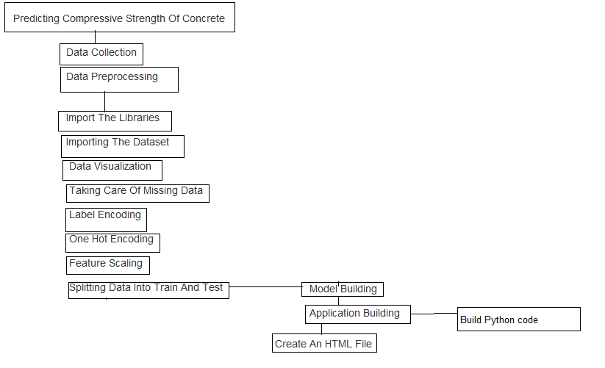

Slide 13
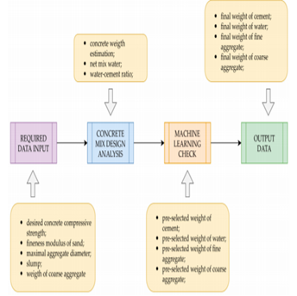
ARCHITECTURE DIAGRAM:

Slide 14
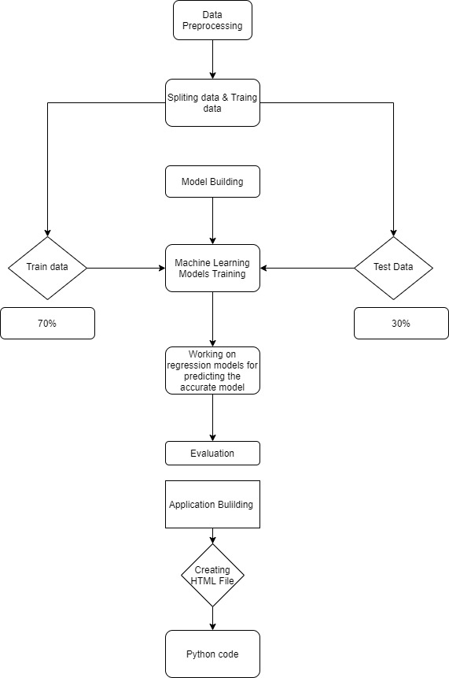

Slide 15
DATA SET SOURCE LINK:
https://archive.ics.uci.edu/ml/datasets/Concrete+Compressive+Strength
Uci machine learning repository

Slide 16
ALGORITHMS :
ANN METHOD:
ANNs consist of the following three major essentials:
Topology: organization and interconnection of a neural network into layers.
Learning: related with the information storage in the network.
Recall: retrieval of information from the network.
ANN model is developed through experimental exploration of various internal parameters to predict the compressive strength of concrete
Artificial Neural Networks techniques are amongst the areas in artificial intelligence that have grown fast and gained popular engineering applications and have been employed in many civil engineering applications such as detection of structural damage, structural system identification,material behaviour modelling, groundwater monitoring, foundation settlement prediction, concrete mix proportioning and concrete strength prediction.

Slide 17
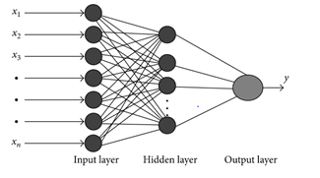

Slide 18
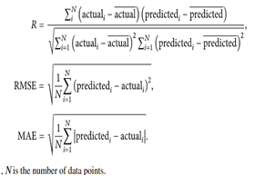
ML methods:
The ML regression method estimates the output value using the input samples of the dataset. Such a procedure is also termed as the training set. The purpose of the regression method is to minimize the error between the predicted and actual outputs .The values were predicted using the ML regression models, namely, DECISION TREE, RF,LINEAR REGRESSION, ANN.
Datasets were randomly split into 70% for the training set and 30% for the independent test set. The training data were used to train the ML model.
Evaluation Metrics:

Slide 19
Experiments and results:
Ann accuracy hidden layer as 5
Ann model accuracy default parameters
0.8298231843
0.9362438074

Slide 20
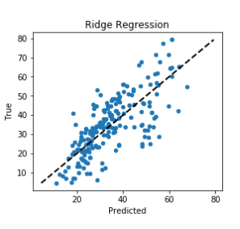
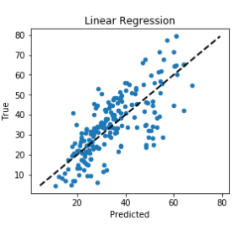
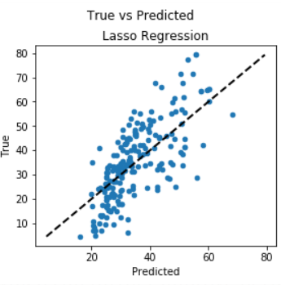

Slide 21
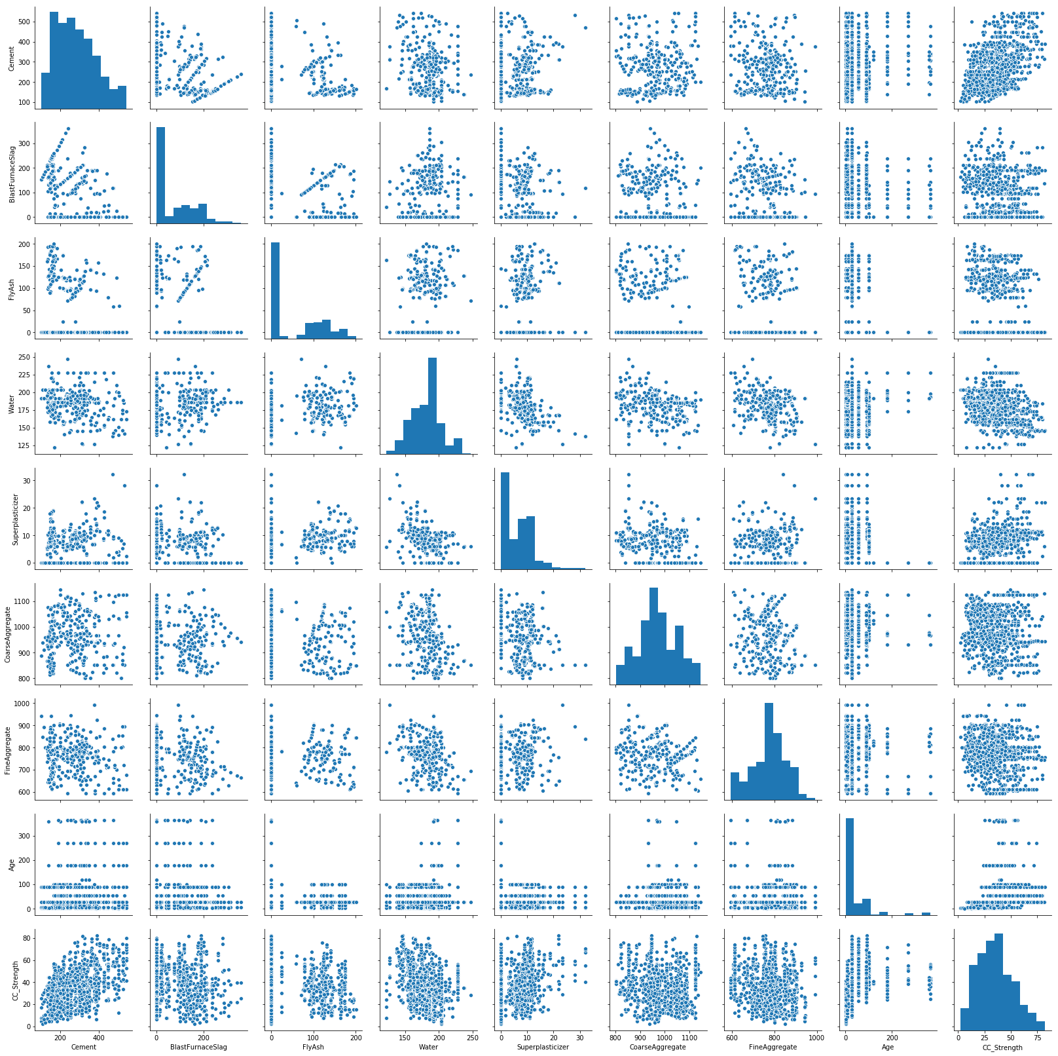
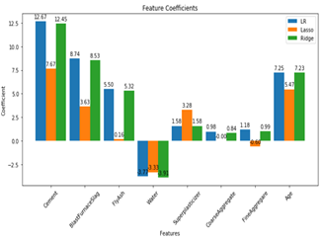
PAIR PLOT
FEATURE COEFFICIENTS

Slide 22
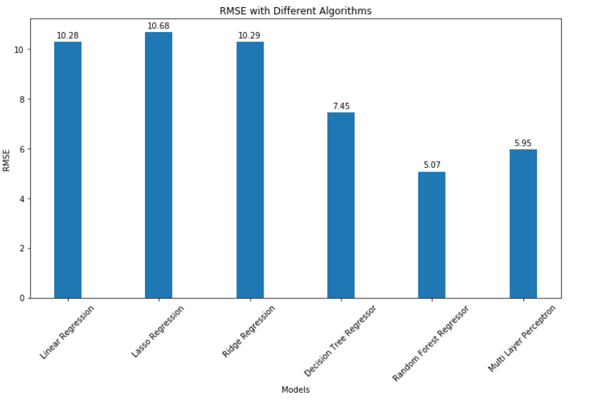
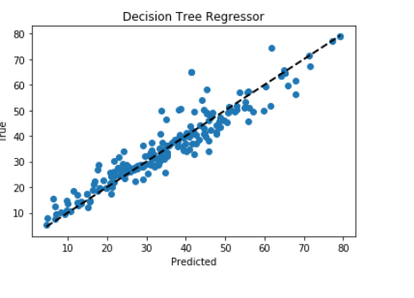

Slide 23
CONCLUSION:
We have analysed the Compressive Strength Data and used Machine Learning to Predict the Compressive Strength of Concrete. We have used Linear Regression and its variations, Decision Trees and Random Forests to make predictions and compared their performance.
NN approaches combine the complexity of many statistical techniques with machine learning techniques .It comes out as the best possible model for the prediction of compressive strength of concrete. It has predicted with high accuracy for all the curing ages, that is, 28, 56, and 91 days.NN USED FOR LARGE DATASETS.
Further work involve investigating more learning schemes, exploring more ML algorithms like Genetic programming and improving the correct prediction rate.

Slide 24
INDIVIDUAL CONTRIBUTION:
1) DATA COLLECTION
2) DATA PREPROCESSING
3) IMPORT THE LIBRARIES
4) IMPORTING THE DATASET
5) DATA VISUALISATION
6) TAKING CARE OF MISSING DATA
7) LABEL ENCODING
8) ONE HOT ENCODING
9) FEATURE SCALING
10) SPLITTING DATA INTO TRAIN AND TEST
11) MODEL BUILDING (ml algorithms and ann)
12) APPLICATION BUILDING
13) CREATE HTML FILE
14) BUILD PYTHON CODE

Slide 25
References:
Asteris, P. G., Apostolopoulou, M., Skentou, A. D., & Moropoulou, A. (2019). Application of artificial neural networks for the prediction of the compressive strength of cement-based mortars. Computers and Concrete, 24(4), 329-345.
Omran, B. A., Chen, Q., & Jin, R. (2014). Prediction of compressive strength of “green” concrete using artificial neural networks. Sulbaran, T.
Moretti, J. F., Minussi, C. R., Akasaki, J. L., Fioriti, C. F., Melges, J. L. P., & Tashima, M. M. (2016). < b> Prediction of modulus of elasticity and compressive strength of concrete specimens by means of artificial neural networks. Acta Scientiarum. Technology, 38(1), 65-70
Dutta, D., & Barai, S. V. (2019). Prediction of compressive strength of concrete: machine learning approaches. In Recent Advances in Structural Engineering, Volume 1 (pp. 503-513). Springer, Singapore.
Słoński, M. (2010). A comparison of model selection methods for compressive strength prediction of high-performance concrete using neural networks. Computers & structures, 88(21-22), 1248-1253.

Slide 26
Silva, P. F., Moita, G. F., & Arruda, V. F. (2020). Machine learning techniques to predict the compressive strength of concrete. Revista Internacional de Métodos Numéricos para Cálculo y Diseño en Ingeniería, 36(4).
Nguyen, T. A., Ly, H. B., Mai, H. V. T., & Tran, V. Q. (2020). Prediction of Later-Age Concrete Compressive Strength Using Feedforward Neural Network. Advances in Materials Science and Engineering, 2020.
8. Yaseen, Z. M., Deo, R. C., Hilal, A., Abd, A. M., Bueno, L. C., Salcedo-Sanz, S., & Nehdi, M. L. (2018). Predicting compressive strength of lightweight foamed concrete using extreme learning machine model. Advances in Engineering Software, 115, 112-125
Poorarbabi, A., Ghasemi, M., & Moghaddam, M. A. (2020). Concrete Compressive Strength Prediction Using Neural Networks Based on Non-destructive Tests and a Self-calibrated Response Surface Methodology. Journal of Nondestructive Evaluation, 39(4), 1-11.
Khashman, A., & Akpinar, P. (2017). Non-destructive prediction of concrete compressive strength using neural networks. Procedia Computer Science, 108, 2358-2362.

Slide 27
THANK YOU

