Slide 1


Slide 2



SAMPLE PPT
IN
JAVA

Slide 3




Slide 4
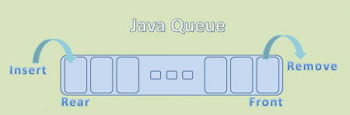
Queue in Java
Java Queue is an interface available in java.util package and extends java.util.Collection interface.
Just like Java List, Java Queue is a collection of ordered elements (Or objects) but it performs insert and remove operations differently.
We can use Queue to store elements before processing those elements.

Slide 5
java.util.Queue interface is a subtype of java.util.Collection interface.
Just like a real-world queue (for instance, in a bank or at ATM), Queue inserts elements at the end of the queue and removes from the beginning of the queue.
Java Queue represents an ordered list of elements.
Java Queue follows FIFO order to insert and remove it’s elements. FIFO stands for First In First Out.
Java Queue supports all methods of Collection interface.
Most frequently used Queue implementations are LinkedList, ArrayBlockingQueue and PriorityQueue.

Slide 6
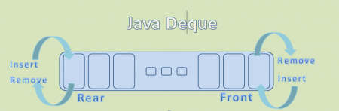
All Queues which are available in java.util package are Unbounded Queues and Queues which are available in java.util.concurrent package are Bounded Queues.
All Deques are not thread-safe.
All Queues supports insertion at the tail of the queue and removal at the head of the queue, except Deques.
Deques are queues but they support element insertion and removal at both ends.

Slide 7
Java Queue Methods
int size(): to get the number of elements in the Set.
boolean isEmpty(): to check if Set is empty or not.
boolean contains(Object o): Returns true if this Set contains the specified element.
Iterator iterator(): Returns an iterator over the elements in this set. The elements are returned in no particular order.
boolean removeAll(Collection c): Removes from this set all of its elements that are contained in the specified collection (optional operation).

Slide 8
Java Queue Methods
boolean retainAll(Collection c): Retains only the elements in this set that are contained in the specified collection (optional operation).
void clear(): Removes all the elements from the set.
E remove(): Retrieves and removes the head of this queue.
E poll(): Retrieves and removes the head of this queue, or returns null if this queue is empty.
E peek(): Retrieves, but does not remove, the head of this queue, or returns null if this queue is empty.
boolean offer(E e): Inserts the specified element into this queue if it is possible to do so immediately without violating capacity restrictions.

Slide 9
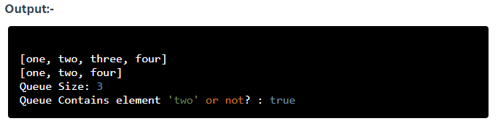
Java Queue Basics
import java.util.*; public class QueueExample { public static void main(String[] args) { Queue<String> queue = new LinkedList<>(); queue.add("one"); queue.add("two"); queue.add("three"); queue.add("four"); System.out.println(queue); queue.remove("three"); System.out.println(queue); System.out.println("Queue Size: " + queue.size()); System.out.println("Queue Contains element 'two' or not? : " + queue.contains("two")); // To empty the queue queue.clear(); } }

Slide 10

Java Array to Queue
convert a Java array to Queue using “Collections.addAll()” method.
import java.util.*; public class ArrayToQueue { public static void main(String[] args) { String nums[] = {"one","two","three","four","five"}; Queue<String> queue = new LinkedList<>(); Collections.addAll(queue, nums); System.out.println(queue); } }

Slide 11
Java Queue to Array
convert a Java Queue to a Java Array using “toArray()”
import java.util.*; public class QueueToArray { public static void main(String[] args) { Queue<String> queue = new LinkedList<>(); queue.add("one"); queue.add("two"); queue.add("three"); queue.add("four"); queue.add("five"); String strArray[] = queue.toArray(new String[queue.size()]); System.out.println(Arrays.toString(strArray)); } }

Slide 12
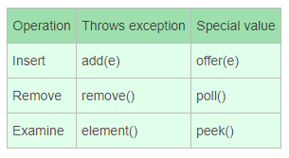
Java Queue Common Operations
Java Queue supports all operations supported by Collection interface and some more operations. It supports almost all operations in two forms.
One set of operations throws an exception if the operation fails.
The other set of operations returns a special value if the operation fails.

Slide 13
Java Queue Insert Operations
Java Queue Insert operation in-detail with some useful examples. If this operation performs successfully, it returns “true” value. As we know, Queue supports insert operation in two forms:
Queue.add(e):
It throws an exception if the operation fails.
Queue.offer(e):
It returns a special value if the operation fails.
NOTE:- Here special value may be either “false” or “null”

Slide 14
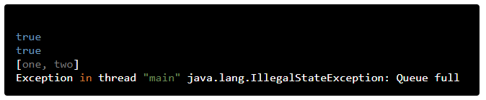
Queue add() operation
The add() operation is used to insert new element into the queue.
If it performs insert operation successfully, it returns “true” value. Otherwise it throws java.lang.IllegalStateException.
import java.util.concurrent.*; public class QueueAddOperation { public static void main(String[] args) { BlockingQueue<String> queue = new ArrayBlockingQueue<>(2); System.out.println(queue.add("one")); System.out.println(queue.add("two")); System.out.println(queue); System.out.println(queue.add("three")); System.out.println(queue); } }
Notes:
As our queue is limited to two elements, when we try to add third element using BlockingQueue.add(), it throws an exception as shown above.

Slide 15
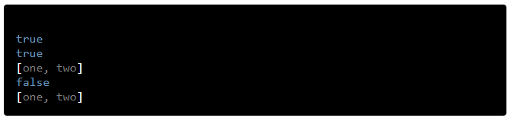
Queue offer() operation
The offer() operation is used to insert new element into the queue.
If it performs insert operation successfully, it returns “true” value. Otherwise it returns “false” value.
import java.util.concurrent.*; public class QueueOfferOperation { public static void main(String[] args) { BlockingQueue<String> queue = new ArrayBlockingQueue<>(2); System.out.println(queue.offer("one")); System.out.println(queue.offer("two")); System.out.println(queue); System.out.println(queue.offer("three")); System.out.println(queue); } }
Notes:
As our queue is limited to two elements, when we try to add third element using BlockingQueue.offer() operation, it returns “false” value as shown above.

Slide 16
Java Queue Delete Operations
Java Queue Delete operation in-detail with some useful examples. The Delete operations returns the head element of the queue, if it performs successfully. As we know, Queue supports delete operation in two forms:
Queue.remove():
It throws an exception if the operation fails.
Queue.poll():
It returns a special value if the operation fails.
NOTE:- Here special value may be either “false” or “null”

Slide 17
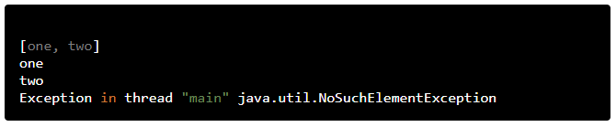
Queue remove() operation
The remove() operation is used to delete an element from the head of the queue. If it performs delete operation successfully,
it returns the head element of the queue. Otherwise it throws java.util.NoSuchElementException.
import java.util.*; public class QueueRemoveOperation { public static void main(String[] args) { Queue<String> queue = new LinkedList<>(); queue.offer("one"); queue.offer("two"); System.out.println(queue); System.out.println(queue.remove()); System.out.println(queue.remove()); System.out.println(queue.remove()); } }
Notes:
As our queue has only two elements, when we try to call remove() method for third time, it throws an exception as shown above.
NOTE:- Queue.remove(element) is used to delete a specified element from the queue. If it performs delete operation successfully, it returns “true” value. Otherwise it returns “false” value.

Slide 18
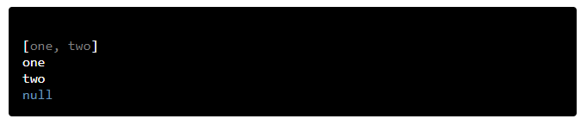
Queue poll() operation
The poll() operation is used to delete an element from the head of the queue. If it performs delete operation successfully,
it returns the head element of the queue. Otherwise it returns “null” value.
import java.util.*; public class QueuePollOperation { public static void main(String[] args){ Queue<String> queue = new LinkedList<>(); queue.offer("one"); queue.offer("two"); System.out.println(queue); System.out.println(queue.poll()); System.out.println(queue.poll()); System.out.println(queue.poll()); } }
Notes:
As our queue has only two elements, when we try to call poll() method for third time, it returns null value as shown above.

Slide 19
Java Queue Examine Operations
Java Queue Examine operations in-detail with some useful examples. If this operation performs successfully, it returns the head element of the queue without removing it. As we know, Queue supports examine operation in two forms:
Queue.element():
It throws an exception if the operation fails.
Queue.peek():
It returns a special value if the operation fails.
NOTE:- Here special value may be either “false” or “null”

Slide 20
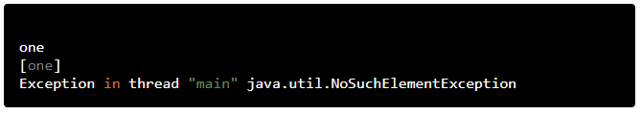
Queue element() operation
The element() operation is used to retrieve an element from the head of the queue, without removing it. If it performs examine operation successfully, it returns the head element of the queue. Otherwise it throws java.util.NoSuchElementException.
import java.util.*; public class QueueElementOperation { public static void main(String[] args) { Queue<String> queue = new LinkedList<>(); queue.add("one"); System.out.println(queue.element()); System.out.println(queue); queue.clear(); System.out.println(queue.element()); } }
Notes:
If we try to call element() method on empty Queue, it throws an exception as shown above.

Slide 21
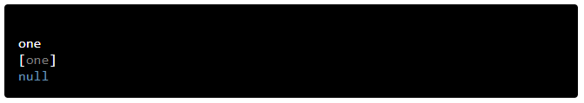
Queue peek() operation
The peek() operation is used to retrieve an element from the head of the queue, without removing it. If it performs examine operation successfully, it returns the head element of the queue. Otherwise it returns null value.
import java.util.*; public class QueuePeekOperation { public static void main(String[] args) { Queue<String> queue = new LinkedList<>(); queue.add("one"); System.out.println(queue.peek()); System.out.println(queue); queue.clear(); System.out.println(queue.peek()); } }
Notes:
If we try to call peek() method on empty Queue, it returns null value, but does NOT throw an exception as shown above.

Slide 22
Java Queue Categories
In Java, we can find many Queue implementations. W can broadly categorize them into the following two types
Bounded Queues
Unbounded Queues
Bounded Queues are queues which are bounded by capacity that means we need to provide the max size of the queue at the time of creation. For example ArrayBlockingQueue.
Unbounded Queues are queues which are NOT bounded by capacity that means we should not provide the size of the queue. For example LinkedList.

Slide 23
Java Queue Categories
All Queues which are available in java.util package are Unbounded Queues and Queues which are available in java.util.concurrent package are Bounded Queues.
In other ways, W can broadly categorize them into the following two types:
Blocking Queues
Non-Blocking Queues
All Queues which implement BlockingQueue interface are BlockingQueues and rest are Non-Blocking Queues.
BlockingQueues blocks until it finishes it’s job or time out, but Non-BlockingQueues do not.

Slide 24
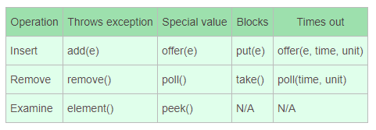
BlockingQueue Operations
In addition to Queue’s two forms of operations, BlockingQueue’s supports two more forms
Some operations are blocked until it finishes it’s job and other are blocked until time out.
That’s all of a quick roundup on Queue in Java. I hope these Java Queue examples will help you in getting started with Queue collection programming.

Slide 25

OUR PRODUCT
Aptimithra
aptimithra.com

Slide 26


Google Review
ethnus.com

Slide 27

THANK YOU

