Slide 1
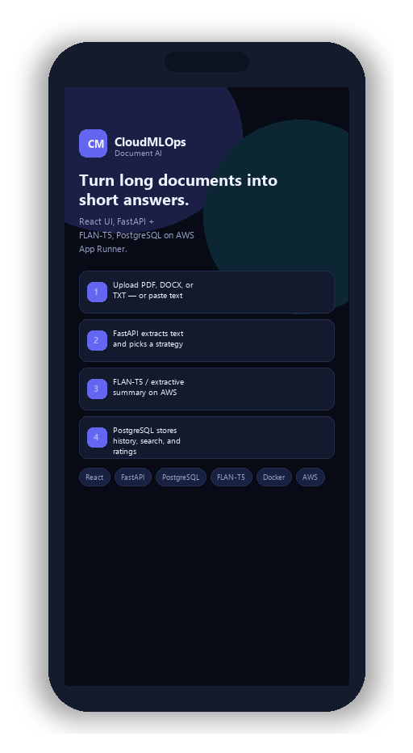
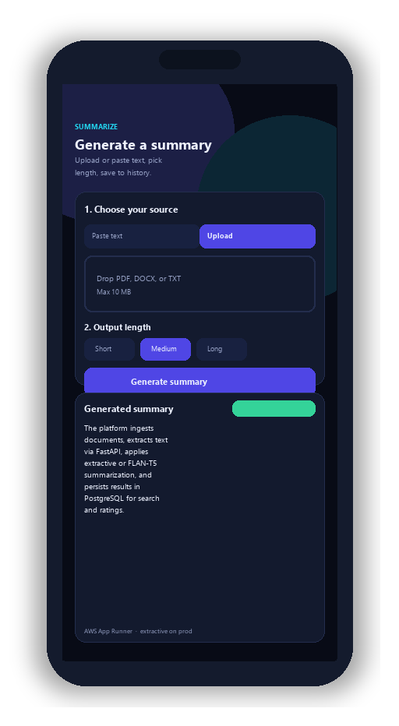
CLOUDMLOPS
AI Document Summarization Platform
• Ingest PDF, DOCX, and TXT in one workspace
• FastAPI + FLAN-T5 / extractive summarization
• History, ratings, and admin MLOps on AWS
• Live on App Runner — demo-ready URLs in-deck
Notes:
Shopez-style title: team left; phones show what the app does (pipeline + summarize UI). Full AWS screenshots on later demo slides. Interactive Demo (F5).

Slide 2
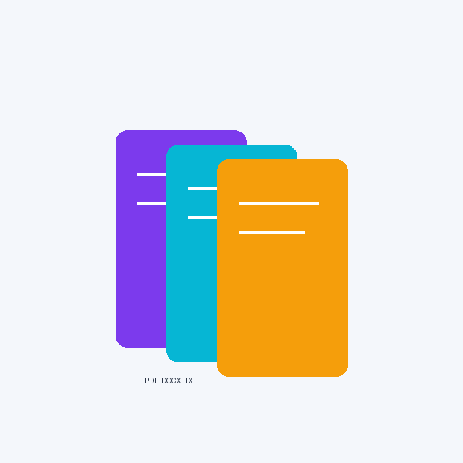
Project Overview
Smart summarization + cloud MLOps in one product
171
Automated tests
3
Architecture tiers
6
Live URLs
AWS
Production
• Upload PDF / DOCX / TXT — or paste text — get a concise summary in seconds.
• Every summary is saved: search history, download, and rate quality.
• Admins track usage, manage users, and approve new model versions.
• Shipped with Docker, GitHub Actions, Terraform, and AWS App Runner.
CLOUDMLOPS | CIS 5690 - Cloud MLOps | Slide 2 of 15
Notes:
Keep this high-level; details come on architecture and demo slides.

Slide 3

Problem Statement
Why manual reading does not scale
• Reports and papers are too long to read end-to-end under time pressure.
• Notes in Word or email are not searchable or shared safely.
• Heavy AI models stall on free tiers and HTTP timeouts in the cloud.
• Teams need one secure app: extract, summarize, store, and deploy reliably.
CLOUDMLOPS | CIS 5690 - Cloud MLOps | Slide 3 of 15

Slide 4

Objectives
What we set out to build
Three-tier design
React + FastAPI + PostgreSQL
Smart ingestion
PDF, DOCX, TXT with validation
AI engine
FLAN-T5 locally; fast extractive on AWS
User experience
Auth, history, downloads, ratings
Admin & MLOps
Metrics + model approve / promote
Cloud ship
CI/CD to App Runner via ECR
CLOUDMLOPS | CIS 5690 - Cloud MLOps | Slide 4 of 15

Slide 5

Proposed Solution
From document to deployed insight
Problem
Too much text, no system
Approach
Clean layers + AI factory
Build
Extract, summarize, store
Launch
Live AWS + 171 tests
End-to-end flow
Users upload or paste documents → FastAPI validates and extracts text → summarizer (171 automated tests) persists output to PostgreSQL → React UI and admin dashboard expose history, ratings, and model lifecycle on AWS App Runner.
CLOUDMLOPS | CIS 5690 - Cloud MLOps | Slide 5 of 15

Slide 6

Technologies Used
Modern stack — only what the project uses
Frontend
React 19, Vite, React Router, Axios
Backend
Python 3.12, FastAPI, SQLAlchemy 2
Database
PostgreSQL 16, Alembic
AI / ML
Transformers, flan-t5-small, extractive
Extraction
PyMuPDF, python-docx
Cloud / DevOps
Docker, Actions, ECR, App Runner, Terraform
CLOUDMLOPS | CIS 5690 - Cloud MLOps | Slide 6 of 15

Slide 7

System Architecture
How traffic flows in production
Browser / User
React frontend — AWS App Runner
FastAPI backend — AWS App Runner
PostgreSQL (RDS) + document storage
CloudWatch + Secrets Manager
CI/CD — GitHub Actions → ECR → deploy
CLOUDMLOPS | CIS 5690 - Cloud MLOps | Slide 7 of 15

Slide 8
Key Features
What users and admins can do
Authentication
JWT sessions, admin roles
Summarization
Text + documents, 3 lengths
History
Search and pagination
Feedback
Star ratings for quality
Admin dashboard
Usage and user management
Model lifecycle
UC-12 / UC-16 ROUGE pipeline
CLOUDMLOPS | CIS 5690 - Cloud MLOps | Slide 8 of 15

Slide 9
Interactive Demo
Click buttons in Slide Show (F5) to open live services
Try the app while you present:
1. Open AWS frontend and log in
2. Upload a sample PDF or paste text
3. Show summary + history
4. Optional: Swagger /docs for API
Launch Web App
Open Swagger UI
Health Check JSON
View Source on GitHub
Presenter tip: keep this slide open during Q&A — every button opens the real production service.
CLOUDMLOPS | CIS 5690 - Cloud MLOps | Slide 9 of 15
Notes:
This is your live demo slide — click buttons during viva.

Slide 10
Live Deployment URLs
Interactive: click any link or button (Slide Show mode)
Tip: Press F5 in PowerPoint, then click highlighted links to open each service in your browser.
Open AWS App
Open API Docs
Open GitHub
AWS production UI
https://asqmhsdwfs.us-east-2.awsapprunner.com
AWS production API
https://p3jivcdmbf.us-east-2.awsapprunner.com
Health check
https://p3jivcdmbf.us-east-2.awsapprunner.com/health
Swagger API docs
https://p3jivcdmbf.us-east-2.awsapprunner.com/docs
ReDoc API docs
https://p3jivcdmbf.us-east-2.awsapprunner.com/redoc
GitHub repository
https://github.com/nitya200/CloudMlOps
CLOUDMLOPS | CIS 5690 - Cloud MLOps | Slide 10 of 15
Notes:
Backup link hub if panel asks for every URL in one place.

Slide 11
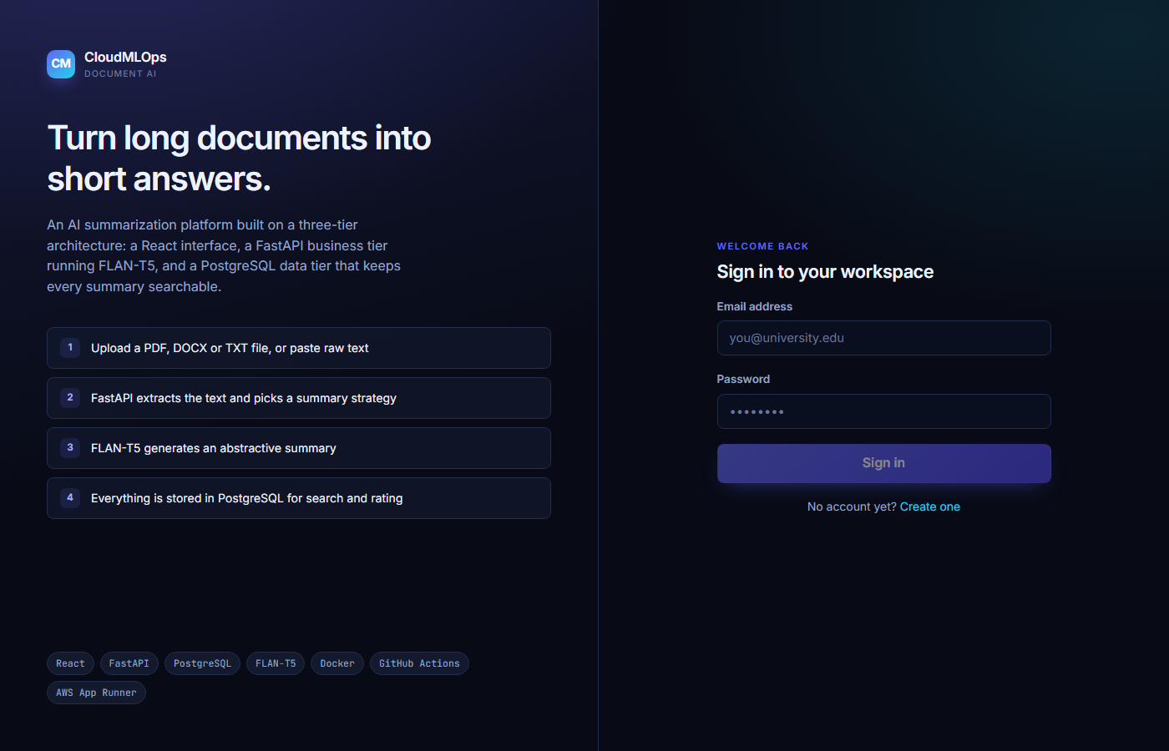
Production Application
AWS App Runner frontend
Live CloudMLOps UI on AWS (home / login route).
CLOUDMLOPS | CIS 5690 - Cloud MLOps | Slide 11 of 15

Slide 12
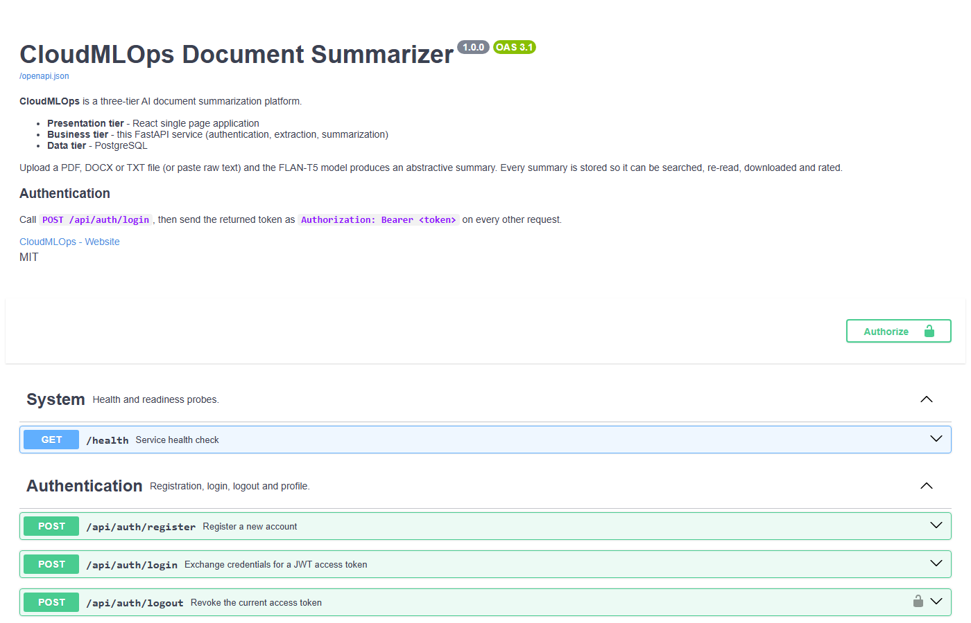
API Documentation
Interactive OpenAPI on production API
Swagger UI served from the deployed FastAPI backend.
CLOUDMLOPS | CIS 5690 - Cloud MLOps | Slide 12 of 15

Slide 13
Results & Outcomes
What is working today
Live
AWS App Runner
OK
DB connected
171
Tests pass
UC-12
Model promote
• 171 pytest cases — auth, uploads, AI paths, admin, migrations.
• Production health: database connected; summarizer ready on AWS.
• Terraform + GitHub Actions: repeatable deploy pipeline.
• Model lifecycle: ROUGE evaluation, approve, promote (UC-12 / UC-16).
CLOUDMLOPS | CIS 5690 - Cloud MLOps | Slide 13 of 15

Slide 14
Future Scope
Planned improvements (not yet implemented)
• GPU App Runner or SageMaker for full FLAN-T5 at scale.
• CloudWatch alarms + email/SNS when services degrade.
• Richer offline benchmarks when extra compute is available.
CLOUDMLOPS | CIS 5690 - Cloud MLOps | Slide 14 of 15

Slide 15
Conclusion
In one minute
• Built a real cloud app — not just slides — with live URLs you can click.
• Solved document overload with extract, summarize, store, and rate.
• Proved engineering quality with tests, CI, and AWS MLOps patterns.
CLOUDMLOPS | CIS 5690 - Cloud MLOps | Slide 15 of 15

Slide 16
Thank You
CLOUDMLOPS
CIS 5690 - Cloud MLOps
Questions & Discussion
Open Live Demo
Notes:
Thank the panel. Offer to show live demo again from slide 9.

