Slide 1
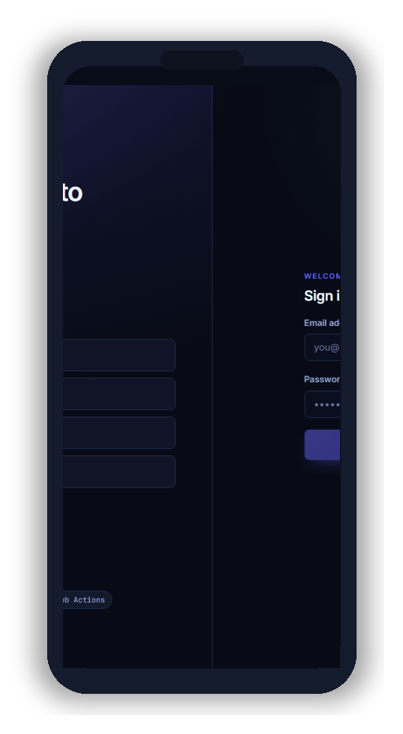
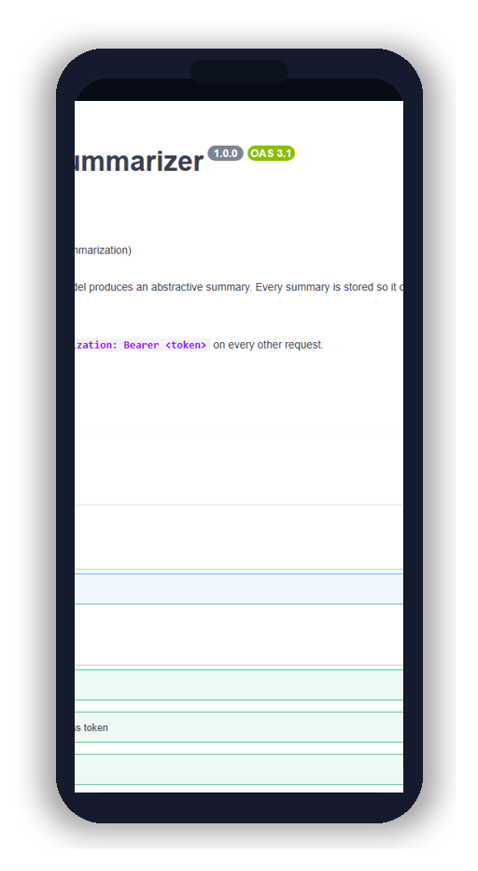
CLOUDMLOPS
AI Document Summarization Platform
APSCHE • Team Project
Team members:-
Nityanandh Chimmili (23P31A05K5)
Keerthana Yarra (23P31A05J8)
Surya (23P31A05K1)
Notes:
Shopez-style title: team on the left, tilted phones show AWS app + Swagger. Full-size screenshots on Production Application / API slides. Demo: Interactive Demo (F5).

Slide 2
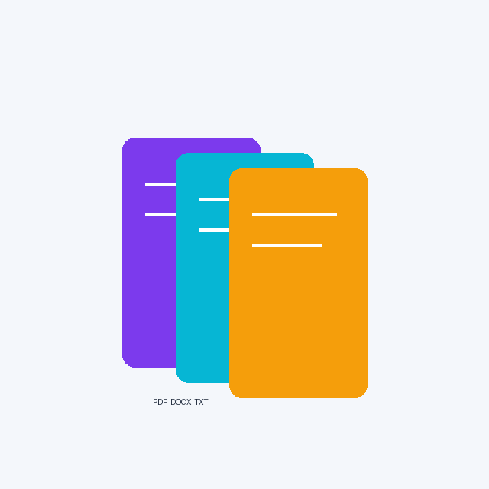
Project Overview
Smart summarization + cloud MLOps in one product
171
Automated tests
3
Architecture tiers
8
Live URLs
2
Deployments
Upload PDF / DOCX / TXT — or paste text — get a concise summary in seconds.
Every summary is saved: search history, download, and rate quality.
Admins track usage, manage users, and approve new model versions.
Shipped with Docker, GitHub Actions, Terraform, and AWS App Runner.
CLOUDMLOPS | CIS 5690 - Cloud MLOps | Slide 2 of 15
Notes:
Keep this high-level; details come on architecture and demo slides.

Slide 3

Problem Statement
Why manual reading does not scale
Reports and papers are too long to read end-to-end under time pressure.
Notes in Word or email are not searchable or shared safely.
Heavy AI models stall on free tiers and HTTP timeouts in the cloud.
Teams need one secure app: extract, summarize, store, and deploy reliably.
CLOUDMLOPS | CIS 5690 - Cloud MLOps | Slide 3 of 15

Slide 4

Objectives
What we set out to build
Three-tier design
React + FastAPI + PostgreSQL
Smart ingestion
PDF, DOCX, TXT with validation
AI engine
FLAN-T5 locally; fast extractive on AWS
User experience
Auth, history, downloads, ratings
Admin & MLOps
Metrics + model approve / promote
Cloud ship
CI/CD to App Runner via ECR
CLOUDMLOPS | CIS 5690 - Cloud MLOps | Slide 4 of 15

Slide 5

Proposed Solution
From document to deployed insight
Problem
Too much text, no system
Approach
Clean layers + AI factory
Build
Extract, summarize, store
Launch
Live AWS + 171 tests
CLOUDMLOPS | CIS 5690 - Cloud MLOps | Slide 5 of 15

Slide 6

Technologies Used
Modern stack — only what the project uses
Frontend
React 19, Vite, React Router, Axios
Backend
Python 3.12, FastAPI, SQLAlchemy 2
Database
PostgreSQL 16, Alembic
AI / ML
Transformers, flan-t5-small, extractive
Extraction
PyMuPDF, python-docx
Cloud / DevOps
Docker, Actions, ECR, App Runner, Terraform
CLOUDMLOPS | CIS 5690 - Cloud MLOps | Slide 6 of 15

Slide 7

System Architecture
How traffic flows in production
CI/CD
GitHub
ECR
Deploy
Browser / User
React frontend - AWS App Runner
FastAPI backend - AWS App Runner
PostgreSQL (RDS) + S3 uploads
CloudWatch + Secrets Manager
CLOUDMLOPS | CIS 5690 - Cloud MLOps | Slide 7 of 15

Slide 8
Key Features
What users and admins can do
Authentication
JWT sessions, admin roles
Summarization
Text + documents, 3 lengths
History
Search and pagination
Feedback
Star ratings for quality
Admin dashboard
Usage and user management
Model lifecycle
UC-12 / UC-16 ROUGE pipeline
CLOUDMLOPS | CIS 5690 - Cloud MLOps | Slide 8 of 15

Slide 9
Interactive Demo
Click buttons in Slide Show (F5) to open live services
Try the app while you present:
1. Open AWS frontend and log in
2. Upload a sample PDF or paste text
3. Show summary + history
4. Optional: Swagger /docs for API
Launch Web App
Open Swagger UI
Health Check JSON
View Source on GitHub
CLOUDMLOPS | CIS 5690 - Cloud MLOps | Slide 9 of 15
Notes:
This is your live demo slide — click buttons during viva.

Slide 10
Live Deployment URLs
Interactive: click any link or button (Slide Show mode)
Tip: Press F5 in PowerPoint, then click highlighted links to open each service in your browser.
Open AWS App
Open API Docs
Open GitHub
AWS production UI
https://asqmhsdwfs.us-east-2.awsapprunner.com
AWS production API
https://p3jivcdmbf.us-east-2.awsapprunner.com
Health check
https://p3jivcdmbf.us-east-2.awsapprunner.com/health
Swagger API docs
https://p3jivcdmbf.us-east-2.awsapprunner.com/docs
ReDoc API docs
https://p3jivcdmbf.us-east-2.awsapprunner.com/redoc
Reference demo UI (Netlify)
https://cloudmlops.netlify.app
Reference demo API (Render)
https://cloudmlops.onrender.com
GitHub repository
https://github.com/nitya200/CloudMlOps
CLOUDMLOPS | CIS 5690 - Cloud MLOps | Slide 10 of 15
Notes:
Backup link hub if panel asks for every URL in one place.

Slide 11
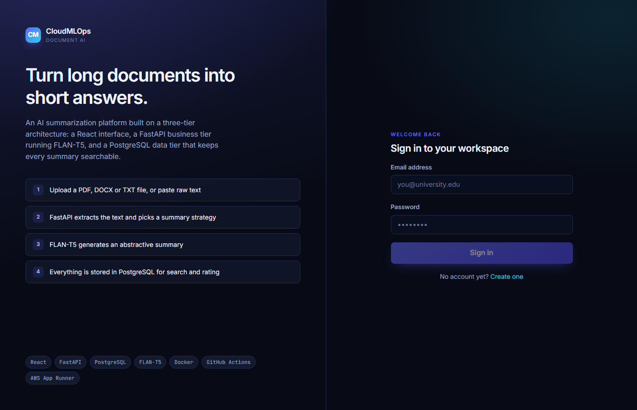
Production Application
AWS App Runner frontend
Live CloudMLOps UI on AWS (home / login route).
CLOUDMLOPS | CIS 5690 - Cloud MLOps | Slide 11 of 15

Slide 12
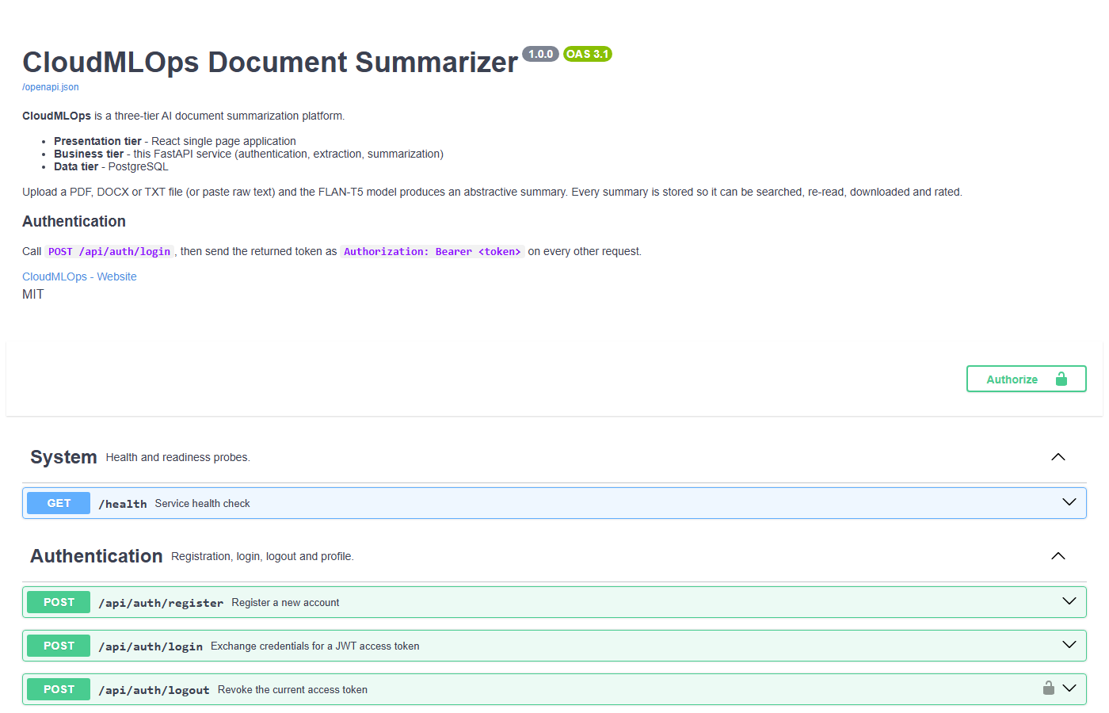
API Documentation
Interactive OpenAPI on production API
Swagger UI served from the deployed FastAPI backend.
CLOUDMLOPS | CIS 5690 - Cloud MLOps | Slide 12 of 15

Slide 13
Results & Outcomes
What is working today
Live
AWS App Runner
OK
DB connected
171
Tests pass
UC-12
Model promote
171 pytest cases — auth, uploads, AI paths, admin, migrations.
Production health: database connected; summarizer ready on AWS.
Terraform + GitHub Actions: repeatable deploy pipeline.
Model lifecycle: ROUGE evaluation, approve, promote (UC-12 / UC-16).
CLOUDMLOPS | CIS 5690 - Cloud MLOps | Slide 13 of 15

Slide 14
Future Scope
Planned improvements (not yet implemented)
GPU App Runner or SageMaker for full FLAN-T5 at scale.
CloudWatch alarms + email/SNS when services degrade.
Richer offline benchmarks when extra compute is available.
CLOUDMLOPS | CIS 5690 - Cloud MLOps | Slide 14 of 15

Slide 15
Conclusion
In one minute
Built a real cloud app — not just slides — with live URLs you can click.
Solved document overload with extract, summarize, store, and rate.
Proved engineering quality with tests, CI, and AWS MLOps patterns.
CLOUDMLOPS | CIS 5690 - Cloud MLOps | Slide 15 of 15

Slide 16
Thank You
CLOUDMLOPS | Nityanandh Chimmili | chimmilinityanandh@gmail.com
Questions & Discussion
Open Live Demo
Notes:
Thank the panel. Offer to show live demo again from slide 9.

