Slide 1
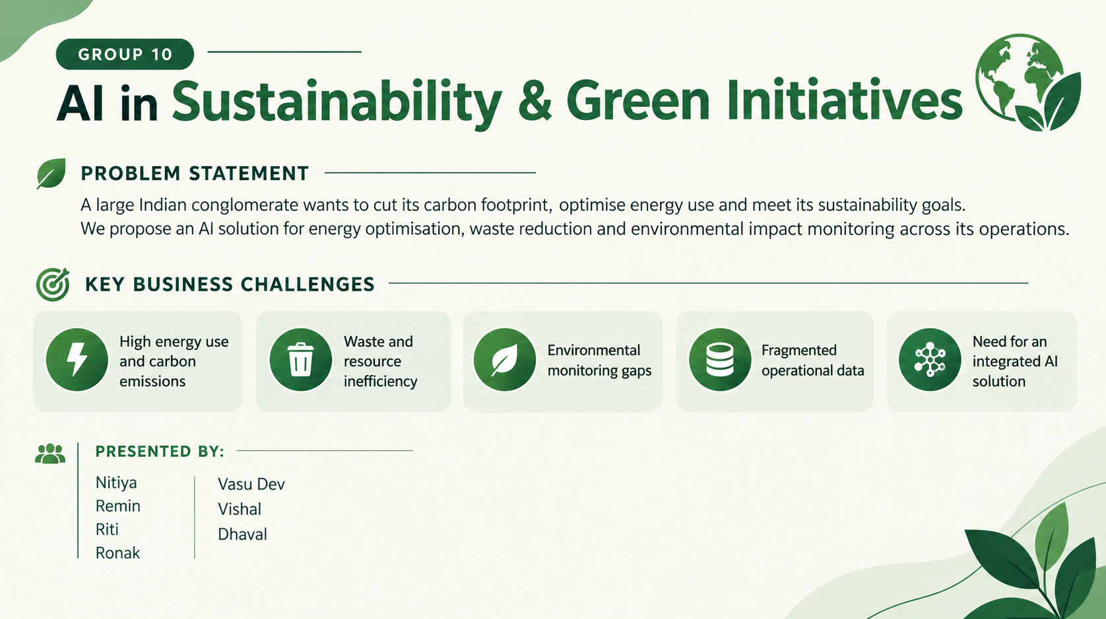

Slide 2








Proposed AI-Based Sustainability System
System objectives
Cut energy use and carbon emissions
Reduce waste and recover materials
Monitor environmental impact in real time
Data Collection & Integration
Knowledge Graph
Rule-Based System
Expert System
Sustainability Dashboard
Sensors, meters and ERP feed one shared data layer
Links plants, assets and energy flows so AI can reason across them
Encodes emission caps and safe operating limits
Turns data and rules into corrective recommendations
One live view of energy, waste and emission KPIs

Slide 3




AI for Energy Optimisation
Types of ML models
Supervised
regression, forecasting
Unsupervised
clustering, anomalies
Reinforcement
scheduling, control
GOOGLE CASE STUDY
Up to 40%
Demand forecasting
Clustering
reduction in energy used for data-centre cooling, as reported by Google (2016)
Regression and time-series models predict load by hour, shift and season
Groups similar machines and sites by consumption pattern to find savings
DeepMind's ML system forecast load and tuned cooling in Google data centres. The same forecast-then-control idea applies to HVAC, compressors and process heat in industrial plants.
Anomaly detection
AI-based scheduling
Flags unusual spikes caused by leaks, idle running or faulty equipment
Moves flexible loads to low-tariff or renewable-rich hours

Slide 4

Search Algorithms for Sustainable Planning
BFS
Explores options level by level and finds the route with the fewest steps
Industrial applications
DFS
Goes deep along one path first; useful for tracing a fault or emission source
Waste-collection routing
Energy scheduling across shifts
Maintenance and logistics planning
Greedy Search
Takes the lowest-cost move right now; fast, but can miss the best overall plan
Limitations
A* Search
Combines cost so far with an estimate to the goal; best for collection routes and schedules
BFS and DFS slow down as the problem grows
Greedy can miss the best overall plan
A* needs a good heuristic and clean data
Adversarial Search
Plans against a changing opponent, such as tariff swings or competing demand

Slide 5



AI for Waste Reduction & Circular Economy
CNN waste classification
Knowledge graph for recovery
Search-based collection planning
Automated segregation
Camera feeds are sorted into paper, plastic, metal, organic and e-waste
Maps each material to its best reuse, recycling or recovery route
A*-style routing finds the cheapest pickup routes and schedules
Conveyors and robotic arms sort waste using the CNN's output
ITC CASE STUDY
Well-being Out of Waste (WOW)
ITC's WOW programme drives segregation and recycling of solid waste across its operations and communities. AI classification and tracking would make this circular-economy model easier to scale.

Slide 6
AI for Environmental Impact Monitoring
Measure
Detect
Act
Carbon footprint calculated from energy, fuel and supply-chain data
Air emissions and water quality tracked through live sensors
Rule-based alerts when readings cross legal or internal limits
ML anomaly detection spots drift before a limit is breached
Expert system suggests fixes, such as tuning a furnace or servicing a scrubber
Each recommendation comes with the reason behind it
CASE STUDY: RELIANCE INDUSTRIES
CASE STUDY: ADANI GROUP
Has committed to net carbon zero by 2035, backed by large-scale emissions tracking across its refining and new-energy businesses.
Tracks its renewable plants from a central energy network operations centre in Ahmedabad, using analytics to spot underperformance early.

Slide 7





Agentic AI & Intelligent Automation
1. Observe
2. Analyse
3. Plan
4. Act
Reads live sensor, meter and ERP data
ML decision support forecasts demand and flags anomalies
Search-based planning picks the lowest-cost action sequence
Runs approved actions, then checks the results
Feedback: outcomes return to Observe and improve the next cycle
Rule-based safety constraints
Human-in-the-loop approval
Automated actions and feedback
Hard limits the agent can never override, such as emission caps and equipment ratings
Engineers review and approve high-impact actions before they run
Low-risk actions run automatically; every result is logged to retrain the models

Slide 8

Implementation, KPIs & Expected Impact
1
Pilot
2
Scale
3
Embed
One plant or unit: set a baseline and validate the models
Extend to more sites and connect every data source
Enterprise-wide rollout with continuous model retraining
Energy efficiency
Carbon emissions
Waste and recycling
kWh per unit of output
Peak demand and energy cost
Share of renewable energy
Total emissions (tCO2e)
Emission intensity per unit
Year-on-year reduction
Waste generated per unit
Recycling and recovery rate
Landfill diversion rate
AI model evaluation
Governance and risk
Expected benefits
Forecast error (MAPE), alert precision and recall, and drift checks
Data privacy, bias checks, audit trail and clear human ownership
Lower energy cost and emissions, less waste, audit-ready ESG reporting

