Slide 1
Statistics For Data Science
Team Members: -
Nityam Churamani (PES1UG19CS307)
Nabeel Khan(PES1UG19CS286)
Mrudhulraj Natarajan(PES1UG19CS281)
Nagaraj M(PES1UG19CS287)

Slide 2
Data Set and Motivation Behind choosing It
Our Data Set deals with job listings for various Data Analyst positions.
It consists of various columns (“Salary”,”Rating”,”Headquarters”,etc to name a few) which can be used to carry out analysis and thereby ease the work of a job-seeker.
Our Data Set had about 16 variables and 2000+ observations.
Amidst the pandemic many people lost their jobs, with this dataset it is possible to ease job search, so that people in need can find employment.
Thus we decided to work on this Data Set as it would help us better our Data Analysis skill and further explore the subject.

Slide 3
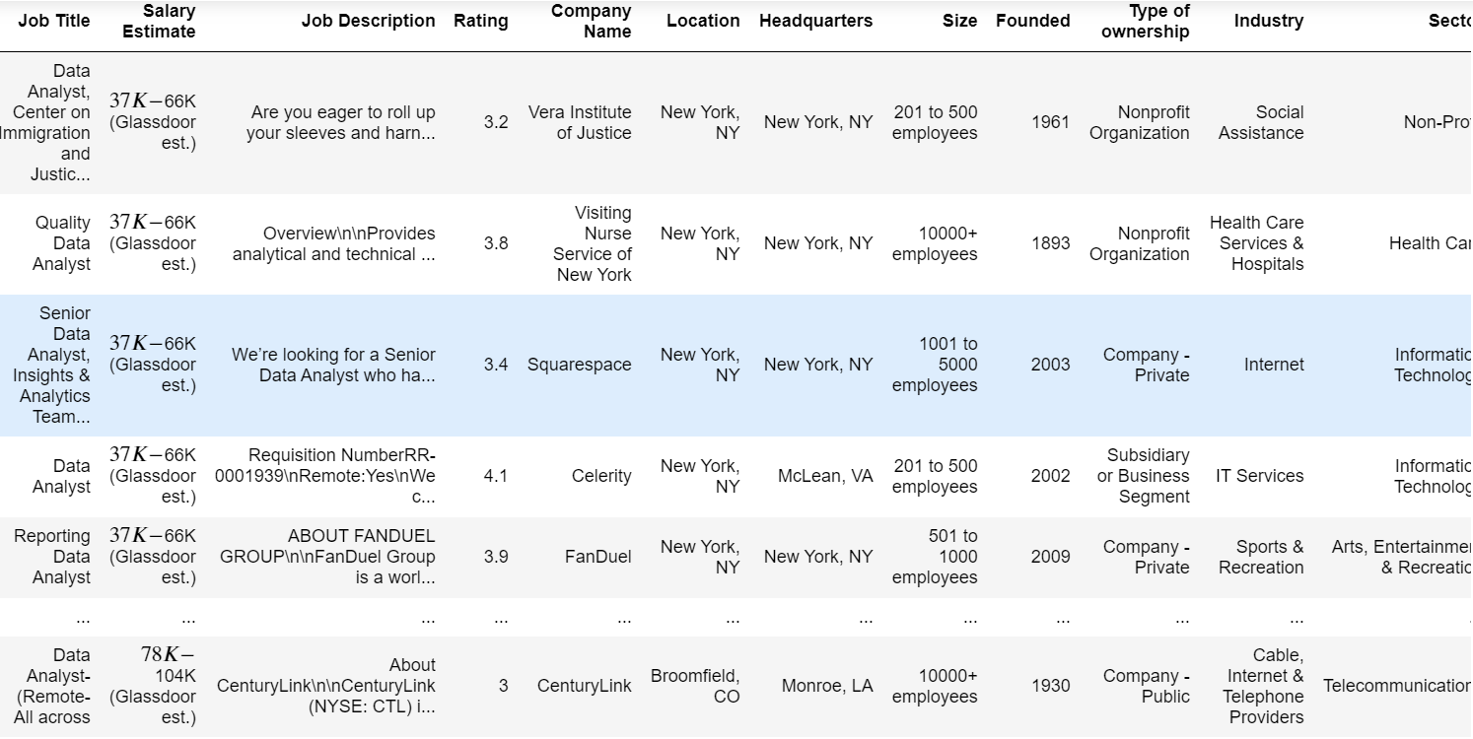
Data Set

Slide 4
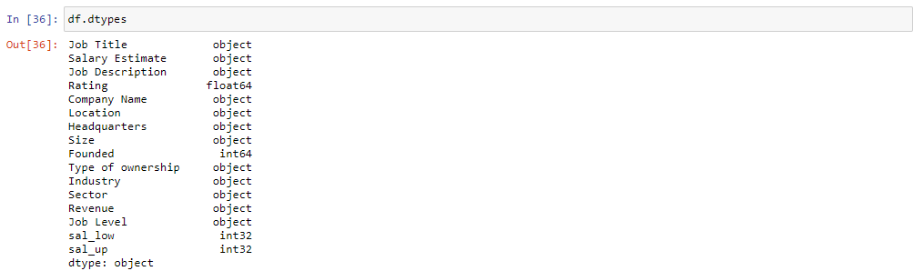
Data Types **Before Pre Processing**

Slide 5
Data Pre-processing
Data Preprocessing involved replacing NaN values with mean or median, or at times dropping of the whole column.
For replacing the NaN values we used the interpolate function to fill the average of the top and bottom value in place of the NaN value.
We also had to convert strings to numerical data for ease of analysis. This was done to standardize data and ease the process of analysis.
The conversion of string to to numerical data was achieved with the help of NLTK library along with Regex expressions.

Slide 6
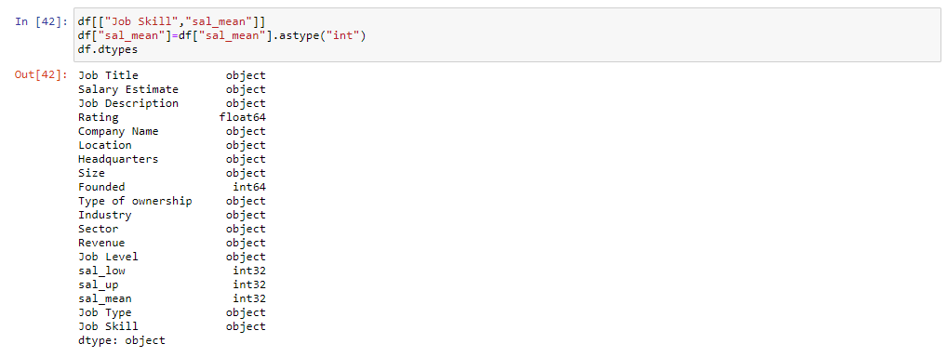
Data Type **After Pre Processing**

Slide 7
Graphical Representations
Graphical representation provides a more engaging way to present data.
It makes more sense to the observer in comparison to a bunch of numbers being displayed randomly.
Therefore we used graphical representation of data to enrich the observers experience.

Slide 8
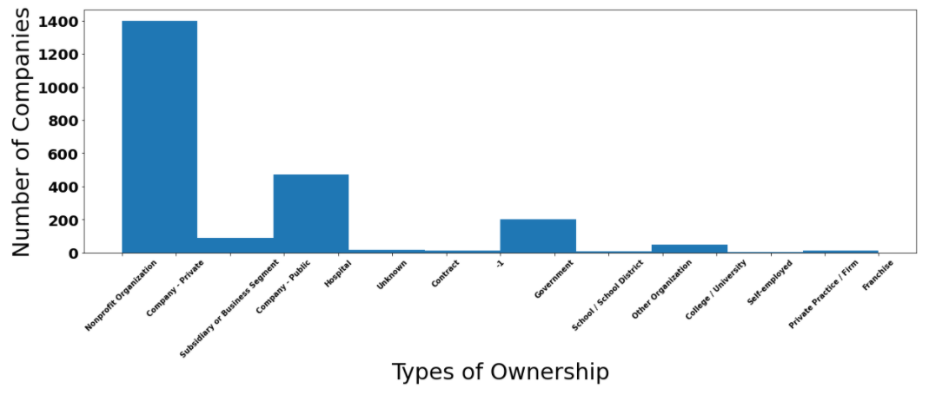
Histogram and Bar Graph
Histogram is a graphical display of data using bars of different heights. The height of each bar denotes frequency.

Slide 9
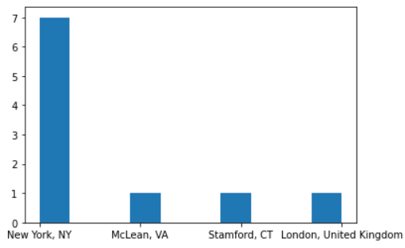
Histogram and Bar Graph
Bar graph is used to represent categorical data with rectangular bars with heights or lengths proportional to the values that they represent.

Slide 10
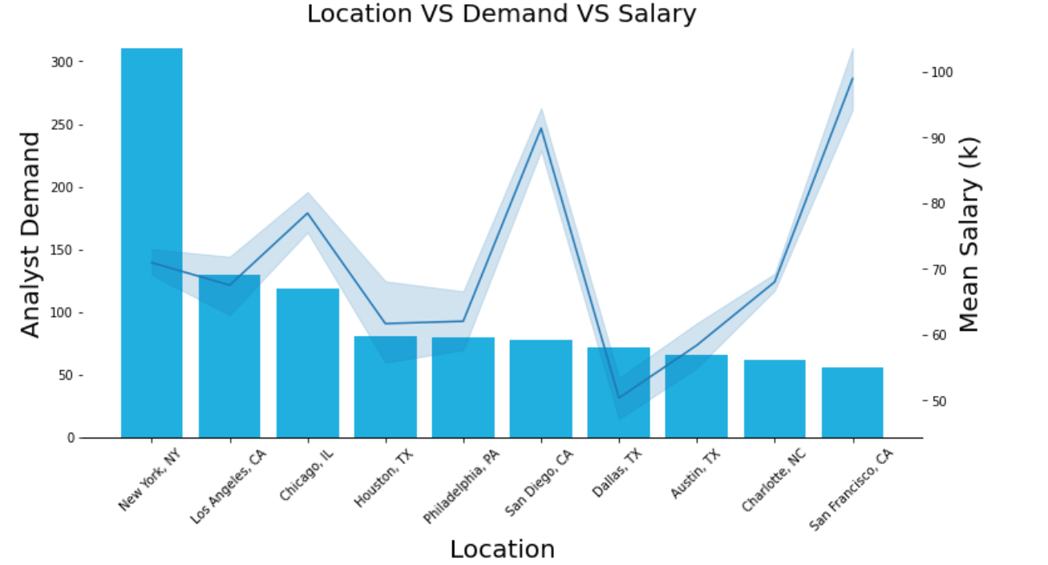
Histogram and Bar Graph

Slide 11
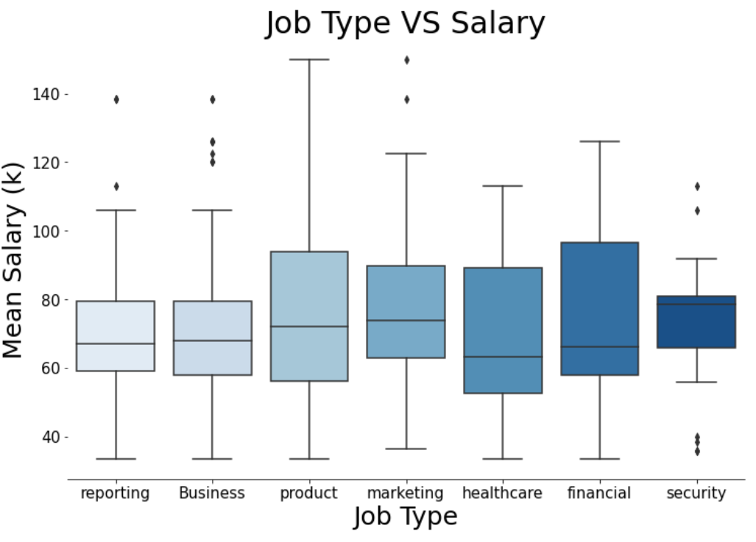
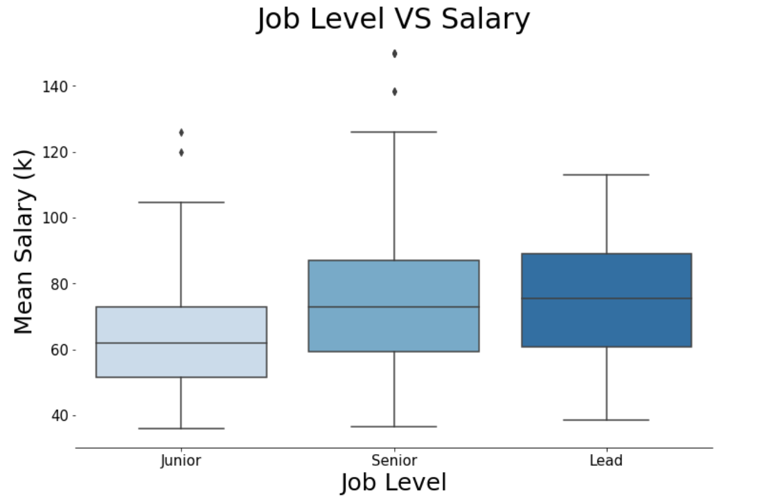
Box Plot
Box plot helps in representing numerical data through quartiles.

Slide 12
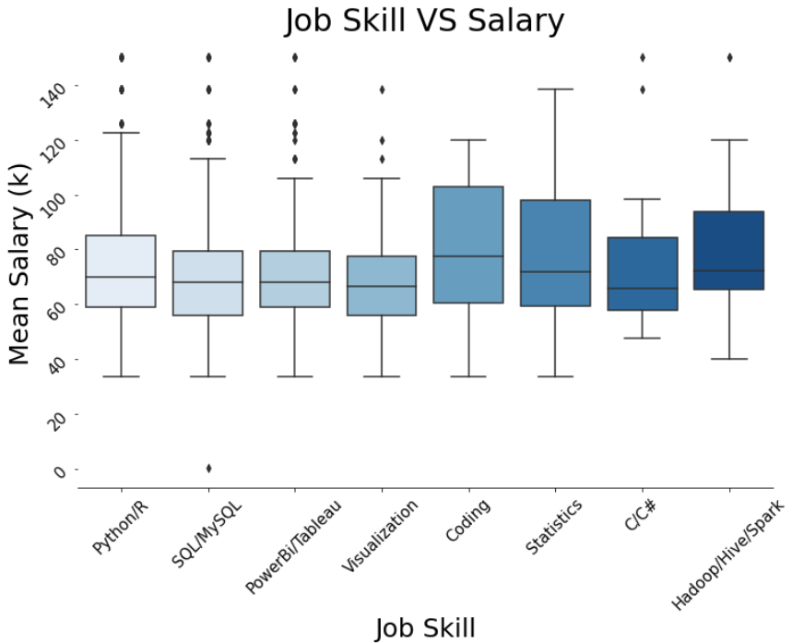
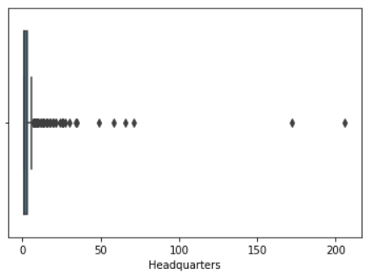
Box Plot

Slide 13
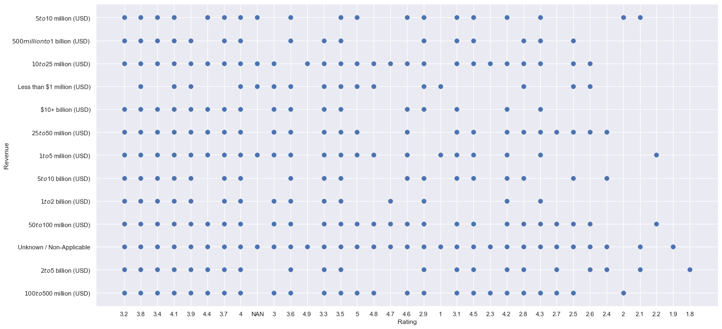
Scatter Plot
Scatter plot helps in explaining the spread of data, thereby also explaining the correlation between data.

Slide 14
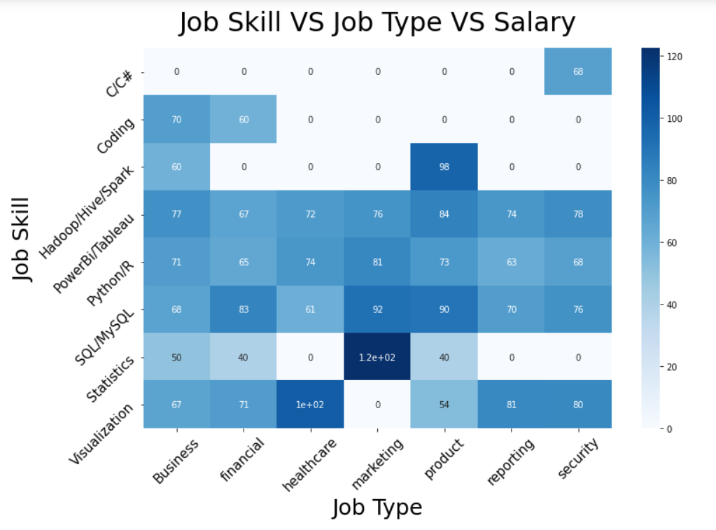
Heat Map

Slide 15
Normalization and Standardization
Normalization is used when we do not know the distribution of our data or when we know the distribution is not a Gaussian curve (a bell curve).
Standardization is useful when the data has varying scales. The result of standardization is that the features/variables will be rescaled so that they have properties like that of a standard normal distribution with μ=0 and σ=1.
In our data set, Size is expressed in terms of number of employees , Foundation of the company is expressed in years and rating has no unit. They can be brought to a standard scale with the help of standardisation and normalization with which we can make meaningful comparison between them.

Slide 16
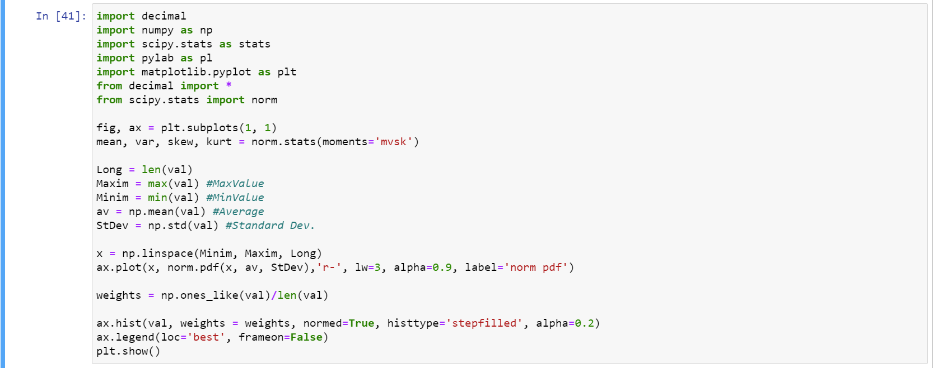
Normalization

Slide 17
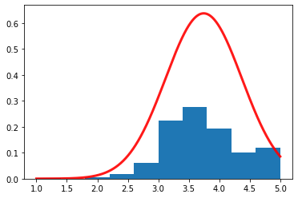
Normalization
The result of the normalization performed.

Slide 18
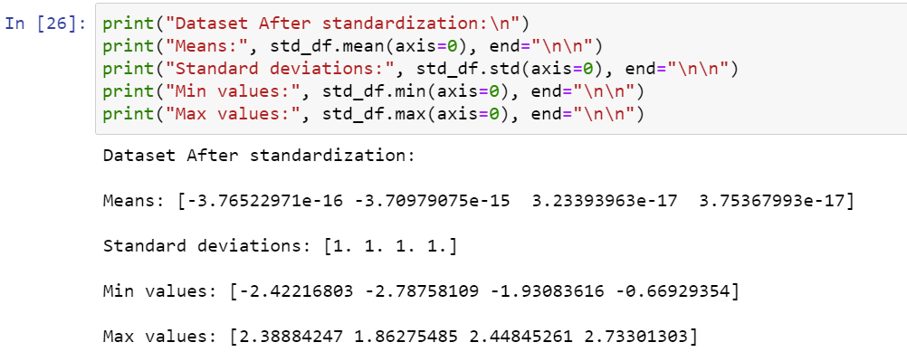
Standardization

Slide 19
Hypothesis Testing
Hypothesis testing is used by data scientists, wherein an analyst tests an assumption regarding a population parameter. This methodology that is employed by the analyst depends on the nature of the data used and the reason for which the analysis is carried out.
We assumed that null hypothesis H₀ = mean of rating column and alternate hypothesis H₁≠ mean of rating column. In performing a hypothesis test, we put the null hypothesis on trial. We begin by assuming that H₀ is true.
We then measure the strength of the disagreement between the sample and H0 to produce a number between 0 and 1, called a P-value. The P-value measures the plausibility of H0. The smaller the P-value, the stronger the evidence is against H₀.

Slide 20
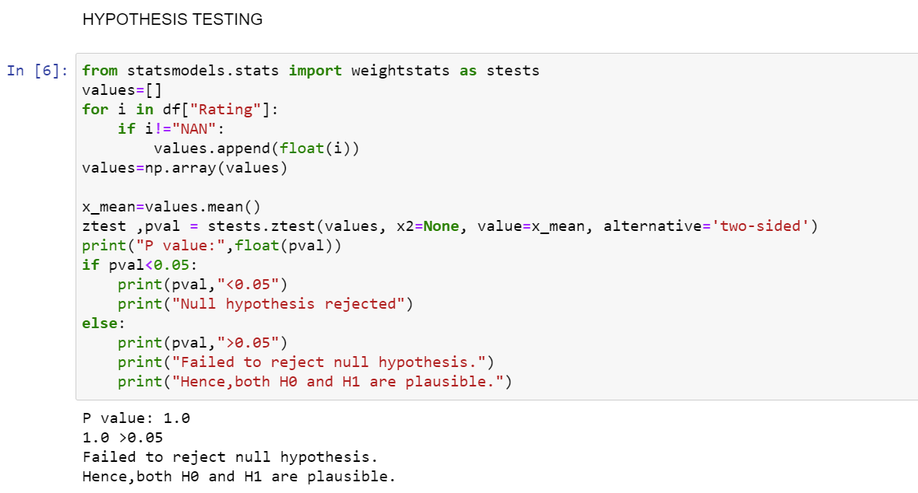
Hypothesis Testing

Slide 21
Conclusions
Most job opportunities are present in New York.
The average rating of a Data Science related job is 3.5.
The best mean salary is given in San Francisco, even-though most job opportunities are present at New York.
There is more demand for data science jobs in Private companies and Public works.
Statistics is the most required topic for marketing, the two are strongly correlated.
Being a tech Lead turns out to be the best level of a data science job.
Median Salary of a Data Scientist is higher if he knows coding.
The ratings of the companies founded after 1980s has been higher than those founded prior to 1980s.

